Slide 1
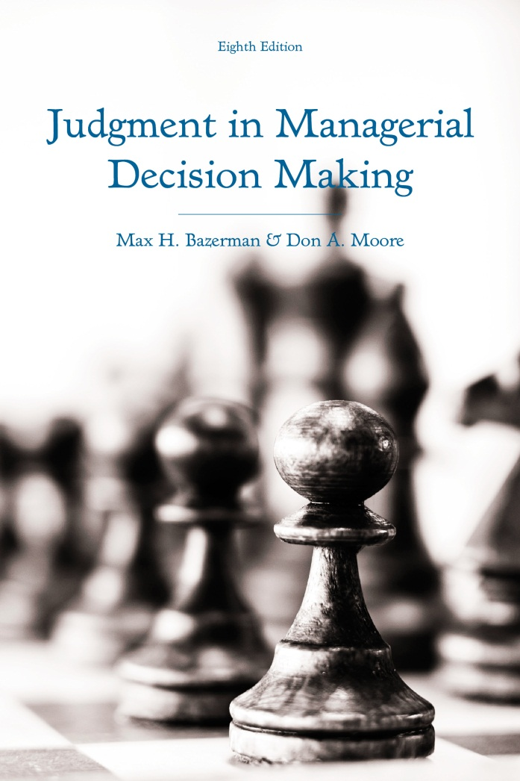
Judgment in Managerial Decision Making 8e
Chapter 12
Improving Decision Making
Copyright 2013 John Wiley & Sons

Slide 2
Strategies for Better Decisions
Use decision-analysis tools
Acquire expertise
Debias your judgment
Reason analogically
Take an outsider’s view
Understand others’ biases
Urge others to improve decisions
Notes:
As we have reviewed throughout this course, we are subject to a variety of biases that limit the effectiveness of our decisions.
This has important implications for the outcomes of organizations.
In the book Moneyball, the story of the Oakland Athletics success in the early 2000s is described.
Many general managers in baseball relied on the intuition of scouts to guide their decision-making. However, this intuition was often biased and led to inefficiencies.
Billy Beane, the general manager of the Oakland Athletics, brought in an economics graduate named Paul DePodesta to help him exploit these inefficiencies by approaching the valuation of players with a quantitative analysis of their performance.
Many managers continue to rely on interviews as a diagnostic tool for predicting future performance despite the evidence that interviews are less effective than using diagnostic performance data.
In order to prevent these mistakes, managers can use several strategies to improve their decision making:
Use decision-analysis tools to help with quantifying decisions into expected value.
Acquire expertise to improve decision-making strategies.
Debias their judgment by using some helpful practices.
Reason analogically to help see the relationship between different types of problems.
Take an outsider’s perspective to help prevent optimistic biases.
Understand others’ biases to determine when others may be prone to errors and adjust for these errors.
Urge others in their organization to improve their decisions by understanding how they may be biased.

Slide 3
Use Decision-Analysis Tools
Linear models
  What are they?
  Why they help decisions
  Why we resist them
Improving admissions decisions
Improving hiring decisions
Notes:
One way to improve decision-making is to use decision-analysis tools.
These tools allow people to guide their decision-making process by converting qualitative preferences into quantitative data that can be converted into expected values and then compared. They typically consider the following:
Weights placed on the importance of different attributes.
The value of each attribute.
The probability of uncertain events occurring.
The objective costs associated with each option.
Linear models facilitate the process of performing a quantitative decisions analysis when there is uncertainty.
These models account for relevant variables that predict future outcomes and combine them in a linear fashion to provide estimates of future outcomes.
They can be used to predict a wide range of things such as:
A child’s adult height given the height of his or her parents and his or her gender.
A baseball player’s future performance given his past performance, age, height, and weight.
A movie studio predicting the potential revenue that will be generated by a movie.
Linear models are effective at improving decisions.
Research in a variety of domains has demonstrated that they make better predictions than “experts”.
More complex models provide limited improvement to simple linear models.
We have inconsistent preferences that are prone to bias while models are consistent and unbiased.
They also are effective at allowing people to gauge the effectiveness of various practices, which helps them learn and fine-tune their managerial strategies.
Despite the demonstrated effectiveness of linear models, people frequently object to their use.
People still believe that brief interviews are more effective at predicting performance than a long history of prior performance and aptitude tests to draw from. Neither of these factors truly give people a sense of an individual’s unique characteristics and the latter requires little effort and provides a lot of unbiased data.
People also believe that it is impossible to model the qualitative preferences and tastes of individuals, but research has demonstrated that linear models are reasonably effective at capturing such qualitative preferences.
One domain in which linear models could improve the decision-making process is admissions decisions.
In a manifestation of what is known as the correspondence bias, graduate school admissions tend to be biased in favor of individuals with high GPAs from lenient institutions because they fail to sufficiently discount the role of lenient grading.
One researcher developed a linear model to make graduate admissions decisions and compared it to the decisions of an admissions committee.
The model was capable of ruling out 55% of applicants who the committee also rejected.
The model also proved more effective at predicting the future ratings of applicants than the committee.
Overall, the effectiveness of this simple model suggests that the implementation of simple models using decision rules to make quick admissions decision can save universities hundreds of millions of dollars in time and resources saved from not having committees review applications.
Decision-analysis tools can also be of assistance in making hiring decisions.
Job interviews predict only 14% of the variability in employee performance. However, people continue to believe in them as an effective diagnostic tool.
Interviewers are biased by the availability of subjective qualities that they associate with effective performance when interviewing potential applicants.
Interviewer affect is influenced by superficial cues associated with a candidate and this influences their perceptions of the candidate.
Individuals who are extroverted, sociable, tall, attractive, and ingratiating are often considered as ones that represent the qualities of effective leaders even though they are far less predictive of performance than less observable traits such as conscientiousness and intelligence.
Managers tend to seek information that confirms the quality of their decision after hiring an applicant, which prevents them from learning. In addition, they never have a sample of performance from those who were interviewed but not hired to use as a comparison group.
Interviews may be difficult to justify based on the time that goes into them and the little predictive validity they have, but if the ratings of interviewers are combined into a linear model with measures of aptitude and past performance, hiring decisions could be improved.

Slide 4
Acquire Expertise
Most studies use inexperienced undergraduates
Experience allows for feedback
Difficulties in learning from feedback
  Accurate and immediate feedback rare
  Misremembering of forecasts
Acquiring expertise
Notes:
One issue with much of what we have covered throughout this course is that much of the evidence supporting it was derived from experiments conducted on undergraduate students with little to no experience in the tasks that they were being asked to conduct.
Presumably, experience should allow people to overcome biases, as it allows them to learn from feedback.
Though this seems like a reasonable assumption, there is a great deal of evidence that people experience difficulty in learning from past experience.
People who play the “Acquire a Company” problem that we discussed earlier (the one where a rational decision-maker would realize that because a hypothetical target company will have more information about the outcome of an oil exploration project than the acquiring company, the acquiring company should not make an offer to acquire the target company) exhibited no learning after playing the game 20 times and receiving outcome feedback immediately after each game. They continued to make bids in the range of $50-$75 even though not making a bid is the optimal decision.
Negotiators reduce the tendency to overestimate the size of the bargaining zone in their negotiations, but there is no evidence that experience reduces other errors or leads to improved performance.
There are several reasons that are responsible for these difficulties in learning through experience:
Feedback is rarely accurate, immediate, and unambiguous.
Even when feedback does meet these criteria, evidence suggests that people misremember their forecasts because they anchor to current states of the world and fail to accurately recall their prior predictions. This prevents the process of learning to make more accurate forecasts, as people fail to underestimate the extent to which they erred in the first place.
Given that experience alone does not necessarily improve the quality of one’s future decisions, people should focus on acquiring “expertise” rather than experience.
Expertise involves the development of a strategic concept for what constitutes rational decision making in a given situation and for learning to overcome the potential biases that may arise in the situation.
It involves constant monitoring of our decision-making processes.
It also can be taught to others, unlike experience.

Slide 5
Debias Your Judgment
Strategies for reducing bias
  Consider the opposite
  Make decisions in groups
  Training in statistical reasoning
  Make people accountable
Unfreezing
Change
Refreezing
Notes:
In order to eliminate their cognitive biases, people ideally should be warned about the possibility of bias, understand the direction of the bias, be provided with feedback about their biased decisions, and undergo an extensive training program oriented at eliminating the bias.
Though this seems like a reasonable plan, it is often difficult to implement an effective training program.
Research also suggests that training and testing must be closely linked and in close temporal proximity for effective learning to occur. In reality, people typically have to make conceptually similar decisions in different domains and feedback is often distant and ambiguous. This makes learning through training difficult.
Some strategies that reduce bias are:
Considering the opposite of what you are thinking of deciding at a given moment. This has been demonstrated to reduce overconfidence, hindsight bias, and anchoring effects.
Make decisions in groups.
Train in statistical reasoning so you are less subject to errors in probability perception.
Making people accountable for their decisions also tends to eliminate certain biases.
In order to eliminate biases, people must first “unfreeze” their biased behaviors that they have learned over time. This is a difficult task because:
Admitting that a strategy you have been using for years is flawed can be disconcerting.
People who have been successful have likely received positive feedback for using particular decision-making strategies that may actually be flawed. This makes them resistant to negative feedback about their decision-making strategies.
Successful individuals often believe that they are effective decision-makers. Receiving feedback that they are not clashes with their self-concept and may lead to them rejecting the notion that their decision-making is flawed.
The goal of presenting you with problems and examples of real-world behavior throughout this course was to provide you with unambiguous feedback about your own biases. Hopefully this made you more likely to reconsider your decision-making strategies and to become receptive to alternative ways of thinking.
Once you have unfrozen your past strategies, you must change them.
First, you should abstract from examples to adopt a more conceptual view of these biases that is not limited to specific contexts. Your decisions are rarely within the same specific context and without a strong concrete representation of the general pattern of cognitive biases, it will be difficult for you to recognize when you should adopt certain decision-making strategies.
If you can successfully abstract from situational examples of bias, you can better understand the root causes of various judgmental biases.
A final crucial step to change is recognizing that everybody is subject to biases. This should help you from being threatened by the possibility that you are biased. Once you are willing to change, the following procedures can help you successfully implement changes into your decision-making strategies:
Play Devil’s advocate with yourself and consider how your decisions may be flawed. This can help you notice any potential biases that are influencing your decisions. It also can debias your information processing.
Think of ways to test whether alternative viewpoints may be more valid than your own. For example, if you are thinking of investing in a startup that looks like a sure success, the fact that nobody else has invested in the firm yet may be a signal that something you cannot observe is flawed about the company.
Once you have successfully abandoned your current decision-making strategies in favor of ones that are unbiased, you then must make sure that this change persists and that you don’t revert to your old strategies that are flawed.
Continuous practice in implementing new strategies will help make them second-nature.
Reexamining your decision-making at various points in time can also help you make sure that you have not relapsed to your old habits.

Slide 6
Reason Analogically
Abstract commonalities from situations
Understand key situational differences
Learn concepts with diverse training
Notes:
Analogical reasoning can also help people learn to debias their judgment.
The process of thinking analogically involves abstracting from two different situations to notice their commonalities and why these commonalities allowed a particular strategy to work rather than some other flawed strategy.
In the context of learning from negotiations, research has demonstrated that people learn better when they conduct two negotiations teaching an identical lesson and then explain how the two different negotiations were related than when they engaged in the same two negotiations and explained the lesson of each one.
This happens because when people focus on a specific situation, they notice the superficial characteristics of the situation as opposed to the abstract concepts that they should be drawing from the situation. Focusing on similarities between different problems allows people to identify the common structure underlying the two problems.
In addition to drawing from similarities, drawing from differences between two situations is also a helpful tool for learning to debias one’s judgment.
One study asked research participants to sole both versions of the Monty Hall problem (the one we did in class where you are asked whether you would like to keep your decision to go with a particular box or to switch to the other remaining box after one of the boxes has been removed on the basis of either an algorithm that always removes a non-winner or one that is geared towards removing the box that minimizes your chances of winning the game) and the Dividing a Pie problem (the one where you can make an ultimatum by allocating a sum of money between yourself and a group of people in a situation where the allocation is accepted in a situation where either the highest or the lowest single willingness to agree to the allocation is used to determine whether you receive your proposed allocation or nothing).
Participants who reviewed both of these problems were more capable of seeing that it is important to think through the decisions of others. This enabled them to improve their decision-making on the Acquiring-a-Company problem where you must think through the decision process of a potential target company for acquisition.
It is crucial to learn to understand the abstract properties of problems in order to effectively debias your judgment. Diverse training can help accomplish this.
Diverse training allows people to consider to learn general concepts by using two different strategies to accomplish the same goal.
For example, people learn the importance of creating value in negotiations better when they compare cases using two different strategies for creating value as opposed to two different cases that use the same strategy.
When people learn from two different strategies, they are better able to understand the importance of creating value in a completely distinct situation.
However, people must be careful, as using too much diversity in training may make it difficult for people to uncover the applicability of the message behind the training.

Slide 7
Take an Outsider’s View
Insider view versus outsider view
  Overprecision
  Optimistic estimates of project completion
  Entrepreneurs overestimating probability of success
Outsiders make better decisions
Ask for outsider advice
Notes:
Another effective debiasing strategy is adopting an outsider’s perspective.
In general, we have two perspectives on decision-making: an insider view and an outsider view.
The insider is biased and sees each new situation as unique.
The outsider is more capable of generalizing across situations and identifying the similarities between them.
There are several documented examples of how our insider view differs from our outsider view
Earlier in the course, you were asked to estimate the value of ten different quantities and to give your 98% confidence interval for these estimates.
Though people are overprecise in estimating these quantities, they seem to understand that a small number of their estimates will fall within their intervals when asked to estimate how many intervals they “hit” on.
People correctly anticipate that construction projects are likely to go past their deadlines, but when they are directly involved with the project, they tend to assume that deadlines will be met.
Entrepreneurs correctly estimate that a large number of startups fail, but they estimate the chances of their own startup succeeding to be much higher than reality suggests.
Overall, the evidence suggests that outsiders make better decisions than insiders because insiders are overly optimistic.
This suggests a key strategy for reducing bias: ask outsiders for their opinion. Often, people cannot recognize that they are overoptimistic, but if they as a friend who they are likely to listen to, they are likely to receive unbiased opinions that can allow them to adjust their optimistic expectations.

Slide 8
Understand Biases in Others
Select a comparison group
Assess the comparison group’s distribution
Incorporate intuitive estimation
Assess the decision’s predictions
Adjust the intuitive estimate
adjusted estimate = group mean +
correlation (initial estimate – group mean)
Notes:
As managers, we often have to make decisions on the basis of recommendations or analyses conducted by others.
In many cases, these recommendations or analyses can be biased and we must be capable of accounting for potential biases when making decisions on the basis of these recommendations.
However, others are not accurate all of the time, but their advice usually provides value. If you have data on the correlation between an advisor’s judgment and actual outcomes, you can appropriately adjust from the advisor’s estimate in the direction of the average expected outcome as a means of accounting for regression to the mean. In determining how to appropriately adjust for an advisor’s judgment, the following steps can be utilized:
Select a comparison group of past observations to compare the current decision or forecast to.
When doing this, you face a tradeoff between having a large and reliable sample and comparability to a specific situation.
For example, if you are considering whether to approve the opening of a new store and you have received a forecast of the store’s expected sales revenue from an analyst, you may be capable of adjusting the analyst’s forecast towards either the mean sales of the population of all stores that your company has opened (an inclusive but large sample with a reliable estimate) or the population of stores opened within the last three years (a less inclusive forecast with more applicability to a new store, but a smaller sample that yields a less reliable estimate). It is important to consider these tradeoffs when selecting the appropriate comparison group.
In addition to estimating the mean of whichever comparison group we choose to use, we may also be well-advised to estimate the range and variance of the distribution so that we can better understand its shape around the mean.
Once we have selected an appropriate comparison group and we understand its distribution, we can incorporate the estimate of an analyst to improve our forecast.
When incorporating the estimate of an analyst, we must incorporate it into the information obtained from our comparison group by determining the correlation between the analyst’s forecasts and actual outcomes and using this to weight the analyst’s forecast. Analysts are never correct 100% of the time, so it is almost inevitable that we must adjust away from the analyst’s forecast towards the estimate obtained from our population mean. If we don’t have information about this correlation, we may have to place a subjective weight on the analyst’s forecast.
If we know the correlation between the analyst’s forecasts and actual outcomes, we can adjust the forecast towards the mean by multiplying the difference between the analyst’s forecast and the mean of the comparison group by the correlation between the analyst’s forecast and actual outcomes. We then can add this total to the mean of the comparison group to arrive at a more realistic and less biased forecast.
In addition to understanding the biases of others when heeding their advice, it is also important to understand the biases of others in competitive contexts. When we can identify situations in which a competitor is likely to be biased, we can take advantage of this information and improve our own outcomes.

Slide 9
Nudge Wider Decisions
Organ donations
Increasing contributions to 401(k) plans
Jointly evaluating employees
Notes:
In addition to debiasing our own judgments from being influenced by the biases of others, it is also important for us to nudge those within our organizations to make better decisions. This not only helps our organizations perform better, but helps society as a whole.
In the context of organ donations, we know that most people are fine with donating organs, but when an opt-in program is in play, they are unlikely to do so. This has resulted in a shortage of organs being available to those in need unlike in many European countries where consent for organ donation is implied unless an individual opts-out.
We also know that people fail to adequately save for retirement. One intervention nudged people towards making more effective savings decisions by pre-committing them to increase their retirement savings once they receive a raise.
This program was based on an understanding of discounting, procrastination, and loss aversion.
By getting people to commit to what they should do in the future, the program is more successful than ones that allow people to succumb to their hyperbolic discounting in the short-term.
Relatedly, we already know from prior research we have discussed that plans to automatically enroll employees into 401(k) plans increases their ability to save compared to opt-in programs, where not nearly as many people enroll.
39% of companies have adopted automatic enrollment plans where retirement contributions increase with raises.
One opt-in enrollment plan used by the Safelite group only resulted in 6% of people automatically enrolled in the program to opt-out the following year.
Another domain in which nudges are helpful is in the domain of employee evaluations.
Stereotypes often result in men being selected for jobs involving mathematical tasks and women being selected for jobs involving verbal tasks.
One study adjusted the hiring system such that potential employees were evaluated jointly rather than separately. This resulted in a reduction of stereotype-consistent hiring decisions and better organizational performance.

Slide 10
Conclusion
Refreeze your new decision-making strategies
Understand the decisions of others
Reward good decisions, not results
Notes:
Throughout this course, you have learned a lot about cognitive biases and how they may adversely impact your ability to effectively make decisions and/or manage an organization.
However, it did not provide you a recipe to make better decisions overnight.
Hopefully, by answering problems presented throughout this course, you have come to recognize your own biases. This should have unfrozen your prior, flawed strategies for making decisions.
Hopefully you have also heeded some of the advice presented throughout this course to help you change your flawed decision-making strategies so that they can improve and become unbiased.
However, refreezing your new decision-making strategies is up to you alone.
It is easy to fall back on your prior decision-making strategies.
Without abstracting the lessons taught in this course, using these lessons to work on improving one’s own decisions, and monitoring the quality of one’s future decisions, you will never be able to refreeze your decision-making strategies. This may lead to you quickly reverting to your old biased ways of making decisions. Please take the time to refreeze your decision-making strategies so that you can get the most out of this course.
This course has also taught you to better understand the decisions of others.
You can better understand the situations in which others are likely to be biased. This can provide you with a competitive advantage.
As a manager, you can better correct for the biases of advisors and help debias the judgments of your employees.
You also should have learned about the value of taking the perspective of others in competitive contexts, which is crucial for identifying traps and utilizing more effective strategies.
Finally, given that many of our judgmental biases result from false perceptions of chance, you should have learned to analyze the process used to make decisions as opposed to merely looking at results.
Results are subject to randomness and it is easy to overweight the value of a small sample of results.
Instead, you should learn to reward employees for adopting sound decision-making strategies and to reward the use of these strategies regardless of the results that come from them.
This should prevent you from rewarding practices that may not continue into the future.

