Slide 1
Basic Epidemiolgic mesurements
-Prevalence & Incidence
PH384

Slide 2
Learning Objectives
  Learn how the epidemiologic data presented
  Learn to apply mathematical terms in epidemiology setting
  Define, differentiate, and interpret incidence and prevalence
  Learn to calculate incidence and prevalence
Notes:
This chapter introduces the concept of measurement in epidemiology.
The learning objectives for this class are followed
Learn how the epidemiologic data presented. What does the epidemiologic data look like? How are they going to be summarized and shown?
Learn to apply mathematical terms in epidemiology setting
The chapter introduced four key mathematical terms : ratio, proportion, percentage, rate to describe or summarize epidemiologic data.
You are required to be able to apply these math term in epidemiology constructs.
Define, differentiate, and interpret incidence and prevalence; Learn to calculate incidence and prevalence
The chapter also relates to above mathematical terms to basic epidemiologic measures for disease and exposure: Incidence and Prevalence
Define incidence and prevalence and interpret each term, and Make sure you know how to calculate incidence and prevalence in the exam.

Slide 3
Terminology of Samples
Population
Sample
  Simple random sampling
  Convenience sampling
  Systematic sampling
  Stratified random sampling
Notes:
First one of characteristics of epidemiology is population.
Each epidemiologic study has target population, which mean who do you most care?
Like if I want to study lung cancer in Kentucky.
The target population will be all of the people in Kentucky.
If we can want to how many people have lung cancer in Kentucky. Easy to say, we need to check disease status of everyone in Kentucky.
Will it possible? Even possible, how long takes, how about the cost?
So ideally, if we do the population may not be realistic , also it is not affordable.
So we are going to find a sample , which is part of population, to represent the whole population , and estimate how many people with disease.

Slide 4
Terminology of Samples (cont.)
Representativeness
  The degree to which characteristics of the sample correspond to the characteristics of the population from which the sample was chosen
Method of sampling
  Simple random sampling
  Convenience sampling
  Systematic sampling
  Stratified random sampling
Notes:
So in epidemiology , we use a sample of target of population to describe or estimate or guess what happened in the target population.
To reflect the truth, and make the reflection close to the truth, the sample is required to represent the whole target population.
So selecting sample (sampling ), which can be a representative the whole population, is really important.
Two major sampling methods : random, and non-random.
Ideally, we want to select random sample.

Slide 5
Presentation of Epidemiologic Data
Counting and tabulating cases
Graphical presentations
Notes:
To study epidemiology , which mean to study distribution and determinants of disease in population, researchers may conduct a survey to collect information(data) from population (many people). For example, the table 2-2 your textbook (page 26) which presents the information(data) from 20 patients with hepatitis C virus infection(population)
Then the dataset is ready.
Counting and tabulating cases: First step to present(summarize/describe) the data
For example: if you take the column “sex” in table 2-2, and count the number of “Female” patients in the data, there are 6, and “Male” as 14. The result after counting was recorded in the table 2-3. You many check yourself if it is correct, such as “race” .
Then
Graphical Presentations: Researchers may plot the data graphically as a bar chart, line graph, or pie chart
Categorical variable: a variable that can take on one of a limited, and usually fixed, number of possible values.
For example, Gender : Male vs. Female. Race: White, Black, Asia, Native American.
Continuous variable: a variable that has an infinite number of possible values. In other words, any value is possible for the variable.
For example, Height can be infinite numbers.
Bar chart: A type of graph that shows the frequency of cases by categories(levels) of a categorical(discrete) variable.
For example : Figure 2-1(page 27), but this is a mistake in the figure(anyone ?)
Line graph: single point represents the frequency of cases for each category of a variable
The line chart can show the trends in the data, such as time trend
For example : Figure 2-3(page 28)
Pie Chart : A circle shows the proportion of cases according to serval categories
The pie chart demonstrates the relative importance of each subcategory.
For example : Figure 2-4(page 29)

Slide 6
Mathematical Terms Used in Epidemiology
  Ratio
  Proportion
  Percentage
  Rate
Why do we use these mathematical terms
Notes:
This lecture covers ratio, proportion and percentage. You are required to know how to use these term in epidemiologic setting.
Ratio : the value obtained by dividing one quantity by another
ratio = x/y
Example 1 : In the study with 20 patients with hepatitis virus infection(shown in table 2-3) , 14 out of 20 patients are male, 6 out of 20 patients are female. The ratio of male vas. Female in the study is 14/6 = 2.5
Example 2 : In the same study, patients interviewed are 11, patients without interviewed are 9, the ratio of interviewed vs. without
interviewed = 11/9 = 1/2
Proportion: A type of ratio in which the numerator is part of the denominator
Percentage = A/(A+B)
Example 1 : In the study with 20 patients with hepatitis virus infection(shown in table 2-3) , 14 out of 20 patients are male, 6 out of 20 patients are female. There are total 20(14 + 6 ) patients in the study. The proportion of male in the study is A/(A+B) =14/20 = 0.7
Example 2 : In the same study, patients interviewed are 11, patients without interviewed are 9. The proportion of patients interviewed = A/(A+B) =11/20 = 0.55
Percentage: A proportion that has been multiplied by 100
Proportion = (A/(A+B)) X 100
Example 1 : In the study with 20 patients with hepatitis virus infection(shown in table 2-3) , 14 out of 20 patients are male, 6 out of 20 patients are female. There are total 20(14 + 6 ) patients in the study. The percentage of male in the study is (A/(A+B)) X 100 =(14/20) X 100 = 70%
Example 2 : In the same study, patients interviewed are 11, patients without interviewed are 9. The proportion of patients interviewed = (A/(A+B)) X 100 = (11/20) X 100 = 55%
Rate:
In Epidemiology, rates are used to measure risks associated with exposures and speed of development of a disease.
Rates can be used to make comparisons among populations
Rate, proportion and percentage are types of ratios.

Slide 7
Let’s say…
The media just reported that 10 cases of hepatitis were detected in one of the dorms on campus.
Is this a big problem??
Notes:
One of the main reasons we use ratios and proportions is that simply reporting raw numbers can be misleading.
For example, let’s say there are 10 confirmed cases of hepatitis in one of WKU’s dorms. This may or may not be a big problem depending on the number of students living in the dorms (the referent). Let’s look at two scenarios: Dorm 1 has 20 residents and Dorm 2 has 500 residents.
Dorm 1 -- 10 cases / 20 residents = 0.50 or 50%
Dorm 2 -- 10 cases / 500 residents = 0.02 or 2%
BIG difference, right?

Slide 8
Ratio
A ratio is a statement of how two groups compare. It is the comparison of the size of one group to the size of another group
Expressed as a:b, where b is the referent
a may or may not be a subset of b
Notes:
Ratios are the most basic measure of disease frequency. A ratio does not have a unit (such as years…). It denotes an amount or magnitude of one quantity relative to another – that is, how much bigger or smaller one group is compared to another.
A ratio is a fraction that is typically expressed using a colon (the punctuation one; not the one found within the host. Haha).The denominator – the number after the colon -- is referred to as the “referent.” The referent is what the other group is being compared to….
For example, let’s say we want to determine the ratio of females to males in this class. Let’s pretend there are 10 students in this class -- 6 females and 4 males. The ratio of female to males students then is 6:4 (or, more accurately 3:2).
The numerator – the first number -- may or may not be a sub-set of the denominator. For example, in the female:male example, we have two independent groups, insomuch as females are not a subset of men (that whole rib debate notwithstanding). If, however, we were to look at the ratio of females to the class as a whole, our numerator would indeed be a subset of the denominator. When the numerator (a) is a sub-set of the referent/denominator (b), it is called a proportion.
Fractions and percentages are both specific applications of ratios. Fractions relate the part (the numerator) to the whole (the denominator) while percentages always indicate parts per hundred.

Slide 9
Proportion
Numerator MUST BE included in the denominator
Range 0 – 1.0
Proportion = [a / (a+b)] x 100
May or may not be for a specific time period
Notes:
A proportion is a type of ratio, as stated earlier, where the numerator is a subset of the denominator (referent). Recall the “class” example a few slides back in which there were 10 students in class. If I want to determine the proportion of female students in class, I would compare the number of females (a) to the total class size, which is comprised of females (a) and males (b). Thus, the proportion of females to class = a /(a+b)
This ratio of a part to the whole is often expressed as a percentage, and therefore multiplied by 100. In our example, the proportion of females is 60% (or 0.6).
The range for a proportion is 0 (i.e., no females in class) to 1 (all females in class). (NOTE: 1 = 100%)
As the slide notes, the numerator MUST be included in the denominator.

Slide 10
Rate
a*/ b
a* = the number of events during a certain time period
b = the population at risk of the event during that time period
Notes:
To a non-epidemiologist, rate means how fast something is happening or going. The speedometer of a car indicates the car's speed, or rate of travel, in miles per hour. This rate is always reported per some unit of time (ie, per hour). Similarly, in epidemiology, a rate is a measure of the quickly a disease (or health characteristic of interest) happens in some unit of time. More formally stated, a rate is the frequency with which an event occurs in a defined population over a specified period of time.
Because rates put disease frequency in the perspective of the size of the population, rates are particularly useful for comparing disease frequency in different locations, at different times, or among different groups of persons with potentially different sized populations; that is, a rate is a measure of risk.
A rate describes how quickly disease occurs in a population; for example: 70 new cases of breast cancer per 1,000 women per year. This measure conveys a sense of the speed with which disease occurs in a population, and seems to imply that this pattern has occurred and will continue to occur for the foreseeable future.
The numerator of a rate consists of the number of an events during a specified period of time & the denominator consists of the population at risk during the same period of time.
Time, place and population must be specified for each type of rate.

Slide 11
In-Class Exercise
Last year in KY, a total of 1,150 female children (age 5 – 14) and 3,810 male children (age 5 – 14) died in automobile accidents. Compare the magnitude of automobile accident fatalities of a) males to females, and, b) males to all automobile accidents among children ages 5-14.
Are these ratios or proportions? Calculate!
Notes:
Calculate then compare your answers to the answers on the next slide.

Slide 12
In-Class Exercise
Last year in KY, a total of 1,150 female children (age 5 – 14) and 3,810 male children (age 5 – 14) died in automobile accidents. Compare the magnitude of automobile accident fatalities of a) males to females, and, b) males to all automobile accidents among children ages 5-14.
Are these ratios or proportions? Calculate!
Notes:
Answers to in-class exercise
Comparing males to females is an independent ratio. Our calculation is this -- 3,810 male : 1,150 female = 3.3 : 1 -- To interpret this we could say that there are 3.3 deaths among male children for every female child… or 3.3 times as many deaths among male children as female children.
Comparing males to all deaths is also a ratio, but the MORE ACCURATE answer would be a proportion, because the numerator (males) is a subset of the denominator (males + females) as such …
Let a = # deaths of male children (ages 5-14) = 3,810
Let b= # deaths of female children (ages 5-14) = 1,150
Then, a+b = total # deaths of children (ages 5-14) = 4,960
Proportion = [a / (a+b) ] X 100 = (3,810 / 4,960) X 100 = 76.8%
To interpret this, we could say that males account for 76.8% of automobile deaths among children
How’d you do?

Slide 13
Example for ratio, proportion, percent
The three largest cities in New Zealand are Auckland, Wellington, and Christchurch. Assume that these are the only three cities in New Zealand. According to a population wide survey in each of the three cities, there were the following existing cases of prostate cancer at the beginning of 2012: Auckland (330) Wellington (270) and Christchurch (250).
1.What is the ratio of men with prostate cancer in Auckland relative to Wellington?
2.What is the proportion (not percent) of men with prostate cancer in New Zealand that live in Wellington?
Notes:
Response:
1.What is the ratio of men with prostate cancer in Auckland relative to Wellington?
Prostate cancer cases in Auckland are 330
Prostate cancer cases in Wellington are 270.
So the ratio of men with prostate cancer in Auckland relative to Wellington is 330/270 = 1.2
2.What is the proportion (not percent) of men with prostate cancer in New Zealand that live in Wellington?
After reading the information proved from this question, we know the following information:
Total three cities in New Zealand: Auckland, Wellington, Christchurch.
Exsting cases of prostate cancer at the beginning of 2012: Auckland ( A) = 330; Wellington(W) = 270; Christchurch (C) = 250
So in 2010 total prostate cancer cases are A+ W+ C = 330 +270+ 250 = 850
The proportion of men with prostate cancer in Wellington is W/(A+ W+ C ) = 270 / 850 = 0.32
If you calculate the pecercent of men with prostate cancer in Wellington is W/(A+ W+ C ) = (270 / 850 ) X 100 = 32%

Slide 14
General Information Regarding Epidemiologic Measures
  Epidemiologic measures provide the following types of information:
    the frequency of a disease or condition
    associations between exposures and health outcomes
    strength of the relationship between an exposure and a health outcome

Slide 15
Basic Epi Measurements of Disease Frequency
Notes:
Ok, so let’s apply these mathematical concepts to epi… Remember, right now we are doing descriptive epi where we are learning how to describe populations in terms of their disease status.

Slide 16
Types of Epidemiologic Measures
    Counts
    Incidence
    Prevalence
Notes:
Quantitative terms are useful in epidemiology to characterize the occurrence of disease, morbidity, and mortality in populations. They can be used to describe the burden of disease(how many people have the disease nowadays) , the risk of the disease (how fast people may get the disease).
The common used epidemiologic measures are
Count
Incidence
Prevalence

Slide 17
Count
  Refers to the number of cases of a disease or other health phenomenon being studied.
  Reports of single cases may have public health significance.
    Case reports of patients with particularly unusual presentations or combinations of symptoms often spur epidemiologic investigations.
    Example: one case of Ebola virus

Slide 18
Incidence
Fundamental tool for etiologic studies
Probability that healthy people will develop a disease in a specified period of time
To determine, we must know:
  Knowledge of the health status of the study population
  Time of onset of D
  Specification of numerator
  Specification of the denominator
  Period of observation
Notes:
Incidence is a fundamental tool for etiologic studies of both acute and chronic disease, as they are the indicators of risk of disease. Incidence rates provide a direct measure of the rate at which individuals in a given population develop disease; thus, they provide a basis for statements about the probability, or risk, of disease.
By comparing incidence rates of a disease among different groups of people varying in one or more identified factors, we can use analytical studies to establish the effect of those factors on disease acquisition. We will learn how to do this later on in the semester when we learn about analytical epi.
For now, though, we will focus on incidence from a descriptive epi perspective. The term incidence is a broad term, but basically what it measures is the probability that healthy people will develop a disease in a specified period of time.
Some basic requirements must be met when measuring incidence:
1. Knowledge of the health status of the study population -- must be able to identify "diseased" and "not-diseased."
2. Time of onset of D (when the person got the disease)
3. Specification of numerator -- Number of persons vs number of conditions. For example, you can catch a cold more than once in a year. We could use "number of people who got colds" as the numerator or "number of colds." How we define the numerator will, potentially, have a significant influence on the incidence.
4. Specification of the denominator -- the denominator must consist of a defined population, accurately enumerated. Two points are noteworthy here. First, because incidence covers a period of time, the number of persons at risk is likely to change. The easiest way to deal with this is let the population at mid-point of the time point represent the population at risk. Second, because incidence refers to new cases of the disease, only those persons at risk for developing the disease (i.e., the population at risk) should form the denominator. Thus, the denominator should not include those who have the disease already or those who are not susceptible because of prior exposure, immunization, etc.
5. Period of observation -- incidence must always be stated in terms of a defined period of time.

Slide 19
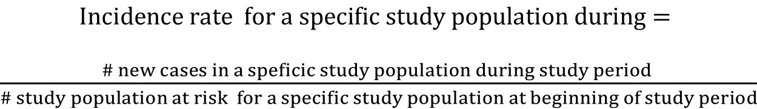
Incidence and Incidence rate
  Incidence: occurrence of new disease or mortality within a defined period in a specified population at risk.
  Incidence rate:
  Group specific incidence rate : Study population at risk may be age, gender, race specific
$Incidence rate =\frac{\# new cases during study period }{\# study population at risk at beginning of study period}$
$$Incidence rate for a specific study population during=$$
$\frac{\# new cases in a speficic study population during study period }{\# study population at risk for a specific study population at beginning of study period}$
Notes:
Incidence is a fundamental tool for etiologic studies of both acute and chronic disease, as they are the indicators of risk of disease. Incidence rates provide a direct measure of the rate at which individuals in a given population develop disease; thus, they provide a basis for statements about the probability, or risk, of disease.
Incidence describes the risk of the disease how fast the development of the disease is
Incidence : Defined as the occurrence of new disease or mortality within a defined period of observation (e.g., a week, month, year, or other time period) in a specified population at risk for developing the disease.
For example: Incidence of lung cancer for Kentucky State in 2000 means the number of new cases of lung cancer reported in Kentucky during the year 2000.
Incidence rate: A rate formed by dividing the number of new cases that occur during a time period by the number of individuals in the
population at risk.
Incidence rate over a time period= $\frac{Number of new cases}{Total Population at Risk}$ over a time period X multiplier(e.g., 100,000)
Numerator : Number of new cases counted over a time period. Number of persons vs number of conditions. For example, you can catch a cold more than once in a year. We could use "number of people who got colds" as the numerator or "number of colds." How we define the numerator will, potentially, have a significant influence on the incidence.
Denominator : at the beginning of study period. During any specified time, Number of total population at risk people can die, can have disease, can move to other places, the number at denominator is changing. So for simplicity, we use the population at the beginning of the study period. Remember to distinguish it from Prevalence later
Population at risk: means that people are capable of developing to disease. In measuring incidence rate, we would like to exclude anyone who was not at risk of developing disease, because they already had the disease or because they couldn't develop it. For example, if one wanted to estimate the risk of developing uterine cancer in postmenopausal women, we ideally would like to exclude women who had previously undergone hysterectomy (removal of the uterus), since they are no longer at risk of developing this particular type of cancer.
Group specific incidence rate: Study population at risk may be age, gender, race specific
Numberator : Number of new cases reported from the specific group of population over study period
Demomiator : Number of total population at risk of the specific group of population at the beginning of study period
For example: if the specific group of population is male, we are estimating the incidence rate in male
$$Incidence rate for male in 2000 =\frac{\# new male cases during 2000}{\# of male study population at risk at beginning of 2000}$$

Slide 20
Incidence rate - example(1)
Consider a study of 3,000 cruise ship passengers.
  Laboratory tests confirm no passenger is carrying norovirus at the beginning of the cruise.
  All passengers complete the two-week cruise.
During the cruise, 500 passengers contracted norovirus.
What is the Incidence rate of norovirus during two-week cruise
Notes:
Response:
$Incidence rate during two weeks=\frac{\# new cases during two−week cruise}{\# study population at risk at beginning of the cruise}$ X multiplier
= $\frac{500}{3000}$x100
=0.17
= 17 per 100 passengers
Which means during two –week , 17 out of 100 passengers contracted norovirus

Slide 21
Prevalence
Now would be a good time to take a break

Slide 22
Prevalence
Compares all people with disease to people in population
Probability of having disease
Measure of existing health conditions
Useful for assessing health of population and planning health services
Notes:
Prevalence is the proportion of a population that is affected at a given time. Prevalence is frequently referred to as a rate, but it is not, because there is no element of time. Epi snobs, like your beloved instructor’s epi instructors, snicker and sneer at people who refer to the "prevalence rates" of different diseases -- especially those who do so in writing. Unfortunately, the ratio of people who misuse this term as compared to those who do not is quite high.
Prevalence measures the number of people with the disease (new and existing cases) compared to the number of people in the population at certain time point. As such, it is useful for assessing the health status of a population and planning health services. Prevalence is also often the only measure possible with chronic diseases, where incident cases (new cases) cannot be easily detected (e.g. prevalence of hypertension)
Prevalence is not very useful for identifying risk factors (disease etiology).

Slide 23
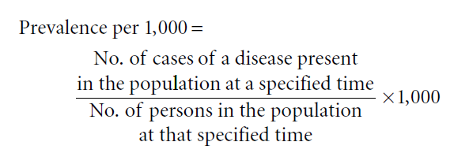
Prevalence and Point Prevalence
Prevalence : The number of existing cases of a disease or health condition, or deaths in a population at some designated time.
Point Prevalence:
Notes:
Prevalence measures are used to describe the scope and distribution of health outcomes in population and the disease load. And prevalence measures the burden of the disease in the community which help distribute the training and education at healthcare .
Even if only a few number of people become ill each year, if the disease is chronic, prevalence will likely be high because of the mounting number of cases (new and existing) in a specified time point. Conversely, if the illness has a short duration -- either because it's short-lived or highly fatal -- then the prevalence will likely be low. This is important to know. So important that I’ll discuss it again later. =)
Point prevalence : All cases of a disease, health condition, or deaths that exist at a particular point in time relatiIncidence rate over a time period
Point prevalence= $\frac{Number of persons ill }{Total number in the group}$ at a point in time
Numerator : Number of persons ill or existing cases at a point in time
Denominator : Total number of persons in the group at a point in time.

Slide 24
In-Class Example
We want to determine the 2015 prevalence of breast cancer among post-menopausal females employees at WKU. During that 2015, there were 100 new cases reported among the 600 post-menopausal female employees at WKU, 100 of whom already have breast cancer. What would the prevalence of breast cancer be?
Notes:
Calculate and compare!

Slide 25
P = 100 new cases + 100 old cases in 2015
600 postmenopausal women
= 200/600
= .33
The 2015 prevalence of breast cancer among postmenopausal women at WKU is 33%.
Notes:
Let’s establish our numerator. Here we use ALL cases of breast cancer cases – the newly diagnosed within the time frame (100) and those already having breast cancer (100).
Our denominator is our population at risk – post-menopausal women. Because we are including the women who already have breast cancer in the numerator, we must also include them in the denominator (an assumption of proportions in general). Therefore our denominator is 600.

Slide 26
Point prevalence: example
The three largest cities in New Zealand are Auckland, Wellington, and Christchurch. Assume that these are the only three cities in New Zealand.
City | Total Population (Jan 1, 2012) | Male Population (Jan 1, 2012) | Prostate Cancer Cases (12:00 AM, Jan 1, 2012)
Auckland | 400,000 | 196,000 | 330
Wellington | 370,000 | 188,700 | 270
Christchurch | 340,000 | 170,000 | 250
What are the point prevalence for Auckland at the beginning of 2012?
What is the point prevalence at New Zealand at Jan 1, 2012
Notes:
Recall : Point prevalence= $\frac{Number of persons ill }{Total number in the group}$ at a point in time
So point prevalence of CHF at Jan 1, 2012=
$\frac{Number of persons with prostate cancer}{Total number of persons in the group}$ at Jan 1, 2012X multiplier(e.g., 100,000)
From the information provided in the question, there are 330 cases for Auckland at the beginning of the years, which mean at the beginning of year of 2011 , the numerators , the number of persons with prostate cancer at the beginning of 2011 is 330.
Then we are figuring out what the denominator is. Do we use the total population or male population only ? We will only apply male population because only males are eligible to get prostate cancer. So the denominator is 196,000.
The point prevalence in Auckland at Jan 1, 2011 is (330/196,000) X 10,000 = 17 per 10,000 in Auckland.
Then you can practice yourself for Wellington, and Christchurch ?
So the point prevalence at New Zealand is (330 + 270 + 250)/ (19600 + 188700+170000) = 850/ 378300 = 22.5 per 10,000.
What if I tell you sex ratios for male vs. female are 1.1, 0.9, 1.2 for Auckland, wellington, Christchurch
respectively and will not provide the male population information.

Slide 27
Example for point prevalence and Incidence rate
An epidemiologic investigation begun on January 1st, 2011 identified a population of 1,000 individuals.
Forty were found to have congestive heart failure (CHF) on this date.
During the year of the study, 16 additional new cases of CHF were found.
There were 12 deaths during the year among persons without CHF.
Questions :
What is the incidence rate during 2011?
What is point prevalence at the end of 2011?
Notes:
Response:
What is the incidence rate during 2011?
Recall : Incidence rate over a time period= $\frac{Number of new cases}{Total Population at Risk}$ over a time period X multiplier(e.g., 100,000)
So Incidence rate of CHF during 2011 =
$\frac{Number of new CHF cases}{Total Population at Risk for CHF}$ during 2011 X multiplier(e.g., 100,000)
First, we need to find out number of new CHF cases during 2011. From the question, we can see there are 16 new cases of CHF found, so the numerator is 16.
Now we need to figure out the denominator, which means total population at risk for CHF at the beginning of 2011. At the beginning of 2011, 40 out of 1000 are having CHF, which means that they are not at risk for CHF, so we need to subtract off those people from 1000 individuals. So the denominator should be 1000-40 = 960.
Incidence rate of CHF during 2011 = (16/960) X 1000 = 17 per 1000 individuals , which means that of 1000 persons, seventeen develop into CHF during a year.
2.What is point prevalence at the end of 2011?
Recall : Point prevalence= $\frac{Number of persons ill }{Total number in the group}$ at a point in time
So point prevalence of CHF at the end of 2011=
$\frac{Number of persons with CHF cases}{Total number of persons in the group}$ at the end of 2011 X multiplier(e.g., 100,000)
From the information provided in the question, there are 40 cases at the beginning of the years, and 16 new cases developed during the years. And it did not say individuals with CHF died during the 2011, which mean at the end of year of 2011 , the numerator, the number of persons with CHF cases at the end of 2011 is 40+16 = 56.
Then we are figuring out what the denominator is . At the beginning of the year there are 1000 , and then 12 of them died during the years. So the total number of persons in the group left at the end of 2011 is 1000-12 = 988 .
Then the point prevalence at the end of 2011 is (56/988) X 1000 = 57 per 1000
The point prevalence at the end of 2011 is 57 per 1000, which means, at the end of 2011 , 57 out of 1000 have CHF disease.

Slide 28
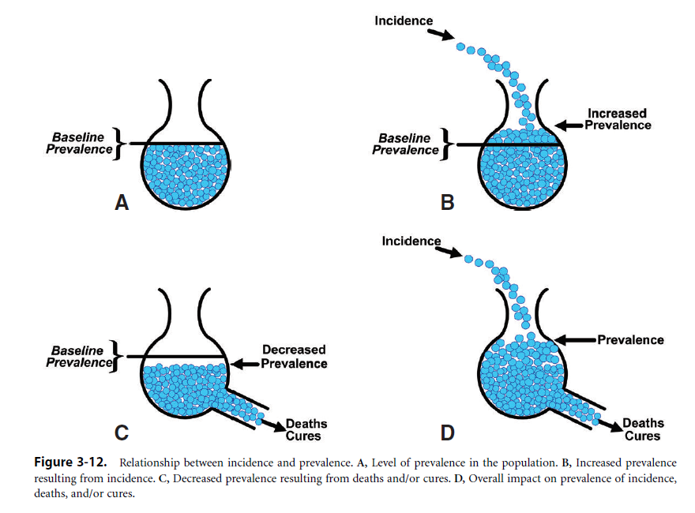
The relationship between Incidence and Prevalence
(Source: Epidemiology, fifth edition. Leon Gordis )
Notes:
A flask is shown that represents a community (Fig. 3-12A), and the beads in the flask represent the prevalent cases of a disease in the community.
How can we add to or increase the prevalence? As seen in Figure 3-12B, we can do so through incidence—by the addition of new
cases.
What if we could drain beads from the flask and lower the prevalence? How might this be accomplished? As seen in Figure 3-12C, it could occur through either death or cure. Clearly, these two outcomes represent a major difference to a patient, but with regard to prevalence, cure and death have the same effect: they reduce the number of diseased persons in the population and thus lower prevalence. what exists is the
dynamic situation shown in Figure 3-12D.
A continual addition of new cases (incidence) increases the prevalence, while death and/or cure decrease the prevalence.

Slide 29

Interrelationships Between Incidence and Prevalence
  Incidence and prevalence are interrelated concepts.
  Factors that cause prevalence to increase
      Increase in incidence
      Longer duration of the case
      In-migration of cases
      Prolongation of life of patients without a cure
  Factors that cause prevalence to decrease
      Decrease in incidence
      Shorter duration of disease
      In-migration of healthy people
      Improved cure rate of disease
Notes:
This effect of lowering prevalence through either death or cure underlies an important issue in public health and clinical medicine. For example, when insulin first became available, what happened to the prevalence of diabetes? The prevalence increased because diabetes was not cured, but was only controlled.
Many patients with diabetes who formerly would have died now survived; therefore, the prevalence increased.
We have said that prevalence is not a measure of risk. If so, why bother to estimate prevalence?
Prevalence is an important and useful measure of the burden of disease in a community. For example, how many people in the community have arthritis? This information might help us to determine, for
example, how many clinics are needed, what types of rehabilitation services are needed, and how many and what types of health professionals are needed.
Prevalence is therefore valuable for planning health services.
When we use prevalence, we also want to make future projections and anticipate the changes that are likely to take place in the disease burden.
if we want to look at the cause, or etiology, of disease, we must explore the relationship between an exposure and the risk of disease, and to do this, we need data on incidence

Slide 30
Other Epidemiology Terminology
  Period prevalence: How many people have had the disease at any point during a certain time period?
    Some people may developed the disease during that period, and others may have had the disease before and die or been cured during the period
    Lifetime Prevalence: cases diagnosed at any time during the person’s lifetime

Slide 31
Mortality
Make sure that you can the notes below
Notes:
This lesson covers rates

Slide 32
Learning Objectives
  Crude rates
  Specific rates
  Adjusted rates
Notes:
In order to examine, the occurrence, development of the disease in human population we need to be able to measure the frequency of both disease occurrence and deaths from the disease.
Last class, we discussed how to use rates to express the extent of morbidity from a disease using incidence and prevalence. Now we look at the rate for mortality . Mortality is an index of the severity of a disease from both clinical and public health perspective, and mortality can also be used as an index of the risk of disease.
You are required to know how to calculate the crude rates, specific rates, adjusted rates, and interoperation of those rates

Slide 33
Mortality Rate (Crude)
Incidence rate of death
Calculated on annual basis
Expressed as per 1000
Total # of deaths from all causes
in one year
M = x1000
# in population midyear
Notes:
A mortality rate is really nothing more than an incidence of death, as opposed to a disease or risk factor. It is usually calculated on an annual basis and expressed as “per 1000.” It is considered a “crude” rate, because it uses raw numbers…
The numerator is the number of deaths that occur during that one year period.
For vital statistics purpose, the midpoint (midyear) population is used as the denominator, with the assumption that: a) additions to and subtractions from the population occur uniformly throughout the year; and, b) if the actual person-years of follow-up were calculated for all individuals in a year, the value will be equivalent to the number of population at midyear times one -- that is, followed for one full year.

Slide 34
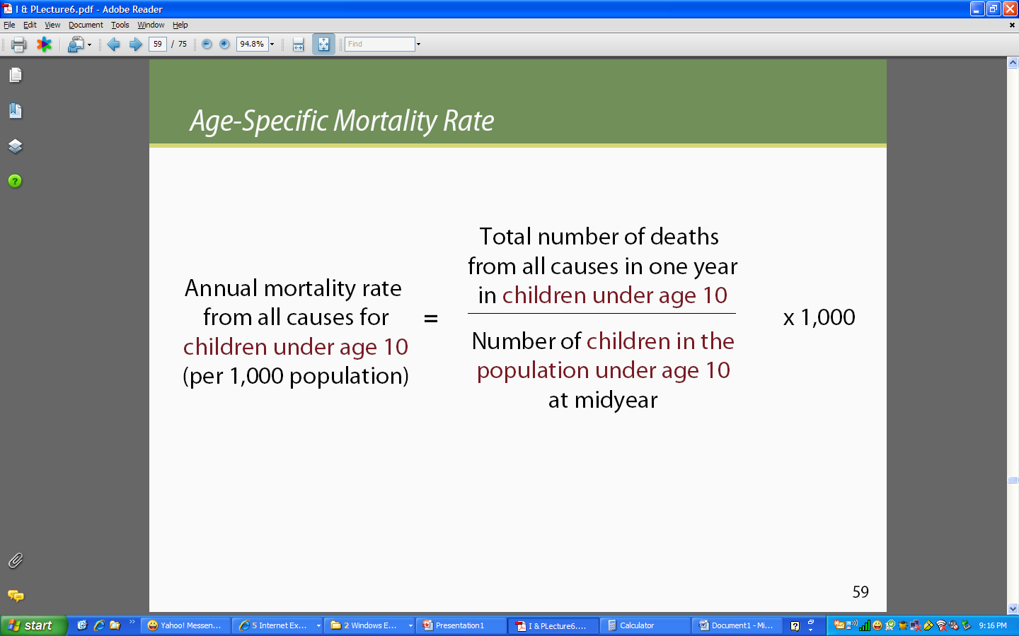
Age-Specific Mortality Rates
Notes:
Mortality can be computed based on specific factors such as age, gender, race, etc. The key to remember is that your population definitions must be the same in the numerator and the denominator to determine a factor-specific mortality proportion, um, rate. =)

Slide 35
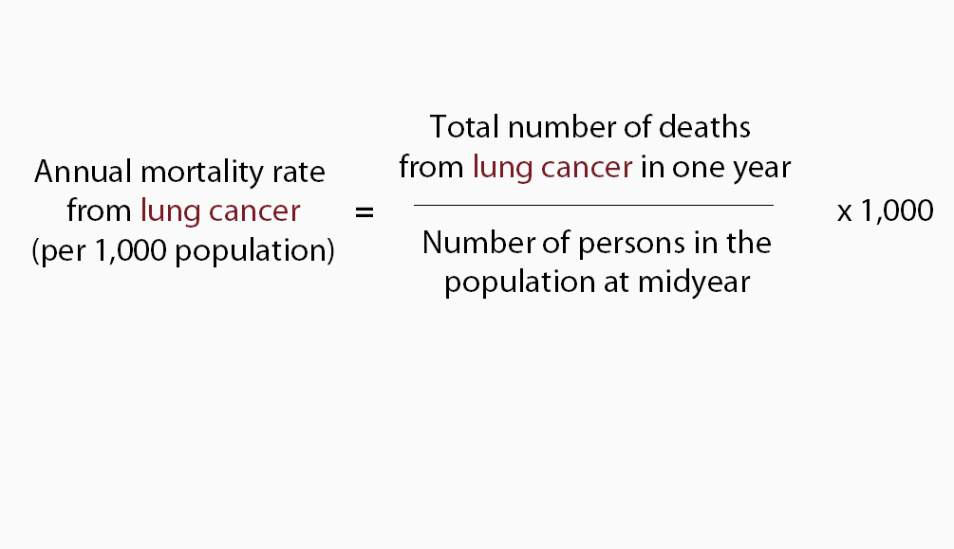
Cause-Specific Mortality Rates (CSMR)
Notes:
Mortality can be measured in terms of a specific cause of death as well. If you were to add up all of the cause-specific mortality rates, you would end up with just a plain old mortality rate. Why is that you ask? Well, the answer is in the denominator….
Note: There are tons of different combinations of mortality rates – age and cause specific, age and gender, etc. They all use the same basic formula, but you have to really think through the denominator in order to make sure your finding is accurate.

Slide 36
Case Fatality Rate (CFR)
CFR = # people who died from a disease
# people who have that disease
(in same time period)
Notes:
"Case-fatality rate" is technically not a rate, even though it has the word “rate” in it... Rather, it is a proportion of people having a disease who die from that disease over a stated period of time. Case-fatality rate is the "risk of death" among the diseased as is calculated as such:
Case-fatality rate (CFR) = (# cases who die from x / # cases of x ) in stated period of time. It is often expressed in terms of a percentage, so your answer is multiplied by 100 to get the percentage.
A high CFR may indicate the following about a disease and it detection & treatment:
a. serious disease (aggressive)
b. late diagnosis (advanced case)
c. poor quality of treatment
CFR may vary by geographical location.
NOTE: Disease is used in the broad sense, here. It could be an injury, risk factor, etc. As with the measures that came before this slide, you can have all sorts of specific CFRs
Why do we care about using case fatality rate (CFR)? CFR measure how deadly the disease is.
For example: Ovary cancer is really rare, however, ovary cancer is fatal cancer. Once the disease is diagnosed, the patient usually dies soon, which indicates the higher CFR. Then we can conclude the point prevalence is low in the community.

Slide 37
In-Class Example:
Mortality Rate vs CFR
Assume a population of 100,000 people
  20 are sick with disease “X.”
  In one year, 18 die from disease “X”
What is the mortality rate in that year from disease “X?”
What is the CFR?
What do these measures tell us (interpret findings)?
Notes:
Compute then compare

Slide 38
In-Class Example:
Mortality Rate vs CFR
Assume a population of 100,000 people
  20 are sick with disease “X.”
  In one year, 18 die from disease “X”
What is the mortality rate in that year from disease “X?”
What is the CFR?
What do these measures tell us (interpret findings)?
Notes:
Mortality Rate = 18/100,000 = .00018 or .018%
CFR = 18/20 = .9 or 90%
Interpretation: Overall, very few people die from disease X (less than 2 per 1000), but the people who get it have a very high rate of death (90%).
POP QUIZ: Given what you know about disease X, would the annual prevalence be high or low?

Slide 39
Proportionate Mortality (PM)
PM = # deaths from specific cause
total # deaths in same time period
Notes:
Another proportion that isn’t really a rate but claims to be in its name is a proportionate mortality rate, which is the number of deaths from a specific cause (ie, cancer) divided by the overall number of deaths in the same time period. It is usually expressed as a percentage.
Note: For “categories” of diseases, like cancer, the PM may be calculated by dividing the number of deaths from a specific cancer, such as colon cancer, by the total number of all cancer deaths in the same time period. This is different than the CFR which would be the number of people who died from colon cancer divided by the number of people who had colon cancer. For both of these proportions, the time frame is the same in the numerator and denominator.

Slide 40
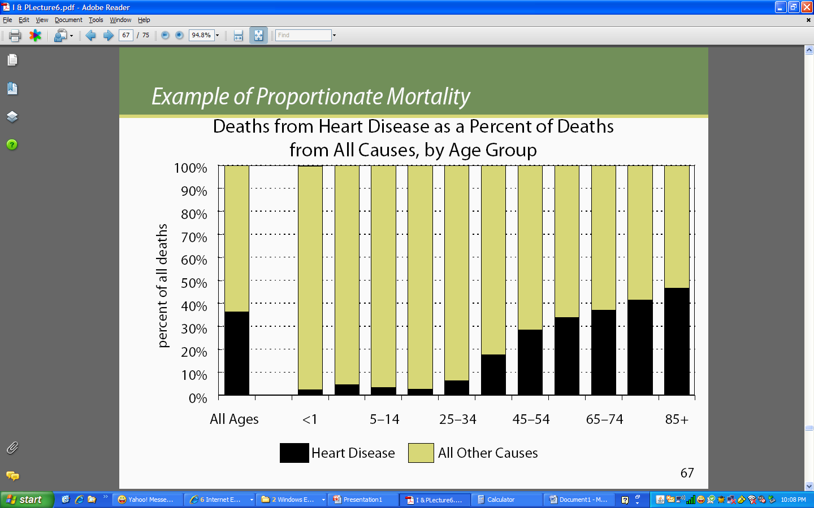
Age-Specific PM of Heart Disease
Notes:
Here is an example of how you may see PM presented in a journal…

Slide 41
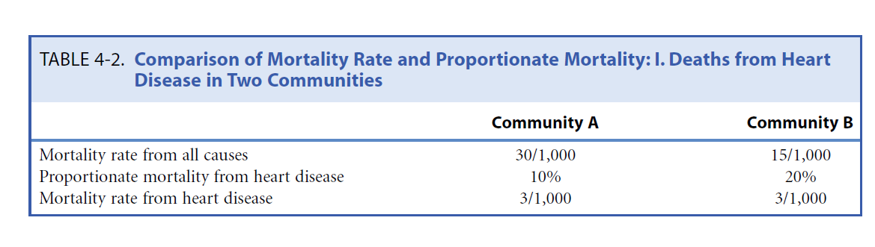
Example for Mortality rate and
Proportionate Mortality ratio
Notes:
This example to illustrate the interpretation of mortality rate for all causes, mortality rate for heart disease, and proportionate mortality rate
Table 4-2 shows all deaths and deaths from heart disease in two communities, A and B. All cause mortality in community A is twice that in community B.
When we look at proportionate mortality, we find that 10% of the deaths in community A and 20% of the deaths in community B are due to heart disease.
Does this tell us that the risk of dying from heart disease is twice as high in community B as it is in A? The answer is no.
The proportionate mortality rates from heart disease are calculated (10% of 30/1,000 and 20% of 15/1,000), community B has higher proportionate mortality rate than community A.
But we will see that the mortality rates for the two communities are identical.

Slide 42
Adjusted Rates
Direct method
Indirect method
Notes:
They are two ways to adjust the rates : direct and indirect
Direct method
Apply stratum-specific rates observed in the population of interest to a standard population to obtain the number of deaths expected in the standard population.
Calculate an adjusted rate based on expected number of deaths and the total population in the standard population.
Indirect method
Apply stratum specific rates in standard population to the populations of interest to obtain the number of expected deaths for populations of interest
Compare the observed number of deaths to the expected number of deaths for population of interest
We have already calculated the crude rates, why do we need to adjust the rate? The following is an example to show

Slide 43
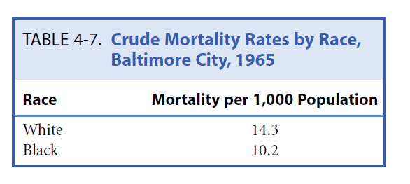
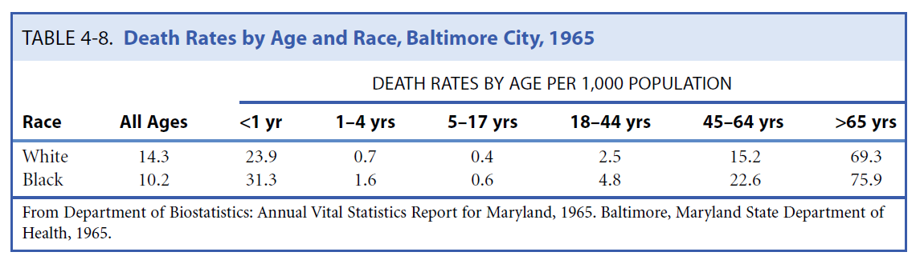
Example to illustrate the
problem of crude rate
Notes:
Table 4-7 shows data that exemplify the problem. Mortality rates for white and black residents of Baltimore in 1965 are given.
The data may seem surprising because we would expect rates to have been higher for blacks, given the problems associated with poorer living conditions and less access to medical care, particularly at that time.
When we look at Table 4-8, we have added data for each age-specific stratum (layer) of the two population (black and white). Interestingly, although in each age-specific group, mortality is higher in blacks than in whites(such as 18-44 yrs : 4.8 in black vs. 2.5 in white; 45-64yrs: 22.6 in black vs. 15.2 in white, and so on). However, the overall mortality in table 4-7 (also called crude or unadjusted. Mortality ) is higher in whites (14.3 per 1000 ) than in blacks (10.2 per 1000).
Why is this so? This is a reflection of the fact that in both whites and blacks, mortality increases markedly in the oldest age groups(table 4-8) . Older age is the major contributor to mortality. However, the white population in this example is older than the black population, and in 1965, there were few blacks in the oldest age groups.
Thus, in whites, the overall mortality is heavily weighted by high rates in the oldest age groups. The overall (or crude) mortality rate in whites is increased by the greater number of deaths in the large subgroup of older whites, but the overall mortality rate in blacks is not increased as much because there are fewer deaths in the smaller number of blacks in the older age groups. Clearly, the crude mortality reflects both differences in the force of mortality, and differences in the age composition of the population.
We need to consider the age composition when we compare two rates and do age-adjustment .

Slide 44
Direct Age Adjustment
Step 1: Identifying a “standard” Population
usually the standard population is the sum of two population
Step 2 : Applying age specific mortality rates in each group to the standard population for both groups to calculate the expected numbers of death in each age group
Step 3 : Summing of expected numbers are obtained
Step 4 : Calculating adjusted rate by using the sum of expected numbers divided by the total “standard” population
Notes:
Here are the steps we take to make direct age adjustment. The example is followed to show the steps

Slide 45
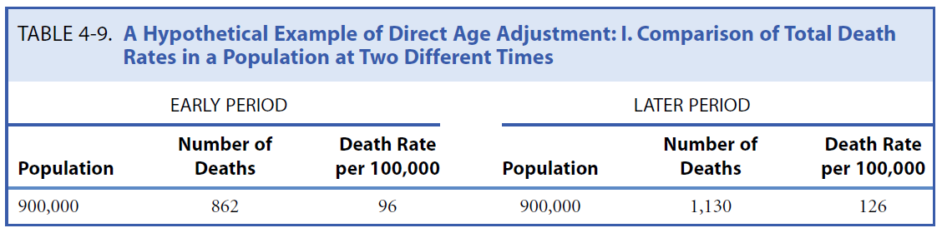
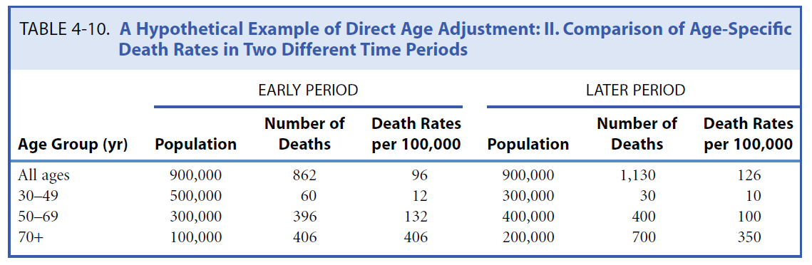
Direct Age Adjustment
Notes:
Table 4-9 shows the crude death rates in a population at early period and later period. In early period, total number of deaths is 862 and total population is 900,000 with the death rate, 96 per 100, 000, while in later period , the death rate is 126 per 100, 000 (1130/ 900, 000). From the crude rate, there is higher rate in later period than in the early period.
But thinking about the improvement of health care, and medical technology, we can guess that death rate in later period should be lower than early period.
Table 4-10 shows age specific rates in two periods, respectively. The death rate in each age group in early period is higher than later period (30-49 yr: 12 in early vs. 10 in later; 50-69 yr: 132 in early vs. 100 in later ; 70 + yr: 406 in early vs. 305 in later ) , which is contradictory with the result in table 4-9.
So we need to perform direct age-adjustment in order to eliminate the effects of any differences in age between two or more populations being compared.

Slide 46
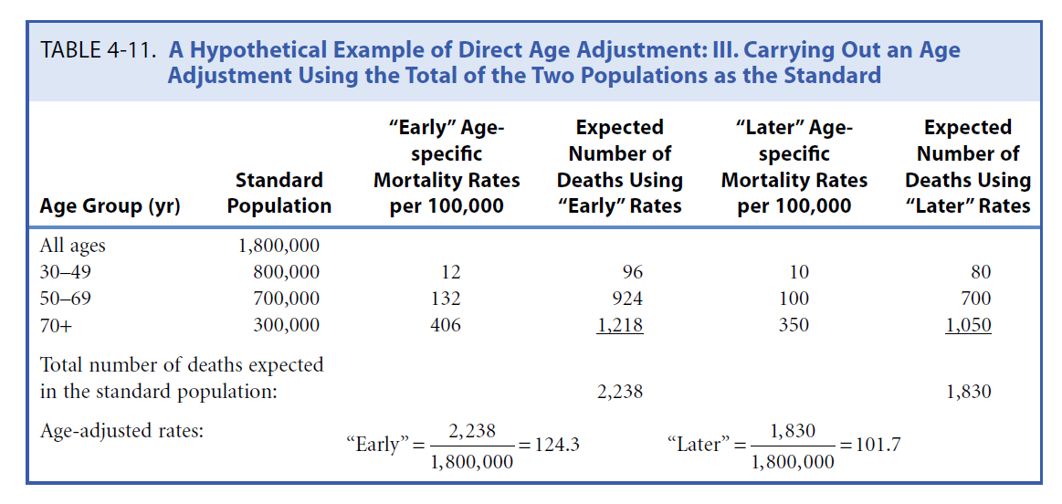
Direct Age Adjustment
Notes:
Step 1: Identifying a “standard” Population - usually the standard population is the sum of two population
so in the red box : based on information in table 4-10 in previous slide
All ages for Standard population : 900,000 in early + 900,000 in later
30- 49 : 500,000 in early + 300,000 in later
50- 69 : 300,000 in early + 400,000 in later
70+: 100,000 in early + 200,000 in later
Step 2 : Applying age specific mortality rates in each period to the standard population for both groups to calculate the expected numbers of death in standard population for each age group
For example :
For 30-49 age group in early period : mortality rate per 100, 000 is 12 (table 10) and there are total 800,00 in that age group from standard population , so the
expected number of death in early period is 800000 * 12 /100000 = 96
For 50-69 age group in early period : mortality rate per 100, 000 is 132 (table 10) and there are total 700,00 in that age group from standard population , so the
expected number of death in the standard population is 700000 * 132 /100000 = 924
Do the same thing for the group 70+ in early period and all age group in later period
Step 3 : Summing of expected numbers are obtained
Looking at the yellow box : expected death in early period is 96+924+ 1218 = 2238 . Same thing for the later period
Step 4 : Calculating adjusted rate by using the sum of expected numbers divided by the total “standard” population .
So we apply those sums of expected number of deaths to total standard population , the we have the adjusted rates in each period (green highlights)
If we compare these two adjusted rate , later period has lower death rates than early period . We also can see compare the crude and adjusted (in early, 96 vs. 124.3 ; in later , 126 vs. 101.7 )

Slide 47
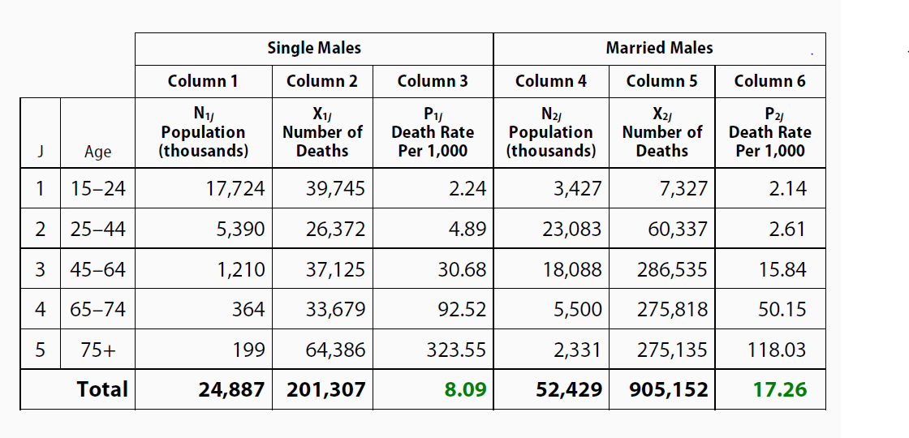
Example of U.S. Mortality - Single vs. Married Males
Direct Method
Source : http://ocw.jhsph.edu/courses/fundepi/PDFs/Lecture7.pdf
Notes:
Here is another example,
I hope that you can work on it yourself a little bit .
Take look at the table for minutes
The table has the mortality rate for single and married males by age group . It also has the total population and number of death by each group for single and married males.
You can the death rate in each age group for single and married males , respectively.
For example Death rate of Age 15-24 in single males is 2.24 per 1000 : 39745 / 17724000 since the population in thousand .
The crude rates for single male (8.09 per 1000) is lower than the married male (17.26 per 1000) . But for each group , single males have higher rate than married males.

Slide 48
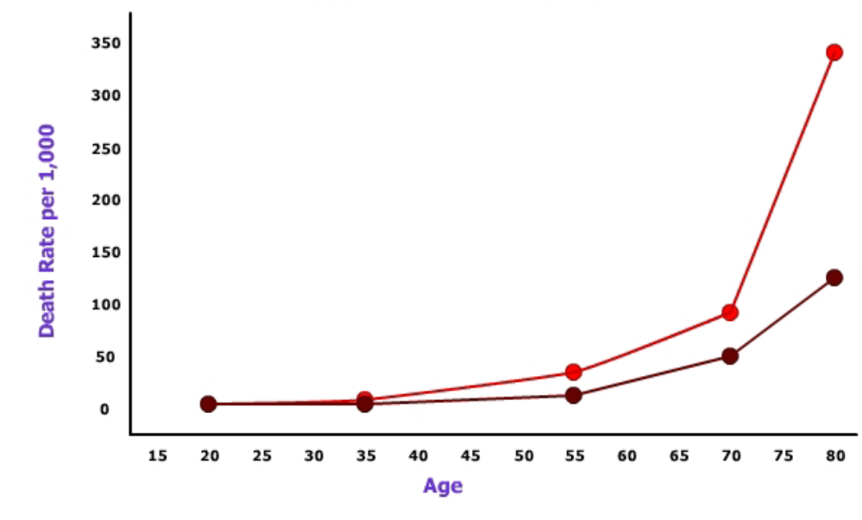
U.S. Males, Death rates by marital status and Age
Single males
Married males
Source : http://ocw.jhsph.edu/courses/fundepi/PDFs/Lecture7.pdf
Notes:
The figure shows the result based on the information in the previous slide.
In all age groups, single males has higher death rates than the married males.

Slide 49
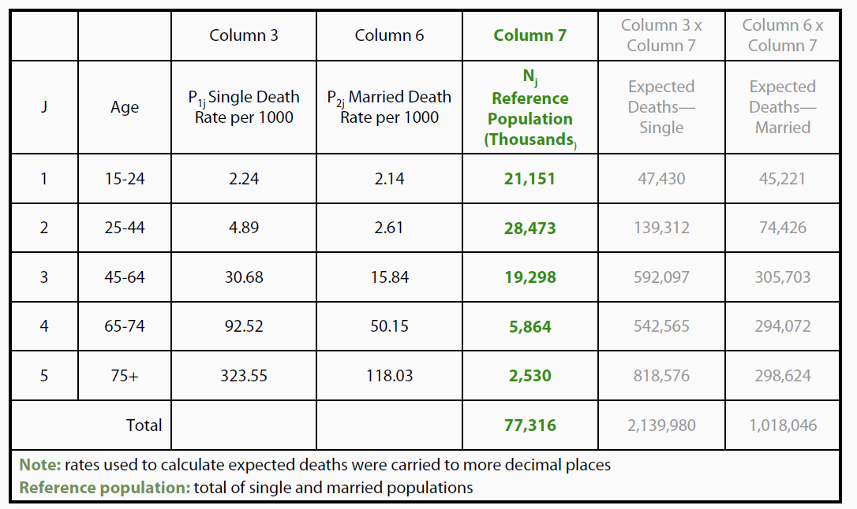
Step 1 . Identifying standard population using sum of single and
married males in each age group
Notes:
From what we see the results, we need to adjust the death rate to compare single male and married males
Step 1, find a standard population (Green highlight) , it is a sum of single and married males

Slide 50
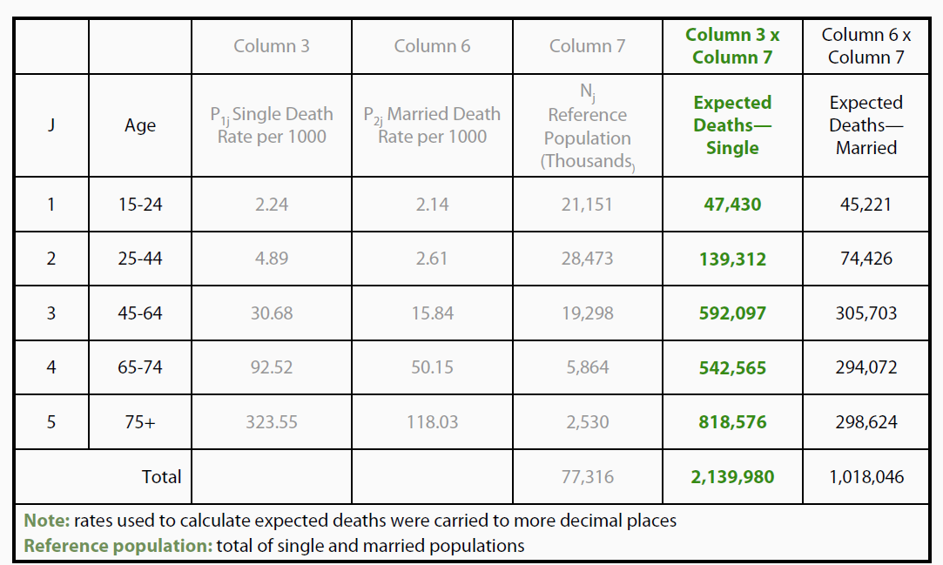
Step 2 .Calculating expected deaths
for U.S. single males
Notes:
For example ,
Age 15-24 group, expected death if we appy the standard population and death rate of age 15-24 for single males is 21151000 * 2.24 per 1000 =
47430
Then calculate the expect death like this for the rest age group .
Then sum 47439 + 139312 + 592097 + 542565 +818576 = 2139980.
Then we do the similar thing for married males group

Slide 51
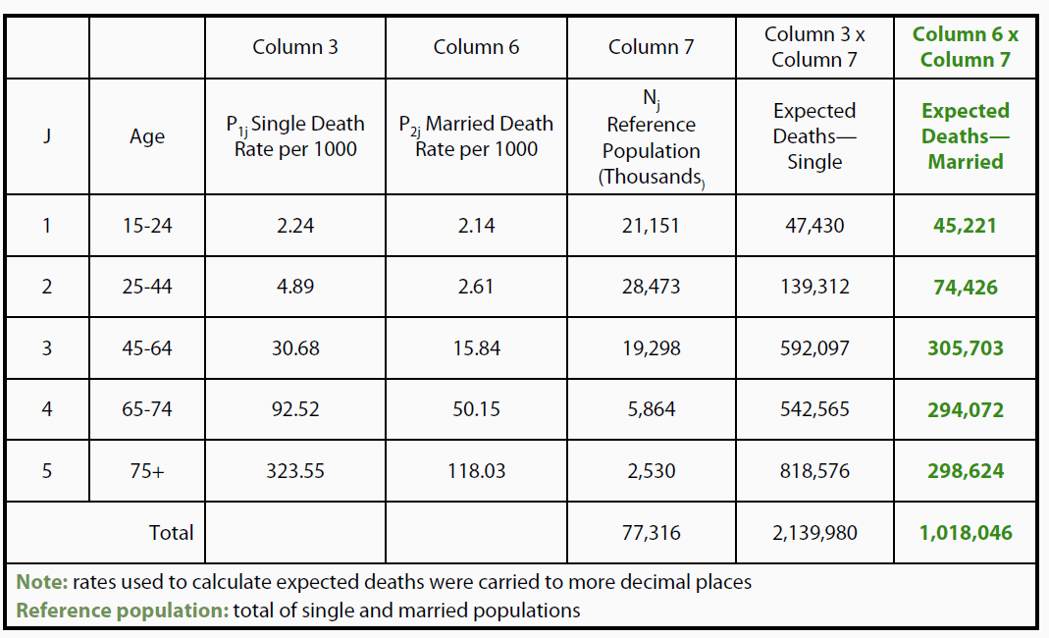
Step 3 .Calculating expected deaths
for U.S. married males

Slide 52
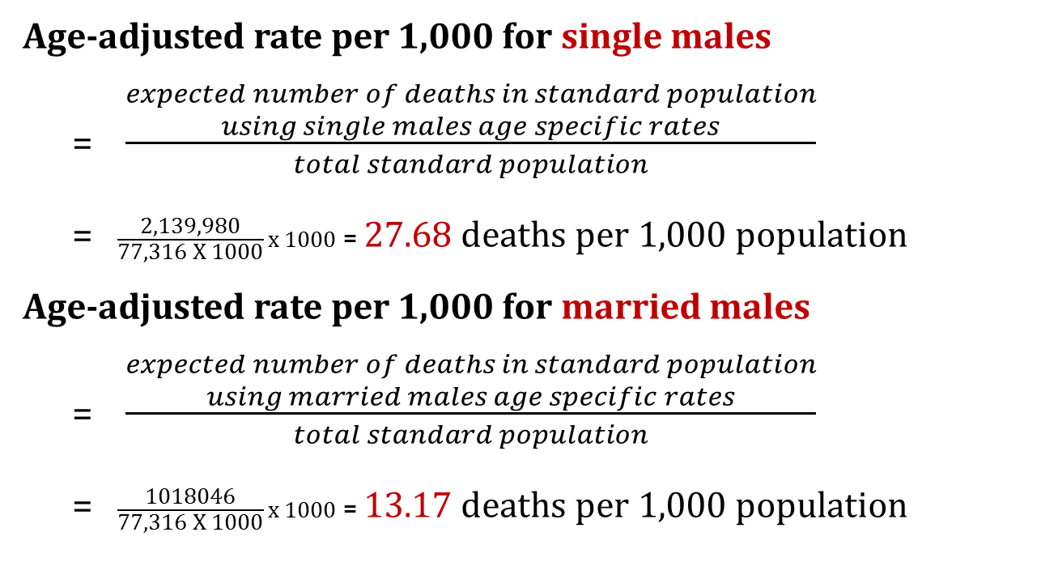
Step 4 .Calculating age adjusted rate for both single and married
Age-adjusted rate per 1,000 for single males
= $\frac{\begin{aligned}expected number of deaths in standard population \\ using single males age specific rates\end{aligned}}{total standard population}$
= $\frac{\text{2,139,980}}{\text{77,316 }\text{X}\text{ 1000}}x 1000$ = 27.68 deaths per 1,000 population
Age-adjusted rate per 1,000 for married males
= $\frac{\begin{aligned}expected number of deaths in standard population \\ using married males age specific rates\end{aligned}}{total standard population}$
= $\frac{\text{1018046}}{\text{77,316 }\text{X}\text{ 1000}}x 1000$ = 13.17 deaths per 1,000 population
Notes:
So we can see higher adjusted rate in single males than married males

Slide 53

Indirect Age Adjustment
Take age-specific rates for a known population are applied to each age group in the population of interest, the expected numbers of death in each group are calculated, and these numbers are totaled
The observed numbers of deaths in that population are calculated
The ratio of total number of deaths actually observed to the total number of deaths expected. The ratio is called the standardized mortality ratio(SMR)
Standardized Mortality Ratio (SMR) =
Observed No. of deaths per year
X 100,000
Expected No. of deaths per year
Notes:
Indirect age adjustment is another way to do the age adjustment
Indirect age adjustment is often used when numbers of deaths for each age-specific stratum are not available.
It is also used to study mortality in an occupationally exposed population: Do people who work in a certain industry, such as mining or construction, have a higher mortality than people of the same age in the general population? Is an additional risk associated with that occupation?
the age-specific rates for a known population, such as all men of the same age, are applied to each age group in the population of interest. This will yield the number of deaths expected in each age group in the population of interest, if this population had had the mortality experience of the known population.
Thus, for each age group, the number of deaths expected is calculated, and these numbers are totaled. The numbers of deaths that were actually observed in that population are also calculated and totaled. The ratio of the total number of deaths actually observed to the total number of deaths expected, if the population of interest had had the mortality experience of the known population, is then calculated. This ratio is called the standardized mortality ratio (SMR).

Slide 54
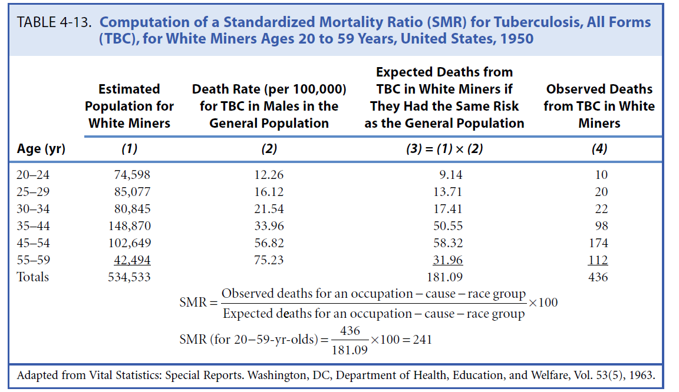
Example of Indirect Age Adjustment
X
=
Notes:
How many deaths would we expect in these white miners if they had the same mortality experience as white men in the same age group in the general
population?
”An SMR of 100 indicates that the observed number of deaths is the same as the expected number of deaths. An SMR greater than 100 indicates that the observed number of deaths exceeds the expected number, and an SMR less than 100 indicates that the observed number of deaths is less than the expected number.

Slide 55
Example of indirect age adjustment
Applying indirect age adjustment to mortality rate of Los Angeles county, using California death rates as the standard for comparison

Slide 56
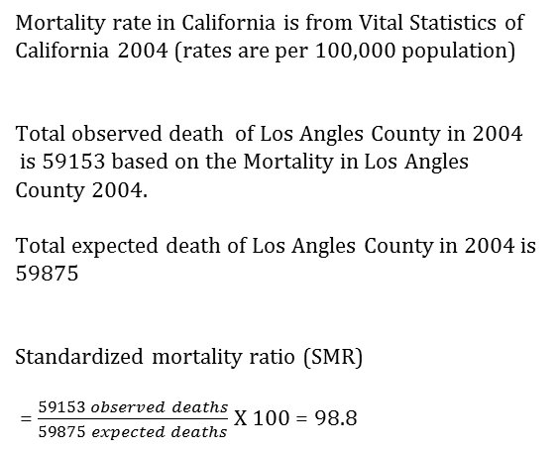
Example of indirect age adjustment of
mortality rate in Los Angeles County , 2004
Age Category | Mortality rate in California, 2004 (per 100,000 population) | Population of Los Angeles county in 2004 | # of expected deaths
<1 | 5.3 | 154,585 | 8
1-4 | 25.6 | 607,984 | 156
5-14 | 14.1 | 1,585,503 | 224
15-24 | 69.2 | 1,440,136 | 997
25-34 | 83.6 | 1,528,427 | 1,278
35-44 | 156.5 | 1,616,982 | 2,531
45-54 | 373.2 | 1,337,288 | 4,991
55-64 | 770.5 | 872,216 | 6,720
65-74 | 1822.1 | 527,629 | 9,614
75-84 | 4626.5 | 365,602 | 16915
85 and over | 11873.4 | 138,471 | 16441
Mortality rate in California is from Vital Statistics of California 2004 (rates are per 100,000 population)
Total observed death of Los Angles County in 2004
is 59153 based on the Mortality in Los Angles County 2004.
Total expected death of Los Angles County in 2004 is
59875
Standardized mortality ratio (SMR)
= $\frac{59153 observed deaths}{59875 expected deaths}$ X 100 = 98.8
Interpretation
A SMR around 100 means the number of observed deaths is
similar as what would be expected if the population in Los Angeles
had the same probability of dying as the population in California, 2004
Total
59875

Slide 57

The End?
Notes:
Yes. That’s it for this lecture. =)

