Slide 1
Descriptive Epidemiology: Patterns of Disease- Person, Place, Time
Notes:
This week, we are going to talk about descriptive epidemiology.
Recall in the previous chapter, we discussed the epidemiologic measures including incidence , prevalence, all kinds of mortality rate.
Those of measure are used to describe the disease/outcome of interest in a study, such as incidence of lung cancer(outcome), or prevalence of lung cancer in Kentucky.
Are these crude rates enough to reflect the risk or burden of disease in the community or the country? What does it like if we compare those rates internationally?
So we want to know more, we want to understand more deeper about the morbidity and mortality of the disease.
In descriptive epidemiology, we look at epidemiologic measure of outcome from difference perspectives, such person, time, location.
We will discuss this more.

Slide 2
Learning Objectives
  Define the term descriptive epidemiology
  Three types of descriptive epidemiologic study: case reports, case series, cross-sectional study
  Learn what is cross-sectional study
  What are the variables for person, time, location, respectively
  Define epidemiologic terms
Notes:
You are required to define what is descriptive epidemiology, what are the types of descriptive epidemiologic study, how are they different from each other?
Epidemiologic terms you are required to know :
Case report
Case series
Cross-section study
Health disparity
Social economic status(SES)
Nativity
Secular trends
Cyclic trends
Point epidemics
Clustering

Slide 3
Descriptive Epidemiologic Study
A descriptive epidemiologic study is concerned with characterizing the amount and distribution of health and disease within a population.
Notes:
The definition of descriptive epidemiologic study is a study to character the amount and distribution of health and disease within a population.
Descriptive epidemiology shows unequal distributions of health and disease in populations and try to determine why health conditions vary throughout populations, one must answer the following questions:
Person: Who was affected?
Place: Where did the (health) event occur?
Time : When did the (health) event occur?
It is not necessary to describe the disease from all person, place, time. But we can describe the lung cancer by race group (people),
Or we can compare cardiovascular disease by geographic area(location), we also can investigate the Lyme disease by looking at the season patterns (time)

Slide 4
Examples of Descriptive Studies
Compare temporal trends in the incidence of heart disease (Time)
Compare geographic patterns in lung cancer and contrast with smoking rates(Place)
Compare estimated lifetime risk by age and race (Person)

Slide 5
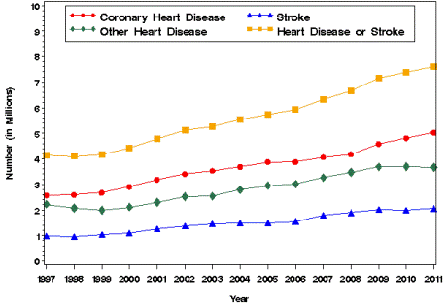
Temporal trends in the incidence of heart disease
Notes:
An example temporal trend in incidence of heart disease from 1997 to 2011. You can see hear disease or stroke increases the most over time.
Research can monitor change of incidence of heart disease

Slide 6
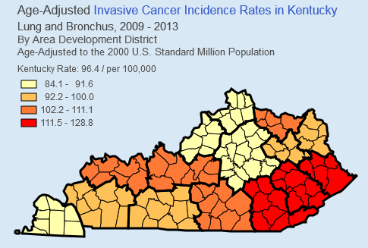
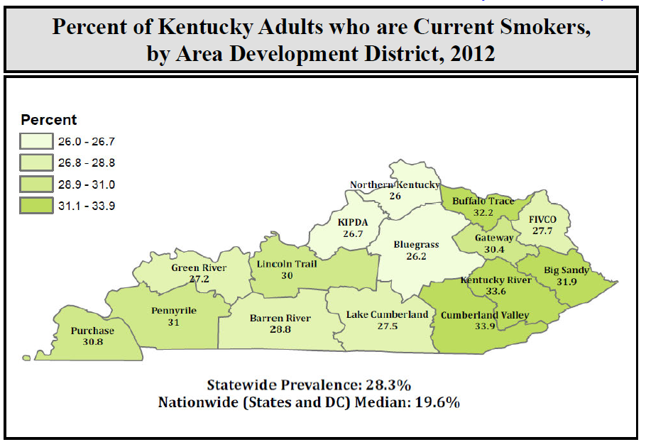
Geographic patterns in lung cancer and contrast with smoking rates
BRFSS
http://www.cancer-rates.info/ky/
Notes:
Figure(left) shows incident rates of lung and bronchus cancer in Kentucky by area development district. We can tell BIG SANDY, KENTUCKY RIVER, and CUMBERLAND VALEY districts have highest incidence rates for lung cancer.
The figure in the right shows the result from BRFSS and present the percent of smokers in Kentucky .
The districts with high incidence rates of lung cancer match with districts with high percentage of smoker

Slide 7
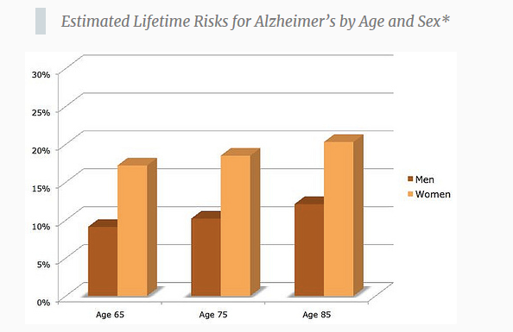
Compare estimated lifetime risk by age and gender
(Source: http://bigthink.com/articles/race-gender-and-alzheimers-disease)
Notes:
The figure above presents estimated lifetime risk of Alzheimer’s disease by age group and gender.
From each age group, women have higher risk of Alzheimer’s disease. Older age has higher risk than young age.

Slide 8
Example of Descriptive Epidemiologic Study
Study of children who were exclusively breastfed
Purpose
  Reinforce the health of babies and mothers
  Promote mother-child bonding
Notes:
The example in the book
Breastfeeding is associated with decreased risk for many early-life diseases and conditions, including otitis media, respiratory tract infections, atopic dermatitis, gastroenteritis, type 2 diabetes, sudden infant death syndrome, and obesity.
Breastfeeding also is associated with health benefits to women, including decreased risk for type 2 diabetes, ovarian cancer, and breast cancer. Health people 2010

Slide 9
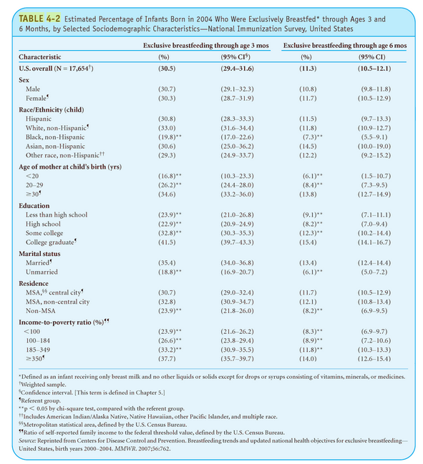
Breastfeeding Study
Notes:
A descriptive epidemiologic study of children who were exclusively breastfed was conducted(table 4-2).
Breastfeeding is associated with decreased risk for many early-life diseases and conditions, including otitis media, respiratory tract infections, atopic dermatitis, gastroenteritis, type 2 diabetes, sudden infant death syndrome, and obesity.
Breastfeeding also is associated with health benefits to women, including decreased risk for type 2 diabetes, ovarian cancer, and breast cancer.
Based on the breastfed data above, overall there are 31% babies who have breastfeeding through age 3 months and 11% for age 6months. Is this the prevalence or incidence rate? Does babies’ gender matters for rate of breastfeeding?
How about race? What conclusion do you can infer ?
Age , race, education, marital status, residence , and income of mother are associated with breastfeeding rate. Older, well educated, married, metro area, and high income are associated with higher breastfeeding rate. Based on the unequal distribution, investigator may want to know the reasons and develop hypotheses for interventions to increase breastfeeding

Slide 10
Descriptive Epidemiology
Provides valuable information for the following activities:
    Evaluation trends in health and disease
    Provide a basis for planning, provision and evaluation of health services
    Identify problem and conduct of additional research
Notes:
The health and status can be evaluated from population groups, geographical areas, and time period.
Why do we conduct descriptive epidemiology?
Descriptive epidemiology provides valuable information :
Evaluation trends in health and disease
Provide a basis for planning, provision and evaluation of health services
Identify problem and conduct of additional research
The descriptive analysis of breastfeeding shows that incomes and residence of the moths are associated with the rate of exclusive breastfeeding.
The program also demonstrated that race, age of mother and marital status were associated with lower frequency of breastfeeding.
An intervention program may be planned to target pregnant, unmarried, younger African American women. Do you know the WIC program (Woman, Infancy and Children) : food and nutrition services. Federal grants to States for supplemental foods, health care referrals, and nutrition education for low-income pregnant, breastfeeding, and non-breastfeeding postpartum women, and to infants and children up to age five who are found to be at nutritional risk.

Slide 11
Types of Descriptive Epidemiologic Studies
  Case reports
  Case series
  Cross-sectional studies
Notes:
What does epidemiologic study mean?
An epidemiologic study means that research collect information and summarize the information obtained to investigate a disease.
What does a descriptive epidemiologic study mean?
The descriptive epidemiologic study means to use descriptive methods including person, time, and location to study a disease.
There are three types of descriptive epidemiologic studies:
Case reports
Case series
Cross-sectional studies

Slide 12
Case Reports
Accounts of a single occurrence of a noteworthy health-related incident or of a small collection of such events
Example: Adverse reactions due to cosmetic surgery in the United States

Slide 13
Case Series
In comparison with a case report, a case series is a larger collection of cases of disease, often grouped consecutively and listing common features, e.g. characteristics of affected patients.
Example: reported cases of primary meningoencephalitis (121 cases reported between 1937 and 2007)

Slide 14
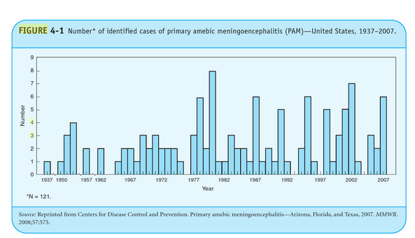
Case series for Primary amebic meningoencephalitis
Notes:
Here is an example of case series.
Primary amebic meningoencephalitis (PAM) is a rare but nearly always fatal disease caused by infection with Naegleria fowleri, a thermophilic, free-living ameba found in freshwater environments.
In 2007, six cases of PAM in the United States were reported to CDC; all six patients died.
This report summarizes the investigations of the cases, which occurred in three southern tier states (Arizona, Florida, and Texas) during June—September. presents preliminary results from a review of PAM cases during 1937--2007.
In response to the six PAM cases reported in 2007, CDC formed a panel , review future actions related to N. fowleri and to determine whether the six cases represented an increase in the annual number of cases.
The workgroup used multiple resources to conduct a review of all PAM cases reported in the United States during 1937--2007:
the Waterborne Disease and Outbreak Surveillance System,
the compressed mortality file of the National Vital Statistics System
medical literature review of reported PAM cases, including those identified by retrospective examination of autopsy records;
searches of media reports since 1990; and 5) CDC laboratory test results. Preliminary results indicate that a total of 121 cases (range: 0--8 cases per year) occurred in the United States during 1937—2007.
Exposure primarily occurred in untreated, warm, freshwater lakes or rivers in 15 southern tier states.
In addition to conducting the review of PAM cases, objectives of the Naegleria Workgroup are to
update PAM risk-communication messages for health-care providers and the public,
propose making PAM a nationally notifiable disease,
develop a more extensive case-reporting form, and
review the role of environmental testing for N. fowleri. Although the workgroup continues to address these issues, this report contains its current findings and recommendations.

Slide 15
Cross-Sectional Studies
Examines the relationship between diseases (or other health-related characteristics) and other variables of interest as they exist in a defined population at one particular time.”
A type of prevalence study
Example: the Behavioral Risk Factor Surveillance System (BRFSS)
Notes:
Make sure you understand what is a cross-sectional study, we will take other epidemiologic study designs in the next chapter. And you are required to define and compare these epidemiologic study designs.
In cross-sectional study, researchers collect information of exposures and outcome in a defined population at on particular time.
For example, I want to conduct a cross-sectional study to examine smoking (exposure) and lung cancer(outcome) in Bowling green at the end of 2016.
Ideally, we will ask everyone in bowling green at the end of 2016 if they smoked or lung cancer.
In reality, we know it is not possible to all of things in one day, but research can do it as soon as possible.

Slide 16
Person Variables: Examples
  Marital Status
  Nativity (place of origin)
  Migration
  Religion
  Age
  Sex
  Race/Ethnicity
  Socioeconomic Status
Notes:
Here are some variables to describe/represent personal information. These information may be related with disease

Slide 17
Socioeconomic Status (SES)
Defined as a term for a person’s position in society
Notes:
SES is often formulated as a composite measure of the following dimensions:
A person’s income level
Education level
Type of occupation
A single dimension of SES (e.g., poverty level) may be used.
The social class gradient
Have strong, inverse association of SES with levels of morbidity and mortality
Those in lowest SES positions are confronted with excesses of morbidity and mortality from numerous causes.

Slide 18
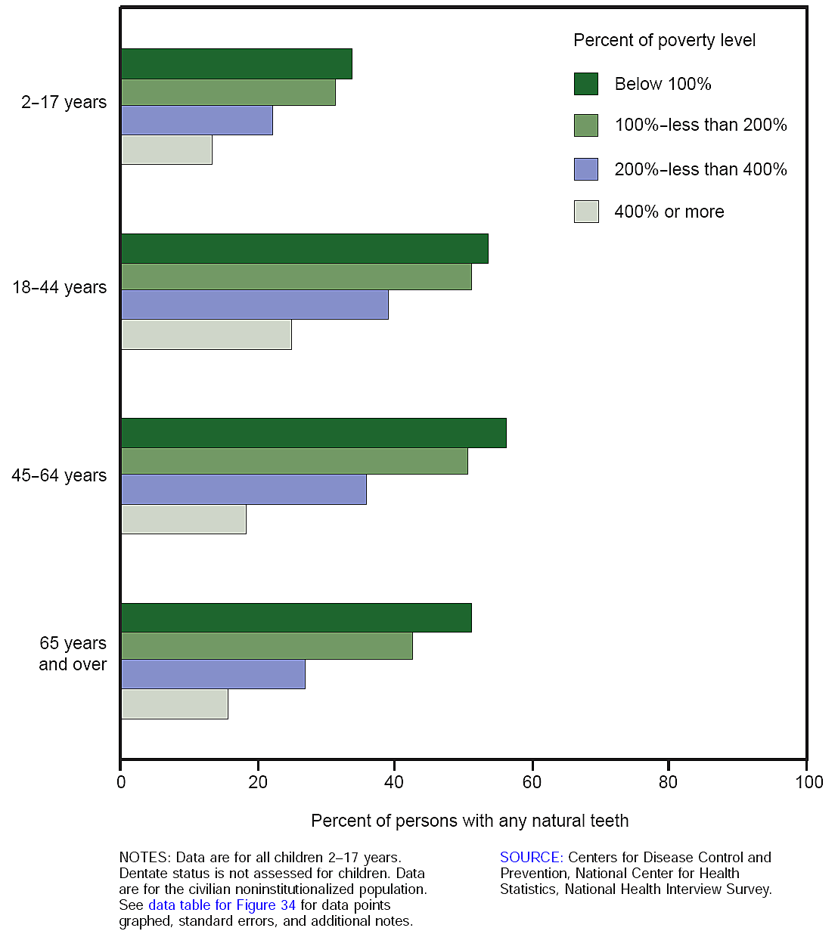
No dental visit in the past year among persons with natural teeth, by age and percent of poverty level: United States, 2005.
Notes:
The figure shows the relationship between poverty level and dental care.
There are more people in “Below 100%” poverty level group who do not have dental visit than the people in 400% or more in 2005.

Slide 19
Nativity
Place of origin of the individual or his or her relatives
  Subdivisions include:
    Foreign-born
    Native-born

Slide 20
Health Disparities
Differences in the occurrence of diseases and adverse health conditions in the population
Example: lung cancer prevalence difference are difference between African American and other racial groups

Slide 21
Place variable
  International
  National (within-country)
  Urban-rural differences
  Localized patterns of disease
Time

Slide 22
International
World Health Organization (WHO) studies:
  Both infectious and chronic diseases show great variation from one country to another.
Climate, cultural factors, national dietary habits, and access to health care affect disease occurrence.
Variations in life expectancy (U.S. ranked number 47 in 2008).
Wild poliovirus is endemic in parts of Asia and Africa (2005 data).

Slide 23
National (Within-Country)
Regional differences may affect the prevalence and incidence of disease.
  Factors include:
    Climate
    Latitude
    Environmental pollution
Example: Regional variations in stroke (see Figure 4-12)

Slide 24
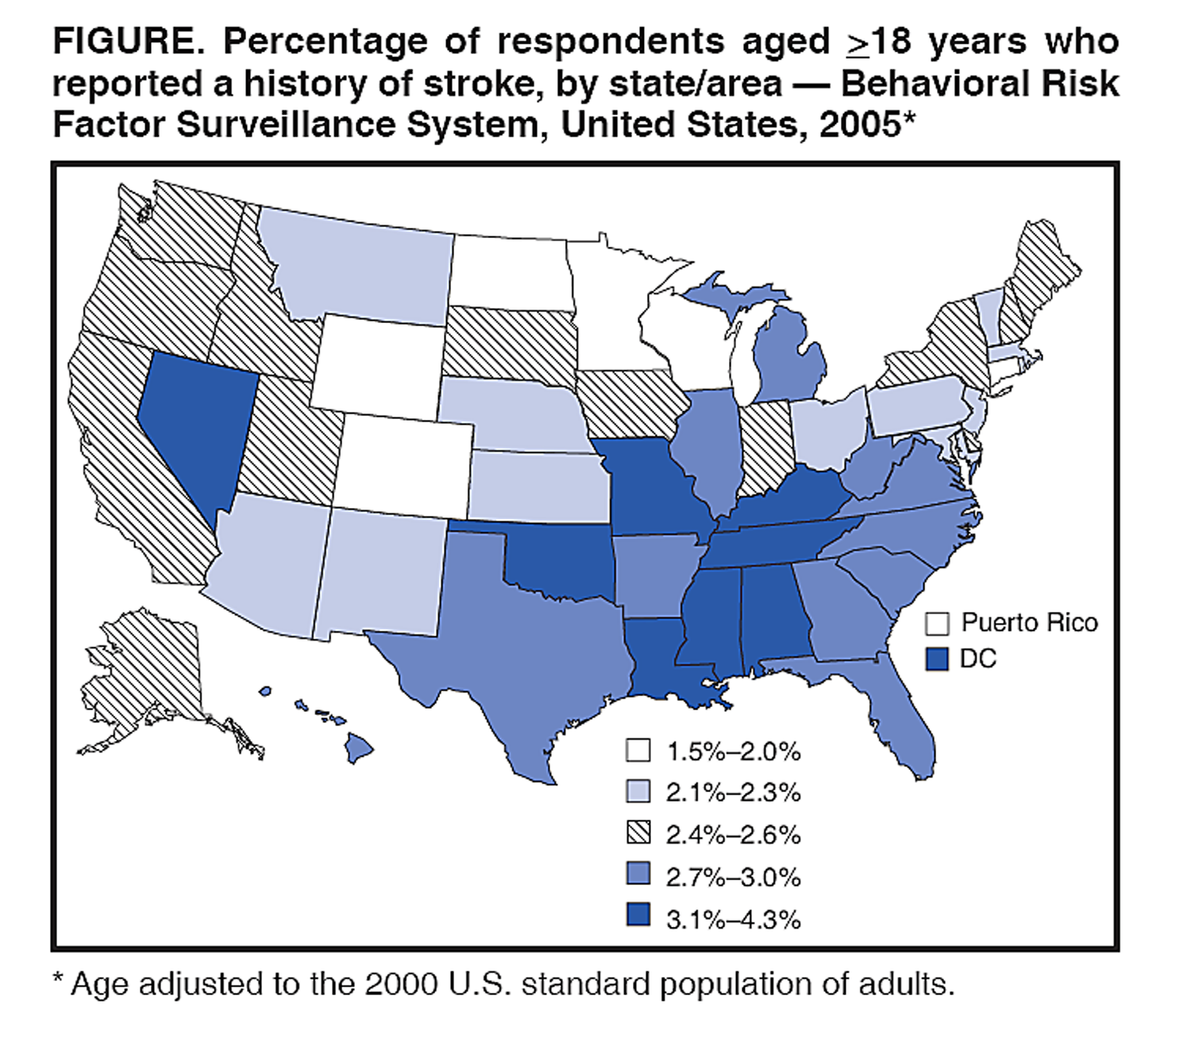
Stroke by state/area from Behavioral Risk Factor
Surveillance System, US, 2005

Slide 25
Urban-Rural Differences
Urban and rural sections of the United States show variations in morbidity and mortality related to environmental and lifestyle issues.
  Urban example: elevated occurrence of lead poisoning among children who live in older buildings.
  Rural example: pesticide exposure and farming injuries among agricultural workers.

Slide 26
Localized Patterns of Disease
Associated with specific environmental conditions that may exist in a particular geographic area. Examples:
  Cancer and radon gas Kentucky
  Naturally occurring arsenic in water supply
  Presence of disease vectors: Dengue fever along the Texas-Mexico border

Slide 27
Time Variables
  Secular trends
  Cyclic (seasonal) trends
  Point epidemics
  Clustering

Slide 28
Secular Trends
  Refer to gradual changes in the frequency of disease over long time periods.
  Examples:
    -Rates(per100,000) for Homicide, Suicide, and Firearm-Related Deaths of Youth from 1970-2014

Slide 29
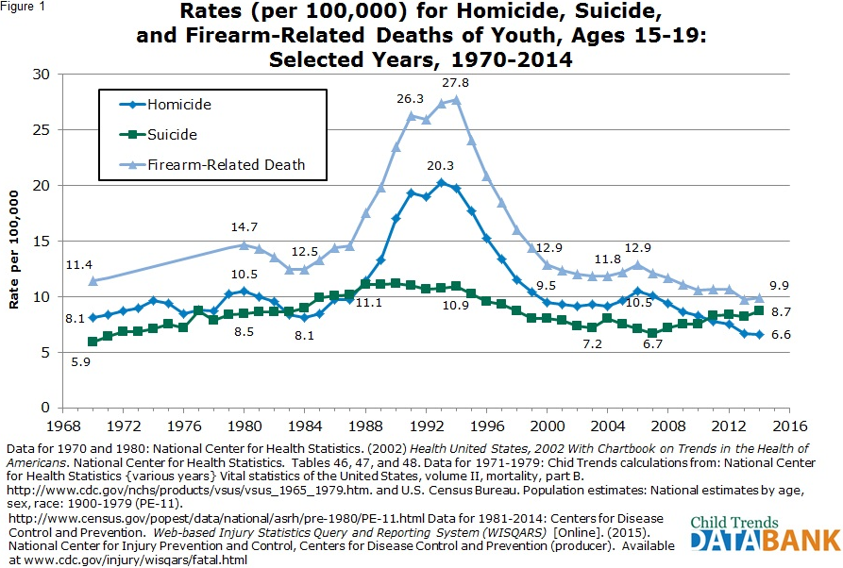
Rates for Homicide, Suicide, and Firearm-related deaths of youth
Notes:
The figure shows the changes in youth death rates for homicide, suicide and firearm-related over time.
As you can see the rate for suicide does not change dramatically. But from 1989-1998, the death due firearm, homicide were changed dramatically, then after that period , the rates go to flat / stable

Slide 30
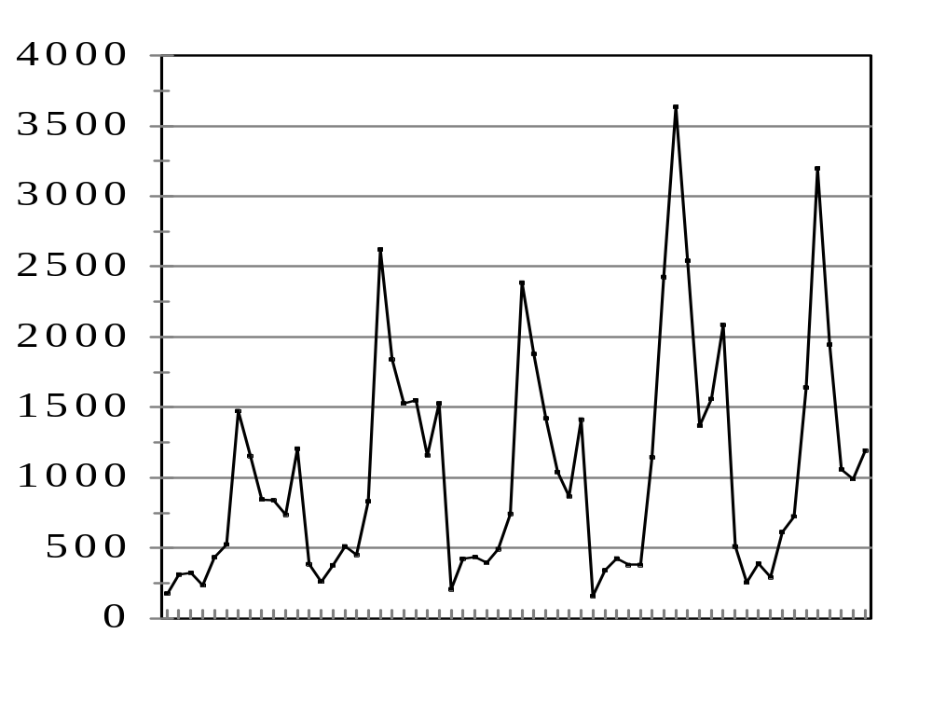
Seasonal Variation
Source: Morbidity and Mortality Weekly Reports: 42(53) 10/21/94; 43(53) 10/6/95; 44(53) 10/25/96; 45(53) 10/31/97; 46(54) 11/20/98
1993 1994 1995 1996 1997
Figure 2.3. Seasonal cycle of Lyme disease cases: 1993-1997
Notes:
Another way to use time variable used to describe the disease is seasonal variable.
The figure shows number of cases of Lyme disease , you can see same pattern presented by each year.

Slide 31
Point Epidemic
Short-term changes occur over limited time frames
  Hours
  Days
  Weeks
  Months
Used for short-term exposures or diseases with short incubation and/or illness durations
Notes:
Point epidemic, also known as the epidemic period, shows the time course of a disease outbreak or epidemic and may indicate the response of a group of people circumscribed in place to a common source of infection, contamination, or other etiologic factor to which they were exposed almost simultaneously.
Point epidemic uses a specialized graph called an epidemic curve that, as with the other graphs discussed, places the number of cases on the vertical axis and time on the horizontal axis. For time, either the time of onset of symptoms or the date of diagnosis is used. For very acute diseases with short incubation periods (i.e., time period between exposure and onset of symptoms is short), time may be shown as the hour of onset. For diseases with longer incubation periods, time may be shown in 1-day, 2-day, 3-day, 1-week, or other appropriate intervals.

Slide 32
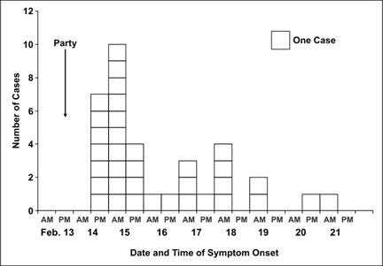
Time: Point Epidemic
Notes:
Conventionally, the data are displayed as a histogram (which is similar to a bar chart but has no gaps between adjacent columns). Sometimes each case is displayed as a square, as shown on the slide. The shape and other features of an epidemic curve can suggest hypotheses about the time and source of exposure, the mode of transmission, and the causative agent

Slide 33
Clustering
A closely grouped series of events or cases of a disease or other health-related phenomena with well-defined distribution patterns in relation to time or place or both

Slide 34
Epidemiologic Inferences from
Descriptive Data
  provide a basis for generating hypotheses.
  Connect intimately with the process of epidemiologic inference.
  Epidemiologic inference is initiated with descriptive observations.

