Slide 1
Association and Causality

Slide 2
Learning Objective
Type of Association found among variables
Describe two methods for displaying data graphically
Set up contingency table
State three criteria of causality
Notes:
In the last class, we learned the type of descriptive epidemiology , which are the studies that compare or present the disease outcome from different dimensions, such as person, time, location. From the descriptive epidemiology, we are able to get a sense of the association between a variable and a disease outcome, which means the variable may be associated with the occurrence of disease.
This class we will discuss what is association , what are the types of association found among variables.
You are required to know :
Learn types of association
Learn what is Pearson correlation coefficient: definition, direction and strength
Learn to set up contingency table: what is the contingency table for?
Learn what are the three criteria of causality
Epidemiologic terms:
Point estimate
Confidence interval
Variable
Pearson correlation coefficient
Dose- response relationship
Threshold
Sample

Slide 3
Descriptive epidemiology and Analytic epidemiology
Descriptive epidemiology
Describing the occurrence of disease in population (distribution)
Analytic epidemiology
Using epidemiology to study the etiology of disease and determing whether there is a causal relationship between exposures and health outcomes (determinants)
Notes:
Determinant is defined as any factor that brings about change in health condition or outcome of interest.

Slide 4
Variable
Variable: any quantity that varies. Any attribute, phenomenon, or event that can have different values.
  Continuous variable : a variable that can have an infinite number of values within a specified range.
    Height
    Weight
  Categorical variable : a variable that can take on one of a limited, and usually fixed, number of possible values
  Gender
  Race
  Is gender a variable in prostate cancer study or cervical cancer study?
Notes:
Variables means any quantity that varies. For example any attribute, phenomenon, or event that can have different values.
For example : one’s gender is a variable because one can be male, or female. One’s age is a variable: one can 7 years old, 10 years old, 15, 30, 60, 90 , 100….. And so on.
Also , there are two major type of variables:
Continuous variable : One can have an infinite number of values. such as age
Categorical variable : One only can take one of a few possible values . Such as gender, race.
But, think about the following study scenario : Is gender a variable in prostate cancer study?
The answer is “No”. Because only male will be included in the prostate cancer study.

Slide 5
Association
Refers to a linkage between or among variables; variables are associated with on another.
Type of associations
    Positive association : as the value of one variable increases , the value of the other variable increases
    Height vs. Weight
    Hour studied vs. GPA
    Negative association: when the value of variable increases, the value of other variable decreases
Hours spent playing video games vs. GPA
Weight of a car and miles per gallon
Notes:
Association means there is a linkage between or among variables, which means change in one variable will cause the change in the another variable.
First, we want to show whether there is an association between the exposures and outcomes, then we determine whether the association is causal or not.
The are two type of associations:
Positive association: which means as the value of one variable increases, the value of the other variable increases.
Negative association: which means when the value of variable increases, the value of other variable decreases.

Slide 6
Direction and strength of an association
Pearson correlation coefficient(r) for continuous variables
  Range from -1 to +1
  When r is negative, the association is negative (Negative association)
  When r is positive , the association is positive (Positive association)
  The closer is to either +1 or -1, the stronger is the association
  0 means that there is no association
Notes:
Pearson correlation coefficient(r) measures the linear relationship between two continuous variables
Linear relationship means that the relationship between two continuous variables can be expressed as a straight line.
The Pearson correlation coefficient ranges from -1 to +1 .
Direction:
When r is negative, the association is negative, which means value of one variable is increasing, the value of another variable is decreasing.
When r is positive , the association is positive , which means value of one variable is increasing, the value of another variable is increasing.
Strength:
The closer is to either +1 or -1 , the stronger is association
For example :
-0.9 indicates stronger association than -0.06
0.9 is stronger association than 0.06.
0 means there is no association

Slide 7
Scatter plots for continuous variables
A diagram plots two variables : one variable on X axis(horizontal axis) and other on a Y axis(vertical axis)
The measurements for each case plotted are a single data point.
Example:
  Height vs. Weight
  GPA vs. Hours playing video game
Notes:
Scatter plots usually are used to show the relationship between two continuous variables.
We will show the two examples in the following slides

Slide 8
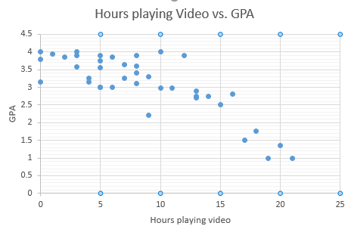
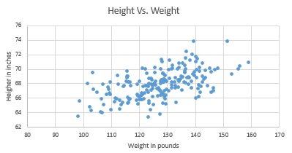
Example of association
Notes:
The figure in left shows that the more hours students played video games, the lower the students have GPA (Negative association).
The figure in right shows that the positive association between height and weight.

Slide 9
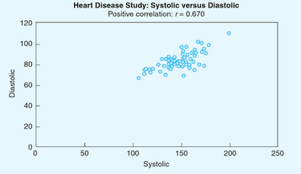
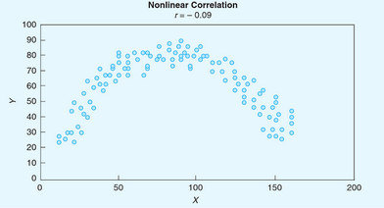
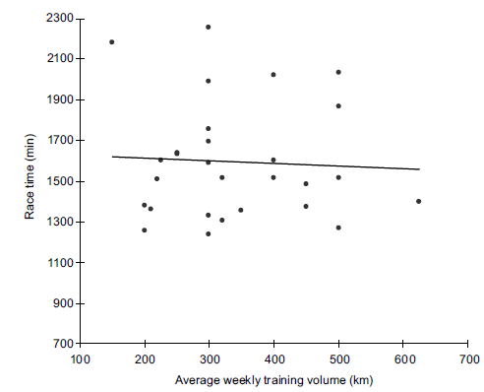
Other example of scatter plot
(a)
(b)
(c)
Notes:
The figure a shows positive association
The figure b shows quadratic association between x an y (notice the r value is really small)
The figure c shows there is no association between two variables

Slide 10
Other figures to illustrate association
Dose-response curve is a plot to show the a dose-response relationship, which is a type of correlative association between an exposure and effect
Notes:
Studying dose response, and developing dose–response models, is to determine "safe" and "hazardous" levels and dosages for drugs. A type of correlative association between an exposure and effect. The dose is indicated along the X-axis, with the response shown along the Y-axis. At the beginning of the curve, the flat portion so that low levels of the dose, no or a minimal effect occurs. Then there is a threshold which refers to the lowest dose at which a particular response occurs. below which there are no adverse effects from exposure to the chemical. When the response is reached, t curve flattens out.

Slide 11
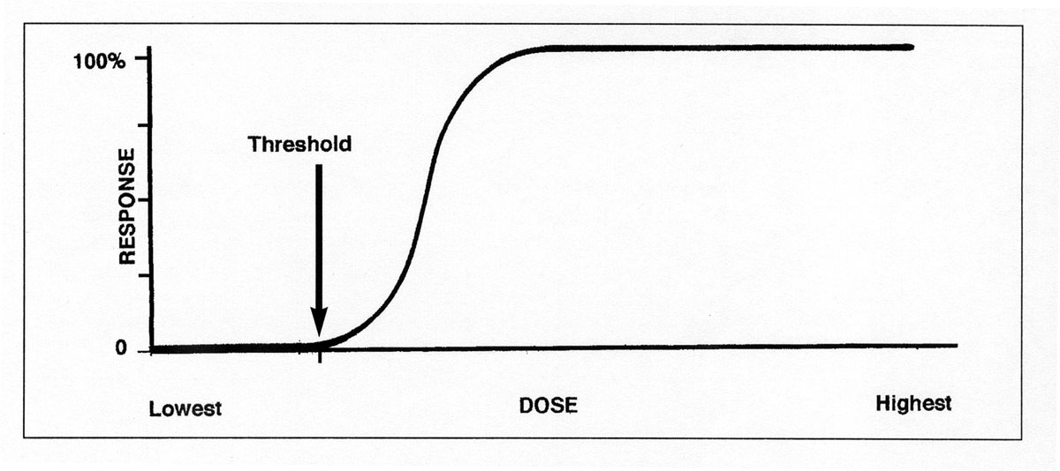
The threshold of a dose-response curve
Source: Reprinted from National Institutes of Health, National Institute of Environmental Health Sciences. Chemicals, the Environment and You: Explorations in Science and Human Health, p. 63. Available at: http://science.education.nih.gov/supplements/nih2/chemicals/guide/pdfs/lesson3.pdf. Accessed July 28, 2008.
Notes:
The plot shows the correlative association between an exposure(dose of a toxic chemical) and effect (a biologic outcome: such as death of heart attack).
At the beginning of the curve in the figure above, the flat portion suggests that at low levels of the dose, no or a minial effect occurs, after a level is reached, the curve rises steeply and the progresses to linear states
Threshold : the lowest dose at which a particular response occurs.

Slide 12
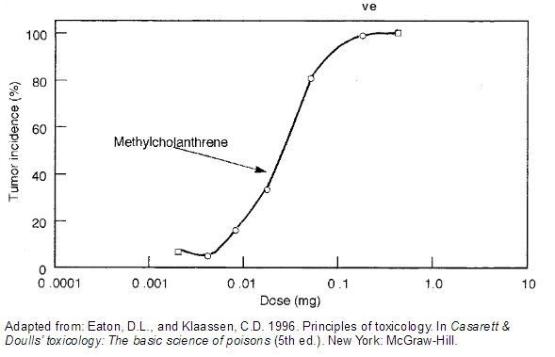
Dose of Carcinogenic Chemicals and Tumor incidence
Notes:
a dose-response curve for a population of mice in a study of a carcinogenic chemical might look like the following graph:

Slide 13
Multimodal Curve
A multimodal curve is one that has several peaks in the frequency of a condition.
    A mode is defined as the category in a frequency distribution that has the highest frequency of cases.
  Possible reasons for multimodal distributions of health outcomes:
    Changes in lifestyle and immune status of the host
    Latency effects (Latency refers to the time period between initial exposure and a measurable response.)

Slide 14
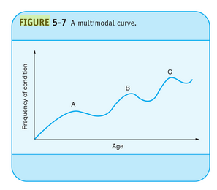
Multimodal Curves
A curve that has several peaks in the frequency of condition
Older person
Young adult
Children
Exposure to carcinogens
Behavioral Changes
Immune Status
Notes:
The hypothetical multimodal curve for frequency of condition along with age.

Slide 15
Epidemic curve
A graphic plotting of the distribution of cases by time of onset
Identify the cause of a disease outbreak

Slide 16
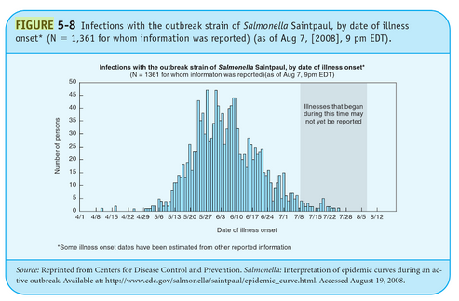
Example of Epidemic Curve
It suggests that there was a common exposure to a single etologic agent
Notes:
This indicated number of sick persons over time in an outbreak.
The form of the resulting distribution of cases can be used to propose hypotheses on the nature of the disease and its mode of transmission. The course of a population outbreak is most evident in infectious disease, but also occurs in situations such as a chemical spill leading to cases of respiratory disease.
We will talk about more in chapter 9.

Slide 17
Contingency table
demonstrating associations for categorical variables
A type of table that tabulates data according to two dimensions
Notes:
We learn how to show the relationship for continuous variables, now we look at how to examine the relationships between categorical variables.
We use contingency table to demonstrate associations among categorical variables.

Slide 18
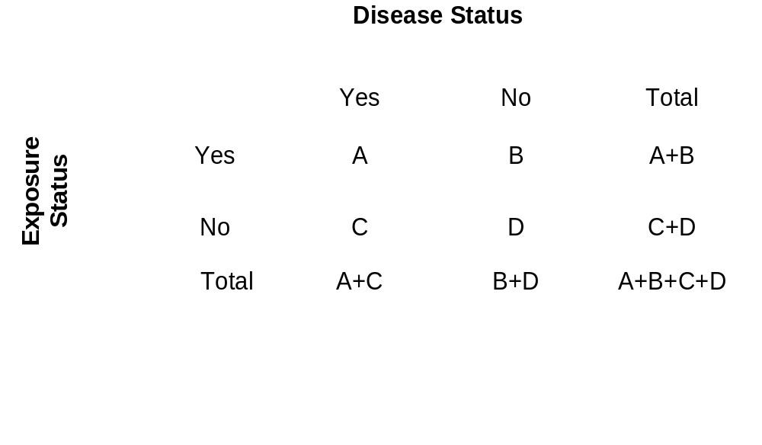
Generic Contingency Table
2 ROW X 2 COL
A= Exposure is present and disease is present
B = Exposure is present and disease is absent
C = Exposure is absent and disease is present
D = Exposure is absent and disease is absent
Alcohol and Heart disease
Notes:
Let us see what the contingency table like.
The contingency table is also called a 2 by 2 table or a fourfold table because it contains four cells. Label as A-D. There are also column and row totals known as marginal totals.
Usually, the exposure will be listed as row, and disease status will be listed as column.
How was the contingency table constructed?
We take an hypothetical research about the relationship between Alcohol and Heart disease.
If We collection information from total 100 subjects (A+B+C+D), 30 people said they have heart disease and are also drinking, which mean A = 30, then another 20 people said that they have heart disease but they never drink, which means C = 20 ; 10 people mentioned that they do not have heart disease but they drink (B= 10), and rest of 40 people claimed that they do not drink and have heart disease (D= 40).

Slide 19
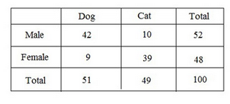
Example of Contingency table
Male who favors dog : 42
Male who favors cat : 10
Female who favors dog: 9
Female who favors dog: 39
How many total subjects in the study ?
How many people are male in this study?
How many people who like dog are in this study
What is the proportion of males who prefer dogs?
What is the proportion of females who prefer dogs?
Notes:
Here is another example to show the contingency table were constructed .
For example: a researcher is interested in the relationship between preference of pet and gender
Male who favors dog : 42
Male who favors cat : 10
Female who favors dog: 9
Female who favors dog: 39
How many total subjects in the study ? 100
How many people are male in this study? 52
How many people who like dog are in this study ? 51
What is the proportion of males who prefer dogs? 42/52 = 0.81
What is the proportion of females who prefer dogs? 9/48 =0.19
So more males likes dogs than females.
What is the proportion of people who prefer dogs are males ? 42/51 = 0.82
What is the proportion of people who prefer cats are males? 10/49 =0.20
So males are more likely to prefer dogs than cats.

Slide 20
Smoking and Lung cancer
Smoking status | Lung Cancer status
 | Yes | No | Total
Yes | 60 | 100 | 160
No | 40 | 300 | 340
Total | 100 | 400 | 500
# of smoker with lung cancer : 60
# of smoker without lung cancer : 100
# of non-smoker with lung cancer : 40
# of non-smoker without lung cancer : 300
How many total subjects in the study ? 500
How many people are smokers in this study? 160
How many people have lung cancer in this study? 100
Notes:
What is the proportion of smokers who have lung cancer? 60/160= 0.375
What is the proportion of non-smokers who have lung cancer? 40/340 =0.118
So more smokers have lung cancer than non-smokers.

Slide 21
Exercise for contingency table (1)
Suppose you were doing a study on whether coffee drinking increased the risk of heart disease. Assume that you are no longer at risk of heart disease if you die, leave the study, or get heart disease You had two group of 110 subjects each who you followed for five years.
Group 1 (the coffee drinkers): 85 followed for 5 years without getting heart disease, 25 people got heart disease at the end of 5 years
Group 2 (non-coffee drinkers): 100 followed for 5 years without getting heart disease, 10 people got heart disease at the end of 5 years.
Set up contingency table based on the information given above
Notes:
The answer is in the following

Slide 22
Exercise for contingency table(2)
Suppose you were doing a study on whether coffee drinking increased the risk of heart disease. Assume that you are no longer at risk of heart disease if you die, leave the study, or get heart disease You had two group of 110 subjects each who you followed for five years.
Group 1 (the coffee drinkers): 85 followed for 5 years without getting heart disease, 25 people got heart disease at the end of 5 years
Group 2 (non-coffee drinkers): 100 followed for 5 years without getting heart disease, 10 people got heart disease at the end of 5 years.
Coffee drinking status | Heart disease
 | Yes | No | Total
Yes | 25 | 85 | 110
No | 10 | 100 | 110
Total | 35 | 185 | 220

Slide 23
Epidemiologic Research Strategies
Epidemiologists ask whether a particular exposure is causally associated with a given outcome. (smoking vs. lung cancer)
Investigators:
  Examine existing facts and hypotheses
  Formulate a new or more specific hypothesis
  Obtain additional facts to test the acceptability of the new hypothesis

Slide 24
Hypothesis
Defined as “Any conjecture cast in a form that will allow it to be tested and refuted.”
One of the most common types is the null hypothesis (negative declaration).
  An example would be to hypothesize that there is no difference between smokers and nonsmokers in the occurrence of lung cancer.
    Difference - reject the null hypothesis
    No difference – fail to reject the null hypothesis

Slide 25
Field of Inferential Statistics
  Inference is “The process of passing from observations and axioms to generalizations.”
Notes:
We can visualize the relationship between continuous variables by scatter plot, and use contingency table to show the relationship between categorical variables.
How do we show if there is association between variables? We use statistics to infer the association among variables. It is the basic for the analytic epidemiology.

Slide 26
Sample Versus Population
  Parent population
  Sample—a subset of the population
  A goal of inference is to draw conclusions about a parent population from sample-based data.
Notes:
Before we talked about inference statistics, we talked about how the statistics works.
We want to talk about this using an example.
Hypothetically , our disease outcome is Lung cancer, and we want to compare the incidence rates of lung cancer in Lexington and bowling green during 2016. From previous chapters , we know how to measure incidence rates and we also know that comparing incidence rates of lung cancer between Lexington and bowling green is descriptive epidemiology (by location).
Ideally, we need to know the total population at beginning of year 2016 for Lexington and Bowling green. And we need to know the exact numbers of new lung cancer at Lexington, and Bowling green during the 2016 , respectively.
But, in reality, we can not know exact number of total population (PARENT population ) and number of news cases in each city.
So we usually take part of total population (SAMPLE population) to represent the result from parent population.
It is easy for us to conduct survey for the sample population. So we want to use the result from the sample population to refer the result of parent population .

Slide 27
Terminology of Inference
Point estimate
-For example: we want to assume the true prevalence of multiple sclerosis (2.0%) in a population. The true prevalence for the population is referred as parameter. Then we collect a sample to from the population to estimate the true prevalence. The estimate (2.2%) is called point estimate.
Confidence interval estimate
-For example: 95% confidence interval means a range of values that with a 95% confidence contain the population parameter
What is the percentage of students who support Trump IN wKU
Notes:
The incidence rates in Lexington and Bowling green, respectively are the numbers we are interested in and we also called parameters.
The parameters mean the number we want to know and try to estimate.
Then if we had a sample population to estimate the true incidence rates , then the incidence rates from the sample population are point estimates for the true incidence rates.
Then in statistics, a range will given for the point estimate, called confidence interval .
So think about the question, what is the percentage of students who support trump in WKU?
To answer this question, we should get the response from each student about their preference of president candidates. And we calculate the percentage of students who support trump (assume 30%), which is the parameter we are interested in
But it is not possible, so we can randomly select 1000 students and ask their opinion, and we know 200 out of 1000 students who support trump (200 out of 1000 is point of estimate for the true parameter , 30%)

Slide 28
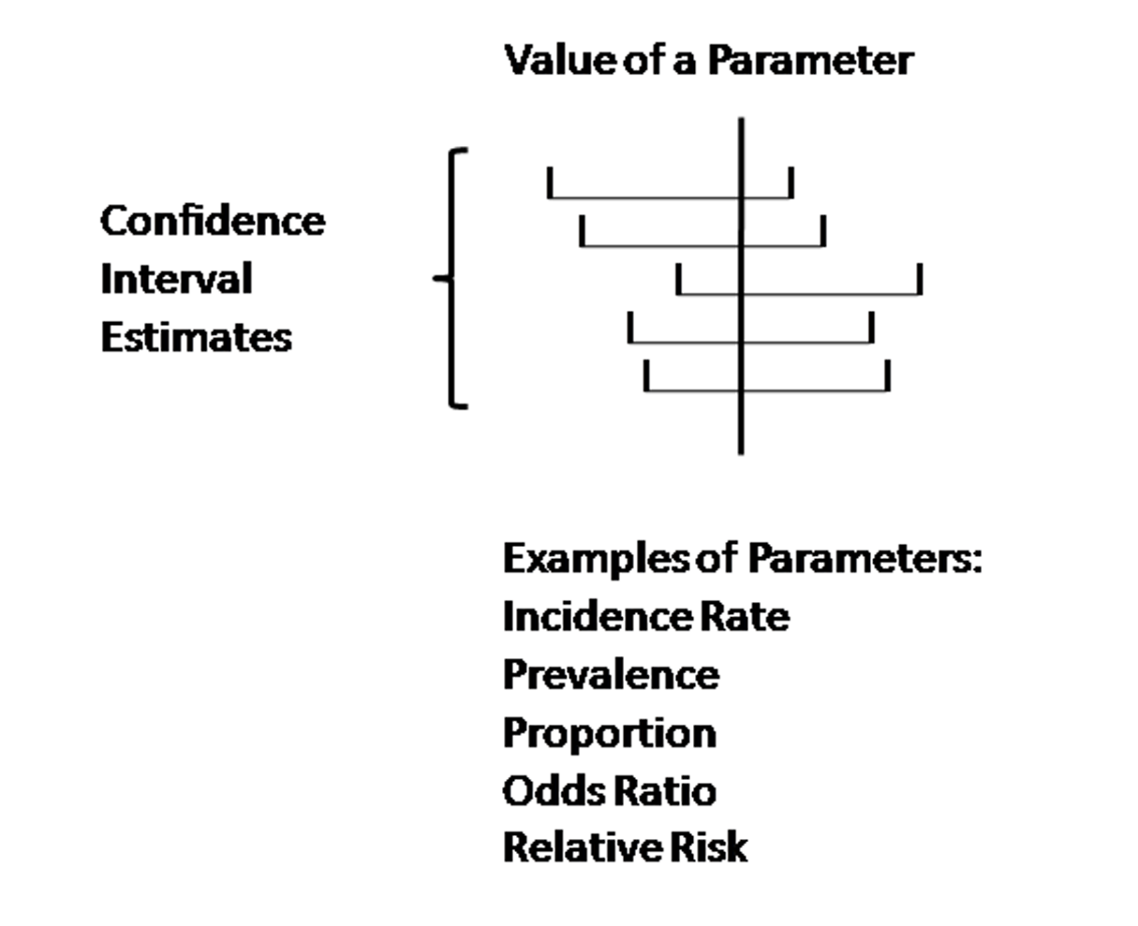
Confidence interval estimates of population parameters
Notes:
The figure shows the relationship between confidence interval estimates and value of a parameter.
The parameter can be incidence rate, prevalence, proportion, odds ratio, or relative risk.

Slide 29
Where Do Hypotheses Come From?
  Method of difference
  Method of concomitant variation
Notes:
There are two methods to generate hypotheses :
Method of difference
Method of concomitant variation

Slide 30
Method of Difference
  All of the factors in two or more domains are the same except for a single factor, which is hypothesized to be the “cause” of a disease.
      Example 1: differences in coronary heart disease rates between sedentary and nonsedentary workers
      Example 2: smokers and nonsmokers in the occurrence of lung cancer
Notes:
For example
Example 1, the hypothesis is asking the difference in coronary heart disease rates between sedentary and non-sedentary workers. So it comparing the difference of two groups of people in coronary heart disease rates : Sedentary people vs. Non-sedentary people

Slide 31
Method of Concomitant Variation
  A type of association in which the frequency of an outcome increases with the frequency of exposure to a factor, the hypothesized cause of the outcome.
    Example: Dose-response relationship between number of cigarettes smoked and mortality from lung cancer
The greater the number of cigarettes smoked, the higher the mortality levels from lung cancer

Slide 32
Operationalization
Refers to the process of defining measurement procedures for the variables used in a study
Example: In a study of the association between tobacco use and lung disease, the variables might be the number of cigarettes smoked and the occurrence of asthma.

Slide 33
Association and Causation
Association : relationship between two variables
  Height is associated with weight
Causation: the changes of one variable cause changes in another variable
  Jumping off the cliff is the cause of serious physical damage
Notes:
For the association, one change , then another change. Or the opposite may be true, too. The other change, one change, for the
But for the causation, there is direction, it is like cause and effect. One (cause) happens, then outcome (effect) happens.

Slide 34
U.S. surgeon General’s Report Smoking and Health (1964)
Stated that evaluation of a causal association does not depend solely upon evidence from a probabilistic statement derived from statistics but is a matter of judgement that depends upon serval criteria
  The assertion of causality is similar to a trial in court.

Slide 35
Sir Austin Bradford Hill
He is an English Epidemiologist and statistician
He pioneered the randomized clinical trial, demonstrated the connection between cigarette smoking and lung cancer
He is widely known for pioneering the Bradford Hill criteria for determining a causal association.

Slide 36
Hill’s Criteria of Causality
Strength: Strong associations give support to a causal relationship between factor and disease.
Consistency: An association has been observed repeatedly.
Specificity: Association is constrained to a particular disease-exposure relationship.
Temporality: The cause must be observed before the effect.

Slide 37
Hill’s Criteria of Causality
Biological gradient: also known as a dose-response curve; shows a linear trend in the association between exposure and disease.
Plausibility: The association must be biologically plausible from the standpoint of contemporary biological knowledge.
Coherence: “the cause-and-effect interpretation of our
data should not seriously conflict with the generally known
facts of the natural history and biology of the disease”
Analogy: Relates to the correspondence between known
associations and one that is being evaluated for causality
(e.g., thalidomide and rubella).
Experiment

Slide 38
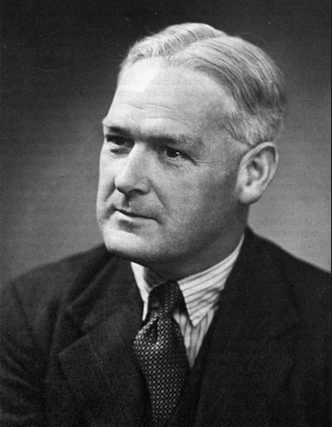
Sir Austin Bradford Hill(1897-1991)
“None of these nine viewpoints can bring indisputable evidence for or against a cause and effect hypothesis….. What they can do , with greater or less strength, is to help answer the fundamental question ---- is there any otherway of explaining the set of facts before us, is there any other answer equally, or more, likely than casue and effect”

Slide 39
Multifactorial (Multiple) Causality
  Many types of causal relationships that are involved with the etiology of diseases involve more than one causal factor.

Slide 40
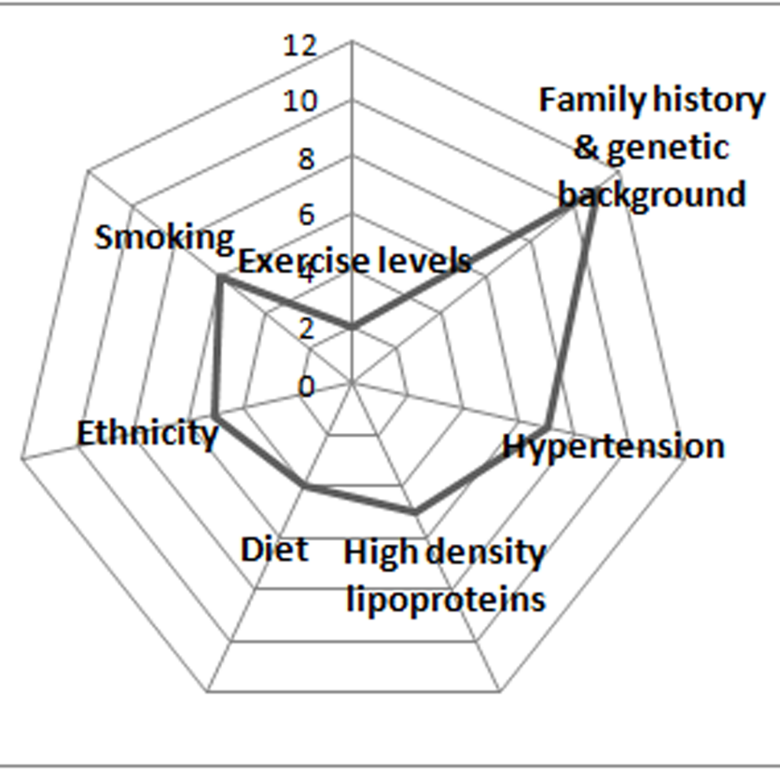
The web of causation for coronary heart disease—a hypothetical model

Slide 41
Defining the Role of Chance in Associations
  Epidemiologists employ statistical procedures to assess the degree to which chance may have accounted for observed associations.

Slide 42
Power
In statistics, power is “the ability of a study to demonstrate an association if one exists.”
Related to sample size and effect size
  Effect size is related to the strength of the association that has been observed.

