Slide 1
Epidemiologic Study Designs:
Ecologic study, Cross-section Study, and Case control Study

Slide 2
Learning Objectives
Describe analytical epidemiologic study designs
State three ways in which study designs differ from one another
Definition and Calculation of an odds ratio
Notes:
Learning Objective:
Descirbe the three epidemigic study designs: Ecologic study, Cross-sectional study, and Case-control study
State at least three ways in which study designs are different from each other
Know the definition of odds ratio and be able to construct the contingency table and calculate the odds ratio

Slide 3
Introduction
Major categories of analytic designs:
  Ecologic study
  Cross-sectional study
  Case-control
  Cohort
  Randomized controlled trial
Notes:
In the previous chapters, we talked about descriptive epidemiology. Based on the results from descriptive epidemiology, we may generate hypothesis to investiage the possible determinant. Then we will design an analytic epidemiology though epidemiologic study design and test the hypothesis we created before.
There are several analytic epidemiologic study designs:
1) Ecologic study
2) Cross-sectional study
3)Case-control
4)Cohort Study
5) Randomized controlled trial
In this lecture, we will cover ecologic and cross-sectional study, and case-control study. Next lectur, we will introduce cohort study and randomized controlled trial
You may notice we talked about cross-sectional study in the descriptive epidemiology We can count it as one of analytic epidemiologic study design, too..

Slide 4
Characteristics of Study Designs
Number of observations made in the study design
Directionality of exposure
Timing of data collection
Unit of observation
Notes:
This slide lists characteristics(factors) of study designs which may help to distinguish the study designs
One can differentiate different study designs by asking:
Number of observations made in the study : How many times the subjects will be asked to provide information
Directionality of exposure: in the study Can we tell if exposure happened before occurrence of outcome
Time of data collection : When the information of exposure was measured? when the information of outcome was measured?
Unit of observation: for the personal information, we get the individual information or population information.

Slide 5
Number of observation
Observations of subjects may be made only once
  Cross-sectional study
  Case control study
Two or more examinations may be made
  Cohort study
  Experimental study
Notes:
Number of observation: means how many times the subjects in the study will be observed.
For example:
In cross-sectional study and case control study, subjects are only asked to provide information one time
While in cohort study, subjects will be observed more than twice. In the cohort study, subjects measured at the first years, then subjects will be measure another time depending on the projected study time.

Slide 6
Directionality of exposure
Refers to the measurement of exposure relative to disease
  Retrospective approach:
    Retrospective means obtaining information
    about exposures that occurred in the past.
  A single point in time:
  Prospective approach
Notes:
Directionality of exposure means that the measurement of exposure in different study designs relative to disease.
There are three approaches :
Retrospective approach: means obtaining measurement of exposures that occurred in the past.
The method usually is used in case-control study. In case-control study, the investigator recruited subjects based on outcome/disease status, then ask them the exposure information in the past.
Single point in time: cross-sectional study . The approach is similar to taking a snapshot of a population. The measurements of exposure and outcome are at the same time.
Prospective approach: Cohort studies and experimental studies. In the prospective cohort studies , investigators recruited the subjects without the disease/outcome into study, and record the status of exposures. Then these subjects will be measured again prospectively for development of disease.

Slide 7
Timing of Data collection
Some studies, information is obtained about exposures that occurred in the past
Or in other studies, subjects may be followed prospectively over a period of time

Slide 8
Unit of Observation
Individual – Cross-sectional, case-control, cohort study
Entire group - Ecologic study
Notes:
In an epidemiologic study, the unit of observation can be individual or an entire group.
Most epidemiologic study designs employ the individual as the unit of observation, such as cohort study, case-control, cross-sectional study
An ecologic study design uses group or community measurement as the unit of observation.

Slide 9
Observational Analytic Studies
Ecologic
Cross-sectional study
Case-control
Cohort

Slide 10
Cross Sectional Study
Determines disease and exposure status as they exist in a defined population at one specific point in time
Snapshot of
  Current disease status of a population
  Current exposure
Notes:
Cross-sectional Studies: by means of a survey, current Es and current Ds are ascertained concurrently at a single point in time. The problem here is a lack of knowledge of the temporal relationship between E and D. That is, there is no way of knowing which came first: E or D. This makes this design weak for studying disease etiology.
Often, the exposure of interest is a personal characteristic (e.g., skin color, blood type, etc.) that is not modifiable. If it is a "lifestyle" exposure, however, that is being measured (e.g. diet, exercise levels, etc.), the current exposure may -- or may not -- be a reasonable surrogate for historical exposure (which is typically more relevant to D today).
Cross sectional studies are useful for studying disease or conditions that are not rapidly fatal, have no clear point of onset, and are transitory -- hypertension, osteoporosis, arthritis, diabetes, asthma, bronchitis and allergies for example. They are not appropriate, however, for rare diseases or diseases of short duration, because they are a snapshot of what is happening at a single moment in time.

Slide 11
Ecologic Studies
a study in which the units of analysis are populations or groups of people rather than individuals.
  Population can be defined many ways
Disease rates and exposures are measured in each of a series of populations and their relation is examined.
E and D info often abstracted from published statistics and
  does not require expensive or time consuming data collection.
Notes:
An ecological study is an observational study in which at least one variable is measured at the group level. Group data on E may be environmental (e.g., average rainfall), lifestyle related (e.g., tobacco sales data), diet-related (e.g., Dept. of Agriculture data on foods sold or consumed, etc.). Group data on D is typically from morbidity and mortality reports. Examples of group-level measures include the rate of cancer incidence, the mean level of hypertension, the average sunlight exposure at specific geographic location, etc.
In ecological studies the unit of comparison is the group or population (e.g., countries, age groups, racial groups, etc.). The variation in measures of effect between groups may be “true” differences, or they may be explained by other factors that haven’t been measured. Thus, it is very problematic when trying to infer the E D relationship from ecological studies. Thus, ecological studies are better at generating hypotheses than in answering them…

Slide 12
Ecologic Studies
Ecologic comparison study: involves an assessment of the association between exposure rates and disease rates during the same time period.
Ecologic correlation: an association between two variables (exposure and outcome) measured at the group level.

Slide 13
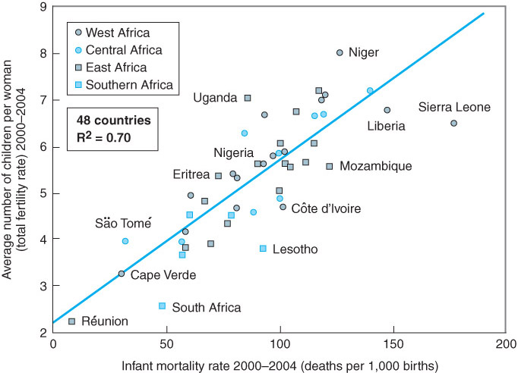
Figure F02: Relationship between fertility and infant mortality in 48 countries of sub-Saharan Africa in 2000-2004.
Example of Ecologic correlation
Notes:
There is an example in your text book about the ecologic correction.
There is a positive linear relationship between average number of children per woman has and infant mortality rate.

Slide 14
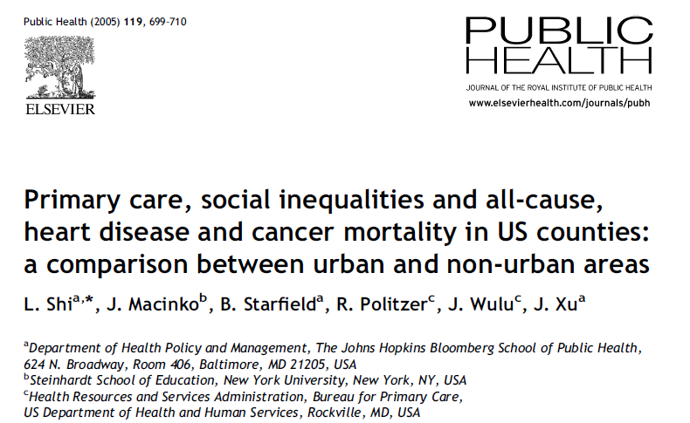
Example of an Ecological study
Notes:
Here is an example of ecologic study:
Primary care, social inequalities in US counties

Slide 15
Example of an Ecological study (cont.)
Exposure:
Primary care: Primary care physicians per 10,000 civilian population in each county who were in active office-based patient care in either family medicine, internal medicine or pediatrics
Income distribution :Gini Coefficient, an indicator of income inequality . Household income data from the 1990 US census were used to measure county-level income inequality.
Notes:
In this study: the exposures (primary care and income distribution ) were measured at population level.
How they evaluate primary care or income distribution, they did not ask each individual what the primary care it is or income. They use averaged information.
For primary care, they are measured using number of primary care physicians per 10,000 civilian population in each county. It is an average
Similar for the measure of income.

Slide 16
Ecologic (Ecological) Fallacy
“An erroneous inference that may occur because an association observed between variables on an aggregate level does not necessarily represent or reflect the association that exists at an individual level”
Notes:
Ecological studies are prone to ecological fallacy, which happens when an inference is made about an individual based on aggregate data for a group.
Here’s a great example to illustrate taken from: http://jratcliffe.net/research/ecolfallacy.htm
Researches looked at the aggregate data on income for a neighborhood of a city, and discover that the average household income for the residents of that area is $30,000. To state that the average income for residents of that area is $30,000 is true and accurate. No problem there. The ecological fallacy can occur when the researcher then states, based on this data, that people living in the area earn about $30,000. This may not be true at all, and may be an ecological fallacy.
A closer examination of the neighborhood might discover that the neighborhood is actually composed of two housing estates: one of a lower socio-economic group of residents, and one of a higher socio-economic group. The poorer part of town residents earn on average $10,000 while the more affluent citizens can average $50,000.
When the researcher stated that individuals who live in the area earn $30,000 (the mean rate), this did not account for the fact that the average in this example is constructed of two disparate groups, and it is likely that not one person earns $30,000.
Assumptions made about individuals based on aggregate data are vulnerable to the ecological fallacy. This does not mean that identifying associations between aggregate figures is necessarily defective, and it doesn't necessarily mean that any inferences drawn about associations between the characteristics of an aggregate population and the characteristics of sub-units within the population are absolutely wrong either. What it does say is that the process of aggregating or disaggregating data may conceal the variations that are not visible at the larger aggregate level, and researchers, analysts and crime mappers should be careful.

Slide 17
Example of Ecologic Fallacy
Worldwide, richer cities have higher rates of coronary heart disease (CHD) than poorer cities.
It would be incorrect to infer that richer individuals have higher rates of CHD than poorer individuals.
In fact, in industrialized cities poorer people have higher CHD rates than richer ones.

Slide 18
Ecologic Studies (cont.)
Advantages
May provide information about the context of health.
Can be performed when individual-level measurements are not available.
Can be conducted rapidly and with minimal resources.
Disadvantages
Ecologic fallacy
Imprecise measurement of exposure

Slide 19
Case-Control Studies
Subjects are defined or recruited on the basis of the presence or absence of an outcome of interest.
Cases are those individuals who have the outcome or disease of interest, whereas the controls do not

Slide 20
Diagram of a case-control study.
Exposure
Investigator
Cases
Non-Exposure
Exposure
Controls
Non-Exposure
Past
Present
Future
Notes:
The above diagram is to show the design of a case-control study.
Case control study is to examine the possible relation of an exposure to a certain disease.
In case control study, researcher identify a group of individuals with the disease(called cases) and, for purposes of comparison, a group of people without that disease(called controls).
Then we determine what proportion of the cases were exposed and what proportion were not.

Slide 21
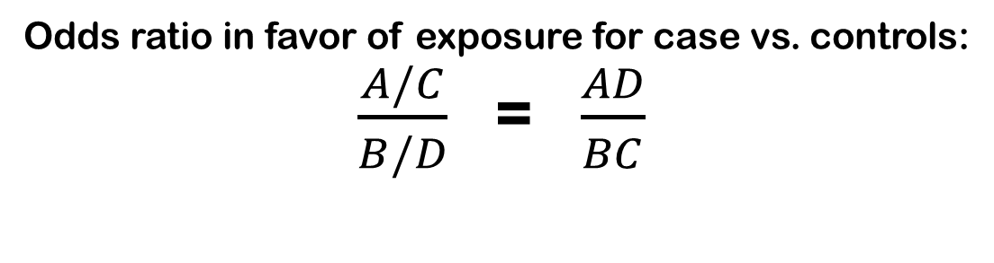
Contingency Table: Case-Control Study
 |  | Disease status
 |  | Yes(Cases) | No(Control) | Total
Exposure Status | Yes | A | B | A+B
 | No | C | D | C+D
 | Total | A+C | B+D | A+B+C+D
Odds in favor of exposure in Cases : A/C
Odds in favor of exposure in Control : B/D
Odds ratio in favor of exposure for case vs. controls:
$\frac{A/C}{B/D}$ = $\frac{AD}{BC}$
Notes:
After we collect subjects’ information in a case-control study, we can construct the contingency table.
Then we odds ratio to describe the direction (negative or positive ) and magnitude (weak or strong) of association between exposure and outcome.
Odds ratio(OR): a measure of the association between frequency of exposure and frequency of outcome used in case-control studies.
OR = (AD)/(BC)
As shown in the contingency table:
The odds in favor of exposure among the disease group (the cases) = A/C.
The odds in favor of exposure among the no-disease group (the controls) = B/D.
The OR is defined as (A/C) ÷ (B/D).
The OR can be expressed as AD/BC.

Slide 22
Interpretation of OR
When OR = 1.00
  No association between exposure & disease
    This is the NULL
When OR < 1.00
  Negative association
    Exposure has lower odds of disease
When OR > 1.00
  Positive association
    Exposure has higher odds of disease

Slide 23
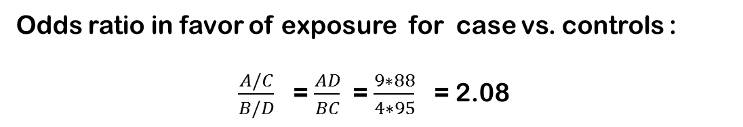
Example of Calculating Odds Ratio
 |  | Disease status
 |  | Yes(Cases) | No(Control) | Total
Exposure Status | Yes | 9(A) | 4(B) | 13
 | No | 95(C) | 88(D) | 183
 | Total | 104 | 92 | 196
Interpretation : Subjects with exposure will have about 2.08 times odds
to be the cases than the subjects without exposure
Notes:
Here is a hypothetical example of contingency table obtained from a case control study.
We applied the numbers into the formula
OR = (AD)/(BC) = (9*88)/(4*95) = 2.08
How do we interpret the number?
Based on the previous slide, if OR is great than 1, the association between exposure and outcome is positive, which means subjects with exposure have greater odds to have the disease
Here the OR is 2.08, which means that the subjects with exposure have 2.08 times odds to have disease than subjects without exposure.

Slide 24
Example
We want to determine how much more common leukemia is among persons with occupational benzene exposure. We conducted a case-control study in which 85 of the 125 workers with leukemia were exposed to benzene on the job. Conversely, among the 125 controls, only 40 had been exposed.

Slide 25
Step 1: Set up data table
Benzene Exposure Yes No | Leukemia case control
 | 85 | 40 | 125 125
 | 40 | 85
 | 125 125 250
Notes:
Note: among the cases, we knew that 85 had been exposed. That is our cell a. To get our cell c, we subtract that number from the total number of cases, which we were given. We were given the value for cell b (exposed among controls), and determined cell d by subtracting that number from the total number of controls, which we were given.

Slide 26
Step 2: Calculate OR
OR = ad/bc = 85 X 85 = 7225 = 4.5
40 X 40 1600
E+ E- | D+ (ca) D- (co)
 | 85 | 40 | 125 125
 | 40 | 85
 | 125 125 250

Slide 27
Step 3: Interpret
The odds of leukemia is 4.5 times common among workers exposed to benzene as compared to those who were unexposed
Notes:
The very technical way of interpreting our findings is to state that the odds of leukemia among people occupationally exposed to benzene is 4.5 times the odds among people who are not occupationally exposed to benzene
It is more commonly stated, however, as such: The odds of leukemia is 4.5 times common among workers exposed to benzene as compared to those who were not exposed.

Slide 28
Matched Case-Control Studies
the cases and controls have been matched according to one or more criteria such as sex, age, race, or other variables.
  Matching aids in controlling confounding.

Slide 29
Case-Control Studies
Disadvantages
Measurement of exposure may be inaccurate
Representativeness of cases and controls may be unknown
Provide indirect estimates of risk
The temporal relationship between exposure factor and outcome cannot always be ascertained.
Advantages
Can be used to study low-prevalence conditions
  Having a disease is a criterion for being selected as a case.
Relatively quick and easy to complete
Usually inexpensive
Involve smaller number of subjects

Slide 30
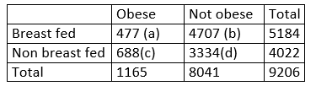
Exercise after class
A study was conducted in southern Germany to determine if breast feeding was related to obesity. Total 9206 subjects were recruited into the study. Of total 4022 infants recruited who had never breast fed, 688 were obese . Of the 5184 who had ever breast fed 477 were obese. (Breast feeding and obesity: von Kries R, Koletzko B, Sauerwald T, von Mutius E, Barnert D, Grunert V, von Voss Hubertus (1999). British Medical Journal 319(7203): 147-150. )
Questions:
1) What is the study design?
2) Construct contingency table?
3) Provide a summary about the study
Of people who reported breastfeeding, what is percentage of them are obese ?
Of people who did not report breastfeeding, what is percentage of them are obese ?
4) Calculate odds ratio ?
Cross-section study, ecologic study, and case-control study
Notes:
What is the study design?
Cross-sectional study
2) Construct contingency table?
See above for the table
3) Provide a summary about the study
Of people who reported breastfeeding, what is percentage of them are obese ?
There are total 5184 people who reported breastfeeding, and there are 477 obese . So the percentage of obese people in the breastfeeding group is 477/5185 *100 =9.2%
Of people who did not report breastfeeding, what is percentage of them are obese ?
There are total 4022 people who reported breastfeeding, and there are 688 obese . So the percentage of obese people in the breastfeeding group is 688/4022 *100 =17.1%
4) Calculate odds ratio ?
OR = ad/bc = 477*3334 /(4707*688) = 0.49
Interpretation : The people who reported breastfeeding who have 51%(1-0.49) less odd to be obese than the people who did not report breastfeeding.

Slide 31
Cohort Study Design

Slide 32
Cohort Studies
A cohort is defined as a population group, or subset thereof (distinguished by a common characteristic), that is followed over a period of time.
Examples:
  Birth or age cohort
  Work cohort
  School/educational cohort

Slide 33
Types of Cohort Studies
Prospective cohort study
Retrospective cohort study
Historical prospective cohort study

Slide 34
Prospective Cohort Study
Subjects are classified according to their exposure to a factor of interest and then are observed over time to document the occurrence of new cases (incidence) of disease or other health events.

Slide 35
Diagram of a prospective cohort study
Investigator
Disease
Exposure
Study
Sample
No Disease
Disease
Non-Exposure
No Disease
Past
Present
Future
Notes:
In the prospective cohort study, subjects who participate the study are disease free. The group of subjects will be identified based on the exposure of status ( smoking or non-smoking) and recruited into the study. Then the group of people will be followed through time to a specified point in the future
The main advantage of a prospective cohort study is that you can use p-years which permits a reduction in the number of study subjects, while increasing the number of years of exposure
Disadvantages:
Prospective prospective studies require the investigator to wait a long time for the D to occur (if the induction period for the disease is long) and "time is money.” A good cohort study will cost you millions of $$ and often take 10 – 15 years to produce meaningful results.

Slide 36
Retrospective Cohort Study
Makes use of historical data to determine exposure level at some baseline in the past
Follow-up for subsequent occurrences of disease between baseline and present is performed.
Example: a study of mortality among an occupational cohort of shipyard workers employed at a specific naval yard during a defined time interval in the past.

Slide 37
Diagram of a retrospective cohort study
Investigator
Disease
Exposure
Study
Sample
No Disease
Disease
Non-Exposure
No Disease
Past
Present
Future
Example: a study of mortality among an occupational cohort of shipyard workers employed at a specific naval yard during a defined time interval in the past.
Notes:
The difference between prospective and retrospective cohort studies is where the epidemiologist is in the study. Everything that is going to happen has already happened; that is, the outcome of interest -- getting the disease or dying from it -- is in the past.
Retrospective cohort are the second most common study design. They don’t take as long as prospective cohort studies and can be done quickly. This is an especially good design for diseases with long induction periods and especially useful in occupational studies where they have good records on exposure status…An example would be workers who were exposed to asbestos in the building of US Navy ships during World War II compared to other workers who were not exposed. In the follow up, having cancer was much more common in those exposed to asbestos than in the others, even after the frequency of smoking in the two groups was controlled. See how both of these things occurred in the past?
Disadvantages:
Retrospective studies require "historical" measurement (or inferences) about exposure at time-zero: Was each individual E+ or E-? Remember for an exposure to cause a disease, the exposure must occur first. If E+, what was the "dose" of E? (This is an example of information bias and is a factor that affects validity).
Another major disadvantage of retrospective f/up studies is that they are prone to confounding (which we’ll learn about in a future lesson) for several reasons. First, there is the prospect that what you think caused the death of a cohort is in fact only a marker for some other cause of death. Secondly, there is a tendency toward observational bias because the researcher is usually working with medical records containing historical information, with little likelihood of confirmation; the decision to exclude or include medical record is based on observer interpretation, and this may vary form on observer to another. Additionally, provider data may also be highly subjective (strong emotions are often involved in recalling the circumstances of illness or death).

Slide 38
Historical Prospective Cohort Study
Combines retrospective and prospective approaches
Investigator
Disease
Exposure
Study
Sample
No Disease
Disease
Non-Exposure
No Disease
Past
Present
Future
Notes:
In the historical prospective cohort study, the epidemiologist stands between occurrence of exposures and outcomes. The exposures have happened at the time the researchers conduct the study, but the outcome has not occurred.

Slide 39
Measure of Association Used in Cohort Studies
Relative risk (RR): the ratio of the incidence rate of a disease or health outcome in an exposed group to the incidence rate of the disease or condition in a nonexposed group.
Relative risk = Incidence rate in the exposed
Incidence rate in the nonexposed

Slide 40
Contingency Table used to Calculate a Relative Risk
 |  | Disease status
 |  | Yes | No | Total
Exposure Status | Yes | A | B | A+B
 | No | C | D | C+D
 | Total | A+C | B+D | A+B+C+D
Risk of having disease( incidence) in exposure : A/(A+B)
Risk of having disease (incidence )in non-exposure : C/(C+D)
  The relative risk (RR) = [A/(A + B)] ÷ [C/(C + D)]

Slide 41
Sample Calculation
Exposed to solvents | Liver Cancer | No Liver Cancer | Total
Yes | A = 3 | B = 104 | A + B = 107
No | C = 2 | D = 601 | C + D = 603
Risk of having disease( incidence) in exposure : A/(A+B) = 3/107
Risk of having disease (incidence )in non-exposure : C/(C+D) = 2/603
Relative Risk = (3/107) ÷(2/603) = 8.43

Slide 42
Difference in Rates (Risks)
Attributable risk, refers to the difference between the incidence rate of a disease in the exposed group and the incidence rate in the nonexposed group in a cohort study.
From the previous example, the attributable risk per thousand is:
  [(3/107) X 1,000] – [(2/603) X 1,000] =28.03 – 3.32 = 24.71 per 1,000
  Attributable risk reflect the absolute risk of the exposure or the excess risk of the outcome (e.g. disease) in the exposed group compared with the non-exposed group
Notes:
When go back to the example in sample calculation.
The risk in the exposure is 3/107
The risk in the non exposure is 3/603
The attributable risk is 3/107 – 3/603

Slide 43
Population Risk Difference
Incidence in the total population − incidence in the nonexposed group.
Calculation example. Suppose that:
  Annual lung cancer incidence among men in the population is 79.4 per 100,000.
  Annual lung cancer incidence among nonsmoking men is 28.0 per 100,000.
  The population risk difference is (79.4 − 28.0), or 51.4 per 100,000 men.
Notes:
Population risk difference is an important measure in public health, which equals the difference between incidence in the total population (risk of having disease in population) and incidence in the non-exposed group (risk of having disease in non-exposed group )
Why do we care about this measure?
The population in the community, which is mixed by exposure people (higher risk) and non-exposure group(lower risk). People may get disease even without exposed to the specific exposure we are interested in.
The population risk difference actually tells us if we remove the specific exposure we are interested in by conducting intervention policy to , how much risk will be removed.
So it tells the public officer if it is worthwhile to implement prevention and intervention

Slide 44
Example for population risk difference
Exposed to solvents | Liver Cancer | No Liver Cancer | Total
Yes | A = 3 | B = 104 | A + B = 107
No | C = 2 | D = 601 | C + D = 603
Risk of having disease( incidence) in exposure : A/(A+B) = 3/107
Risk of having disease (incidence )in non-exposure : C/(C+D) = 2/603
Relative Risk = (3/107) ÷(2/603) = 8.43
Notes:
How do we calculate population risk difference from a cohort study?
From this study, we have total 107 +603 = 710 subjects,
Of them, 3+2 = 5 have liver cancer.
So in the study population, the risk of having liver cancer is 5/710 .
Then the population risk difference is
Risk of having liver cancer in population – risk of having liver cancer in nonexposed group = 5/710 – 2/603 = 0.007 – 0.003 = 0.004 = 4 per 1000
To interpret this number, which means if the policy is conducted to prevent community people from the exposure, 4 people out of 1000 people can be saved for liver cancer.

Slide 45
Cohort Studies
Advantages
Permit direct observation of risk
Exposure factor is well defined
Can study exposures that are uncommon in the population
The temporal relationship between factor and outcome is known
Disadvantages
Expensive and time consuming
Complicated and difficult to carry out
Subjects may be lost to follow-up during the course of the study
Exposures can be misclassified

Slide 46
Experimental Studies
In epidemiology, experimental studies are implemented as intervention studies.
An intervention study is “An investigation involving intentional change in some aspect of the status of the subjects,…”
  Randomized control trial (RCT)
  Quasi-experimental design

Slide 47
Randomized Controlled Trial
Randomized controlled trial (RCT): “subjects in a population are randomly allocated into groups, usually called study and control groups, to receive or not to receive an experimental preventive or therapeutic procedure, maneuver, or intervention.”

Slide 48
Example of Randomized controlled trial
Prevention of Alzheimer’s Disease with Vitamin E and Selenium (PREADVISE) study recruited 7547 subjects from 130 local clinical study sites in the United States, Canada, and Puerto Rico during 2002 to 2009
Double-blind, placebo controlled 2×2 randomized controlled trial
  Subjects with placebo
  Subjects with Vitamin E
  Subjects with Selenium
  Subjects with Selenium and Vitamin E
Subjects were followed up annually until 2015
Notes:
Here is an example of randomized controlled trial.
In PREADVISE trial , 7547 subjects were recruited for investigating an Alzheimer’s disease during the years 2002 to 2009, and these subjects will be followed each year untile 2015.
These subjects was randomly assigned to 4 groups (placebo, vitamin E, Selenium, Selenium and Vitamin E). The subjects in each group will be taking the medication assigned in that group. For example, Subjects in vitamin E group will be given vitamin E, Subjects in Selenium group will be given Selenium.

Slide 49
Challenges to the Validity of Study Designs
External validity
Sampling error
Internal validity
Bias

Slide 50
External Validity
Refers to one’s ability to generalize from the results of the study to an external population.
  A convenience sample (grab bag sample) may not demonstrate external validity.
  Random samples are more likely to demonstrate external validity than convenience samples.
Notes:
The external validity refers to the ability to generalize from the results from the study to an external population.
For example, if we want to know the incidence rate of lung cancer in Kentucky, but in a study, the people in bowling green only recruited, then the estimate from the study will not be a good representative estimate for the whole Kentucky, which means the result can not be generalized to Kentucky. The external validity for the study is not good.
So in a study, if the researcher just takes the convenience sample over a random sample for the target population, the external validity in the study is questionable.

Slide 51
Internal Validity
Refers to the degree to which the study has used methodologically sound procedures
Notes:
The internal validity is a way to measure if research is sound (i.e. was the research done right?)
For example, if we were having a study about blood pressure and we did not calibration the instrument before we do the measurement, then the measurement of blood pressure will be not accurate, then the internal validity will be missing.

Slide 52
Bias in Epidemiologic Studies
Epidemiologic studies may be impacted by bias, which is “Systematic deviation of results or inferences from truth”
Types of bias include the following:
  Hawthorne effect
  Recall bias
  Selection bias
  Healthy worker effect

Slide 53
Confounding
Refer to the distortion of a measure of the effect of an exposure on an outcome due to the association of the exposure with other factors that influence the occurrence of the outcome
Example
A case-control study of the relationship between cigarette smoking and pancreatic cancer was done. In this study, coffee drinking is associated with smoking and is a risk factor for pancreatic cancer among both smokers and nonsmokers.

