Slide 1
Safety Management System Student’s name Affiliation Course Professor Date

Slide 2
Introduction
A safety management system has four main components to follow to be a successful safety plan. Those are safety policy, Safety Promotion, Safety Assurance, and Safety Risk Management. They all connect in order to have a complete safety system.
I will talk more about the safety promotion side and the effectiveness of having a safety culture inside the organization.
Safety promotion is the procedure to ensure employees are trained to perform their safety policy or the whole safety idea and are fully prepared to do so.
Safety culture is a way that safety promotion can make safety promotion easier for employees to understand.

Slide 3
Continuation…
One good example can be if the upper management has a safety culture and middle management follows it. It is more likely employees will come along. Like, no shortcuts or cutting corners, or that is the way we do it. This is not good for the aviation organization.
Safety culture is Important and can have a significant impact on the organization, and it can impact the performance of the employees, which would reflect on the company. If someone starts not having a belief that SMS is essential, this when things can turn around.

Slide 4
Safety management system
A systematic and persistent Management measure dependent on proactive recognizable proof of Hazards, and investigations of their Risk.
A safety management system requires information on Human Error Mechanisms. Human Error represents sixty-eighter percent of all Aviation Accidents.
The safety management system is tied in with dealing with the sensible, so it requires information on how what, and why human mistakes happen.
The safety management system is worked around four columns that are; strategy, confirmation, hazard management, and advancement.

Slide 5
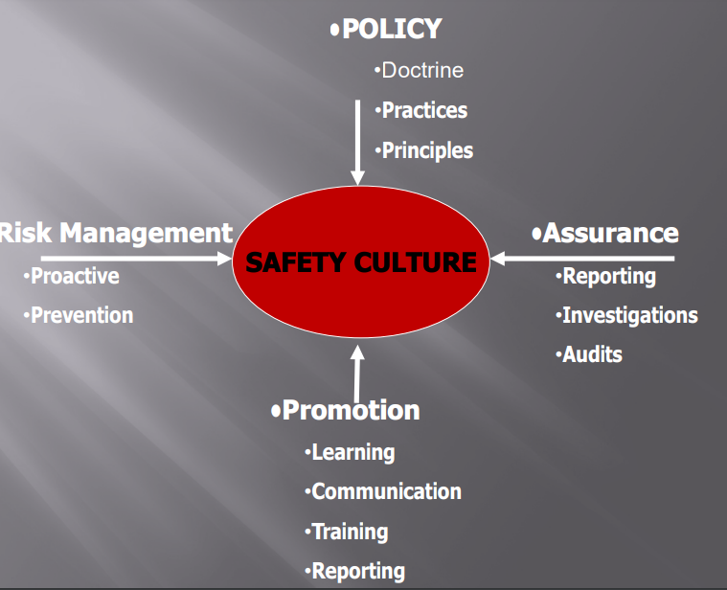
The containments of the four pillars

Slide 6
Features of Safety management system
Systematic – Safety the executives' exercises are as per a pre-decided arrangement and applied in a steady way all through the association.
Proactive – A methodology that stresses danger distinguishing proof and hazard control and moderation, before occasions that influence security to happen.
Explicit – All wellbeing the executives' exercises are recorded and noticeable.

Slide 7
Organization failure model
Administrative factors.
Unsecure supervisions.
Necessities for unsecure actions.
Unsecure actions.

Slide 8
Latent conditions
May lie lethargic for quite a while, and possibly become obvious when they consolidate with a setting off component to penetrate the framework's protections.
Idle conditions can be made by:
Corporate environment and qualities
How corporate choices are made Corporate needs.
Who impacts the dynamic chain.
How the dynamic cycle is recorded and execution followed
Not estimating results against assumptions.

Slide 9
Problem and solution
Current security approaches cannot stay aware of intricacy development.
We need another methodology for our security the board and oversight issues.
Builds up a "Simply culture" or "Security Culture" to:
Catch the operational information and experience of the representatives
Include the representatives in the wellbeing accomplishment measures.

Slide 10
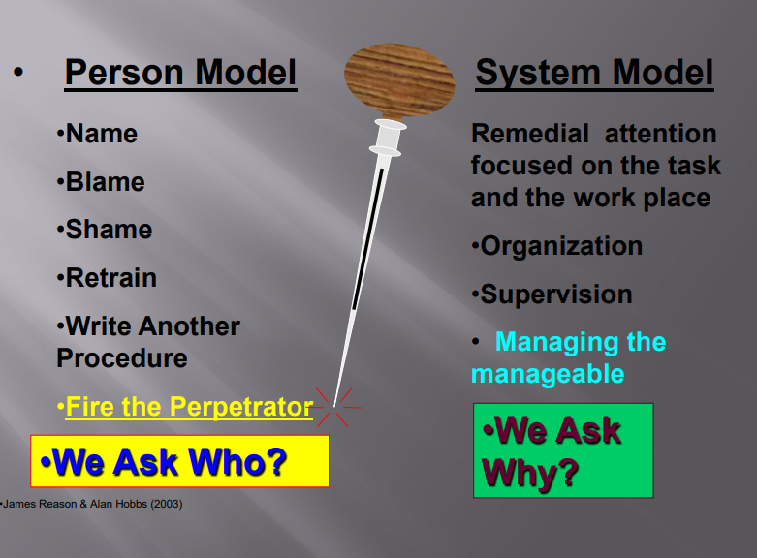
Continuation..

Slide 11
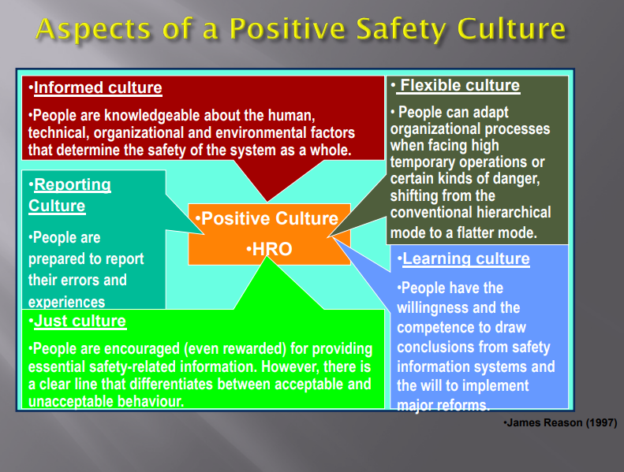
Continuation…

Slide 12
Justifiable Culture
A justifiable culture has a reported disciplinary strategy
Characterize clear lines between the adequate and the unsuitable.
Fault culture advances covering up.
Justifiable culture advances organization.

Slide 13
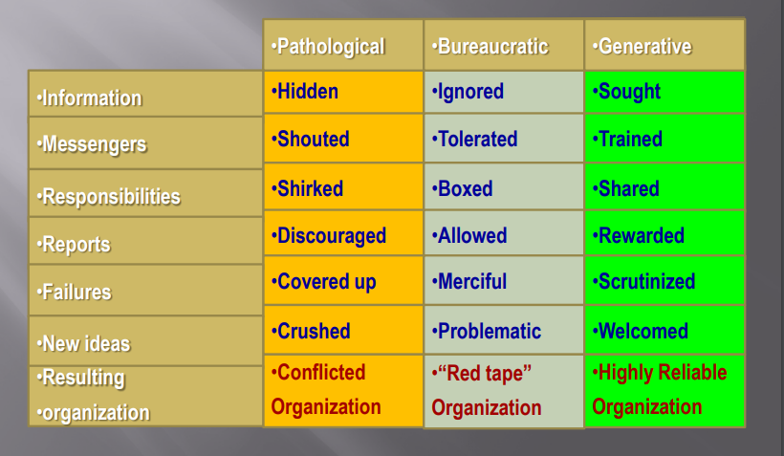
Three possible organizational cultures

Slide 14
Cultural shifts
What do Interagency Aviation Managers need?
A Safe and Efficient security framework.
Compelling and Strong suppliers.
We are seeing critical help in the positions because of ongoing field assessments, the utilization of hole examination apparatuses in upkeep circles, and the interest at all levels in operational danger the board.
The FS and DOI flying projects are gaining ground with key danger appraisals and doctrinal modifications in the strategy.

Slide 15
Reasons for the Safety management system adoption of Risk Management Practices
The safety management system underscores the hazard management by incorporating safety with Line Management.
Adjusts to changes.
Oversees asset application.
Comprehends the entanglements of the working climate.

Slide 16
Implementing SMS
Follows a staged methodology
The cycles hidden the four columns are modularized.
"Development" or "expanding development" is underlined for the system in general and its inner cycles.

Slide 17
Safety management system growing steps
Orientation and commitment.
Planning and organization.
Reactive processes.
Predictive processes.
Continuous Improvement.

Slide 18

Safety management system is a tool box for...
Strategy and Management Practices.
Safety Assurance measures.
Safety advancement rehearses.
Hazard Management measure.

Slide 19
References
Britton, T. (n.d.). Why safety promotion component is the overlooked pillar in aviation SMS. Retrieved April 13, 2021, from http://aviationsafetyblog.asms-pro.com/blog/4-pillars-what-is-safety-promotion-component-the-overlooked-pillar
Forbes, Silke J., and Mara Lederman. “Does Vertical Integration Affect Firm Performance? Evidence from the Airline Industry.” The RAND Journal of Economics, vol. 41, no. 4, 2010, pp. 765–90.
Gerz, Thomas, et al. “Commercial Aircraft Wake Vortices.” Progress in Aerospace Sciences, vol. 38, no. 3, 2002, pp. 181–208.
Merritt, A.C., & Helmreich, R.L. (2016). Creating and sustaining a safety culture: Some practical strategies. In B. Hayward & A. Lowe (Eds.), Applied Aviation Psychology: Achievement, Change and Challenge (pp. 20-26). Sydney: Avebury Aviation.
Merritt, A.C., & Helmreich, R.L. (2020). Creating and sustaining a safety culture: Some practical strategies. In B. Hayward & A. Lowe (Eds.), Applied Aviation Psychology: Achievement, Change and Challenge (pp. 20-26). Sydney: Avebury Aviation.
Merritt, A.C., Helmreich, R.L., Wilhelm, J.A., & Sherman, P.J. (2017). Flight Management Attitudes Questionnaire 2.0 (International) and 2.1 (USA/Anglo). The University of Texas Aerospace Crew Research Project Technical Report 96-4.
Safety management system. (2017, September 11). Retrieved April 13, 2021, from https://www.faa.gov/about/initiatives/sms/explained/components/#safety_promotion

