Slide 1
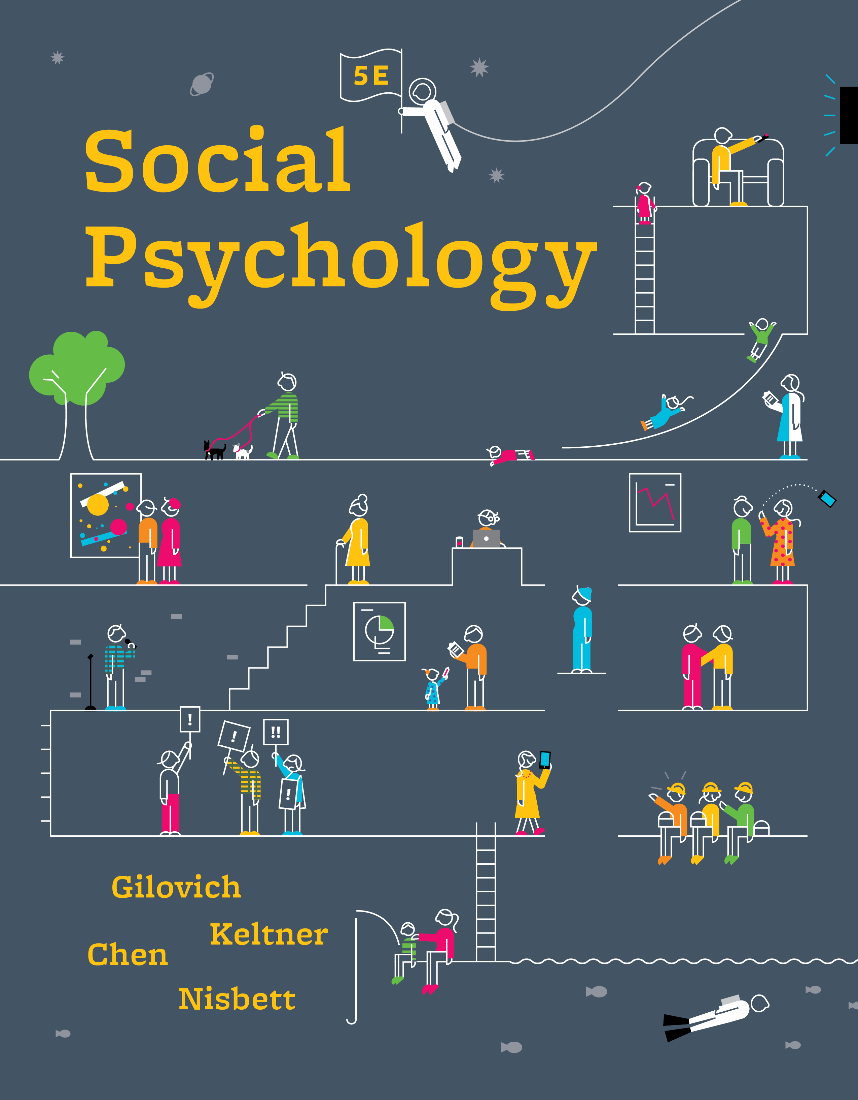
CHAPTER 7
Attitudes, Behavior, and Rationalization
Social Psychology, 5th edition
© 2019 by W. W. Norton & Company

Slide 2
Components and Measurement of Attitudes
What are attitudes, and how are they measured?
  Attitudes can have multiple components, and researchers use a variety of methods to measure them

Slide 3
Three Components of Attitudes
Attitude
  An evaluation of an object in a positive or negative fashion that includes three components:
    Affect
    Cognition
    Behavior

Slide 4
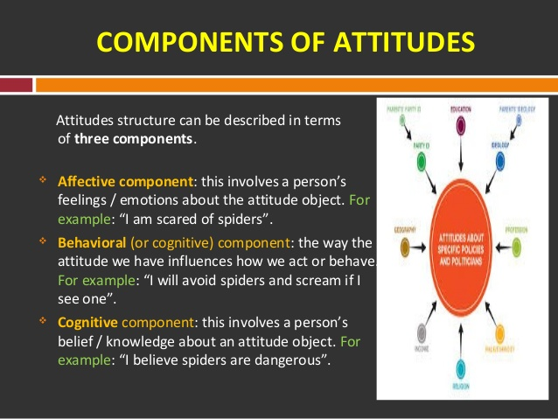

Slide 5
Measuring Attitudes: Self-Report Measures
Likert scale
  A numerical scale used to assess attitudes; includes a set of possible answers with labeled anchors on each extreme
Response latency
  The amount of time it takes to respond to a stimulus, such as an attitude question

Slide 6
Measuring Attitudes
Implicit attitude measure
  An indirect measure of attitudes that does not involve a self-report
    Implicit association test (IAT)
Nonverbal measures
  Example: degree of physical closeness to another person
Physiological measures
  Example: increased heart rate or sweaty palms in response to an attitude object
Notes:
Attitudes may be inconsistent.
There may be people in our lives with inconsistent attitudes. Thoughts and feelings may differ (“off the top of my head”). This may include your boyfriend/girlfriend, wife/husband, family, or boss.
Let’s take the boss. Your feelings about your boss may be, “I really don’t like that person,” but your thoughts may be, “That person gives me money.” Your “I like money attitude” may conflict with your “I don’t like that person” attitude.
6

Slide 7
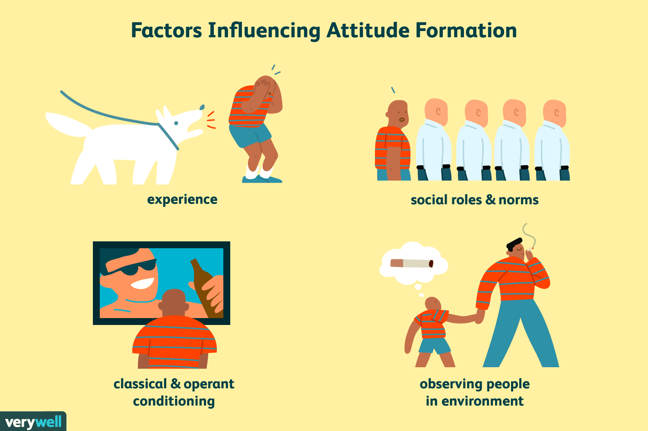

Slide 8
Predicting Behavior from Attitudes
Attitudes may be poor predictors of behavior.
  LaPiere study in the 1930s
    Traveling across the United States with a Chinese couple at time when anti-Chinese prejudice was high
    Surprisingly, they were denied service at only one of the 250 places they visited.
    However, when each place was later contacted and asked if they would serve Chinese customers, 90 percent said they would not.
    Attitudes may conflict with other influences on behavior.
    Social norms, other conflicting attitudes, and situational factors may also influence behavior.

Slide 9
Introspecting about the Reasons for Our Attitudes
Introspection may influence attitudes.
  Introspection may fail to capture the full cause of our attitudes.
  Introspection may cause a rift between your expressed attitude and subsequent behavior, but primarily when the basis of an attitude is affective (emotional).
  In these cases, cognitive (thoughtful) analysis of your reasons for the attitude may yield misleading cognitive reasons.

Slide 10
The Mismatch between General Attitudes and Specific Targets
General attitudes may not match specific targets.
  Attitudes are more accurate predictors of behavior when specific attitudes toward a specific behavior are measured.
  Attitudes may be poor predictors of behaviors, but behaviors can be good predictors of attitudes.
  Attitudes may change in order to be consistent with behaviors.

Slide 11
Cognitive Dissonance Theory
Cognitive consistency theories
  Theories that maintain that the impact of behavior on attitudes reflects our tendency to justify or rationalize our behavior and to minimize any inconsistencies between our attitudes and actions
Cognitive dissonance theory
  Theory that inconsistencies among a person’s thoughts, sentiments, and actions cause an aversive emotional state (dissonance) that leads to efforts to restore consistency

Slide 12
Reducing Cognitive Dissonance
  Cognitive dissonance can be reduced by changing thoughts, feelings, or behavior in order to make them consistent.
    For instance, smoking may cause dissonance because it is bad for health and most people want to be healthy.
    Dissonance can be reduced by quitting smoking.

Slide 13
Reducing Cognitive Dissonance
  Cognitive dissonance can also be reduced by adding thoughts, feelings, or behaviors to reduce apparent inconsistencies.
    For instance, many people may find it too difficult to quit smoking.
    Dissonance can be reduced by adding such thoughts as “My grandfather smoked every day and he lived to be 100 years old,” or, “Yes, I know it’s bad for me, but it helps me relax.”

Slide 14
Cognitive Dissonance Theory and Decisions
Because behaviors cannot be taken back, cognitive dissonance often causes changes in thoughts and/or feelings to rationalize behaviors.
  Difficult choices can induce cognitive dissonance.
  Dissonance can be aroused by the inconsistency of accepting the negatives of one choice while rejecting the positives of the other choice.

Slide 15
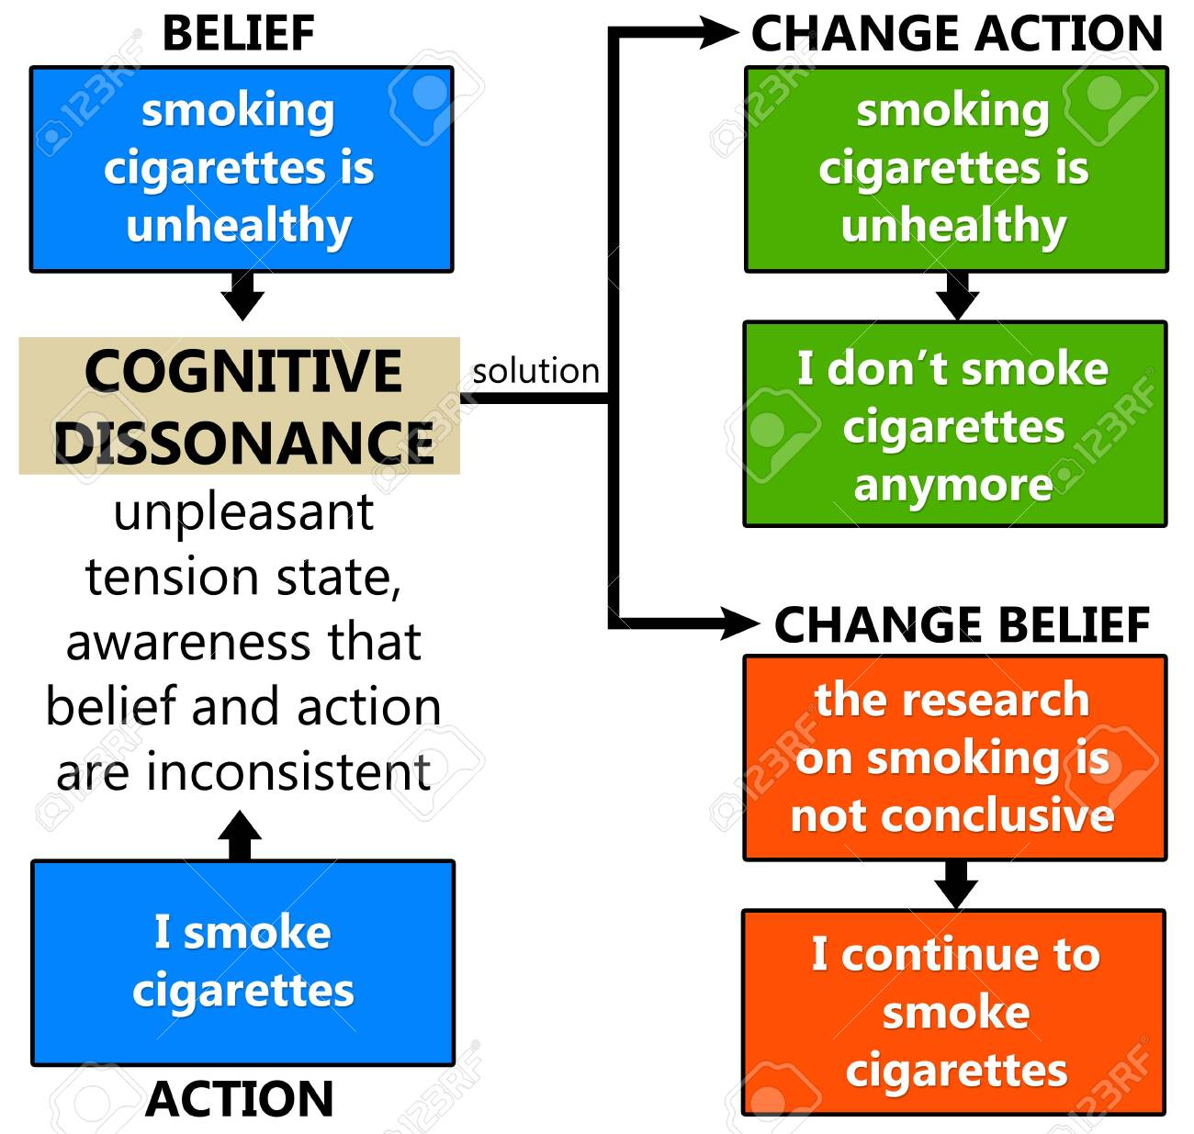

Slide 16
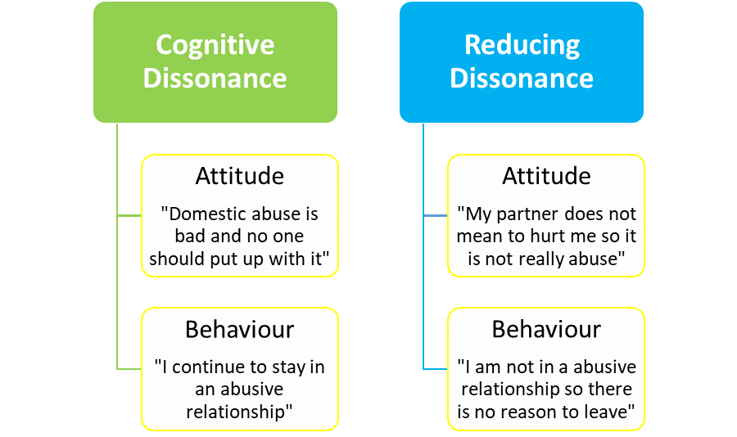

Slide 17
Rationalizations Can Reduce Decision Dissonance
Decision dissonance typically is resolved by emphasizing the positives and minimizing the negatives of the selected choice.
  Also resolved by emphasizing the negatives of the unselected choices and minimizing the positives

Slide 18
Rationalization: Example
For instance, choosing between living in a big city or small town
  If the big city is chosen, people may emphasize how great it is to go to restaurants and museums and minimize how frustrating the traffic is.
  If the small town is chosen, people may emphasize how great it is to not deal with traffic and minimize not being able to go to fancy restaurants or museums.
  Rationalizations can occur before or after the decision is made

Slide 19
Cognitive Dissonance Theory: Effort Justification
Effort Justification
  The tendency to reduce dissonance by justifying the time, effort, or money devoted to something that turned out to be unpleasant or disappointing
  Greater effort expended leads to more dissonance and more attempts to rationalize behavior

Slide 20
Effort Justification: Examples
Club initiations
    A study found that women who had to undergo the most severe initiation to join a discussion group reported the most liking for the group, even though the discussion was actually uninteresting.
Fraternity hazings
    Fraternities with more severe initiations have more loyal members.
“Sweet lemons rationalization”
    People may think “It’s not so bad after all” to justify a costly or unpleasant effort.

Slide 21
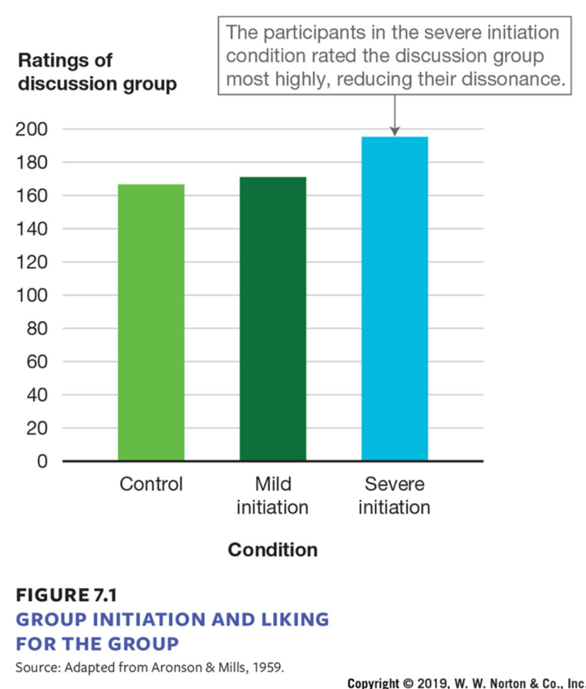
Effort Justification
Condition (x-axis)​ | Ratings of discussion group (y-axis)​
Control​ | 165​
Mild initiation​ | 170​
Severe initiation​ | 195​
Notes:
FIGURE 7.1
GROUP INITIATION AND LIKING FOR THE GROUP
This graph shows the different ratings of a discussion group by participants who experienced no initiation (the control condition), a mild initiation, or a severe initiation to join the group.

Slide 22
Cognitive Dissonance Theory: Induced (Forced) Compliance
Induced (forced) compliance
  Subtly compelling people to behave in a manner that is inconsistent with their beliefs, attitudes, or values, in order to elicit dissonance, and therefore a change in their original views

Slide 23
Cognitive Dissonance Theory: Experiment
Original study of dissonance
  Participants first completed a long and boring task.
  Then participants were either paid $1 or $20 to lie to another person and say the task was really fun.
  Then participants were asked how much fun they really thought the task was.
  Participants who were paid $20 thought the task was boring, but participants who were paid only $1 said the task was actually enjoyable.

Slide 24
Why Did Cognitive Dissonance Occur?
Why?
  Lying to someone for $1 caused more dissonance than lying to someone for $20; $1 is not a lot of money to reward acting against one’s beliefs.
  So attitude changes to match behavior and resolve cognitive dissonance
    “I didn’t really lie [for only $1]; that task wasn’t so bad after all.”

Slide 25
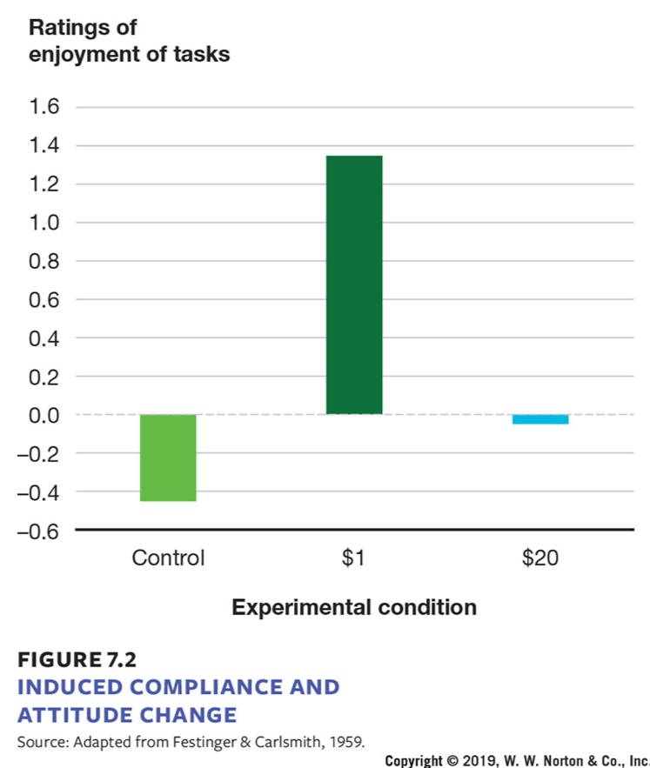
Induced Compliance and Attitude Change
Experimental Condition (x-axis)​ | Ratings of enjoyment of tasks (y-axis)​
Control​ | –0.5 to 0​
$1 ​ | 0 to 1.3​
$20 ​ | 0 to –0.1​
Notes:
FIGURE 7.2
INDUCED COMPLIANCE AND ATTITUDE CHANGE
Saying something we don’t believe, and doing so with little justification ($1 instead of $20), produces dissonance. To reduce this dissonance, in this study the participants in the $1 condition rated the boring task more favorably than participants in the other two conditions, thereby
providing some justification for their behavior (they did really lie). Ratings of task enjoyment were made on a−5 (extremely dull and boring) to +5 (extremely interesting and enjoyable) scale.

Slide 26
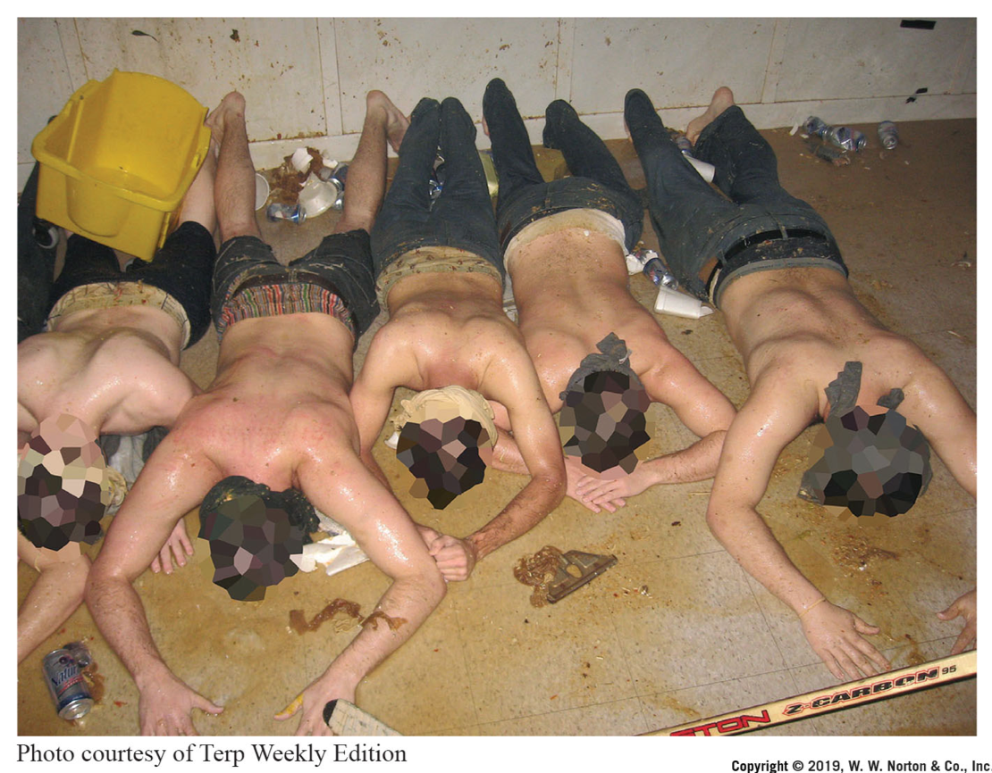
Fraternity Hazing and Commitment
Notes:
FRATERNITY HAZING AND COMMITMENT
Fraternities try to increase the commitment of members by having them undergo difficult and embarrassing initiation rituals like the one shown here.

Slide 27
Cognitive Dissonance Theory: Forbidden Toy Study
“Forbidden toy” study
  Children are given a set of toys and asked to rate each one.
  They are then told that they could play with any of the toys, except for one.
  They then are told that playing with the forbidden toy would make an adult “annoyed” (mild threat) or “very, very angry” (severe threat).

Slide 28
Cognitive Dissonance Theory: Devaluing the Forbidden Toy
  All children resisted playing with the forbidden toy.
  Later, children were asked to rate the toys again.
  Many children given a mild threat found the toy less desirable than before, but children given a severe threat found the toy more desirable. Why?

Slide 29
Cognitive Dissonance Theory: Devaluing the Forbidden Toy
Mild threats of punishment are a weak reason for resisting something that is desired, so attitude changes to rationalize behavior.
  “That toy isn’t so great after all.”
Severe threats are a good reason to resist a behavior, but may result in the behavior seeming even more appealing.

Slide 30
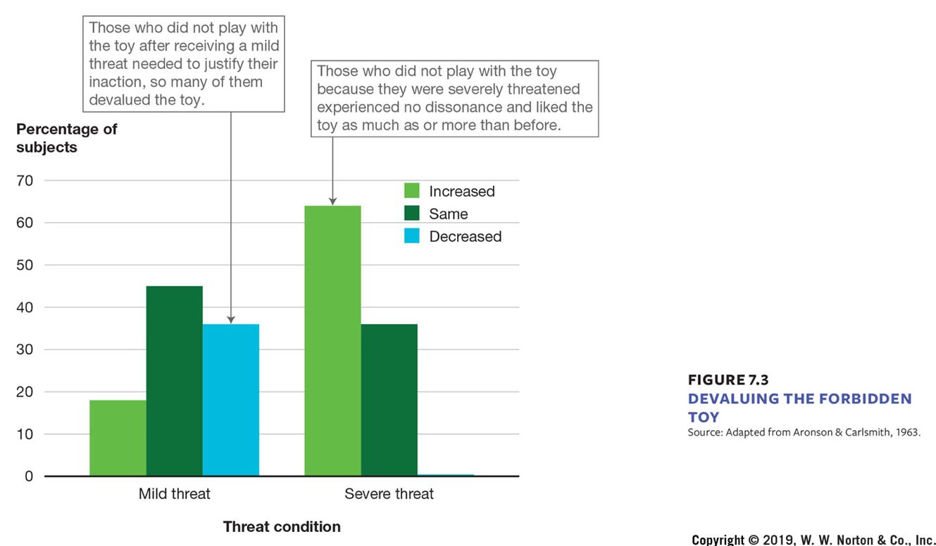
Cognitive Dissonance Theory: Devaluing the Forbidden Toy
Threat Condition (x-axis)​ | Percentage of subjects (y-axis)​
Mild threat​ | 18 to increased, 45 to same, 35 to decreased​
Severe threat​ | 64 to increased, 35 to same​
Notes:
FIGURE 7.3
DEVALUING THE FORBIDDEN TOY
For this study, the graphs show the percentages of children in the mild and severe threat conditions whose opinion of the forbidden toy increased, stayed the same, or decreased.

Slide 31
When Does Inconsistency Produce Dissonance? Free Choice
Free choice
  Choosing to engage in a behavior that is inconsistent with beliefs will cause dissonance.
  Forced behavior does not cause dissonance, since the reason for the behavior is clear (“I didn’t have a choice”).
  There is no need to rationalize behaviors we didn’t choose.

Slide 32
When Does Inconsistency Produce Dissonance? Insufficient Justification
Insufficient justification
Dissonance may occur when the reason for a behavior is weak or unclear.
  Payment of $1 may be insufficient justification for lying.
  Annoying an adult may be insufficient punishment to resist playing with a favorite toy.
With sufficient justification (that is, more money, larger threat), the behavior doesn’t need to be rationalized.

Slide 33
When Does Inconsistency Produce Dissonance?
Negative consequences
Freely chosen inconsistent behaviors may not cause dissonance if there was no negative consequence of the behavior.
  Lying may not cause dissonance if the person doesn’t believe what you say anyway.
If nothing happened as a result, there is nothing to rationalize.

Slide 34
When Does Inconsistency Produce Dissonance? Foreseeability
Foreseeability
Dissonance may not occur if the negative consequence was not something that could be foreseen.
  For instance, if you give someone food they are allergic to but you had no prior knowledge of the allergy, then you have no reason to rationalize your behavior.

Slide 35
Self-Affirmation and Dissonance
Cognitive dissonance results from challenges or threats to people’s sense of themselves as rational, moral, and competent
Self-affirmation
  Boosting our self-esteem and identity by focusing on important aspects of the self
Self-affirmation can reduce dissonance

Slide 36
Is Dissonance Universal?
Cognitive dissonance may be universal across cultures but may be aroused by different situations.
  Euro-Canadians’ cognitive dissonance may result from threats to how people see themselves.
  Asian-Canadians’ cognitive dissonance may occur from threats to how people believe they are seen by others.

Slide 37
Cognitive Dissonance and Culture
Culture and decision dissonance
  Euro-Canadians experienced more dissonance when making a choice for themselves than for a friend.
  Asian-Canadians experienced more dissonance when making a choice for a friend than for themselves.
  Asian-Canadians are more likely to experience dissonance when primed with thoughts of how other people would view their choices and behavior.

Slide 38
Self-Perception Theory
Like all prominent theories that have been around for a long time, cognitive dissonance theory has faced many theoretical challenges, and there have been numerous critiques​

Slide 39
Self-Perception Theory
Self-perception theory
  The theory that people come to know their own attitudes by looking at their behavior and the context in which it occurred, and inferring what their attitudes must be

Slide 40
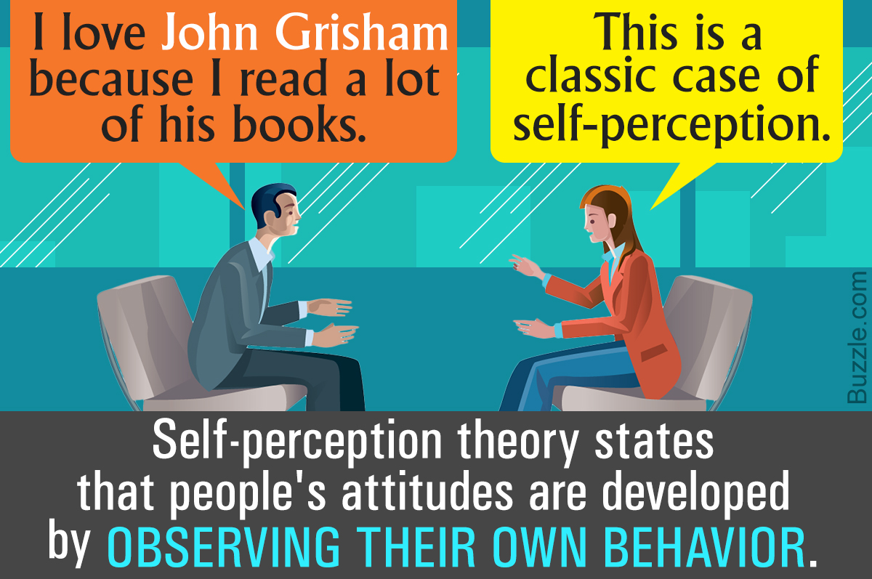

Slide 41
Inferring Our Own Attitudes
Self-perception theory suggests a different interpretation of the cognitive dissonance research.
  Cognitive dissonance theory argues that people change attitudes to fit their behavior because inconsistencies are mentally unpleasant.
  Self-perception theory argues that an unpleasant mental state is not needed as explanation for the results of the cognitive dissonance studies.

Slide 42
Inferring Our Own Attitudes from Our Behavior
Self-perception argues that people didn’t change their attitudes; instead, they inferred their attitudes from their behavior in the situation.
  “I told them that the task was fun, so it must have been fun because there wasn’t any other reason to say it was.”

Slide 43
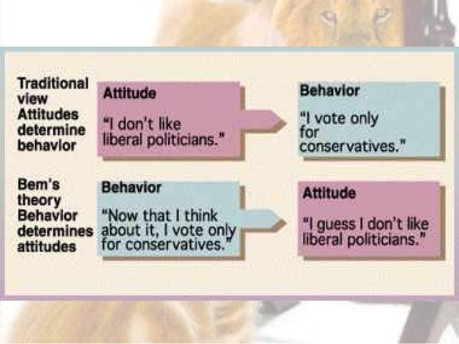

Slide 44
Reconciling the Dissonance and Self-Perception Accounts
Cognitive dissonance may occur when behavior doesn’t fit a preexisting attitude, and the attitude is important to the self-concept.
  Inconsistency is threatening to self-concept, so dissonance is aroused

Slide 45
Reconciling the Dissonance and Self-Perception Accounts
Self-perception may occur when attitudes are weak or ambiguous.
  No strong prior attitude → no sense of inconsistency → no dissonance
  Many attitudes are relatively weak and changeable.

Slide 46
Overjustification Effect
The overjustification effect occurs when an expected external incentive such as money or prizes decreases a person's intrinsic motivation to perform a task
intrinsic vs extrinsic motivation

Slide 47
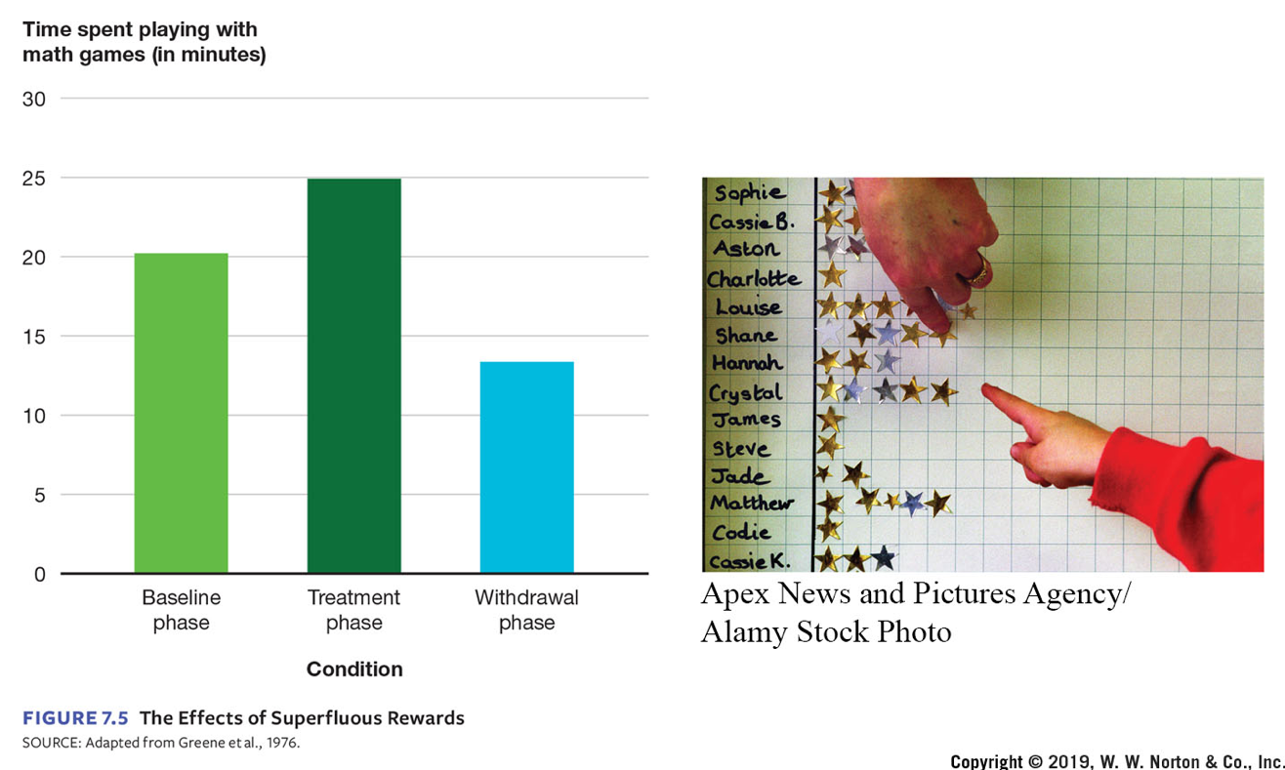
The Overjustification Effect and Superfluous Rewards
Condition​ | Time spent playing with math games (in minutes)​
Baseline phase​ | 21​
Treatment phase​ | 25​
Withdrawal phase​ | 13​
Notes:
FIGURE 7.5 The Effects of Superfluous Rewards
This graph shows the amount of time elementary school children spent playing math games originally (baseline phase), when they received rewards for playing them (treatment phase), and afterward (withdrawal phase).

Slide 48
Beyond Cognitive Consistency to Broader Rationalization
The core of dissonance theory is the idea that people find cognitive inconsistency uncomfortable and therefore try to find ways to relieve the discomfort.

Slide 49
System Justification Theory
System justification theory
  The theory that people are motivated to see the existing sociopolitical system as desirable, fair, and legitimate.
Notes:
https://www.apa.org/science/about/psa/2017/06/system-justification

Slide 50
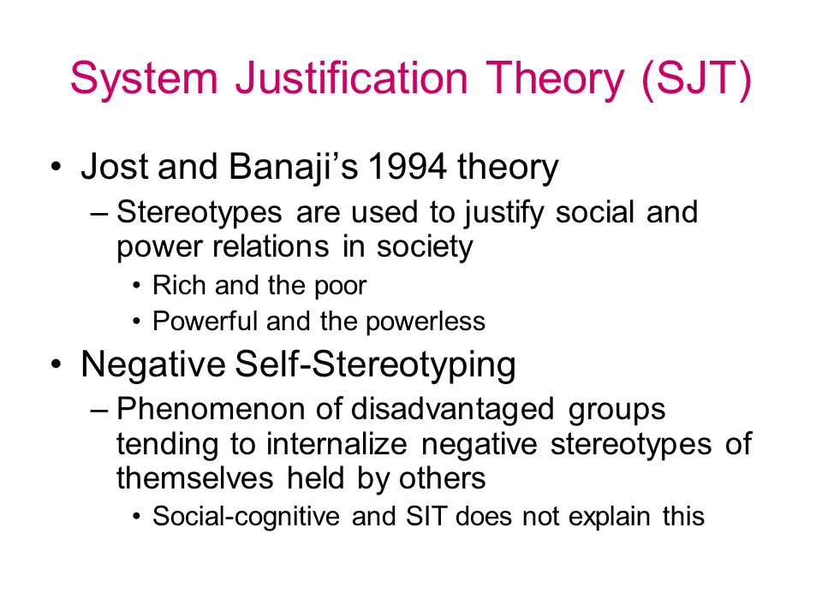

Slide 51
System Justification Reduces Dissonance
System justification reduces dissonance
  Promotes the virtues of the status quo
    “If I could go to school and get a job, then homeless people could do the same thing.”
  Positive or compensatory stereotypes
    “Sure, women make less money for the same job, but they are better liked at work.”

Slide 52
Terror Management Theory
Terror management theory (TMT)
  The theory that people deal with the potentially crippling anxiety associated with the knowledge of the inevitability of death by striving for symbolic immortality through preserving valued cultural worldviews and believing they have lived up to their standards

Slide 53
Terror Management Theory and Symbolic Immortality
Ways to achieve symbolic immortality
View self as connected to broader culture, worldview, and social institutions
  Stronger identification with family, country, religion, and so on
High self-esteem
  View self as a good, valued member of the culture
Meaningful Interpersonal Relationships
  Sense of purpose

Slide 54
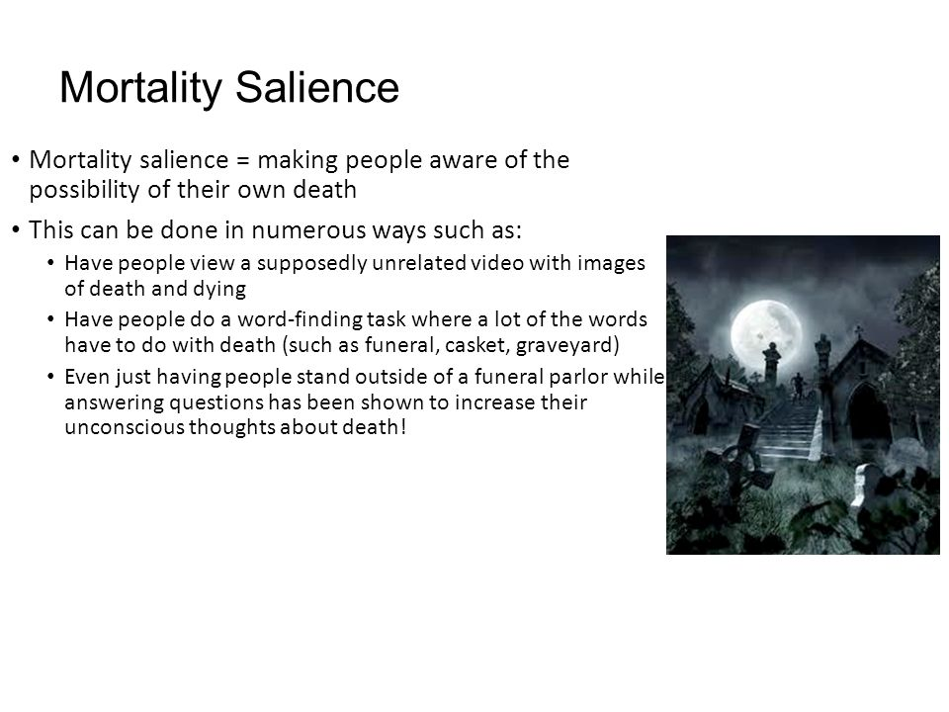

Slide 55
Effects of Mortality Salience
Effects of mortality salience
  More commitment to ingroups and more hostility to outgroups
  Increased hostility to people who criticize one’s country
  More punitive to people who challenge prevailing laws
  Reluctance to use cultural artifacts for mundane purposes
  More acceptance of positive feedback about the self
  During the 2004 election, mortality salience made people feel more favorable toward Bush and less favorable toward Kerry
    Possibly because Bush was already president and was seen as defending the
    country from outside threats

