Slide 1

CHAPTER 8
Persuasion
Social Psychology, 5th edition
© 2019 by W. W. Norton & Company

Slide 2
Dual-Process Approach to Persuasion
The literature on persuasion suggests that there is no simple, one-solution-fits-all means of persuasion.
Instead, persuasion theorists propose that there are two basic ways of trying to persuade people, or two “routes” to persuasion.

Slide 3
Elaboration Likelihood Model
Elaboration likelihood model (ELM)
  A model of persuasion maintaining that there are two different routes to persuasion: the central route and the peripheral route

Slide 4
ELM: The Central Route
According to the ELM, the central route to persuasion occurs when people think carefully and deliberately about the content of a persuasive message, attending to its logic and the strength of its arguments, as well as to related evidence and principles.

Slide 5
ELM: The Peripheral Route
Through the ELM’s peripheral route, people primarily attend to
peripheral aspects of a message—relatively superficial, easy-to
process features of a persuasive communication that are
tangential to the persuasive information itself (such as its
length or the expertise or attractiveness of the source of the
message)

Slide 6
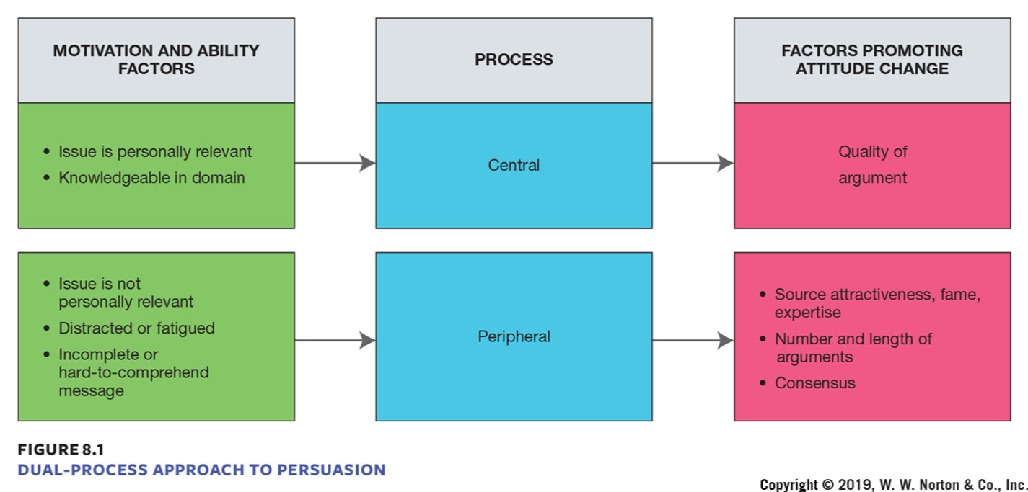
The Elaboration Likelihood Model (ELM)
Notes:
FIGURE 8.1
DUAL-PROCESS APPROACH TO PERSUASION
According to Petty and Cacioppo’s elaboration likelihood model, there are two routes to persuasion: a central route and a peripheral route. The routes are engaged by different levels of motivation and ability to attend to the message, and different types of persuasive appeals are more effective through one route than through the other. Any persuasion variable, such as a source’s expertise, can bring about attitude change through either or both central and peripheral routes to persuasion.

Slide 7
The Roles of Motivation and Ability
What determines whether we will engage in central or peripheral processing in response to a persuasive message?
  Motivation
  Ability

Slide 8
Motivation, Ability, and the Central Route to Persuasion
For persuasion to occur via the central route, we have to be both motivated and able to engage in more in-depth processing. If either (or both) is lacking, persuasion generally relies on peripheral cues.
For long-lasting attitude change, persuasion through the central route is preferable.

Slide 9
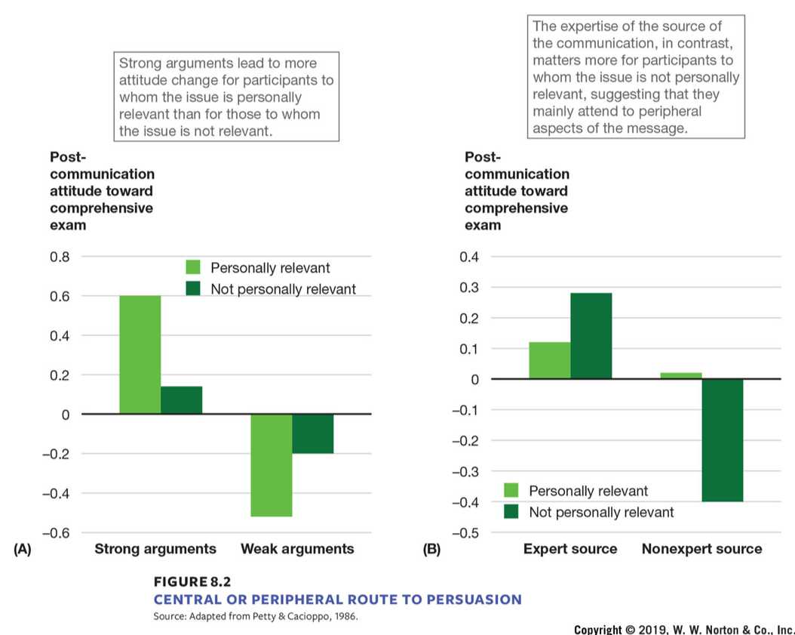
Central or Peripheral Route to Persuasion
A​ | A​ | A​ | B​ | B​ | B​
Arguments (x-axis)​ | Arguments (x-axis)​ | Post-communicationattitude towardcomprehensiveexam (y-axis)​ | Source (x-axis)​ | Source (x-axis)​ | Post-communicationattitude towardcomprehensiveexam (y-axis)​
StrongArguments​ | Personallyrelevant​ | 0.60​ | Expert source​ | Personallyrelevant​ | 0.12​
StrongArguments​ | Not-personallyrelevant​ | 0.15​ | Expert source​ | Not-personallyrelevant​ | 0.28​
WeakArguments​ | Personallyrelevant​ | -0.53​ | Non-expertsource​ | Personallyrelevant​ | 0.02​
WeakArguments​ | Not-personallyrelevant​ | -0.20​ | Non-expertsource​ | Not-personallyrelevant​ | -0.40​
Notes:
FIGURE 8.2
CENTRAL OR PERIPHERAL ROUTE TO PERSUASION
Attitude change can be brought about by (A) strong arguments when people are motivated and by (B) the expertise of the source of the persuasive message when people aren’t motivated.

Slide 10

Subliminal Advertising
Notes:
SUBLIMINAL ADVERTISING
In a television ad run by the Republicans during the 2000 U.S. presidential election, the word RATS was quickly flashed on the screen in a subliminal attack on Al Gore, the Democratic candidate, and his Medicare plan.

Slide 11
The Elements of Persuasion
The Yale School approach to persuasion
  Persuasive messages have three components:
    The who, or the source of the message
    The what, or the content of the message
    The whom, or the target of the message

Slide 12
Source Characteristics
Source characteristics
  Characteristics of the person who delivers a persuasive message, such as attractiveness, credibility, and certainty

Slide 13
Source Characteristics: Attractiveness
Attractiveness
  Attractive spokespeople are more persuasive, even for topics completely unrelated to attractiveness.
  Effects of attractiveness are through the peripheral route: attractive people are rated more favorably, and those favorable feelings become associated with the message.

Slide 14
Source Characteristics: Credibility
Credibility
  People who are seen as knowledgeable and trustworthy are more persuasive.
  However, noncredible sources can change attitudes through the sleeper effect.
    An effect that occurs when a persuasive message from an unreliable source initially exerts little influence but later causes attitudes to shift

Slide 15
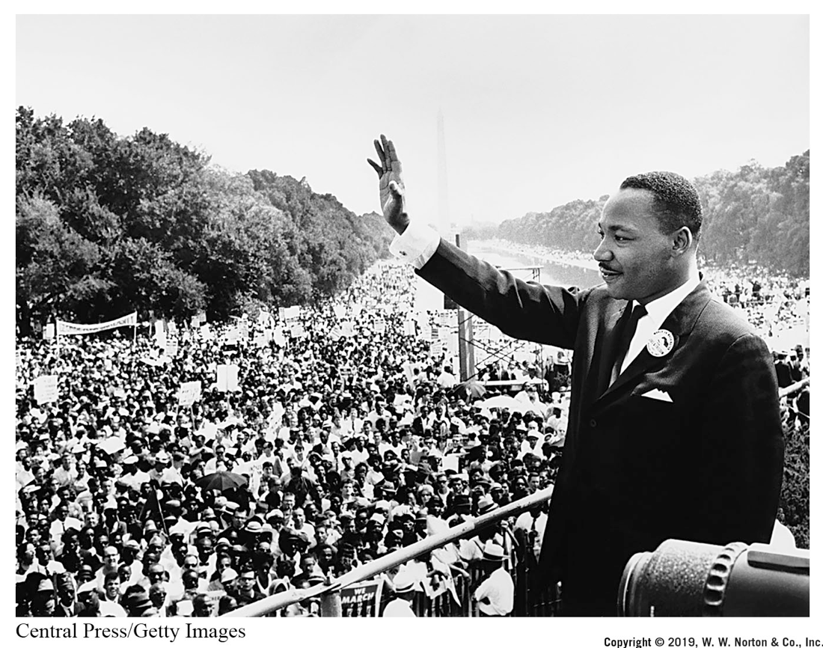
Credibility and Persuasion
Notes:
CREDIBILITY AND PERSUASION
Martin Luther King, Jr., is pictured here during the March on Washington in August 1963 as he is about to give his “I Have a Dream” speech. His credibility, due to his leading role in the civil rights movement and having repeatedly put his life on the line, undoubtedly contributed to his ability
to persuade.

Slide 16
Source Characteristics: Certainty
Certainty
  Sources who express their views with certainty and confidence tend to be more persuasive.
  If your goal is to persuade someone, be sure to express lots of confidence.

Slide 17
Message Characteristics
Message characteristics
  Aspects, or content, of a persuasive message, including the quality of the evidence and the explicitness of its conclusions

Slide 18
Message Characteristics: Message Quality
Messages quality
  High-quality messages are more persuasive in general, especially for people who are strong in motivation and ability.
  More attitude change will result if the conclusions are explicit in the message.

Slide 19
Message Characteristics: Vividness
Vividness
  When information is vivid—colorful, interesting, and memorable—it tends to be more effective.
  Identifiable victim effect
    The tendency to be more moved by the vivid plight of a single individual than by a more abstract number of people

Slide 20
Message Characteristics: Fear
Fear
  Fear messages contain vivid information and can be very persuasive.
  But fear messages are most effective when combined with instructions on how to avoid negative outcomes.

Slide 21
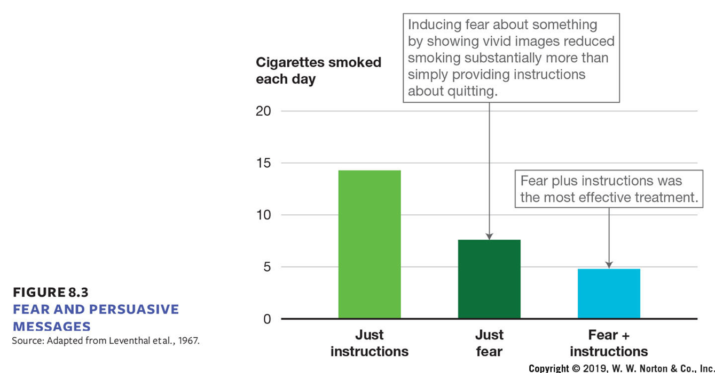
Fear and Persuasive Messages
Messages (x-axis)​ | Cigarttes smoked each day (y-axis)​
Just Instructions​ | 14​
Just fear​ | 7.5​
Fear + instructions​ | 4.8​
Notes:
FIGURE 8.3
FEAR AND PERSUASIVE MESSAGES
Fear, especially when paired with instructions on how to respond to the fear, is likely to lead to attitude change.

Slide 22
Message Characteristics: Culture
Culture
  It can be important to tailor a message to fit the norms, values, and outlook of a particular cultural group.

Slide 23
Audience Characteristics
Audience characteristics
  Characteristics of those who receive a persuasive message, including need for cognition, mood, age, and audience size and diversity

Slide 24
Audience Characteristics: Need for Cognition
Need for cognition
  Drive to think deeply about judgments
  People high in need for cognition are more persuaded by central route messages than by peripheral route messages.

Slide 25
Audience Characteristics: Mood
Mood
  Messages are more persuasive when they match the mood of the receiver.
    Optimistic messages work best on happy people.

Slide 26
Audience Characteristics: Age
Age
  Younger people are more persuadable than older people.
    Older people may have strong and long-held attitudes.
  Children may be most vulnerable to persuasion attempts.

Slide 27
Metacognition and Persuasion
Metacognitions
  Secondary thoughts that are reflections on primary cognitions

Slide 28
The Self-Validation Hypothesis
Self-validation hypothesis
  The idea that the likelihood of attitude change can depend not only on the direction and amount of thoughts people have in response to a persuasive message but also on the confidence with which they hold the thoughts

Slide 29
Embodiment and Confidence
The self-validation hypothesis also has been brought to bear on research showing that bodily movements can influence the attitudes people hold; in other words, attitudes are partly “embodied.”
Bodily movements can signal varying degrees of thought confidence, and it’s this confidence that determines whether or not persuasion occurs.

Slide 30
The Surprisingly Weak Effects of the Media
What effect does the media have on our attitudes?
  This is difficult to study because media is so pervasive, it’s hard to establish specific causal relationships.
  However, several studies have shown that, surprisingly, the effects of media appear very weak.

Slide 31
The Media and Conceptions of Social Reality
Agenda control
  Efforts of the media to select certain events and topics to emphasize, thereby shaping which issues and events people think are important

Slide 32
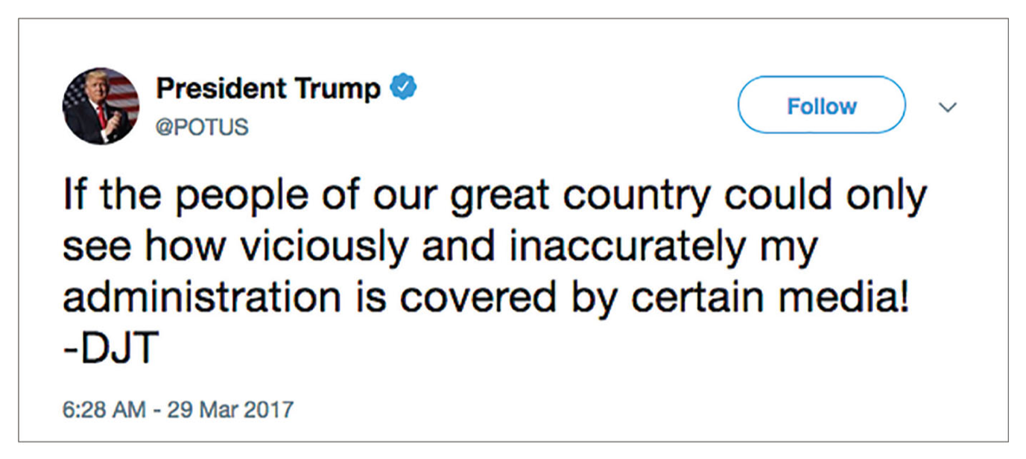
The Hostile Media Phenomenon
Notes:
PERCEIVED BIAS IN THE MEDIA
The hostile media phenomenon is arguably stronger than ever in today’s political and media climate. Accusations of bias on the part of mainstream media seem to accompany reports of any controversial event or issue. The leader of our country himself regularly tweets about such bias against him.

Slide 33
Media Representations Do Not Resemble Reality
Media representations do not resemble reality.
  Males are portrayed three times more often than females.
  Children, the elderly, racial minorities, and blue-collar and lower-income individuals are underrepresented.

Slide 34
Television Consumption and Social Attitudes
Television consumption linked to social attitudes
  Heavy television watchers endorse more racial and gender stereotypes, overestimate the prevalence of violence and crime, and overestimate the number of professionals in the population.

Slide 35
Resistance to Persuasion
Why doesn’t the media have a stronger effect on what we buy, who we vote for, or whether we adopt healthier habits?

Slide 36
Attentional Biases and Resistance
Attentional biases and resistance
  Preexisting attitudes may resist change by guiding how information is attended to, interpreted, and remembered.
    For instance, a study found that students who were in favor of legalizing marijuana preferred to listen to strong arguments in favor of their position and arguments against their position that were easy to refute.

Slide 37
Attentional Biases and Resistance: Selective Evaluation
We tend to evaluate information in biased ways to support our preexisting opinion.
  For instance, when people were presented with results of studies favoring or opposing their positions on the death penalty, they believed the studies that supported their position and questioned those studies that didn’t.

Slide 38
Previous Commitments and Resistance
Previous commitments
  Attitudes tied to our social identity are more resistant to change.
  Public commitments to certain attitudes make them resistant to change.
    Publicly discussing or announcing an opinion will make it resistant to change because we want to keep a consistent self-concept.

Slide 39
Previous Commitments and Resistance
Thought polarization hypothesis
  The hypothesis that more extended thought about a particular issue tends to produce a more extreme, entrenched attitude

Slide 40
Knowledge and Resistance
Knowledge
  Attitudes based on more knowledge are more resistant to change.
  Having greater knowledge means we can offer more and better counterarguments to defend our attitude.

Slide 41
Attitude Inoculation
Attitude inoculation
  Small attacks on people’s beliefs that engage their preexisting attitudes, prior commitments, and background knowledge, enabling them to counteract a subsequent larger attack and thus resist persuasion

Slide 42
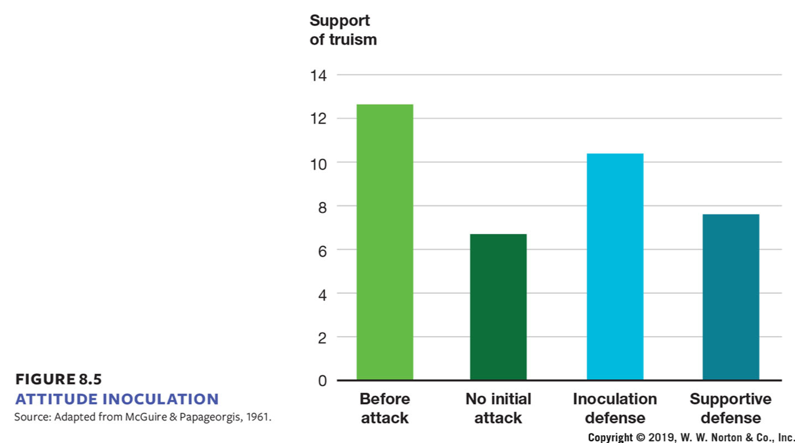
Attitude Inoculation: Study
Change in attitudes (x-axis)​ | Support of truism (y-axis)​
Before​ Attack​ | 12.8​
No initial​ Attack​ | 6.8​
Inoculation​ Defense​ | 10.4​
Supportive​ Defense​ | 7.8​
Notes:
FIGURE 8.5
ATTITUDE INOCULATION
This study showed that using preexisting attitudes, commitments, and knowledge to come up with counterarguments against an initial attack on an attitude makes people more resistant to persuasion in the face of a subsequent attack (third bar) compared with when there was no initial attack
(second bar), or when they initially generated supportive arguments in favor of their attitude (fourth bar).
42

Slide 43
Changes in Attitude Certainty
The conviction or certainty with which an attitude is held may change in response to a persuasive message, even if the direction and strength do not.
  A good way to get people to dig in their heels and become more confident about their position on an issue is to present them with lousy counterarguments.

Slide 44
Credits
This concludes the Lecture PowerPoint presentation for Chapter 8 of Social Psychology.
For more resources, please visit https://digital.wwnorton.com/socialpsych5

