Slide 1


Slide 2
What is a Safety And Quality Dashboard?
A safety and quality dashboard is a panel constructed by healthcare organizations to determine their safety and quality levels.
The safety levels involve the degree of the patient’s security in terms of the kind of treatment received.
Quality levels comprise of the extent by which the organization meets or exceeds patient expectation.
Notes:
The panel contains various metrics, representing data collected from all departments that make up the organization (Lamé & Dixon-Woods, 2020). These metrics are used by managers to determine the level of quality that the organization offers to the patient in real-time and can be used to improve both quality and safety levels in future.

Slide 3
Role of Safety and Quality Dashboards
To compile data from all the various organizational departments under one panel.
Monitor key performance indicators in the safety and quality sectors in the most dynamic way.
Assist in easily assessing the quality of care and client satisfaction.
Indicate areas of improvement in care provision.
Notes:
Instead of having every department present its data, which may be tiring to the managers, and regulators, the dashboards provide a system where all the data is collected in one place (Brown et al., 2018). Additionally, monitoring the key performance drivers, as well as quality assessment, is made easy.

Slide 4
Determination of Areas of Interest
When under pressure from the payers, the organization should measure the average treatment costs
When under the regulator’s and the industry’s pressure, measuring hospital acquired infections and risks of lawsuits would be prudent.
Other areas of interest may include length of stay, readmission rates, ratings by patients.
Notes:
To determine the areas in which the organization need to measure, some factors such as the payers, the regulators and the industry standardizers, are put into consideration (Ghazisaeidi et al., 2015). However, the dashboards are programmed in such away that they store all the provided data and offer the necessary metrics.

Slide 5
CQI Tools and the QI Team’s Role
Continuous quality improvement tools used in the dashboard include run charts, graphs, diagrams and reference checks tables.
The quality improvement team’s role in addressing the reported measures is to educate the rest of the workforce especially the departments that need modification.
Notes:
Charts, graphs, diagrams and reference checks are provided in the new organizations dashboard. These continuous quality improvement tools assist the dashboard reader to interpret the trends at a glance (Lamé & Dixon-Woods, 2020). The quality improvement team has a role to ensure that quality goals are achieved and new ones are set.

Slide 6
Significant Metric
The metric of interest to the Quality Director is admission and readmission rates metric.
This metric shows the rate by which admitted patients seek readmission within three months after their release.
High rate of readmission suggests that patients received a treatment that did not meet the desired results.
Quality Director
Notes:
The Quality Director would be interested in the readmission rates metric because the quality of healthcare provided determines the success of the treatment (Brown et al., 2018). Poor treatment will lead to high rates of readmissions and consequently bad reviews.

Slide 7
Recommendations from the Metric
Workforce orientation on the need to provide high quality care to the patients.
Increased patient engagement and request for feedbacks.
Closely monitoring the trends of client readmission and analyzing the collected data.
Quality Director
Notes:
The staff need to be educated and motivated on the importance of quality care to the organization's success. Moreover, patients may be requested to give feedback on areas that need improvement (Lamé & Dixon-Woods, 2020). Analyzing the data on the trends of client readmission will be crucial in making decisions that would enhance quality improvement.

Slide 8
Best Quality Models
PDSA cycles may be vital in this metric because they will help measure the management’s intervention on quality improvement.
The Lean method would ensure efficiency in providing quality care is enhanced..
Quality Director
Notes:
PDSA is the abbreviation for Plan-Do-Study-Act and may comprise of a combination of Total Quality Management and Rapid Cycle Improvement as provided by The Institute of Healthcare Model for Improvement (Lamé & Dixon-Woods, 2020).

Slide 9
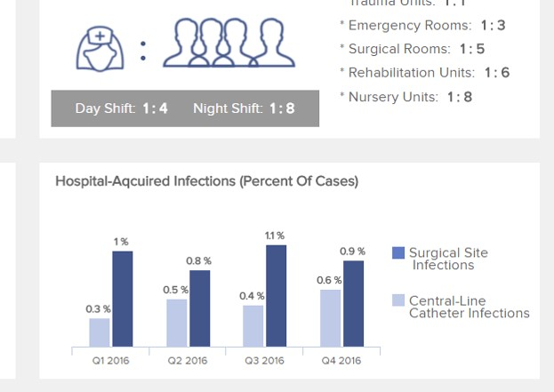
Significant Metric
Patient Safety Officer
The Patient Safety Officer would be interested in hospital-acquired infections metric.
Notes:
Hospital acquired infections and other injuries that occur on patients when they are in the hospital is the area of interest for the Patient Safety Officer.

Slide 10
Hospital Acquired Infection
Patient Safety Officer
The hospital-acquired infections metric indicates the percentage of cases of infections acquired by patients while undergoing treatment in the hospital.
These may be surgical site infections or central line catheter infections.
This metric is important because increased rates of infection may attract pressure from regulators and industry standardizers.
Notes:
The hospital acquired infections metric may include all kinds of illnesses contracted by the patient while in the hospital (Brown et al., 2018). Increase in rates of these infections may mean that the organization does not meet the country’s healthcare organizations standards.

Slide 11
Role of Patient Safety Officer
Patient Safety Officer
Create and enforce procedures to be followed by nurses.
Assess staff performance in collaboration with other managers.
Provide avenues for staff to report incidents and concerns.
Research on new procedures and policies that may help improve patient safety and satisfaction.

Slide 12
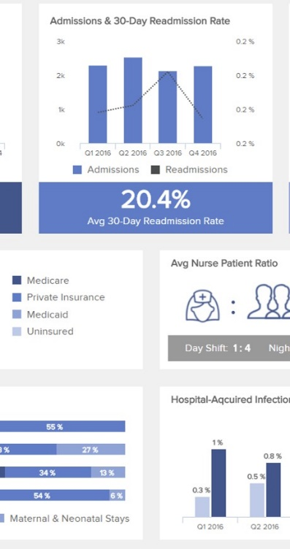
Significant Metric
Risk Manager
The Risk Manager’s metric of interest is the admission and readmission rates.
Notes:
Readmission of patients poses risks to the organization in terms of possible lawsuits and minimal profits (Lamé & Dixon-Woods, 2020). Thus, it would be the metric of interest to the Risk Manager.

Slide 13
Admission and Readmission Metric
Risk Manager
The admission and readmission rates metrics indicates the number of patients who were hospitalized again.
This would be caused by errors during treatment or treatment that did not produce the desired results.
This metric is important because it provides an insight on the rate of errors committed.
Notes:
The second hospitalization in this case is given a range of one to three months after discharge. The rate of readmission is directly proportional to the rate of errors committed.

Slide 14
Role of the Risk Manager
Risk Manager
Research and provide error management insights.
Work closely with the Patient Safety Officer to create the best incident-reporting avenues.
Notes:
The risk manager may additionally work with organization lawyers to understand possible chances of lawsuits and hence prepare the organization when such a case emerges (Lamé & Dixon-Woods, 2020).

Slide 15
Role of the Chief Executive Officer
Chief Executive Officer
Enhance a working environment that provides quality and safe health care.
Make decisions on the recommendations provided by the dashboard while considering profit-making.

Slide 16
Steps to Take from Recommendations
Chief Executive Officer
The nurse patient ratio should be increased.
The condition of beds and meals should be enhanced.
Visitation limitations as well as admission costs should be addressed.
Notes:
Reducing the number of patients assigned to one nurse is vital in ensuring the every patient is offered enough time-based care (Buttigieg et al., 2017). From the feedback of the patients, enhancing the conditions of beds and meals my attract more positive feedback in future.

Slide 17
Conclusion
Regulation Agencies and their concerns
National Patient Safety Foundation – concerned on the safety of the patients as indicated by the dashboard.
The Agency for Healthcare Research and Quality – collect insight on the methods to be used to improve quality.
The Joint Commission for Accreditation of Healthcare Organizations – use the dashboard to determine whether the organization meets standards.
Notes:
The regulation agencies’ concerns can easily be met by studying the dashboard's results.

Slide 18
Conclusion
Importance of Safety and Quality Dashboards
They provide insight on almost real-time information.
They assist managers and health workers to make better choices in order to improve the quality of patient care.
Providing context on which departments require implementation of change to enhance better performance.
Enabling organizations to compare their data with their competitors.
Through thorough analysis of the data provided by these dashboards, organizations can predict future outcomes.
Notes:
Real-time data is available due to the constant feeding of information to the system (Buttigieg et al., 2017). The dashboard keeps updating the results in graphs, charts or tables.

Slide 19
References
Brown, A., Dickinson, H., & Kelaher, M. (2018). Governing the quality and safety of healthcare: A conceptual framework. Social Science & Medicine, 202, 99-107.
Buttigieg, S. C., Pace, A., & Rathert, C. (2017). Hospital performance dashboards: a literature review. Journal of Health Organization and Management.
Ghazisaeidi, M., Safdari, R., Torabi, M., Mirzaee, M., Farzi, J., & Goodini, A. (2015). Development of performance dashboards in healthcare sector: key practical issues. Acta Informatica Medica, 23(5), 317.
Lamé, G., & Dixon-Woods, M. (2020). Using clinical simulation to study how to improve quality and safety in healthcare. BMJ Simulation and Technology Enhanced Learning, 6(2).

