Slide 1
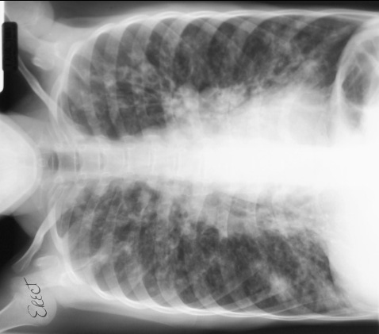
Cystic Fibrosis

Slide 2
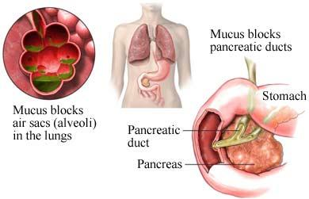
What is Cystic Fibrosis?
Cystic Fibrosis (CF) is a hereditary chronic disease that affects the lungs and digestive system
A defective gene and its protein product cause all of the endocrine glands to secrete excessively viscous mucus
This mucus then clogs the lungs and leads to life threatening respiratory problems
The mucus also obstructs the pancreas and stops natural enzymes from helping the body digest food properly

Slide 3
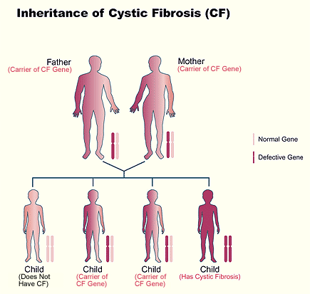
Inheritance of Cystic Fibrosis
Millions of Americans carry the defective cystic fibrosis gene but do not have symptoms
A person with Cystic Fibrosis must inherit two defective genes- one from each parent.

Slide 4
Cystic Fibrosis
http://www.youtube.com/watch?v=VxhQAQYgrKY&NR=1

Slide 5
Who is affected by Cystic Fibrosis?
Cystic Fibrosis is the most common deadly genetic disorder among Caucasian children.
About 30,000 children and adults in the United States have the disease.
Most children are diagnosed before age two.
However, a small portion of individuals are not diagnosed until eighteen or older, and they usually have a milder form of the disease.

Slide 6
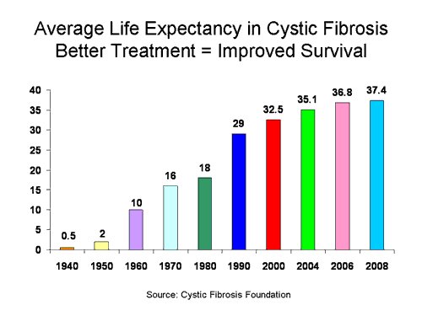
Life Expectancy
As recently as the 1950’s, a child diagnosed with CF would not be expected to make it past elementary school.
Now, due to medical advances, the life expectancy of a sufferer has been extended to mid-30 with 90 percent of CF patients dying due to respiratory failure

Slide 7
CFTR Gene
In a patient with cystic fibrosis, thick mucus secreted by mucosa in the trachea and bronchi blocks the air passages.
Normally, the healthy CF gene makes a protein, CFTR (Cystic Fibrosis conductance Transmembrane Regulator). This protein is found in the cells that line various organs like the lung and the pancreas.
It controls the movement of electrically charged particles like sodium and chloride (salt) in and out of the cells
With a defective protein, like in cystic fibrosis, the salt balance in the body is disturbed. There is too little salt and water on the outside of the cells. This allows the normally thin layer of mucus, which keeps the lungs germ-free, to thicken and become hard to move.

Slide 8
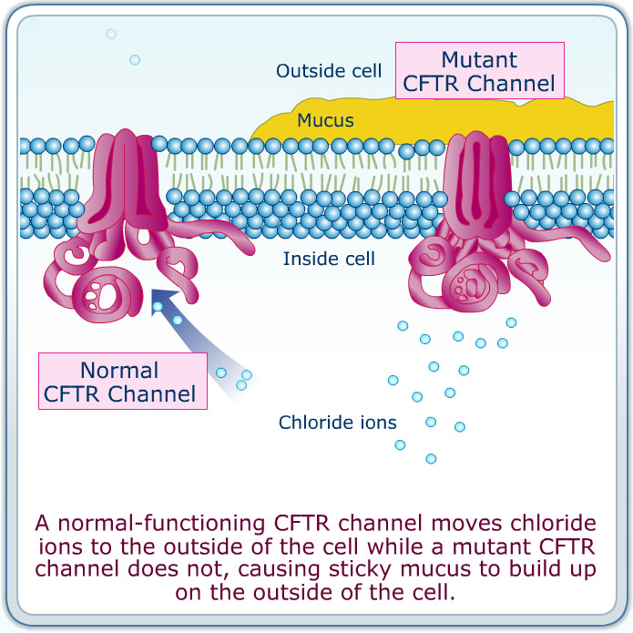
CFTR Gene

Slide 9
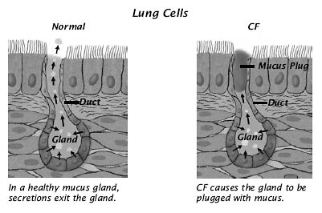
Cystic Fibrosis with the Respiratory System
Because the mucous is difficult to cough out, the mucus clogs the airways leading to infections that damage the lungs.
The mucous plugs lead to focal areas of lung collapse and the repeat of infections that lead to widespread destruction and widening of the airways with the formation of large cysts and abscesses

Slide 10
Cystic Fibrosis with the Digestive System
The abnormally thick mucus forms mucus plugs and blocks the ducts and passageways to the pancreas.
This prevents the pancreatic juices from being able to play their role in the digestive process. The result is that it is virtually impossible to digest proteins and fats.
This, in turn, causes a lack of nutrition to the body, manifesting in a failure to gain weight and the production of large, bulky, foul-smelling stools.
In some cases, the thick mucus causes bowel obstruction or perforation which can be deadly

Slide 11
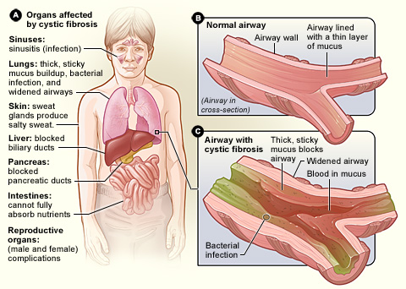
Organs affected by Cystic Fibrosis

Slide 12
Symptoms
**Because there are over a thousand different mutations of the Cystic Fibrosis gene, symptoms of Cystic Fibrosis vary **
Symptoms in a newborn
delayed growth
failure to gain weight normally
no bowel movements in the first 24 to 48 hours of life
salty tasting skin

Slide 13
Respiratory Symptoms
Respiratory Symptoms may include:
coughing and increased mucus
fatigue
nasal congestion with polyps
recurrent episodes of pneumonia which would include fever, increased coughing, increased shortness of breath, loss of appetite, and increased sputum
sinus pain and pressure from infection and polyps

Slide 14
Digestive Symptoms
Symptoms dealing with the digestive system include:
Stomach pain from constipation
Gas
Bloating
Swelling
Stools that are pale or clay colored, foul smelling, have mucus, or that float
Weight loss
Gallstones

Slide 15
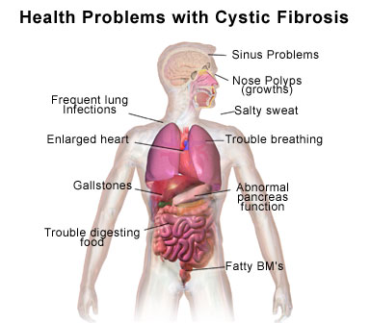
Symptoms

Slide 16
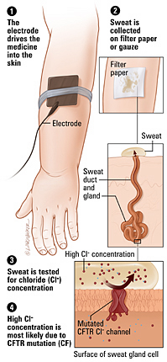
Testing for Cystic Fibrosis
In the United States, all newborns receive a standard screening test for cystic fibrosis – the immunoreactive trypsinogen (IRT) test. A high level of IRT requires further testing to make a definitive diagnosis
The “gold standard” test for diagnosing CF is the sweat test. A small electrode is placed on the arm to stimulate the sweat glands. The sweat is then collected and the chloride level is tested. A high level means the person definitely has Cystic Fibrosis.

Slide 17
Sweat Test
http://www.cff.org/AboutCF/Testing/SweatTest/
1:56

Slide 18
Testing for Cystic Fibrosis (Continued)
Genetic testing can also be done and is used if the results of a sweat test are still unclear. A blood sample or a swab from the cheek is sent to the lab where it is checked for the most common mutations of the CF gene.
Other tests used to identify problems related to CF include fecal fat tests, lung function tests, measurements of pancreatic fluid, upper GI and small bowel series, chest x-ray, and CT scans

Slide 19
Cystic Fibrosis: Radiographically
Radiographically, CF causes an appearance similar to severe chronic lung disease of adults.
There is generalized irregular thickening of linear markings throughout the lungs.
Early manifestations of CF are hyperinflations caused by the mucous obstructing the small airways. These same findings are common to other diseases such as bronchitis, asthma, and some pneumonias
As this disease progresses it is easier to tell from the x-ray that it is definitely cystic fibrosis and not another lung condition.

Slide 20
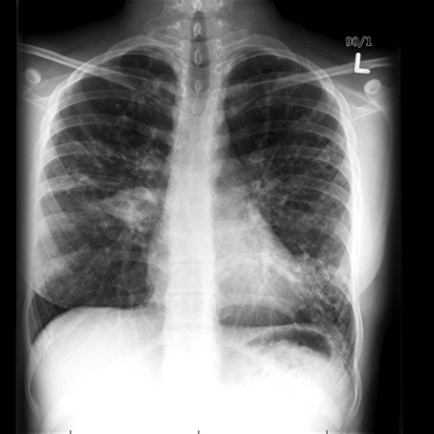
X-Rays of CF

Slide 21
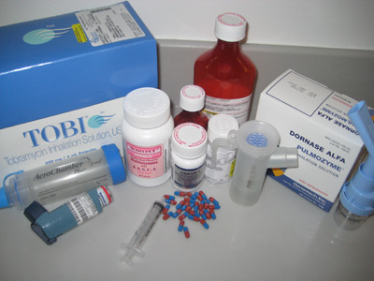
Treatments for CF
Currently there is no cure for cystic fibrosis. The most important factor for treatment is early diagnosis. This allows for the necessary treatment, follow up, and monitoring necessary to improve quality of life and survival.
Every CF patient must always take a pancreatic enzyme supplement to aid digestion of fats and proteins, a multi-vitamin, do some form of airway clearance (chest percussions), take aerolized medicines in a nebulizer, drink plenty of fluids to combat excessive sweating and help thin mucus, and exercise regularly (but no contact or endurance sports)

Slide 22
Treatments for CF
Specific treatment for respiratory problems include antibiotics to treat and/or prevent infections, DNAse enzyme therapy to thin mucus so that it can be expelled by coughing, flu and pneumonia vaccines, lung transplants (in some cases), and oxygen as the disease progresses
Specific treatment for digestive problems includes a high protein, high calorie diet, and stool softeners

Slide 23
Research to Keep Airways Clear
http://www.dnaindia.com/health/report_video-games-help-cystic-fibrosis-patients-keep-their-airways-clearer_1538169

Slide 24
Case Study
A male patient now 19 years old was diagnosed with cystic fibrosis before the age of one. After suffering what doctors first diagnosed as several bouts of bronchitis, coupled with his slow weight gain, the patient was sweat tested for cystic fibrosis. This test came out to be positive. Since then the patient goes to the cystic fibrosis clinic every four months or as his condition warrants. The patient has remained in fairly good health thanks to a regiment of daily inhalation treatments, chest percussions, and enzyme supplements to aid digestion as well as a high protein, high calorie diet. The patient also follows a changing antibiotic regiment to combat infections. His primary disease symptom has been pulmonary congestion causing shortness of breath and intermittent fevers.

Slide 25
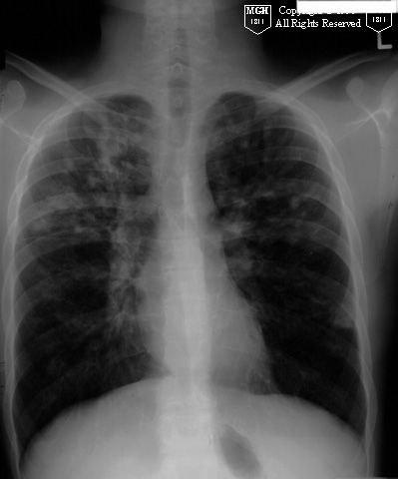
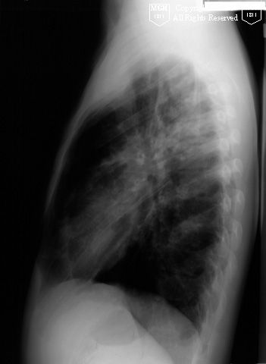
Case Study
The following chest x-rays show patchy air space disease in the right middle and upper lobes and lingula accompanied by bronchiectatic changes. This is caused by the excess formation of mucous that is a symptom of CF.

Slide 26
Summary
Cystic Fibrosis is an inherited disease caused by a defect in the CTFR
This gene makes a protein that controls the movement of water and salt out of the cells.
A child who inherits a defective CTFR gene from each of their parents will have cystic fibrosis.
A person with one defective gene will be a carrier, will never have symptoms, and will probably never know that they are a carrier unless they have genetic testing done.

Slide 27
Summary
The disease affects all your secretory glands including your mucus and sweat glands.
It predominantly affects a person lungs and pancreas due to mucus that thickens, becomes sticky and blocks airways (lungs) and ducts (pancreas).
Overtime repeated lung infections cause permanent damage and severe breathing problems.
The duct blockages result in vitamin deficiencies and malnutrition.
Because salt does not move out of cells correctly, a person with CF has very salty sweat which in turn leads to mineral balance upsets. This causes things like dehydration, increased heart rate, tiredness, decreased blood pressure, and heat stroke

Slide 28

Awareness
About a thousand new cases of Cystic Fibrosis are diagnosed each year.
Each of these people will someday die of complications from the disease since there is no cure.
Treatments have improved dramatically and can increase both a patient’s quality of life and life span.
Today it is not unusual for a CF patient who takes good care of themselves to live into their mid-thirties/forties.
If you or someone you know has this disease, encourage them to learn as much as they can about it.
For additional information you can go to http://www.cff.org/

Slide 29
References
About CF: Causes, Signs & Symptoms of Cystic Fibrosis | CF Foundation. (n.d.). Cystic Fibrosis
Foundation - Home. Retrieved March 11, 2011, from http://www.cff.org/AboutCF/
Bontrager, K, Lampignano, J. Textbook of Radiographic Positioning and Related Anatomy.
7th ed. St. Louis, MO: Mosby, 2010.
Cystic Fibrosis - All Sections (printer-friendly). (n.d.). National Heart, Lung and Blood Institute.
Retrieved March 10, 2011, from http://www.nhlbi.nih.gov/health
Cystic Fibrosis Foundation – About Cystic Fibrosis. (n.d.). Cystic Fibrosis Foundation - Home.
Retrieved March 9, 2011, from http://www.cff.org/AboutCF/
Cystic fibrosis - Genetics Home Reference. (n.d.). Genetics Home Reference - Your guide to
understanding genetic conditions. Retrieved March 12, 2011, from
http://ghr.nlm.nih.gov/condition/cystic-fibrosis
Cystic fibrosis - PubMed Health. (2010, July 14). National Center for Biotechnology
Information. Retrieved March 10, 2011, from
http://www.ncbi.nlm.nih.gov/pubmedhealth

Slide 30
References
Cystic Fibrosis. (n.d.). Medicine Net. Retrieved March 29, 2011, from
http://www.medicinenet.com/cystic_fibrosis /article.htm
Eisenburg, R. L., & Johnson, N. M. (2007). Comprehensive Radiographic Pathology (4th ed.). St. Louis: Mosby elsevier.
Pickerman, K. (2009, January 26). Cystic Fibrosis Life Expectancy Statistics. Disability News, Information and Resources - Disabled World. Retrieved April 11, 2011, from http://www.disabled-world.com/health/respiratory/cystic-fibrosis/life- expectancy.php
Simon, R. (2010, August 5). Cystic fibrosis: Overview of the treatment of lung disease.
UpToDate Inc.. Retrieved March 14, 2011, from
http://www.uptodate.com/contents/cystic-fibrosis-overview-of-the- treatment-of-lung-
disease?source=search_result&selectedTitle=3%7E150

