Slide 1
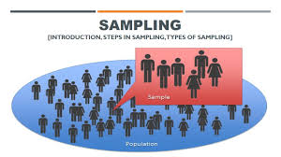
Health Research Methods, PHHI 522
Sampling
Mohammed R. Alanazi, PhD
Chief of Curriculum Development in Military School for Health Sciences
Joint Assistant Professor in King Saud bin Abdulaziz University for Health Sciences
Research Fellow in Monash University, Australia

Slide 2
Learning Objectives:
On completion of this session, you should be able to demonstrate your understanding of:
Sampling concepts:
Population, sample, sampling frame, parameter and statistics, sampling error, sampling bias, inclusion and exclusion criteria
Probability and non-probability sampling approaches
Various types of probability sampling
Various types of non-probability sampling
Sample size & factors influence determination of sample size
Checklist to evaluate the sampling section in research proposal

Slide 3
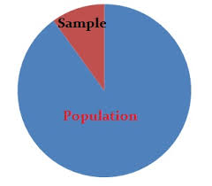
Sampling Concepts
Population
Sample
Sampling frame
Parameter and statistics
Sampling error
Sampling bias
inclusion and exclusion criteria

Slide 4
Sampling Concepts:
Population:
The entire group of persons or objects that is of interest to the researchers; i.e. meets the criteria which is researcher is interested in studying
Sample:
a part or fraction of a whole, or a subset of a larger set, selected by the researcher to participate in a research study.
Sampling frame:
a comprehensive list of the sampling elements in the target population.
inclusion and exclusion criteria:
those to include and/or exclude participants

Slide 5
Sampling Concepts:
Parameter and statistics
Parameter: a specific measure or numerical value that relates to the population
Statistics: the corresponding measures, or numerical values or quantities of a sample.
Sampling error
The difference between a sample statistic and a population parameter.
Larger sample & more homogeneous population = smaller sampling error
Sampling bias
Caused by researcher
Samples are not carefully selected

Slide 6
Sampling Approaches
Probability or random sampling
Non- probability sampling

Slide 7
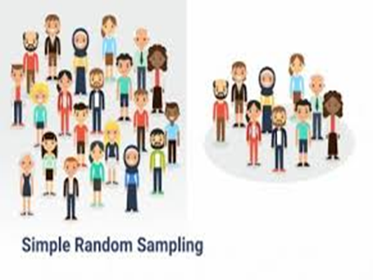
Probability or random sampling
Sample more likely to represent population
All elements in population have equal chance of being included in the sample
Findings can be generalized
Availability of a list of all members of population

Slide 8
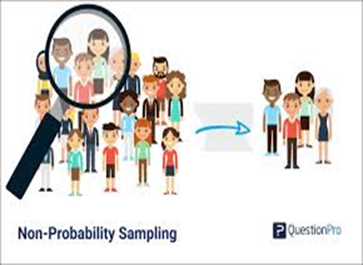
Non- probability sampling
may or may not represent the population
require researcher to judge and select subjects who know the most about the phenomenon
unable to locate the entire population
limited access to the subjects or elements

Slide 9
Probability or random sampling:
Simple random
Systematic or interval
Stratified random
Cluster random

Slide 10
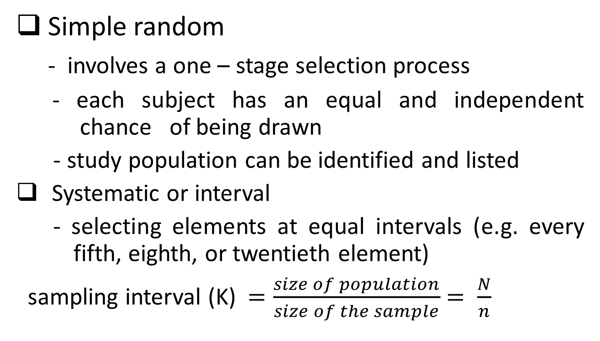
Probability or random sampling
Simple random
- involves a one – stage selection process
- each subject has an equal and independent chance of being drawn
- study population can be identified and listed
Systematic or interval
- selecting elements at equal intervals (e.g. every fifth, eighth, or twentieth element)
sampling interval (K) $=\frac{size of population}{size of the sample}$ $= \frac{N}{n}$

Slide 11

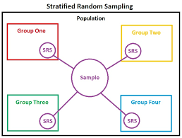
Probability or random sampling
Stratified random
- Adv. provide representation of a particular segment of population
- Dis Adv. Require extensive knowledge of pop.
costly

Slide 12
Probability or random sampling
Cluster random
used in large – scale studies
can’t obtain a total listing of some population
take places in stages
Adv. more economical in terms of time & costs
Dis Adv. more sampling errors & complexity in statistical data

Slide 13
Non- probability sampling
Convenience sampling
Quota sampling
Purposive/ theoretical/ judgmental sampling
Snowball sampling

Slide 14
Non- probability sampling
Convenience sampling
elements included in sample because they happen in right place at the right time
e.g: first 20 pt. arriving clinic
Or. Pts. available in a specific ward on a certain day
Quota sampling
Equivalent to stratified sampling
Researcher determine which strata are to be studied
Researcher determine a quota, or number of participants needed for each group.
proportionate vs. disproportionate

Slide 15
Non- probability sampling
Purposive/ theoretical/ judgmental sampling
based on judgment of researcher
More in qualitative research
Adv. subjects selected based on knowledge of phenomena being studied
Dis Adv. Sampling bias & generalization issue
Snowball sampling
Consists of different stages
Study subjects assist obtaining other potential subjects
e.g. research to help people stop smoking

Slide 16
Sample Size
Factors influence determination of sample size
Precision of data –collection instrument
(less precise the tool, the larger the sample needed)
Heterogeneity of the population
(10 subjects for each variable)
Incidence of type of subject in the population
(incidence of study phenomenon rare, large number required)

Slide 17
Sample Size
The larger the sample, the better it is (not always)
Sample size not enough can give misleading results
Over large – sample = increase cost , increase complexity of analysis process
Power Analysis: enable researcher to determine the appropriate sample size

Slide 18
Power analysis
Type I error (alpha or α ) 0.05
Type II error (beta or β ) 0.20
Power (1 – β ) 0.8
Effect size (∆)
The directionality / non directionality (one-tailed / two –tailed)

Slide 19
Checklist to evaluate the sampling section in research proposal
Are the target pop. & sample described?
Was a probability or non-probability sampling method used?
Is specific sampling method or technique named and described?
Does type of sample fit with type of design?
Does type of sample fit with purpose of study?
Are inclusion or eligibility & exclusion criteria listed?
Is the sample size & power analysis calculated?

Slide 20
Exercises

Slide 21
Conclusion
Sampling is a powerful tool for health research
Well –designed samples require careful planning
Ability to generalization is not completely certain

Slide 22

Thank you
Questions or Comments

