Slide 1
Samsung Competition with Apple
Student’s Name
Institution

Slide 2
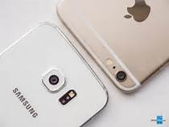
INTRODUCTION
Samsung and apple business organization are the leading brands in massive sales of electronic in the globe.
Both Apple and Samsung change with a change in technological advancement thus meeting customers’ needs and wants.
Notes:
Samsung and apple business organization are the leading brands in massive sales of electronic in the globe. Both Apple and Samsung change with a change in technological advancement thus meeting customers’ needs and wants. Apple business organization was established by Steve Wozniak, Steve Jobs and Ronald Wayne in 1976 (Heracleous, 2013). Apple was launched as a computer business company. Apple business organization produces products such as iPods, iTunes, iTouch, iCloud, Macintosh laptops, desktops, and computers.
, Samsung is also an outstanding organization as it has established its brand across the world. It operates a variety of electronic appliances and technology. Samsung is a South Korea based company but operates mostly in Europe, Asia, and the United States. Samsun entered the electronic industry in 1960.

Slide 3
Competitive Strategy between Samsung and Apple Company.
Apple Company
Samsung Company
It uses blue ocean strategy.
the Apple company immune to new entrant following Porter's five forces.
It uses a red ocean strategy.
Samsung is vulnerable to the porter five forces. Thus, it is vulnerable to threat of new entrants.
Notes:
Since Apple and Samsung companies are in fierce completion of the Smartphone market, they do employ different market strategies. Apple being the pioneer of smartphones it uses blue ocean strategy (Jaruzelski, Loehr, and Holman 2011). It uses blue ocean strategy.
the Apple company immune to new entrant following Porter's five forces.
Samsung Company uses a red ocean strategy. The red strategy involves a company to work on an already existing product, but it exploits existing product weaknesses and develops on them to gain a competitive advantage

Slide 4
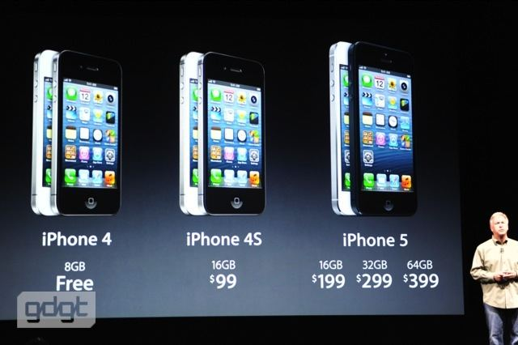
Strategies put in place to enhance Apple competitive position
Apple Company is focusing on improving its competitive position by enhancing the already existing iPhone products rather than focusing on producing a new, different type of smartphone (Lee and Lee 2007). For example transformation of iphone 4 to iPhone 5.
Notes:
The Apple Company is focusing on improving its competitive position by enhancing the already existing iPhone products rather than focusing on producing a new, different type of smartphone (Lee and Lee 2007). Thus, the apple company focus on improving its existing products since carrying out research to produce a new and unique product will cost the organization a considerable amount of money and time. For example, iPhone 4 did not have tangible innovation; thus the company improved its size and other features introducing iPhone 5 in the smartphone market.

Slide 5
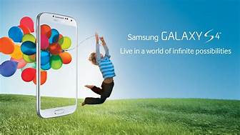
Strategies put in place to enhance Samsung competitive position
Samsung invests much of investment to carry out research that will help the organization identify the weaknesses of Apple products to improve on them.
Samsung floods the smartphone market with a new smartphone of different types targeting to varying customers from different dynamics.
Samsung creates awareness of the new products through adverts.
Notes:
As noticed earlier main competitive strategy of Samsung Company is building on the inadequacies of its smartphone competitors. Unlike Apple, Company Samsung invests almost 6% of its total revenues on research (Olsen, 2011). Also, Samsung invests heavily on its marketing thus reaching out to new potential customers in the globe. As I did mention earlier, Samsung floods the smartphone market with a new smartphone of different types targeting to varying customers from different dynamics.

Slide 6
Possible shifts for Apple companies to enhance competitive advantage in the future.
Apple is likely to create a variety of new products to meets the needs and wants of its customers, as it is one of the main weakness being exploited by the majority of its competitors such as Samsung.
Apple needs to indulge in product advertising to attract more customers.
Notes:
In the market. Apple is likely to create a variety of new products to meets the needs and wants of its customers, as it is one of the main weakness being exploited by the majority of its competitors such as Samsung. Also, Apple needs to indulge in product advertising as it will attract most customers

Slide 7
Possible shifts for Samsung company to enhance competitive advantage in the future.
The Samsung product is relatively cheap compared to the apple products.
Samsung has to be patient until its competitors produce a new product to improve on the same product with new features.
to invest more on research to come up with that unique product.
Notes:
Samsung is likely to change this competitive strategy in the future. Besides, Samsung Competitive force lies in research. It means Samsung Company need to invest more on research to come up with that unique product. Thus, it will be possible to turn around smartphone market favor on itself however Samsung companies had to establish a measure to ensure that research on a new product does not take long as it might limit Samsung from flooding the smartphone market with new phones.

Slide 8
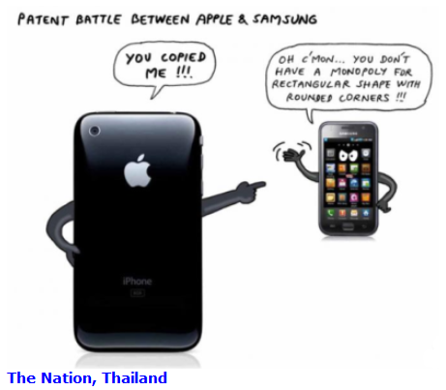
Samsung Company weakness
lacks innovation; thus it waits for its competitors to come up with a product then develops on its own with improving on its competitors’ products (Chang Kim, and Joo, 2013)
Samsung has filled in the market niche through the production of low priced products to apple, this might make Samsung vulnerable as customers might think that Samsung offers low-quality products)..
Notes:
Samsung Company lacks innovation; thus it waits for its competitors to come up with a product then develops on its own with improving on its competitors’ products (Chang Kim, and Joo, 2013). This strategy of improving on other companies’ product might backfire in the future as customers might think that Samsung Company duplicates rather than manufacturing unique products.
Although Samsung has filled in the market niche through the production of low priced products to apple, this might make Samsung vulnerable as customers might think that Samsung offers low-quality products.

Slide 9
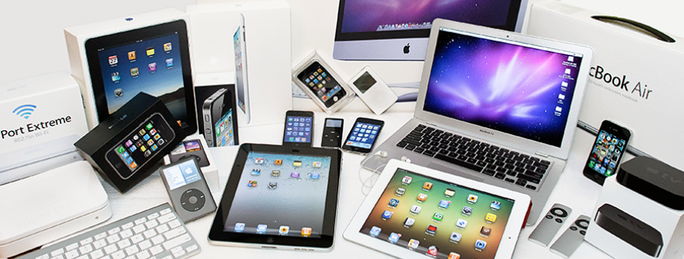
Apple Company weakness
Apple company lack product diversification as it only manufactures one product line that iPhone for the smartphone market.
Notes:
While on the other hand Apple company lack product diversification as it only manufactures one product line that iPhone for the smartphone market.

Slide 10
Conclusion
Both Apple Samsung is one of the most significant sales of smartphones in the world.
They sell almost have of smartphones in the world compared to other business organization but both organisation are fierce competitive rivals.
Both use different competitive strategy to retaliate or to acquire their position in the smartphone market.
Notes:
Apple was the dominant smartphone producer before Samsung overthrew it. Thus, it means that Apple Company thrives on retaining its initial position in the smartphone market. While Samsung, on the other hand, thrives on retaining its acquired competitive advantages over Apple company. For instance, the growth of Samsung Company can be attributed to its competitive strategy of flooding the smartphone market with a new, unique, variety of smartphones in the market for an extended period of time.
Moreover, Samsung products are relatively cheap compared to the apple products. As discussed before, Samsung develops its products.

Slide 11
References
Chang, Y., Kim, J., & Joo, J. (2013). An exploratory study on the evolution of design thinking: Comparison of Apple and Samsung. Design Management Journal, 8(1), 22-34.
Heracleous, L. (2013). Quantum strategy at apple inc. Organizational Dynamics, 42(2), 92-99.
Lee, W., & Lee, N. S. (2007). Understanding Samsung's diversification strategy: The case of Samsung Motors Inc. Long Range Planning, 40(4-5), 488-504.

