Slide 1
Sandpiper
Elizabeth Bishop

Slide 2
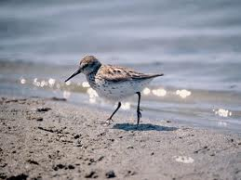
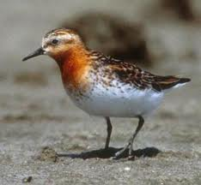
Sandpiper

Slide 3
“He runs, he runs to the south, finical, awkward”
finical [ fin-i-kuhl ] adjective
finicky.

Slide 4
“in a state of controlled panic, a student of Blake”
William Blake (1757-1827; see pp. 732-47), English poet, whose 1803 poem "Auguries of Innocence" begins,
"To see a World in a Grain of Sand
/And a Heaven in a Wild Flower, /
Hold Infinity in the palm of your hand /
And Eternity in an hour.
The little bird in "The Sandpiper" is a "student of Blake," looking for eternity in the grains of sand

Slide 5
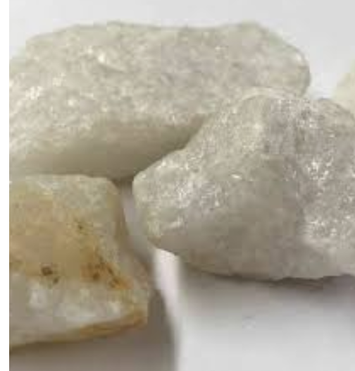
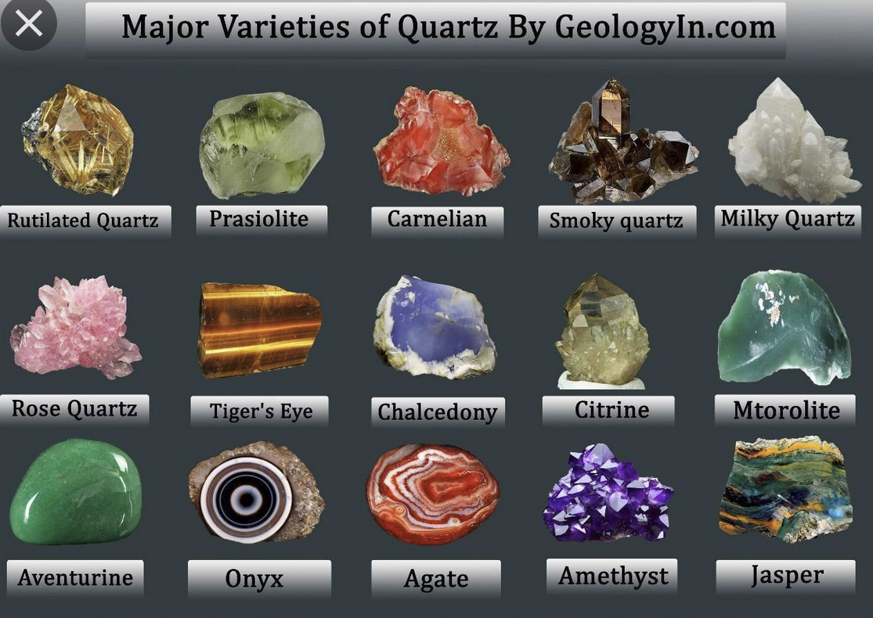

“The millions of grains are black, white, tan, and gray, mixed with quartz grains, rose and amethyst.”

Slide 6
Plot Summary: ignoring the Big Picture, preoccupied by the Small details
Stanza 1: Sandpiper is able to take into stride, accept somewhat (in controlled panic”) or ignore the immense, destructive forces of the ocean/nature (“roaring” “world…bound to shake”) because he is “a student of Blake absorbed in a process, focusing on particularities and takes for granted the enormous ocean
Stanza 2: Though again threatening “hisses” and disrupting “interrupting” forces of nature should draw his attention, the sandpiper runs along focused only on his toes.

Slide 7
Plot Summary
Stanza 3: Bishop corrects herself and tells us that he is not watching his toes, but grains of sand. But he might as well be watching his toes, because the sandpiper completely ignores the regular transformations his “world” undergoes: the changing nature of the beach.
Stanza 4: A description of the “big picture” that the poet provides, or the sandpiper is cognizant of but thinks irrelevant because he is focused, preoccupied with….
Stanza 5: searching, “looking for something.” Perhaps obsessed with the beauty and splendor of universe that he espies in the grains of sand.

Slide 8
Tension in the poem
Tension is btw
the big picture
small details
Engrossed in the small details, one can fail to see the big picture.

Slide 9
Theme 1: Observation of nature/world
Observation of small details
SHOULD (but sometimes doesn’t) LEAD TO
The big picture.

Slide 10
Theme 2: Searching for constants
Searching for constants ---
in a (picture) ever-changing/Transforming
/Unsettling world

Slide 11
Theme 3: search for “something” “constants”
And finding
Beauty and splendor of the universe

