Slide 1

OMGT1039
Operations Management
Week 10
Scheduling

Slide 2
Learning Objectives
  Explain what scheduling involves and the importance of good scheduling
  Compare product and service scheduling hierarchies
  Describe scheduling needs (job shops)
  Use and interpret Gantt charts
  Use the assignment method for loading
  Give examples of commonly used priority rules

Slide 3
Scheduling
Scheduling:
  Establishing the timing of the use of equipment, facilities and human activities in an organization
Effective scheduling can yield
    Cost savings
    Increases in productivity
    Other benefits

Slide 4
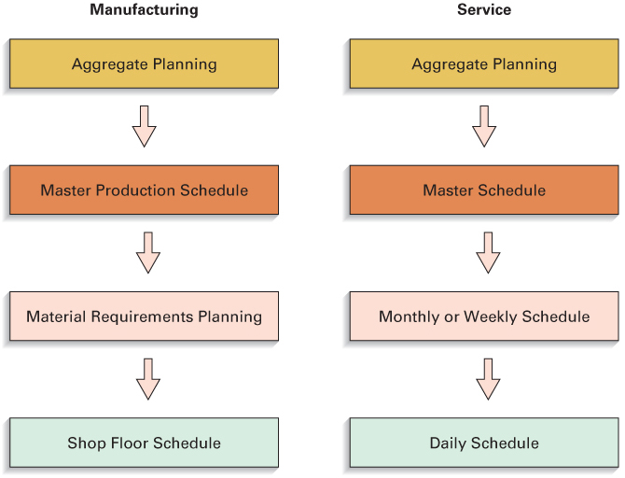
Scheduling Hierarchies

Slide 5
Scheduling Approaches
Forward scheduling
  Scheduling ahead from some point in time.
  Used when the question is:
    “How long will it take to complete this job?
Backward scheduling
  Scheduling backwards from some due date
  Used when the question is:
    “When is the latest this job can be started and still be completed on time?”

Slide 6

Job shop scheduling
  Scheduling for low-volume systems with many variations in requirements
    Make-to-order products
    Processing requirements
    Material requirements
    Processing time
    Processing sequence and setups
  A complex scheduling environment
    It is impossible to establish firm schedules until actual job orders are received

Slide 7
Job shop scheduling
1. How to distribute the workload?
2. What job processing sequence to use ?
Loading
  the assignment of jobs to processing centers
  Gantt chart
    Used as a visual aid for loading and scheduling purposes
    Purpose of the Gantt chart is to organize and visually display the actual or intended use of resources in a time framework
    Managers may use the charts for trial-and-error schedule development to get an idea of what different arrangements would involve

Slide 8
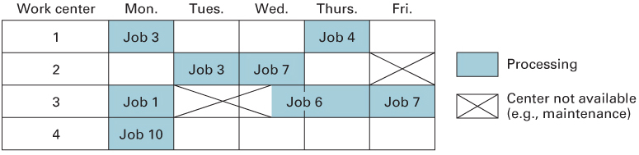
Loading
1. Load Gantt chart
  A Gantt chart that shows the loading and idle times for a group of machines or list of departments

Slide 9
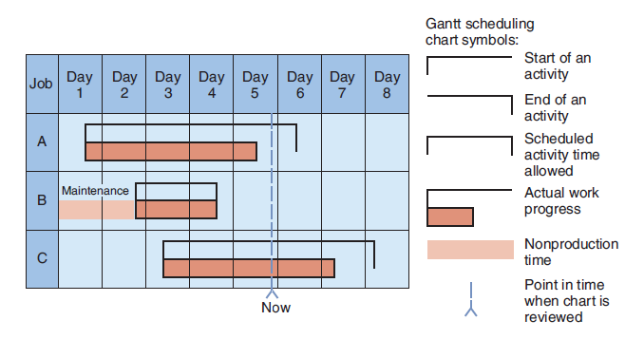
2. Schedule Gantt chart
  A Gantt chart that shows the orders or jobs in progress and whether they are on schedule
  Example¹:
  - Job A is about a half-day behind schedule at the end of day 5.
  - Job B was completed after equipment maintenance
  - Job C is ahead of schedule.
  ¹: Haizer and Render 2015 Operations Management Pearson

Slide 10
Assignment
Assignment model
  A linear programming model for optimal assignment of tasks and resources
Hungarian method
  Method of assigning jobs by a one-for-one matching to identify the lowest cost solution

Slide 11
Hungarian Method
Row reduction: subtract the smallest number in each row from every number in the row
  Enter the result in a new table
Column reduction: subtract the smallest number in each column from every number in the column
  Enter the result in a new table
Test whether an optimum assignment can be made
  Determine the minimum number of lines needed to cross out all zeros
  If the number of lines equals the number of rows, an optimum assignment is possible. Go to step 6
  Else, go to step 4

Slide 12
Hungarian Method (contd.)
If the number of lines is less than the number of rows, modify the table:
  Subtract the smallest number from every uncovered number in the table
  Add the smallest uncovered number to the numbers at intersections of cross-out lines
  Numbers crossed out but not at intersections of cross-out lines carry over unchanged to the next table
Repeat steps 3 and 4 until an optimal table is obtained
Make the assignments
  Begin with rows or columns with only one zero
  Match items that have zeros, using only one match for each row and each column
  Eliminate both the row and the column after the match

Slide 13
Example: Hungarian Method
Determine the optimum assignment of jobs to workers for the following data:
 |  | Worker
 |  | A | B | C | D
Job | 1 | 8 | 6 | 2 | 4
 | 2 | 6 | 7 | 11 | 10
 | 3 | 3 | 5 | 7 | 6
 | 4 | 5 | 10 | 12 | 9

Slide 14
Example: Hungarian Method (contd.)
 |  | Worker |  |  |  | Row minimum
 |  | A | B | C | D
Job | 1 | 8 | 6 | 2 | 4 | 2
 | 2 | 6 | 7 | 11 | 10 | 6
 | 3 | 3 | 5 | 7 | 6 | 3
 | 4 | 5 | 10 | 12 | 9 | 5
Subtract the smallest number in each row from every number in the row
 |  | Worker
 |  | A | B | C | D
Job | 1 | 6 | 4 | 0 | 2
 | 2 | 0 | 1 | 5 | 4
 | 3 | 0 | 2 | 4 | 3
 | 4 | 0 | 5 | 7 | 4

Slide 15
Example: Hungarian Method (contd.)
 |  | Worker
 |  | A | B | C | D
Job | 1 | 6 | 4 | 0 | 2
 | 2 | 0 | 1 | 5 | 4
 | 3 | 0 | 2 | 4 | 3
 | 4 | 0 | 5 | 7 | 4
Column min. |  | 0 | 1 | 0 | 2
Subtract the smallest number in each column from every number in the column
 |  | Worker
 |  | A | B | C | D
Job | 1 | 6 | 3 | 0 | 0
 | 2 | 0 | 0 | 5 | 2
 | 3 | 0 | 1 | 4 | 1
 | 4 | 0 | 4 | 7 | 2

Slide 16
Example: Hungarian Method (contd.)
 |  | Worker
 |  | A | B | C | D
Job | 1 | 6 | 3 | 0 | 0
 | 2 | 0 | 0 | 5 | 2
 | 3 | 0 | 1 | 4 | 1
 | 4 | 0 | 4 | 7 | 2
Determine the minimum number of lines needed to cross out all zeros. (Try to cross out as many zeros as possible when drawing lines
Since only three lines are needed to cross out all zeros and the table has four rows, this is not the optimum. Note: the smallest uncovered value is 1

Slide 17
Example: Hungarian Method (contd.)
 |  | Worker
 |  | A | B | C | D
Job | 1 | 6 | 3 | 0 | 0
 | 2 | 0 | 0 | 5 | 2
 | 3 | 0 | 1 | 4 | 1
 | 4 | 0 | 4 | 7 | 2
Subtract the smallest uncovered value from every uncovered number, and add it to the values at the intersection of covering lines.
 |  | Worker
 |  | A | B | C | D
Job | 1 | 7 | 3 | 0 | 0
 | 2 | 1 | 0 | 5 | 2
 | 3 | 0 | 0 | 3 | 0
 | 4 | 0 | 3 | 6 | 1

Slide 18
Example: Hungarian Method (contd.)
 |  | Worker
 |  | A | B | C | D
Job | 1 | 7 | 3 | 0 | 0
 | 2 | 1 | 0 | 5 | 2
 | 3 | 0 | 0 | 3 | 0
 | 4 | 0 | 3 | 6 | 1
Determine the minimum number of lines needed to cross out all zeros. (Try to cross out as many zeros as possible when drawing lines
Since four lines are needed to cross out all zeros and the table has four rows, this an optimal assignment can be made

Slide 19
Example: Hungarian Method (contd.)
 |  | Worker
 |  | A | B | C | D
Job | 1 | 7 | 3 | 0 | 0
 | 2 | 1 | 0 | 5 | 2
 | 3 | 0 | 0 | 3 | 0
 | 4 | 0 | 3 | 6 | 1
Make assignments: Start with rows and columns with only one zero. Match jobs with workers that have a zero
Assignment | Cost
2-B | $7
4-A | $5
1-C | $2
3-D | $6
Total | $20

Slide 20

Sequencing
Sequencing
  Determine the order in which jobs at a work center will be processed
Priority rules
  Simple heuristics used to select the order in which jobs will be processed
  The rules generally assume that job setup cost and time are independent of processing sequence
    Job time
      Time needed for setup and processing of a job

Slide 21

Priority Rules
FCFS - first come, first served
SPT - shortest processing time
EDD - earliest due date
CR - critical ratio
S/O - slack per operation
Rush - emergency
$$CR= \frac{Due date−current time}{Processing time}$$

Slide 22
Priority Rules: Assumptions
The set of jobs is known; no new orders arrive after processing begins and no jobs are canceled
Setup time is independent of processing sequence
Setup time is deterministic
Processing times are deterministic
There will be no interruptions in processing such as machine breakdowns or accidents

Slide 23

Sequence: Performance Metrics
Common performance metrics:
  Job flow time
    This is the amount of time it takes from when a job arrives until it is complete
    It includes not only processing time but also any time waiting to be processed
  Job lateness
    This is the amount of time the job completion time is expected to exceed the date the job was due or promised to a customer
  Makespan
    The total time needed to complete a group of jobs from the beginning of the first job to the completion of the last job
  Average number of jobs
    Jobs that are in a shop are considered to be WIP inventory

Slide 24
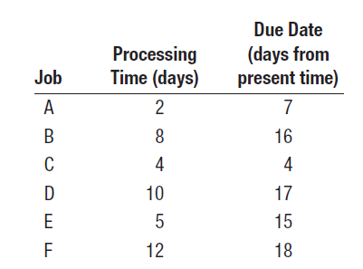
Priority Rules Example
Processing times (including setup times) and due dates for six jobs waiting to be processed at a work center are given in the following table. Determine the sequence of jobs, the average flow time, average tardiness, and average number of jobs at the work center, for each of these rules:
a. FCFS
b. SPT
c. EDD
d. CR
Assume jobs arrived in the order shown.

Slide 25
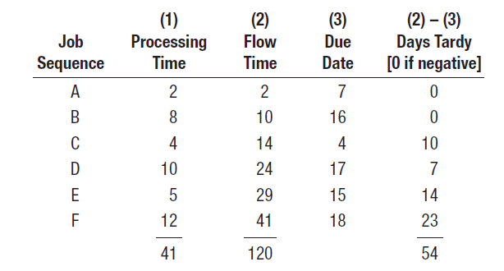
Priority Rules Example Solution
FCFS
(1) Average flow time: 120/6 = 20 days.
(2) Average tardiness: 54/6 = 9 days.
(3) The makespan is 41 days. Average number of jobs at the work center: 120/41 = 2.93.

Slide 26
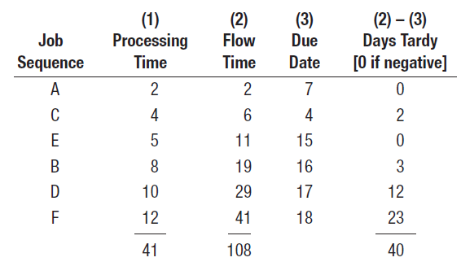
Priority Rules Example Solution
b. SPT
(1) Average flow time: 108/6 = 18 days.
(2) Average tardiness: 40/6 = 6.67 days.
(3) Average number of jobs at the work center: 108/41= 2.63.

Slide 27
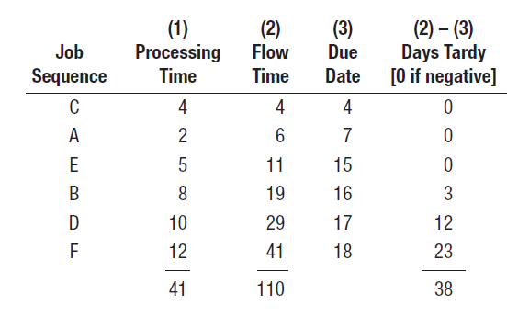
Priority Rules Example Solution
c. EDD
(1) Average flow time: 110/6= 18.33 days.
(2) Average tardiness: 38/6 = 6.33 days.
(3) Average number of jobs at the work center: 110/41 = 2.68.

Slide 28
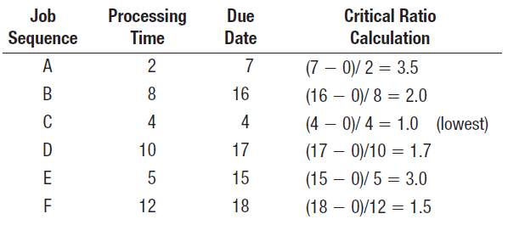
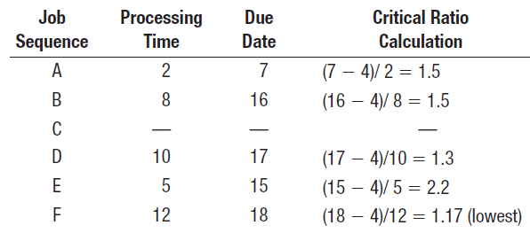

Priority Rules Example Solution
d. Critical Ratio
$$CR= \frac{Due date−current time}{Processing time}$$
At day 4 C completed
At day 16 C and F completed

Slide 29
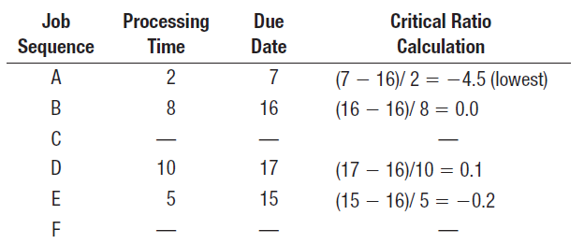
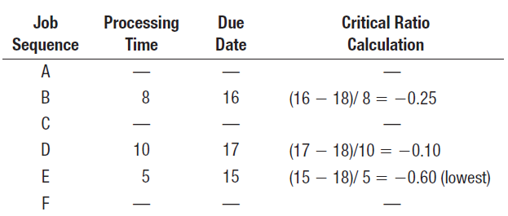
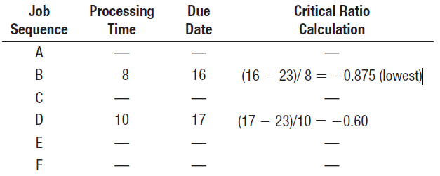
Priority Rules Example Solution
d. Critical Ratio
At day 18, C, F, and A
completed
At day 23, C, F, A, and E
completed
The job sequence is
C-F-A-E-B-D

Slide 30
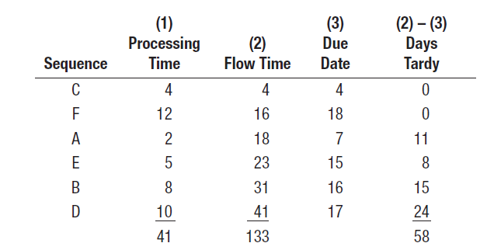
Priority Rules Example Solution
d. Critical Ratio
(1) Average flow time: 133/6 = 22.17 days.
(2) Average tardiness: 58/6 = 9.67 days.
(3) Average number of jobs at the work center: 133/41 = 3.24.

Slide 31
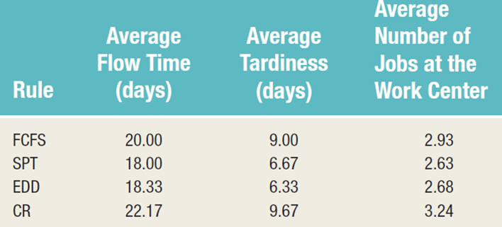
Priority Rules Example Solution

Slide 32
Two Work Center Sequencing
Johnson’s Rule
  Technique for minimizing makespan for a group of jobs to be processed on two machines or at two work centers.
    Minimizes total idle time
    Several conditions must be satisfied

Slide 33

Johnson’s Rule Conditions
Job time must be known and constant for each job at the work center
Job times must be independent of sequence
Jobs must follow same two-step sequence
All jobs must be completed at the first work center before moving to second work center

Slide 34
Johnson’s Rule: Optimum Sequence
List the jobs and their times at each work center
Select the job with the shortest time
  If the shortest time is at the first work center, schedule that job first
  If the shortest time is at the second work center, schedule the job last.
  Break ties arbitrarily
Eliminate the job from further consideration
Repeat steps 2 and 3, working toward the center of the sequence, until all jobs have been scheduled

Slide 35
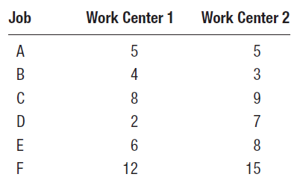
Johnson’s Rule: Example
A group of six jobs is to be processed through a two-machine flow shop. The first operation involves cleaning and the second involves painting. Determine a sequence that will minimize the total completion time for this group of jobs. Processing times are as follows:

Slide 36
Johnson’s Rule: Example
D
E
C
F
A
B
➔ Sequence ➔

Slide 37
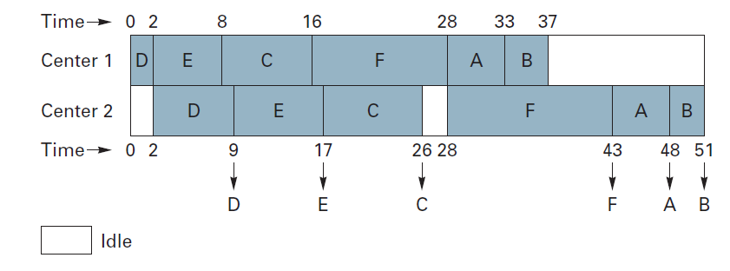

Slide 39
Questions

