Slide 1
Schizophrenia and substance disorders
Students Name
Institutional Affiliation
Course code and Name
Instructors Name
Date

Slide 2
Introduction
Schizophrenia spectrum disorder is a group of mental disorders that affect the body senses and feelings.
The disorder affects how one acts and thinks.
Schizophrenia is categorized into subtypes which include;
Residual
Paranoid
Disorganized and catatonic

Slide 3
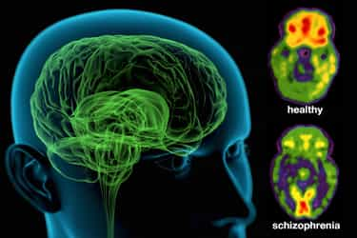
Symptoms
Some of the common symptoms of the disorder include
Hallucinations; one hear and sees things that are not happening.
Disorganized speech; speaking incomplete sentences which don’t make sense.
Abnormal behaviors; sitting still and being quiet for a long time.
Delusions; one thinks that they have superpowers and holds on strange beliefs.

Slide 4
Etiology
Schizophrenia disorder is caused by;
Genetic factors
Stress and childhood trauma
Substance use
Biochemical factors whereby some biochemical substances found in the brain are associated with the disorder.

Slide 5
Epidemology
More men are affected by schizophrenia compared to women.
The age of onset is at adolescent.
The disorder occurs worldwide.
Approximately 10000 new cases of schizophrenia are recorded annually.
In 2011, 20 million people were diagnosed with the disorder (De Crescenzo et.al, 2019).

Slide 6
Treatment
Treatment comprises of a combination of special care services, psychotherapy and medications.
Anti-tremor and antipsychotic are the common medications to treat the disorder.
Rehabilitation, behavioral therapy and psychoeducation help in modification of the patients psychological distress.
In most cases, the patients are treated by mental community teams.

Slide 7
Nicotine use disorder
Nicotine is a chemical found in tobacco that is much addictive.
It causes pleasing effects in the brain which are temporary.
The effects makes it difficult for one to stop using tobacco due to the need of the pleasant feeling.
One experiences unpleasant and disturbing physical and mental changes when trying to stop nicotine.

Slide 8
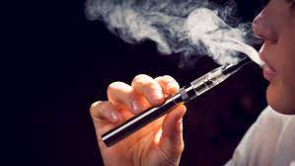
Symptoms
Some of the symptoms of nicotine disorder are;
One cant smoke smoking tobacco.
Withdrawal symptoms when they try to quit smoking.
Development of health smoking.
Giving up in community or social activities since one cant smoke in presence of their families and friends.

Slide 9
Etiology
The use of tobacco is influenced by factors such as;
Age, in that some people begin substance use while teenagers.
Parents and peers, especially where people grow up with smokers.
Mental illness, stress and depression.
Other substance abuse for example alcohol.

Slide 10
Epidemiology
Nicotine use disorder is mostly associated to men and young people.
Also, illiterate people and those with low incomes are frequent smokers hence affected by the disorder.
The dependency of tobacco use has led to lack of improvements and growth in life among the adolescent.

Slide 11
Treatment
Treatment involves;
The use of patch, which is a sticker applied on ones back to reduce nicotine levels in the body.
Nicotine gum, helps manage smoking cravings through chewing.
Inhaler, it provides nicotine doses through inhaling hence discouraging the use of tobacco (Prochaska, 2019).
The common medication prescribed comprise of bupropion and varenicline.

Slide 12
References
Prochaska, J. J., & Benowitz, N. L. (2019). Current advances in research in treatment and recovery: Nicotine addiction. Science advances, 5(10), eaay9763.
De Crescenzo, F., Postorino, V., Siracusano, M., Riccioni, A., Armando, M., Curatolo, P., & Mazzone, L. (2019). Autistic symptoms in schizophrenia spectrum disorders: a systematic review and meta-analysis. Frontiers in psychiatry, 10, 78.

