Slide 1
Shinto
Religion of Japan

Slide 2
Shinto- The Way of the Gods
The indigenous religion of Japan and it cannot be traced to a founder.

Slide 3
Prehistoric Period (Jamon Period)
Sacred kingship
Agricultural festivals, revering the dead, fertility
3 layers of the world
  Spirit controlled
  Human controlled
  Spirit Controlled (Yo mi- Land of the Dead)
Kami
  800,000 traditionally
  Yorishiro

Slide 4
Shinto Mythology (Jamon Period)
Izanagi and Izanami
Amaterasu (sun goddess)
Susanoo (storm god)
Salt- purification

Slide 5
Kamakura Period
Response to outside religions
Clan and village shrines
Shoguns
Syncretism

Slide 6
Tokugawa Period
Shogunate
Persecuted Christians
Merchant Class
Kokugaku (National Learning)
Shinto Reform
Kojiki edited
Tenrikyo (Nakayama Miki)
Bushido Code (Samurai Warrior)

Slide 7
Meiji Restoration
Emperor restored
Nationalism with state sponsored Shinto
Divinity of the emperor and the people
World War II
Shattering of national pride

Slide 8
Japanese Democracy
Religious Freedom

Slide 9
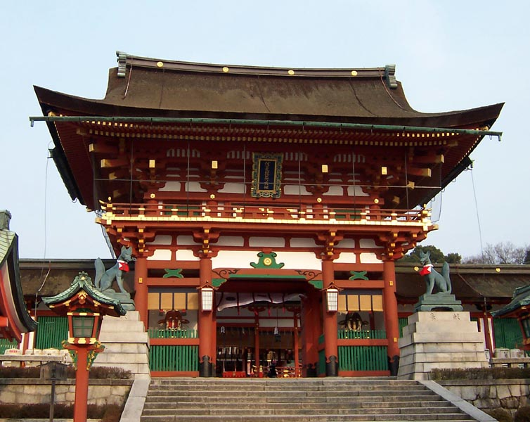
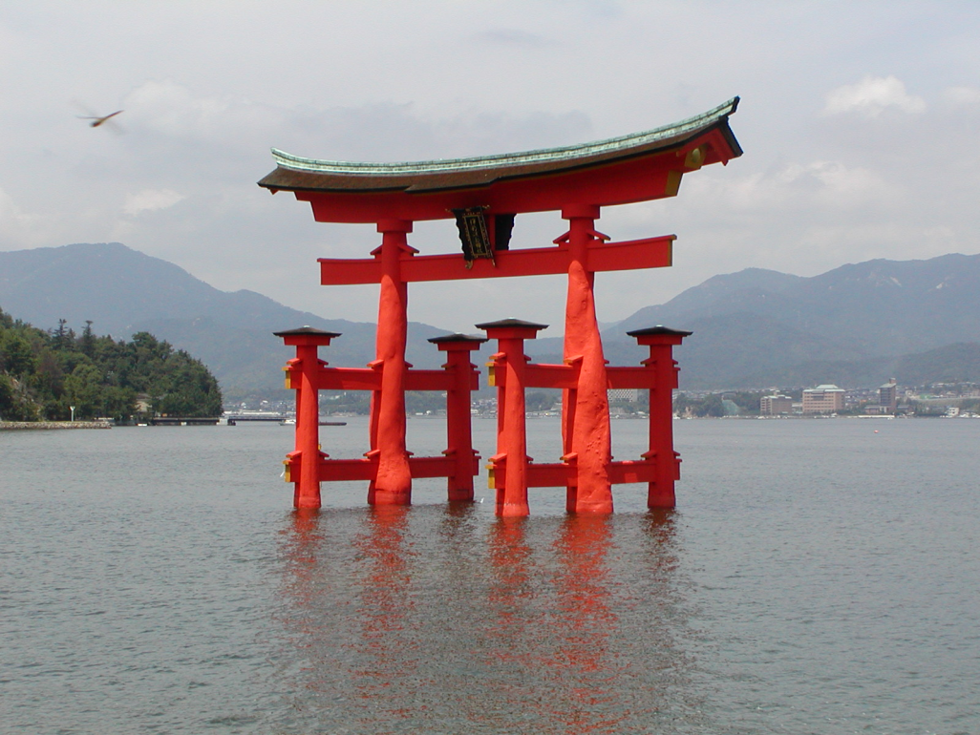
Main Gate of Fushimi Inari, one of the oldest Shinto shrines in Japan
Itsukushima Shrine - Shinto Shrine, Island of Miyajima, Japan

Slide 10
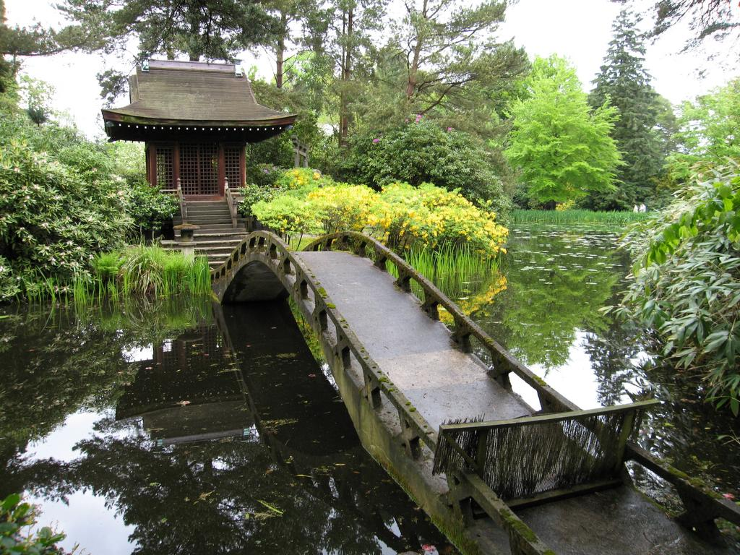
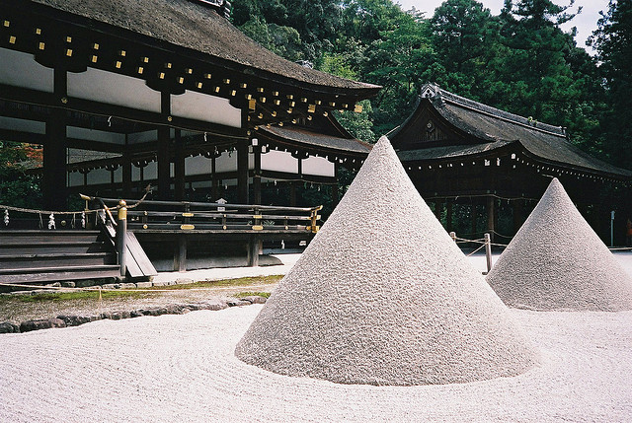
Kamigamo Shrine, Kyoto

Slide 11
Shinto is missing…
Founder
Written scriptures
Exclusionary patterns of worship
Rigid dogma
Strict formal doctrines or bodies of religious laws

Slide 12
Core Beliefs
Affirmation of family and tradition
Affirmation of reverence toward nature
Affirmation of physical cleanliness
The affirmation of matsuri, or festivals held in honor of one or more kami

