Slide 1
Still Life
Thom Gunn

Slide 2

Context: The devastating AIDS crisis of 1980s

Slide 3
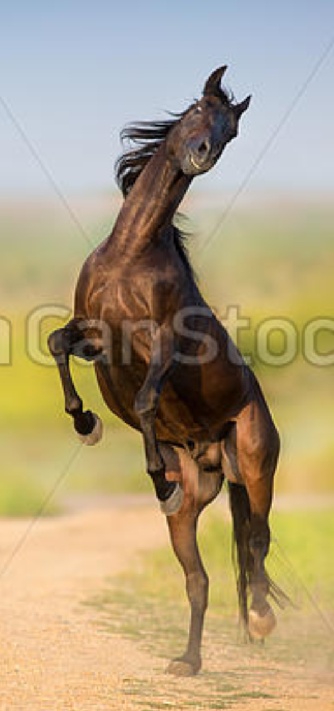
“The angle of his head,
Arrested and reared back
On the crisp field of bed,
suggesting a horse risen on its hind legs
Rearing occurs when a horse or
other equine "stands up" on its hind
legs with the forelegs off the ground.
Rearing may be linked to fright,
aggression, excitement, disobedience,
or pain. It is not uncommon to see
stallions rearing in the wild when
they fight, while striking at their
opponent with their front legs.

Slide 4
This is the rhythm you are hearing
x x / / x /
I shall | not soon | forget Note: ADV, VERBS, ADJ, NOUNS stressed
X / x / x /
The grey| ish-yell| ow skin
X / x / x /
To which | the face | had set: ← auxiliary verb doesn’t get a stress. Not main verb
/ / / x x x
Lids tight: | nothing | of his, ← his is a pronoun, so not stressed….
/ x x / x x
Played on | the sur| faces.

Slide 5
Plot Summary:
Stanza 1: No metaphors. Adjectives descriptive rather than comparative. Face of the patient sets into stillness. No sign of life. But there is still life in the dying man.
Stanza 2: Metaphoric image (of humiliation): suggesting a horse risen on its hind legs. Body of the patient paralyzed in this position. Survival, continued breathing depends on contortion (contorting one’s body and head): “It was an obscure knack” (obscure knack = grotesque trick).
Stanza 3: Metaphoric image: dire materiality of this frozen image: “The tube his mouth enclosed /In an astonished O.” Language itself as trope, as the metaphor. Invoking our senses (feeling of gagging). Humiliation of modern way of dying: unacceptable position of powerlessness: neither accept or reject the ventilator tube in the mouth.

Slide 6
Theme 1: Poetry is speech and breath
Gunn’s task to speak for the afflicted (sick with AIDS)
whose incapacity to speak, or even breathe on their own,
literalizes the way in which he must presume to speak for them.

Slide 7
Theme 2: Language itself as trope (metaphor)
Metaphoric inscription of AIDS
Works because it speaks to (invokes) our senses

Slide 8
Theme 3: Border region between life and death
Still Life

Slide 9
Theme 4: Humiliation of the modern way of dying
To be put into what should be an unacceptable position of powerlessness (3 Stanza):

