Slide 1
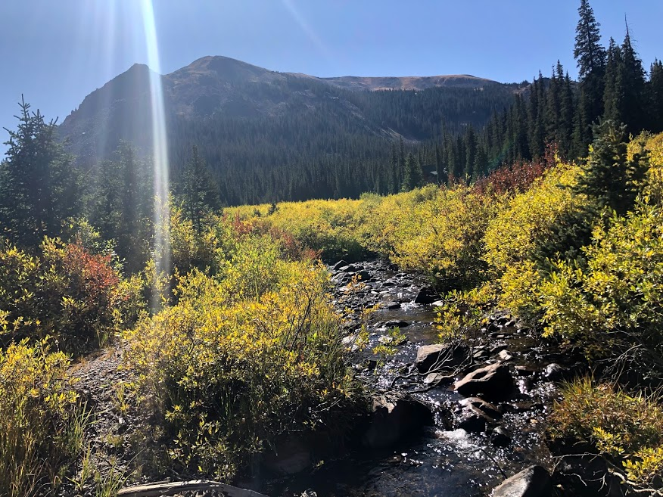
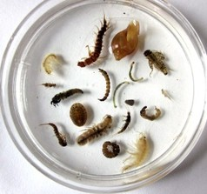

Stream Ecology

Slide 2
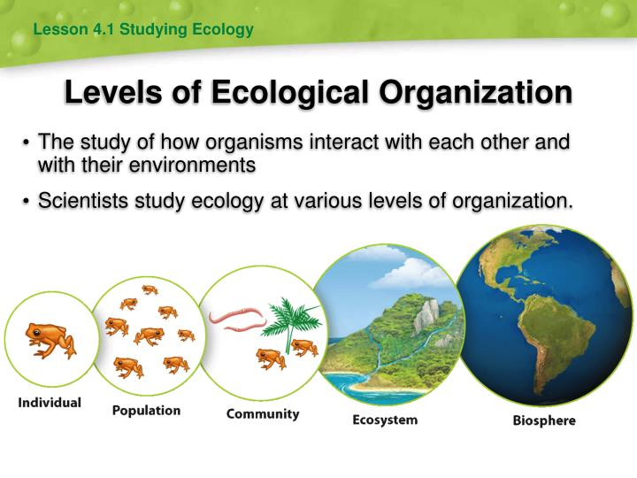
Ecology
Ecology: The study of how organisms influence and are influenced by their biotic (living) and abiotic (non-living) environment
In this lab you will be looking at a community of organisms in two locations within a stream

Slide 3
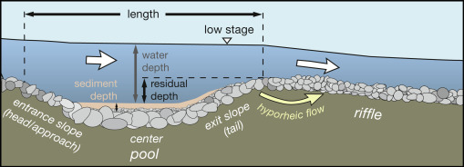
Habitats
Habitat: The particular type of environment within an ecosystem in which the organism lives
Stream habitats
  Pools: slow moving water, deeper
  Riffles: rapidly moving water, shallower

Slide 4
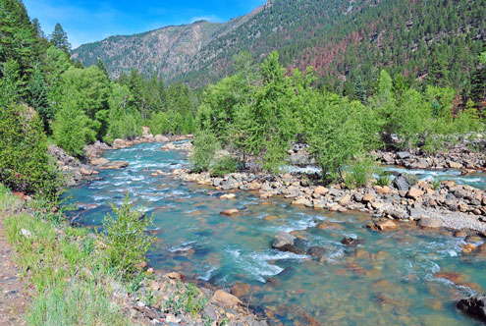
Habitats
Generalists: Live in a variety of habitats
Specialists: Limited to one habitat or microhabitat (small pockets of unique environments)
Niche: an organism’s “occupation”
  The habitat in which it lives
  Interactions with other animals

Slide 5
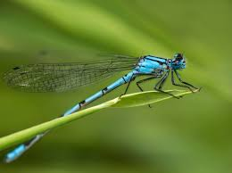
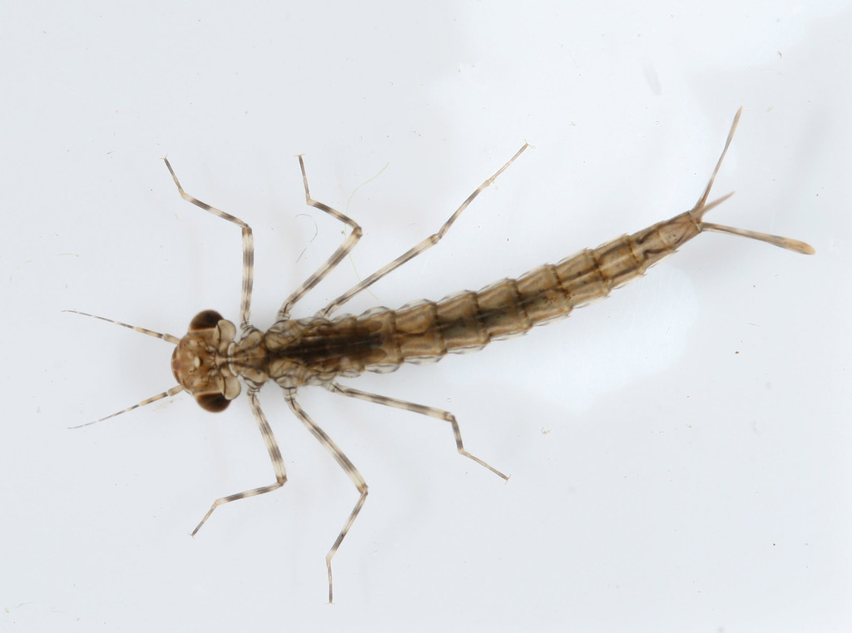
Indicator Species
Indicate change in a habitat, community, etc.
  In aquatic environments, insect larvae and/or nymphs that develop in streams are good bioindicators
  Example: Damselfly
    Presence of adults and nymphs indicates relatively clean water
    Sensitive to pollution

Slide 6

Abiotic Factors
Dissolved Oxygen
pH
Nitrate, Phosphate
Temperature
Flow Rate
Substrate
Sunlight: canopy cover over the stream
Biotic Factors
Primary Producers: photosynthesis
Primary Consumers:
Scrapers: eat algae attached to rocks
Shredders: feed on leaves, needles, and wood
Collectors: eat small particles of organic matter
Secondary Consumers:
Predators: feed on other animals

Slide 7
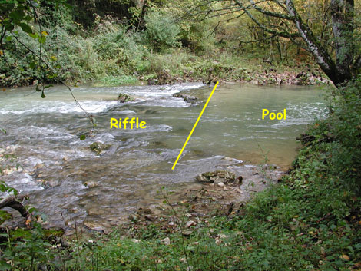
Pool vs.
Riffle
Also shown in the procedure video on Canvas!
Notes:
Maggie, let me know what you would like for this slide after you watch the video. It might be good enough to just put a still photo from one of the videos we made. Or to just get a photo online of a pool v. riffle, depending on what you want to discuss here.

Slide 8
Stream Organisms
Ephemeroptera | Mayflies | Aquatic nymph, terrestrial adult; nymphs found on the underside of rocks
Plecoptera | Stoneflies | Aquatic nymph, terrestrial adult; nymphs found among rocks in streams
Hemiptera | True bugs | Boatmen/water striders; found swimming in water, diamond shape on back
Odonata | Dragonflies & damselflies | Aquatic nymph, terrestrial adult; nymphs found in ponds, lakes, and streams
Diptera | True flies | Mosquito, cranefly, black fly, midge; aquatic larvae, terrestrial adults
Trichoptera | Caddisflies | Larvae abundant in nearly all ponds, lakes, streams; terrestrial adults
Coleoptera | Beetles | Whirligig beetle; often found in slow moving water

Slide 9
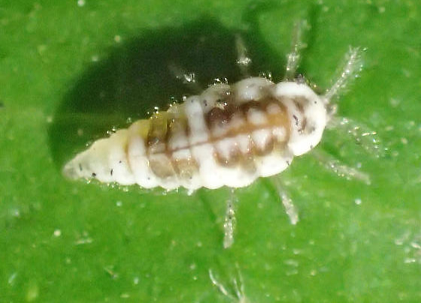
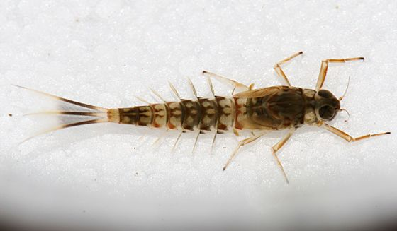
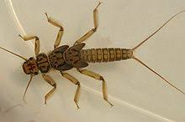
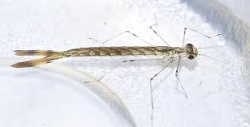
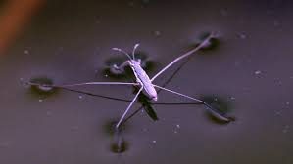
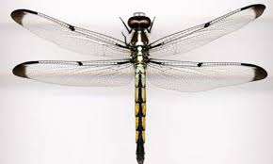
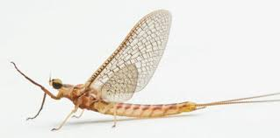
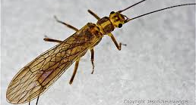
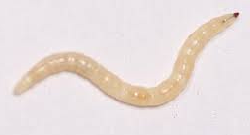
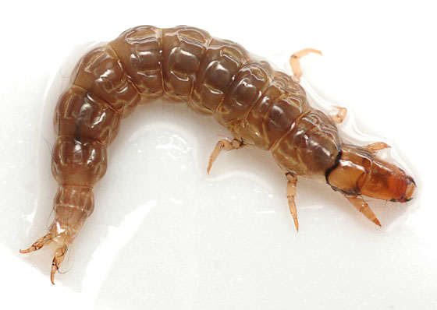
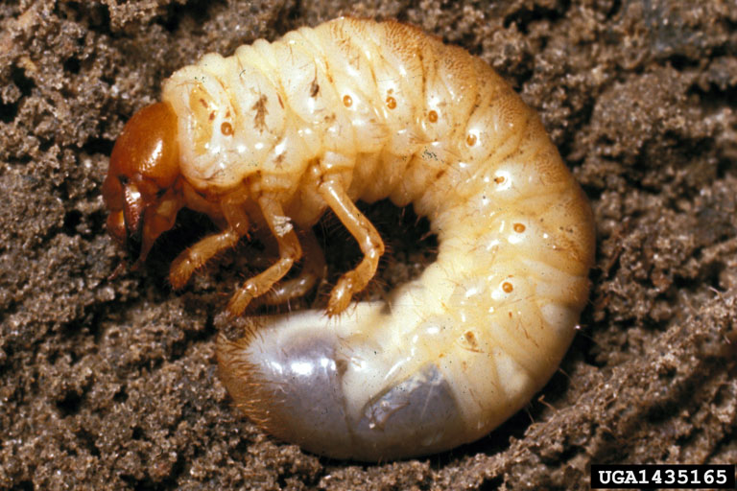
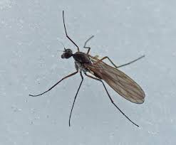
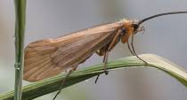
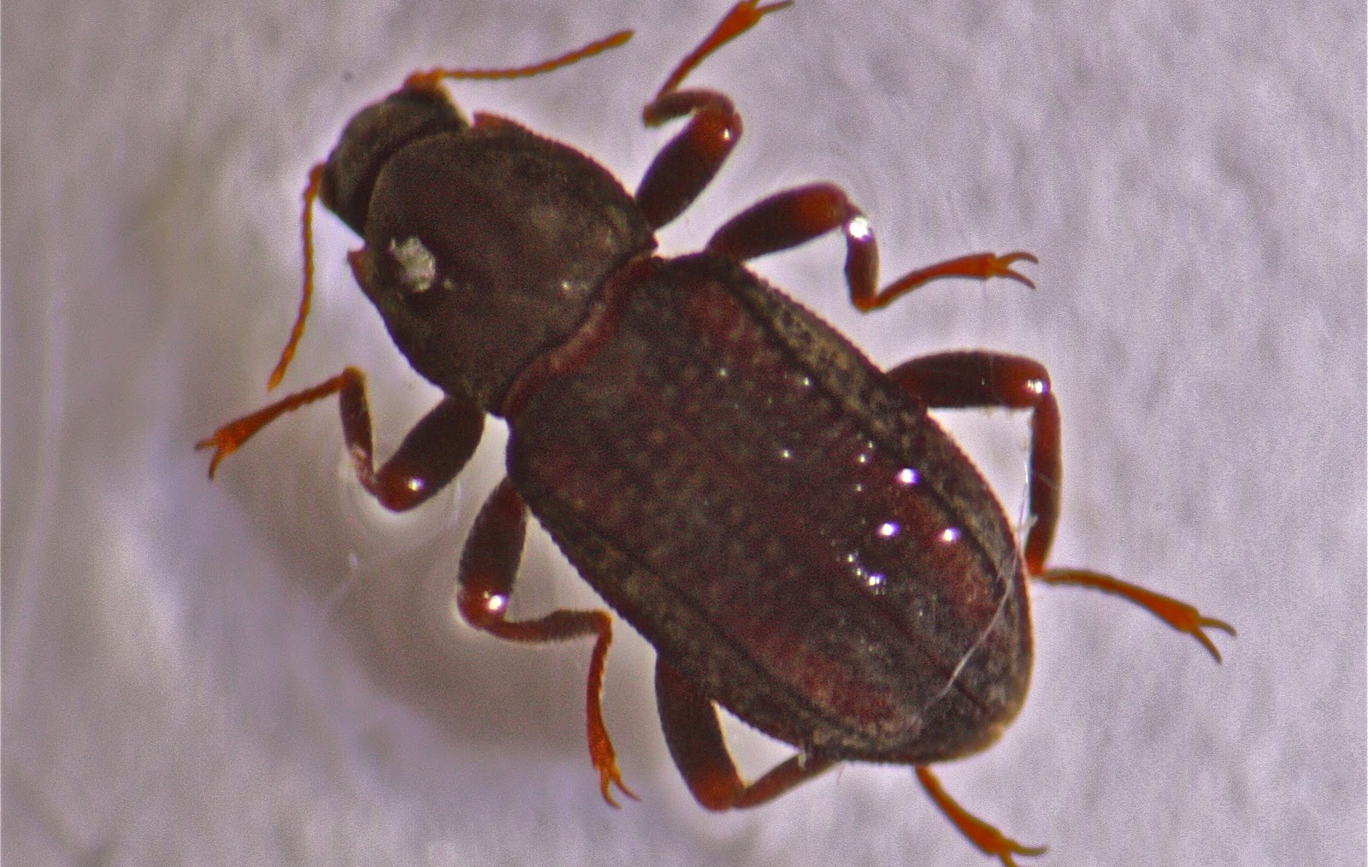
Ephemeroptera
Plecoptera
Hemiptera
Odonata
Trichoptera
Coleoptera
Diptera

Slide 10
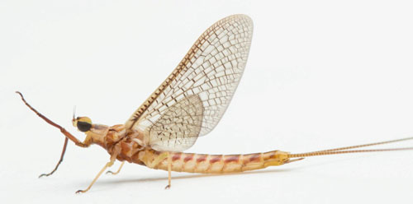
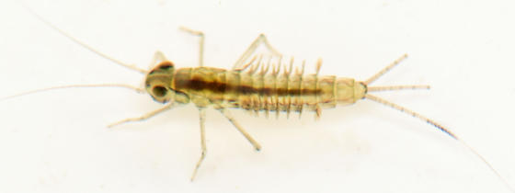
Incomplete Metamorphosis
Young individuals resemble the adults and are called nymphs
  Example: Ephemeroptera (mayflies)

Slide 11
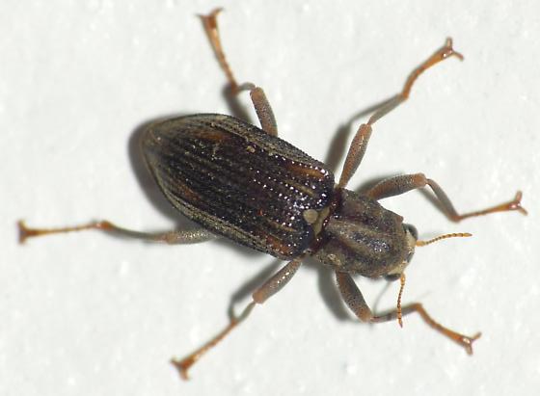
Complete Metamorphosis
Young individuals do not resemble the adults and are called larvae
  Example: Coleoptera (beetles)

Slide 12
Dichotomous Key (page 182)
A dichotomous key is used to decide between two choices. Once you decide, you will move on to another set of choices, until you finally are able to classify the individual
Page 182 offers a series of questions as well as used to classify the insects from the stream samples to their order

