Slide 1
Successful Collaboration
Name
Course Unit
Institution of Affiliation

Slide 2
Introduction
Collaboration by all departments in a company is crucial.
When two or a group of individuals work together towards a common goal.
Successful organizations formulate an explicit strategy to foster collaboration.
Changes are made to aid performance in collaborative efforts.
Collaboration is the new strategy for competitive advantage.
It is the epicenter of the social economy that has emerged in recent years,
Notes:
Today, what drives value is the ability to collaborate with the various tasks in an organization and both humans and machines, and this is where advantage lies today. That’s why today’s economy is a social economy with collaboration at its center. In the past, we could dominate by accumulating resources and driving efficiency, but now agility and interoperability that rule the day. We need to shift our focus from assets and capabilities to empathy, design and networked organizations (Satell, 2015). Successful firms develop an explicit strategy and make organizational changes to aid performance in these efforts (MacCormack 2007).

Slide 3

Importance of Collaboration Information Systems
It will help integration of all employees in different locations under system
It will promote a sense of responsibility and self analysis.
Improved problem solving.
Platform for learning
Brainstorming
Providing Value
Equal Partaking
Notes:
Responsibility and self- analysis - Collaboration challenges people to think, articulate and receive clarity about their competencies. It serves as a mirror that gives them a glimpse of their strengths and weaknesses. Because two heads are better than one, teams work better together and plug each other’s gaps.
Improved problem solving- When a variety of knowledge and skills are pooled, it creates a talent pool that is vast and more competent, able and experienced. Virtual collaboration minimizes or even eliminates the need for finances and infrastructure. Thanks to the Internet, businesses can gain better market reach and organizations with people from diverse backgrounds can thrive.
Learning – When teams are collaborating, they are essentially learning new things from each other. Your organization becomes a body which encourages a culture of continuous learning, and supports that learning through opportunities for growth and development, as well as through safety nets for failures. Whenever team members collaborate, they enhance their capacity to go and grow beyond their comfort zones and take your business to new heights.
Brainstorming- the collaboration will allow team members to come together on a common platform and work towards the achievement of a common goal by thinking, brainstorming, and offering various perspectives to provide solutions.
Providing Value- Working towards the same goal inspires employees in the team members with a strong sense of purpose. The team sees value in working together as the common goal gives them a meaningful reason to work together, along with receiving mutual benefits for the company as well as the team.
Equal Partaking- the system will provide every team member with equal opportunities to participate and communicate their ideas (Nut Cache, n.d.)

Slide 4
Improvement of Team Communication
Collaboration tools can enhance communication within a team.
Collaborative chats through establishing groups or person-to-person talk.
People can ask questions and get immediate answers.
There is easy access to a conversation when a need to reference arises.
The tools fosters brainstorming by exchanging ideas in the established platform.
The tools allow one to attach narratives, files, and documents as well as links and pictures.
In spite of the geographical setback, the tools provide space to work under one roof.
Notes:
Communications is the lifeblood of any team, really any project. If you’re not able to articulate what you want and when you want it, clearly and easily, well, then you’re asking for headaches and worse. So, how are you going to communicate, with emails? You’ve used emails. They pile up, get ignored, are hard to find the one you want and, worst of all, don’t provide immediate feedback.
No one is saying trash your email account. It serves a purpose, but you need a more vibrant means of communication. Communications needs to be a dialogue, not a relay race of statements. Team collaboration is improved by collaborative chat, either by setting up groups or person-to-person. Now you can get not only an immediate answer to your question, but you have easy access to the conversation if you need to reference it.
Also, by creating a collaborative communication platform for your team, you have a place where they can brainstorm together. Collaboration apps allow you to attach files to the narrative streams, files and other documents as well as pictures and links, all of which creates a virtual meeting place for your team. If they’re all under one roof or distributed across the globe, it doesn’t matter. There’s now a space in which they can work together (Ray, 2017).

Slide 5
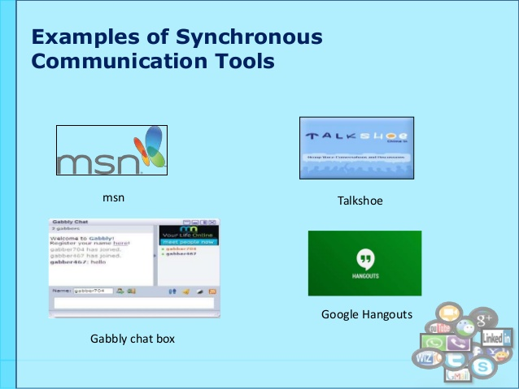
Tools for Synchronous Communication
Video conferencing such as Polycom
Teleconferencing
Instant messaging
Notes:
To standardize the collaborative process in the organization, there ought to be tools to access all the employees and talk with them at the same time. The appropriate tools to use for synchronous communication with the employees in different locations are video conferencing, teleconferencing, and instant messaging.
Video conferencing allows the organization to hold meetings with its employees and see each other as they interact and share ideas or discuss about the topic on hand. This tool allows people to connect at a single point in time, at the same time.
Teleconferencing allows employees in remote locations to discuss and talk in a virtual meeting organized by the organized. They can continue with their tasks as they listen and participate in the talk.
Instant messaging such as Skype and messenger allows the management to communicate by drafting and sending a message that the receiver get within seconds. The primary drawback of these tools, they require same-time participation -different time zones and conflicting schedules can create communication challenges. In addition, they tend to be costly and may require significant bandwidth to be efficient. However, setting up a schedule for this communication ensures a success when using tools and establishment of an efficient bandwidth proves worthwhile by fostering collaboration within the organization.

Slide 6

Tools for Asynchronous Communication
Goggle Hangouts
Discussion boards
Skype for Business
Notes:
Studies have shown that asynchronous communication between employees leads to an increase in productivity when compared to email based communication alone. This is because one of the key traits of asynchronous communication is it’s ability to notify and empower its end user to communicate in near real time. By adding a one-to-many chat room experience, the user is given efficient communication with his/her peers. When coupled with the ability to share files, this method of collaboration can lead to accelerated consensus and or support. Some of these tools include Goggle Hangouts, Skype for business, and discussion boards.
Discussion boards: whether integrated into your online interaction platforms or not (such as Google Groups), well-managed discussion board can produce incredibly rich conversations about the topics at hand. Employees can use this tool to make suggestions and assist each other without a limit in time.
Skype for business: With one click, anyone can join your online meeting, from any device. You can choose to meet right away, or schedule from Outlook for later. The meeting URL is personalized just for you. It enable one to record meetings, share your screen, and annotate PowerPoint for real-time collaboration with up to 250 people.
Goggle Hangouts: Some people consider mailing lists to be quaint relics of a previous technological age, but it’s hard to argue with the fact that they still work: an Hangout-based discussion list does afford one the ability to carry on threaded discussions in a private environment, yet outside the confines of a managed system (for discussion boards). In fact, Google Groups (referenced above) is a threaded discussion board that can also take place via e-mail.

Slide 7
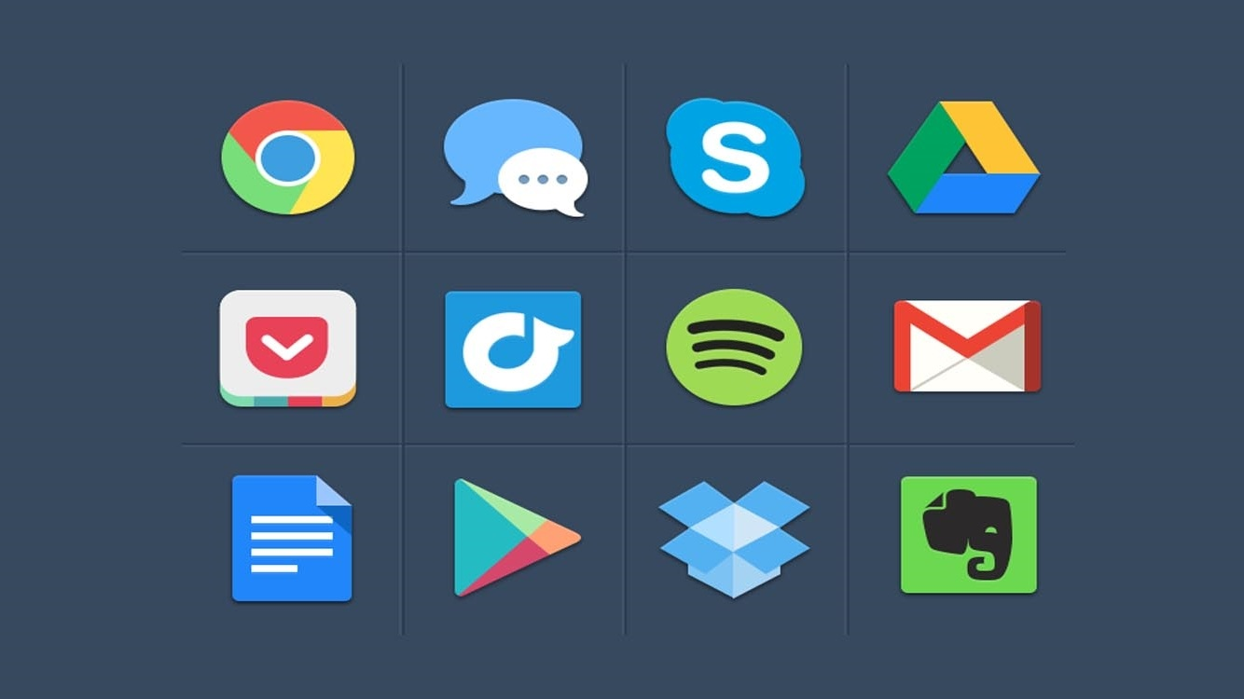
Sharing of Project Files
Need to simplify documents exchange between management and employees.
The tools to be used for this process include:
    Dropmark
    Dropbox
    Google Drive
Notes:
Dropmark provides simple collaboration and file sharing in the cloud, with drag-and-drop facility from your desktop to browser, so your files are automatically uploaded to the cloud. You can invite colleagues to view and collaborate privately, and organize files into collections with sharable shortlinks. You can view every collection as a full screen presentation, mixing images, websites and more. You can even drag in audio or video from YouTube, Vimeo, Sound Cloud or your desktop to create custom playlists and podcasts. With the Dropmark for Mac app you can just drag and drop to your Mac menu bar and upload directly to your account.
Dropbox provides effortless file synchronization, with support for Windows, Mac, Linux, iOS, Android and Blackberry. You can set up share files or folders to work in collaboration with others -- once you create a shared folder and add people to it, it will appear in their Dropbox, so any member of the folder can add, delete or edit files within it. You can also share with non-Dropbox users by creating a link to a file or folder. Users can then use the link to preview the contents through their browsers. Once you install Dropbox on your desktop, simply add files to your Dropbox folder and it will automatically sync those files to your Dropbox account (meaning you have access to your work anywhere).
With Google Drive you can create new documents, spreadsheets and presentations, and share files or folders with anyone, choosing who can view, edit or comment on your content. You can collaborate at the same time, on the same document, and see changes as they appear. You can open more than 30 file types in your browser, even if you don't have the program installed on your computer.
Google Drive tracks every change you make, and each save creates a new revision, so you can look back as far as 30 days automatically or choose a revision to save forever.

Slide 8
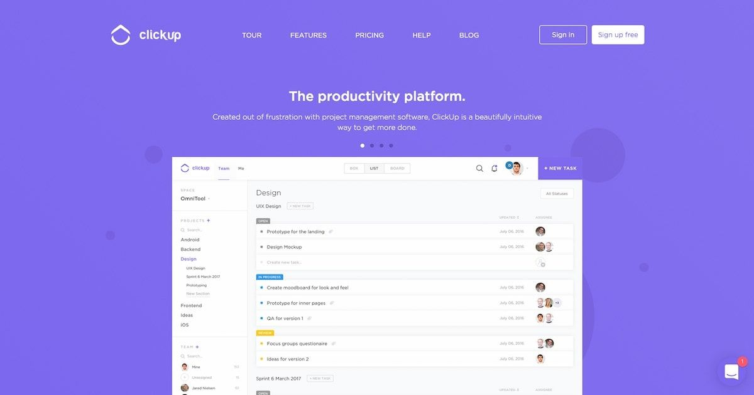
Sharing of Task List
Sharing tasks for managing tasks will require an online software for simplify the process in the organization.
Each employee will know what he/she needs to do.
The software to use is ClickUp
Notes:
ClickUp Software will be the appropriate tool to share task list for managing tasks among the employees. ClickUp combines amazing simplicity with enough customization to fit any person, team, or organization who is looking to be more productive. In ClickUp, you can set up different teams and spaces–some can be personal, for your work, or anything else you can think of.
The feature that helps ClickUp do this best is the option for multiple views (list, board, box and time). What makes that special is that you can view the same tasks and projects through any of these lenses while keeping the same task details, statuses, due dates, and task dependencies. Not every task management tool can do that. Another great feature of ClickUp is the Chrome extension; You can take screenshots, track time, manage emails and create tasks no matter where you are on the Web. This is perfect for creating tasks in a hurry. ClickUp is a very simple task management solution that’s great for personal use or teams.

Slide 9
Competitive Advantage from the Collaboration IS
Contemporary economy has all the features of being called a social economy; it thrives on effective communication.
Employees’ organization and design of department are also crucial facets.
A favorable design and organization is achieved through collaborative tools.
These tools foster communication and responsibility among the employees.
Competitive advantage is reached through this organized network.
Innovation is also fostered through exchange of ideas and project planning.
Notes:
As the organization begins to implement this collaborative information system employees will be able to interact in different ways while files and documents will be shared more easily. This system allows users to brainstorm ideas together without the necessity of physical, face-to-face meetings. Utilizing tools such as discussion boards, document sharing, and video, this system made it possible for ideas to be shared in new ways and the thought processes behind these ideas to be documented. This offers a competitive advantage in the contemporary social economy why the success of a firm depends on effective communication and workers’ organization and design.

Slide 10
References
MacCormack, Alan; Forbath, Theodore; Brooks, Peter; Kalaher, Patrick (2007). Innovation Through Global Collaboration: A New Source of Competitive Advantage. Harvard Business School Working Paper 07-079. http://www.hbs.edu/faculty/Publication%20Files/07-079.pdf.
Nut Cache (n.d.). The Importance of Collaboration in the Workplace. https://www.nutcache.com/blog/the-importance-of-collaboration-in-the-workplace/
Ray, S. (2017). 5 Ways Collaborative Tools Builds Stronger Teams. Project Manager. https://www.projectmanager.com/blog/5-ways-collaborative-tools-builds-stronger-teams
Satell, G. (2015, Dec). Why The Ability To Collaborate Is The New Competitive Advantage. Forbes. https://www.forbes.com/sites/gregsatell/2015/12/04/why-the-ability-to-collaborate-is-the-new-competitive-advantage/#7acaebfa1e10

