Slide 1
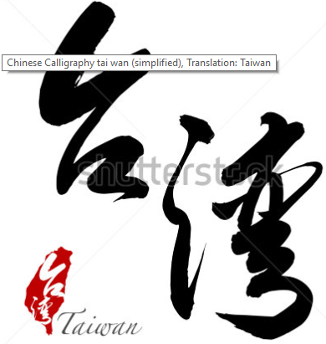
TAIWAN

Slide 2
TAIWANESE CULTURE
Initially inhabited by aborigines.
Currently ,Taiwanese culture is a blend of the native aboriginal with Chinese, Japanese, Confucianist and Western lifestyles.
This is due to the various periods of colonization and their domination by foreigners.
Their culture is mainly laden with Chinese tradition due to Kuomintang Dynast imposal of promoting Chinese traditions and culture in place of the native cultures.

Slide 3
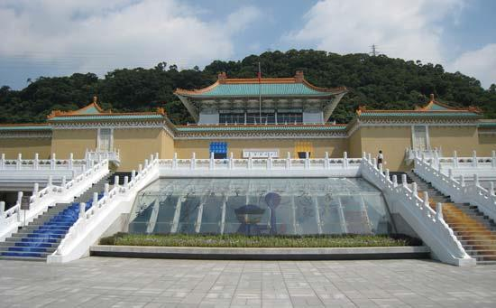
Besides , approximately 700,000 artifacts of Chinese heritage, spanning 8,000 years spanning from the New Stone Age era to the modern era are housed in the National Palace Museum.
During the Kuomintang era, Mandarin was universalized by law and simultaneous prohibition of Taiwanese ways except in science and technological spheres.
Co-operation with western nations in education and technology could be attributed to the rise and embracing of western lifestyle.

Slide 4
RELIGIONS PRACTICED.
Buddhism
Taoism
Chinese folk practice
Christianity
Falun Gong(marries Buddhist, Taoist and Chinese cultures)

Slide 5

LANGUAGES SPOKEN
Hokkien
Mandarin(official)
Hakka
Formosan
Amis

Slide 6
FOODS AND CUISINES
Pearl milk tea/bubble tea
Pork rice
Oyster
Milkfish
Danzai noodles
Gua bao(Taiwanese Hamburger)
Tian bu la (Taiwan fish paste)
Ba wan (meat dumplings)
Fish ball soup
Ding bian cuo(rice flour pasta)
Mochi(rice balls)
Hong Ryen Jen (ham and cheese sandwich)
Pidan tofu(duck egg)

Slide 7
TAIWANESE RESTAURANTS
Mainly deal in Chinese cuisine, Japanese grilled foods, Thailand, Italian and major western foods.
Taiwan hospitality industry ranges from small local stalls to major hotels and restaurants.
CONVENIENCE STORES
Deal in general household commodities.
Provide services from financial institutions and government agencies, such as utility payments.
Operate on 24 hour basis.

Slide 8
Majorly deal in street foods and snacks
Some are fully fledged night hotels with various food options.
Boost exposure by gifting customers with discounted gift hampers.
Some have their food supplied from food service companies that ensure express delivery.
Globally, Taiwan has the highest convenience store density (1 for every 2,300 residents).

Slide 9
HOTEL, RESTAURANT AND INSTITUTIONS (HRI)
Mainly source food supplies locally, on a non-contract basis to enable flexible choosing of goods from the various prices floated to them.
Other fresh supplies are also directly imported.
HRI operators usually buy commodities in bulk to attain the lowest price possible.
Westernized food chain franchises may contract suppliers or do their supply activities independently.

Slide 10
Large hotels are heavily involved in research and development efforts so as to update customer menus based on demand and trending tastes.
Food and beverages account for bulk income of international hotels based in Taiwan.
According to tourism data (2014), food and beverage is attributable to 44.5 % of their income.

Slide 11
Holidays have been commercialized. Hotels therefore exploit such seasons or days for example providing set menus of foreign cuisine strictly exclusive to the event calling for celebration.
Also offered are gift food packages that coincide with specific holidays, for example: chocolate gifts for valentines.
With thee help of courier services, such gift packages are found accessible by people away from the hotels.

Slide 12
High-end resorts have been built in tourist attraction sites such as cultural sites, scenic views, hot springs and amusement parks.
Investment in these resorts was encouraged by development of highways connecting the capital city of Taipei to coastal areas.
Some firms have invested in airline catering serving in-flight passengers especially during long flights.

Slide 13
RETAIL FOOD CHAINS
Some convenient stores have built extensions which are used as food kiosks, operating on a 24 hour basis.
There also exists family style chains with a centralized kitchen from which cooked food is supplied to the affiliated outlets.
Cheap labor have made them grow.
There exist breakfast shops which offer food at budget-friendly prices, a relief for people on a shoe string budget.

Slide 14
LIST OF REFERENCES
Oxford Business Group.(2007). The Report: Taiwan. (pp. 107-119).
David, K.J.,Morris,D.A. & Moskowitz, L.M.(Eds).(2004) The Minor Arts of Daily Life: Popular Culture in Taiwan.(pp. 17-35)University of Hawaii Press.
Hiufu, W.M. (2015). 40 of the Best Taiwanese Food and Drinks. Retrieved December 7, 2017 from http://edition.cnn.com/travel/article/40-taiwan-food/index.html

