Slide 1
Effectiveness of pain medication compared to aerobic stretching in controlling post operative pain
Student’s Name
Date

Slide 2
Introduction
Total hip replacement (THR) is a painful surgery which needs to effective pain management
However, 50% of THR do not have effective pain management in the post-operative phase.
More so, 75% of patient complains of moderate to severe pain in THR (De Luca et al., 2018)
This meta-analysis research will provide suggestion of the best way to enhance effective pain management
Notes:
Total hip replacement (THR) is a painful surgical procedure that needs to be evaluated for pain management after the surgery. Effective pain management in the postoperative phase should be established to ensure that the patient's recovery to normal functioning is enhanced. Researchers suggest that effective pain management leads to functional recovery after THR. However, various reports show that more than 50% of THR do not have effective pain management in the postoperative phase. After the procedure, more than 75% of the patients complain of moderate to severe pain (De Luca et al., 2018). This research is significant because it will enhance understanding of the bests way to enhance pain management in patients who have undergone THR

Slide 3
Research Questions
Is pain medication an effective strategy to enhance post-operative pain management in THR?
How effective is aerobic stretching in enhancing post-operative pain management in THR?
How effective is pain medication in enhancing perioperative and recovery time in THR?
How effective is aerobic stretching in enhancing perioperative and recovery time in THR?

Slide 4
Objectives
To determine the effectiveness of pain medication in enhancing post-operative management in THR.
To determine the effectiveness of aerobic stretching in enhancing post-operative management in THR
To evaluate the effectiveness of pain medication in enhancing perioperative and recovery time in THR.
To evaluate the effectiveness of aerobic stretching in enhancing perioperative and recovery time in THR.
Notes:
Meta-analysis to investigate the comparison between the effectiveness between pain medications and aerobic stretch in management of post-operative pain to enhance perioperative and recovery time in THR.

Slide 5
Methods
Eligibility criteria:
Types of studies- articles that provide information concerning pain medications and stretch exercises.
Both primary and secondary sources not older than 5 years
Types of participants- 18 year and above
Interventions- pain medications and aerobic stretch.
Types of outcomes measures- comparing the pain medication or aerobic stretch in enhancing post operative pain management in THR.
Notes:
The main criteria used to determine the type of studies used in this research are discussed. All the research articles used in the research were ensured to provide information which the use of pain medications or stretch exercises in the management of pain for the postoperative stage of THR. Both primary and secondary sources were used. The year of publication of the articles was another element considered in the studies' choice. The studies chosen in this research were five years or less, which enhanced their viability

Slide 6
Methods
Search Strategies and Data Sources
Systematic search of data bases such as Google scholar, PubMed, Research Gate, Musculoskeletal Medicine, JAMA Network, Springer Link, MAG Online Library, BMJ and Tand Fonline.
Date: between 2017-2021
English language
Different terms were used in the search of articles.
Notes:
Most of the articles were published by medical publications such as PubMed, BMJ, Research Gate, Musculoskeletal Medicine, JAMA Network, Springer Link, MAG Online Library and Tand Online. Terms used for the search includes THR, THR pain management, pharmacological management of THR, effectiveness of pain medication in post-operative management of THR, non-pharmacological management of THR, aerobic exercise in managing pain post operative THR, and effectiveness of pain medications and aerobic stretch in management of pain in THR.

Slide 7
Methods
Methodological Quality Assessment
Research published in the last five years
Exclusions criteria- Studies that did not provide relevant information concerning THR
Research articles with eligible titles and well-established abstract were chosen.
Notes:
All the studies which were not published within the last five years were excluded. More so, studies that did not provide relevant information concerning THR postoperative pain management was excluded. An extensive search strategy was developed through different databases to ensure that all the research needed in this study were accessed. Research articles with eligible titles and well-established abstract were chosen

Slide 8
Data Extraction
Name of the authors, year of publication, number of participants and interventions carried out
Results obtained from tables, discussions and conclusions.
Data Synthesis
Combining information from each study.
Development of conclusion from various studies
Notes:
Variables that will be extracted includes the name of the authors, year of publication, the number of participants and interventions carried out. The data from the chosen research articles were retrieved from the results of the research. The results were obtained from tables that explain different outcomes of the research and the discussion of the results. Data were synthesized by combining information from each study used in this research to draw inferences. The studies were tabulated and research compared through metanalysis.

Slide 9
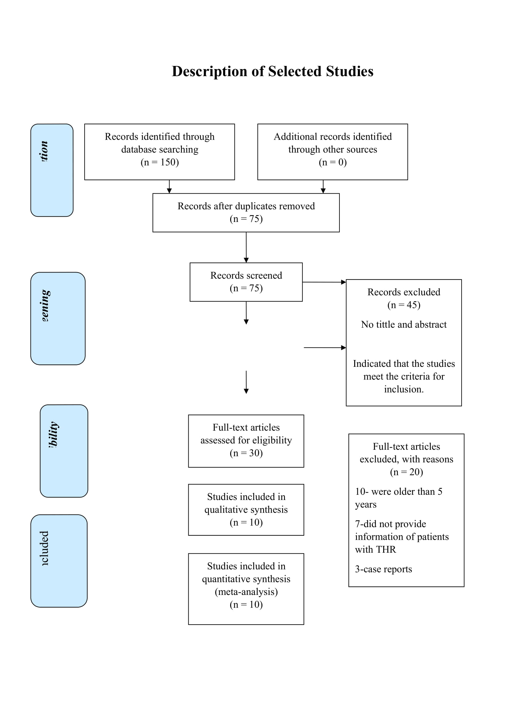
Results
Notes:
In the identification step, 150 records was established from the database searching. Among the articles, 75 duplicates were removed and 75 screened. 45 articles were excluded because they had not tittle and abstract. Among the remaining 30, 20 were excluded because they 7 of them did not have sufficient information concerning treatment of pain in TRH, 3 were case reports and 10 were older than five years. The remaining 10 were included in the research and were involved in quantitative analysis in the meta-analysis.

Slide 10
Five studies represented pain management another five represented aerobic exercises.
Medications were revealed to be effective in enhancing post-operative pain management and recovery time for the patients.
For impact of aerobic stretching, three supported effectiveness of the strategy in enhancing post operative pain management.
Two of the studies reveled that aerobic exercise enhances reduction in hospitalization which influences recovery time.
Notes:
Among the 10 studies that were included in the research, 5 of them were representing medication pain management while 5 represented the use of aerobic stretching in pain management. All the five studies which represented management of pain through medication showed that medications are effective in enhancing post-operative pain management and recovery time for the patients. Out of five studies which were chosen to present the impact of aerobic stretching, three showed that it is an effective strategy in enhancing post operative pain management. Two of the studies reveled that aerobic exercise enhances reduction in hospitalization which influences recovery time leading to patient satisfaction.

Slide 11
Pain medication is more effective in enhancing post-operative pain control, perioperative and recovery time.
Tsinaslanidis, Tsinaslanidis & Mahajan (2020 shows that multimodal drug utilization enhances effective management of pain in TRH.
Also, Madara et al. (2019) shows that the lack of adherence to aerobic stretch influences the lack of effectiveness of the strategy.
Therefore, the use of pain medication is presented to be more effective.
Notes:
Results suggested that pain management through pain medication is more effective in enhancing post-operative pain control, perioperative and recovery time compared to the use of aerobic stretching. Similar results are presented by Tsinaslanidis, Tsinaslanidis & Mahajan (2020 who shows that multimodal drug utilization enhances effective management of pain in TRH. Also, Madara et al. (2019) shows that the lack of adherence to aerobic stretch influences the lack of effectiveness of the strategy in enhancing post-operative management of pain in TRH. Therefore, the use of pain medication is presented to be more effective.

Slide 12
Limitations
Absence of research articles that had direct comparison of the two interventions.
9 out of the 10-research used in this study were metanalysis research
Primary sources of research that were accessed for this study were excluded because they were more than 5 years old
Limited number of studies
Notes:
The main limitation of this study was the absence of research articles that had a direct comparison of the two interventions (aerobic exercise and pain medications) in the postoperative management of THR. More so, 9 out of the 10-research used in this study were metanalysis research. Primary sources of research that were accessed for this study were excluded because they were more than five years old. Therefore, the research relied on the evidence provided by the secondary source. Also, a limited number of studies is another limitation that could affect the result of this research.

Slide 13
Conclusions
The present research shows that pain medication is more effective.
Use of aerobic strategy is supported maximumly
Aerobic exercises is dependent on the willingness and involvement of the patient.
However, there is a need to evaluate the underlying factors that influences the effectiveness of aerobic stretches.
Notes:
According to the results of the research used in this study, the use of pain medications is presented to be an effective strategy in the management of postoperative THR cases. The evidence concerning the use of aerobic stretches provides their effectiveness in minimal cases, which suggests that they are not effective in enhancing pain control in THR. However, other researchers suggest that the effectiveness of aerobic exercises is dependent on the willingness and involvement of the patient to carry out the aerobic stretches consistently.

Slide 14
Implications
Essence of choosing pain medications over aerobic stretches.
Significance in following up patients and encouraging than to engage in aerobic stretch consistently.
More research should be done to confirm the effectiveness of aerobic stretch.
Notes:
The use of medications has been presented to be effective in enhancing the control of pain and reduction of recovery time for the patient. More so, patient satisfaction in management is enhanced when pain medications are used. Other researchers have suggested that other underlying factors, such as the commitment of patients, is of great significance in enhancing pain control through aerobic stretches. Therefore, more research should be done to confirm the effectiveness of aerobic stretch.

Slide 15
Acknowledgement!

Slide 16
Thank you
Information including name, email, phone number and website.

Slide 17
References
De Luca, M. L., Ciccarello, M., Martorana, M., Infantino, D., Letizia Mauro, G., Bonarelli, S., & Benedetti, M. G. (2018). Pain monitoring and management in a rehabilitation setting after total joint replacement. Medicine, 97(40), e12484. https://doi.org/10.1097/MD.0000000000012484
Madara, K. C., Marmon, A., Aljehani, M., Hunter-Giordano, A., Zeni, J., Jr, & Raisis, L. (2019). PROGRESSIVE REHABILITATION AFTER TOTAL HIP ARTHROPLASTY: A PILOT AND FEASIBILITY STUDY. International journal of sports physical therapy, 14(4), 564–581.
Tsinaslanidis, G., Tsinaslanidis, P., & Mahajan, R. H. (2020). Perioperative Pain Management in Patients Undergoing Total Hip Arthroplasty: Where Do We Currently Stand? Cureus, 12(7), e9049. https://doi.org/10.7759/cureus.9049

