Slide 1
THREATS TO GLOBAL ENVIRONMENT
Student Name
Institution affiliations
Date

Slide 2
Introduction.
Global environment encompasses of aspects of the environment that are worldwide and beyond the scope and control of the a state, a community or an nation.
Global environment is faced with threats that involve the following:
Energy sources
Globalization
Climate change
The civil war.
Notes:
Global environment is important because it reduces the risks on human health by eliminating pollutive production as well as managing of global wastes.

Slide 3
ENERGY SOURCE.
Energy sources involve forms like fossil energy, nuclear energy, natural gas and renewable sources.
From the beginning, fire was the essential source of energy and homes were oriented with respect to he sun.
However, industrialization led to the use of fossil fuels such as oil that lead to destruction of environment through acid rains, global warming and pollution.
Notes:
Some energy sources release substances into the air can mix and react with water, oxygen and other compounds in the air to form more acidic compounds.
Acid rain has the ability to burn vehicles and even power plants.

Slide 4
Nations affected by ineffective use of energy sources.
China
India
Poland
Scandinavia
Canada
Taiwan.
North eastern parts of the United States of America.
Notes:
These countries are often affected by alteration In the pH of the soil thus affecting the balance in their ecosystem.

Slide 5
Negative impacts of energy sources to population.
Sulphur dioxide particles in air and water can lead to development of chronic lung problems such as asthma and bronchitis.
Acid rain lead to formation of ground level ozone layer that blocks the ultraviolet rays leading to severe health problems such as pneumonia and emphysema.
Gases released by some sources affect visibility and causes irritation of eyes and nose.
Huge complications of the large infections can cause death of permanent disabilities.
Notes:
Most energy dources do not directly affect population. That is, a person can swim in acid water and no effect would be seen in their skin.
However, they affect the plants and trees causing them to turn brown. Moreover, aquatic ecosystem are highly affected since little or no air is able to flow into the water.

Slide 6
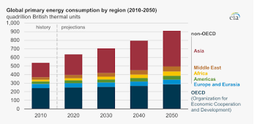
Statistics image link: Energy sources and the environment

Slide 7
CLIMATE CHANGE
(GLOBAL WARMING)
Global warming refers to excessive heating of the climate of the earth.
It was observed between 1850 and 1900 and it was due to the irresponsible human activities such as burning of fossil fuels that traps greenhouse gas thus increasing their levels in the atmosphere.
Global warming can also be caused by the increase in the intensity of the sun, industrial and agricultural activities, deforestation and the earths own feedback loop.
Notes:
Greenhouse gas pumps carbon dioxide, methane and other gases into the atmosphere.
These gases become harmful when they are collected in the air causing them to absorb the sunlight and the solar radiation that bounces off the surface of the earth causing increase in heat levels.

Slide 8
Countries affected by global warming.
Japan.
Philippines.
Germany
Madagascar
India
Sri Lanka
Kenya
Rwanda
Canada
Fiji

Slide 9
Effects of global warming to population.
High temperatures lead to development of many disasters such as storms, heat waves, floods and drought that causes death and reduction in health levels, destruction of habitats.
Melting glaciers and droughts causes dramatic water shortages in some places leading to wildlife risks.
Forests, farms and people will face new pests and diseases that may ruin agricultural activities and create health hazards.
Global warming leads to increased levels of pollen-producing ragweed that causes allergies, asthma and other infections.
Notes:
To avoid the increasing effects of global warming, the world should reduce the overdependence in utilization of fossil fuels and begin the utilization of clean energy instead.

Slide 10
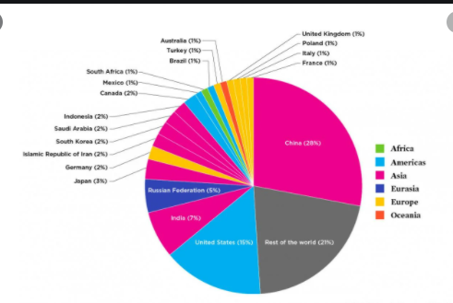
Statistics.
Image link: global warming statistics worldwide

Slide 11
GLOBALIZATION.
Globalization has enabled us to have faster access to technology, improved communication, better production of goods and services and advanced innovation.
It ushered a new era of economic prosperity and has opened bigger channels of development.
However, increase in consumption of products leads to an increased demand in production thus straining the resources of the environment.
Notes:
Globalization has also led to increase in transportation of raw materials . Transportation leads to pollution of air since it releases some gases into the atmosphere that destroy the ozone layer.

Slide 12
Nations affected by globalization.
India
China
Iraq
Syria
Lebanon
Jordan
South Africa
Russia
Iran
USA

Slide 13
Environmental effects of globalization to the population.
Industrialization leads to accumulation of greenhouse gases that cause problems to indigenous people and leads to global warming.
It also leads to damage of plants because it interferes with their genetic make up thus putting pressure on the available land resources.
Cutting down of forest to set up industries may lead to increased levels of deforestation that causes global warming while the industries may increase the levels of acid rains.
Notes:
Deforestation cases can be reduced by raising awareness of effects of deforestation, going paperless to avoid wastage, tree planting, frequent recycling and buying certified wood products. Therefore, to ensure that there is effective harmony between globalization and the environment, policies need to be implemented so that the environment is not damaged.

Slide 14
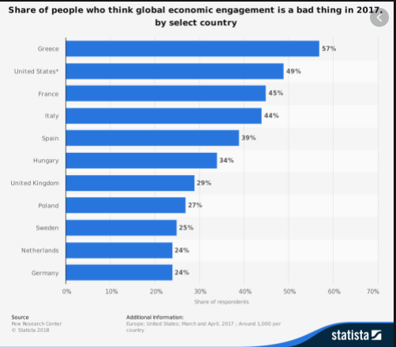
Statistics.
Image link: globalization and the environment

Slide 15
CIVIL WAR.
Military activities and equipment used during this can produce a lot of greenhouse gases that contribute to climate change through globalization and pollution, and causes depletion of natural resources.
Some civil war may last over a decade and fought at a high intensity. Therefore, these wars may require huge quantities of fuel, leading to huge emissions of carbon dioxide.
Notes:
There exists seven different types of pollution. That is, water, radioactive, land, soil, thermal, light and sound pollutions. Therefore, building sustainable military forces and develop sustainable and renewable military equipment to avoid destruction of the environment

Slide 16
Nations affected by the civil war.
Indonesia
Congo
Syria
Burundi
Sierra Leone.
China
Sudan
Egypt
Philippines
Colombia

Slide 17
Environmental effects of the civil war.
Pollution increases the risk of contracting respiratory diseases such as asthma or lung cancer, accumulation of gases into the atmosphere leading to development of acid rains, Pollution may lead to formation of gases that depletes the ozone layer forming a coat that reflects the harmful ultraviolet rays risking both human and animal life.
Destruction of forests, disruption of waterways and wastage of natural resources led to increased droughts, drainage of healthy lands and poverty.
Notes:
Weapons and materials used during the war leave landmines, cluster munitions and other explosive remnants that can restrict access to agricultural lands, pollutes water sources and leads to soil erosion.

Slide 18
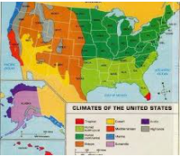
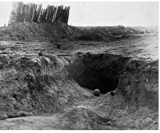
Statistics.
Image link: civil war and the environment

Slide 19
Conclusion.
Global environment faces threat that involve energy sources, globalization, lack of education opportunities, poor health of the entire population, climate change and cultural taboos.
Humans play a major role in the increase in these threats. Therefore effective maintenance of climatic changes, globalization and other factors can ensure that global environment is effectively maintained.
To reduce the risks of pollution, the population can reduce the utilization of fossil fuels and practice the use of clean energy. For instance, avoid using cars when unnecessary, avoid burning of leaves and trash, and avoid using gas powered lawn and garden equipment.

Slide 20
Reference.
Tienhaara, K. (2010). A tale of two crises: what the global financial crisis means for the global environmental crisis. Environmental Policy and Governance, 20(3), 197-208.
Hamilton, C., Gemenne, F., & Bonneuil, C. (Eds.). (2015). The Anthropocene and the global environmental crisis: Rethinking modernity in a new epoch. Routledge.

