Slide 1
Descriptive statistics

Slide 2
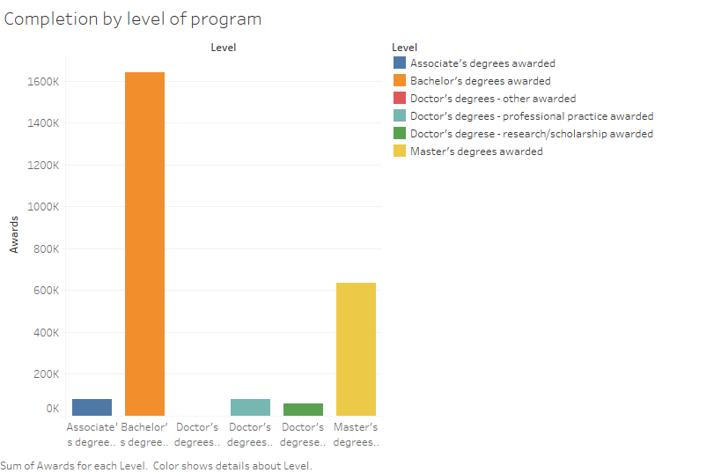
Bachelors’ degree leading in completion.
Notes:
Commentary: Bachelors’ degree recorded high levels in completion rate followed closely by Masters degree. Doctors’ degrees had the lowest completion rate.

Slide 3
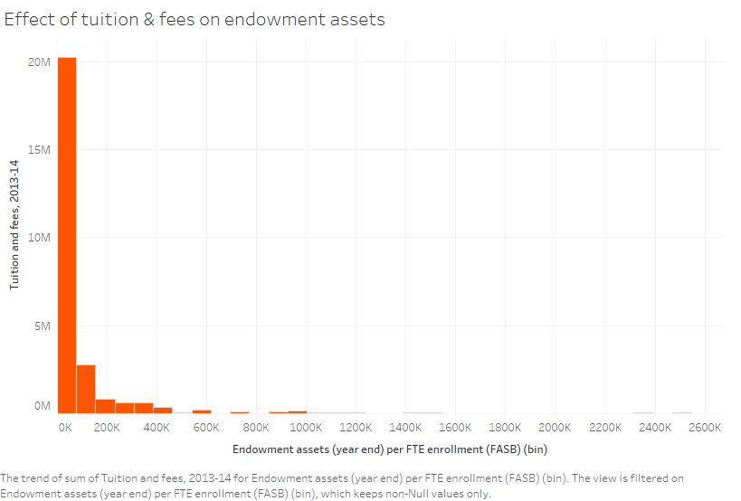
Does tuition and fees set the trend in Endowment assets?
Notes:
Commentary: Endowment assets are indirectly proportional to tuition and fees. The endowment assets of the university have not increased tremendously as compared to tuition and fees.

Slide 4
REFERENCES
Procheş, Şerban. (2015). Descriptive statistics in research and teaching: are we losing the middle ground?. Quality & Quantity. 50. 10.1007/s11135-015-0256-3.

