Slide 1
HR 173
TEAMS Part A
Dr Stephanos Avakian

Slide 2
Introduction
Introduce the importance of teams and their role to organizations
Explain how teams are dependent on the management of goals and interpersonal skills
Introduce the concept of ‘self-managed teams’ and ‘high performance teams’

Slide 3
Definition
“Team a collection of individuals who exist to achieve a shared goal; are interdependent with respect to achieving that goal; whose membership
is bounded and stable over time; and who operate within a system” (Buchanan and Huczynski, 2015)

Slide 4
Definition
Group two or more people in face-to face interaction, each aware of their group membership and interdependence as they strive to achieve common group goals

Slide 5
Why Teams?
Tasks require the involvement of more than one individual to be accomplished.
In theory the use of teams is viewed in a positive light but in reality there are many challenges that hinder their effectiveness.
Teams generate synergy where the sum of the collective effort becomes a lot more than then ‘best’ individual effort

Slide 6
Conditions for a successful team
Clear focus on outcomes
Understanding of how and why the individual parts contribute to the ‘whole’
Collective commitment
Understanding skill variations, namely element distinctive/unique to the individuals – what is it that really people bring to a project/task?

Slide 7
“Creative problem solving is required involving the application of different types of specialized knowledge.
• There is a need to closely coordinate the work on a specific project, e.g. design and development or the production and testing of a new product”
Buchanan and Huczynski, 2015, p.426

Slide 8
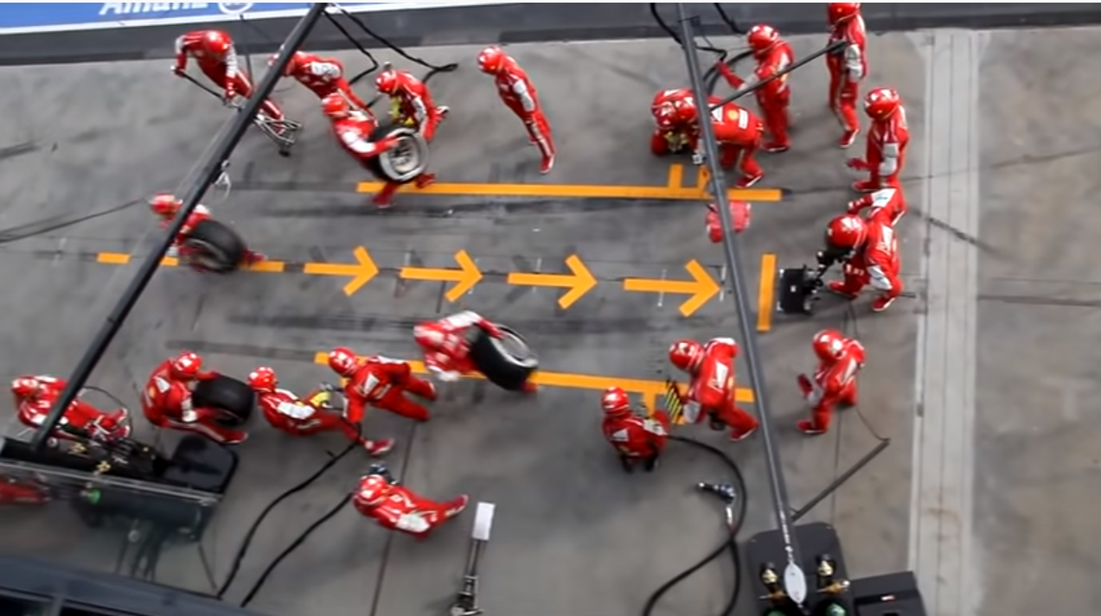
https://www.youtube.com/watch?v=aHSUp7msCIE

Slide 9
A pit crew can change all four tyres of an F1 racing car in under two seconds. Pit stops are a critical time as they can make the difference between victory and defeat.
The speed of the mechanics practically defeats the eye. Have you seen a tyre change on a Formula 1 car? Count the number of mechanics involved.

Slide 10
Problems with Teams
Lack of understanding how the parts contribute to the whole
Planning initiatives as a totally different experience from what happens during action
Competition between members
Lack of trust and personality compatibility and self-awareness

Slide 11
Task
Read Pages: 424-427. Notice the following key points
Project team: a collection of employees from different work areas in an organization brought together to accomplish a specific task within a finite time.
Cross-functional team: employees from different functional departments who meet as a team to complete a particular task

Slide 12
Activity
What specific behaviours are required so that people perform effectively as team members in ‘project teams’ and in ‘cross functional teams’?
What challenges/obstacles people are likely experience when working as part of a project or cross-functional team?

