Slide 1
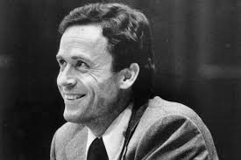
Presentation
Analysis of Ted Bundy, a Serial Killer.

Slide 2
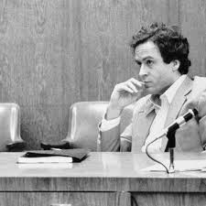
History
Ted Bundy was born on November 24th(Theodore Robert Cowell ).
Buddy lived between 1946 and 2012.
Jack Worthington, a war veteran, is believed to be his father, according to King County Sherif's office records (Williams, 2020).
Bundy is suspected of having been fathered by an extremely abusive Samuel Cowell who was the husband to Louise.
Notes:
Theodore Robert Cowell was the official name of Ted Bundy, who was born on November 24th, 1946. Buddy lived between 1946 and 2012, where he resided in Elizabeth Lund Home for Unwed Mothers and mothered by Eleanor Louise Cowell (Williams, 2020). Buddy's father is unknown to the public; however, a man who seduced him, Jack Worthington, a war veteran, is believed to be his father, according to King County Sherif's office records (Williams, 2020). According to the family members, Bundy is suspected of having been fathered by an extremely abusive Samuel Cowell who was the husband to Louise.

Slide 3
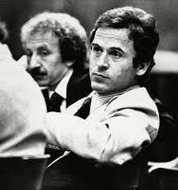
Cont. History
Bundy was brought up by his blood grandparents in Philadelphia.
The grandparents took him as their son to prevent him from social stigma (Williams, 2020).
Bundy left his grandparents' home for Tacoma, Washington in 1950.
Bundy did not know who really he was until he found his birth certificate, and that moment marked the onset of his frustrations, claiming that his mother did not reveal his real identity.
Notes:
During the first three years, Bundy was brought up by his blood grandparents in Philadelphia since his father believed he was sired outside wedlock. As a result, the grandparents took him as their son to prevent him from social stigma (Williams, 2020). In 1950, Bundy left his grandparents' home for Tacoma, Washington, where he lived with cousins. Buddy did not know his birth parents since he was told that his grandparents (Samuel and Cowell) were his parents, and he referred to his mother as an elder sister (Williams, 2020). Bundy did not know who really he was until he found his birth certificate, and that moment marked the onset of his frustrations, claiming that his mother did not reveal his real identity.

Slide 4
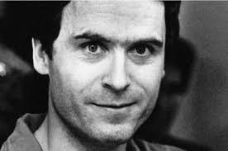
Cont. History
Bundy pursued detective magazines, true crime documentaries, and sexual violence and crime novels during his childhood.
Bundy's close friends, including his cousins, revealed that the suspect had much interest in naked women.
Bundy engaged in high school athletic activities, where he pursued the action using forged lift tickets and stolen equipment.
Bundy was convicted twice of auto theft and burglary, where the instances were removed from his records when he reached 18 years.
Notes:
Bundy had much interest in pursuing detective magazines, true crime documentaries, and sexual violence and crime novels during his childhood. Again, Bundy's close friends, including his cousins, revealed that the suspect had much interest in naked women. He had various social life accounts and stayed alone due to complexity in interpersonal relationships (Innes, 2017). Bundy engaged in high school athletic activities, where he pursued the action using forged lift tickets and stolen equipment (Innes, 2017). According to Washington customary laws, Bundy was convicted twice of auto theft and burglary, where the instances were removed from his records when he reached 18 years.

Slide 5
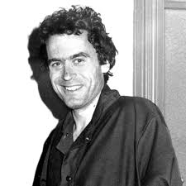
Summary of Buddy’s crimes
In 1974, Bundy was directly involved in various rape and murder cases both in California and Orlando (Innes, 2017).
On January 4th Joni Lenzi, an 18-year-old girl was sexually abused by Bundy while asleep in her bed, but she survived.
Lynda Ann Healy, a 21-year-old, was abducted Lynda as she was sleeping, and later the FBI detectives recovered her skull and mandible next to Tailor mountain site (Innes, 2017).
Bundy abducted Donna Gail, 19 years old, on March 12th as she was locating her way to The Evergreen State College.
Notes:
Bundy began committing rape and murder crimes in 1974 and focused his activities within Washington, Utah, Colorado, Florida, Oregon, Idaho and California. In 1974, Bundy was directly involved in various rape and murder cases both in California and Orlando (Innes, 2017). The first incidence took place on January 4th that involved Joni Lenzi, an 18-year-old girl. The victim was sexually abused by Bundy while asleep in her bed, but she survived. Lynda Ann Healy, a 21-year-old, was the next victim where the incident happened on February 1st. Bundy abducted Lynda as she was sleeping, and later the FBI detectives recovered her skull and mandible next to Tailor mountain site (Innes, 2017). Besides, Bundy abducted Donna Gail, 19 years old, on March 12th as she was locating her way to The Evergreen State College. Donna's body was abandoned in the Taylor Mountain site.

Slide 6
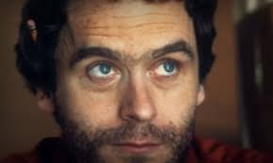
Summary of Buddy’s crimes
On April 17th, 1974, Susan Elaine's 18-year-old disappearance was noticed after she was last seen attending advisors meeting in the evening at Central Washington State College.
A 22-year-old: Roberta Kathleen Parks disappeared on May 6th, where the detectives later discovered her body in the same site.
On June 1st, A 22-year-old Brenda Carol Ball lost and her body discovered at the Taylor Mountain site in 1975 (Browne, 2016).
On June 11th, Bundy abducted an 18-year-old Hawkins while she was making a way into her house.
Notes:
On April 17th, 1974, Susan Elaine's 18-year-old disappearance was noticed after she was last seen attending advisors meeting in the evening at Central Washington State College. Her skull and mandible were discovered next to the Tailor mountain site in 1975 (Browne, 2016). A 22-year-old: Roberta Kathleen Parks disappeared on May 6th, where the same site detectives later discovered her body. On June 1st, A 22-year-old Brenda Carol Ball lost after she left Flame Tavern in Burien, where her skull and mandible were discovered at the Taylor Mountain site in 1975 (Browne, 2016). On June 11th, Bundy abducted an 18-year-old Hawkins while she was making a way into her house. Hawkins skeletal remains were found at the Issaquah site.

Slide 7
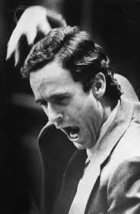
Summary of Buddy’s crimes
A 16-year-old Nancy Wilcox on October 13th, where Bundy assaulted, ambushed and struggled her to death(Browne, 2016).
An 18-year-old Melissa Anne Smith met Bundy on October 24th, and she disappeared mysteriously, and her body was later discovered in the surrounding mountains after nine days (Browne, 2016).
Another Bundy's case took place on October 31^{st,} where Laura Ann disappeared. Buddy abducted Laura, raped her and dumped the body at American Fork Canyon.
Notes:
In 1974, Bundy was also involved in other murder cases that took place specifically in Utah. The first Utah-based case involved a 16-year-old Nancy Wilcox on October 13th, where Bundy assaulted, ambushed and struggled her to death in Holiday and buried her body in Reef National Park, but never discovered (Browne, 2016). Again, an 18-year-old Melissa Anne Smith met Bundy on October 24th, and she disappeared mysteriously, and her body was later discovered in the surrounding mountains after nine days (Browne, 2016). Another Bundy's case took place on October 31^{st,} where Laura Ann disappeared. Buddy abducted Laura, raped her and dumped the body at American Fork Canyon.

Slide 8
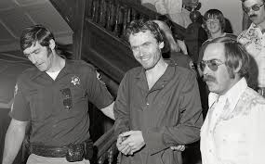
Utah, Colorado, Idaho ( 1975)
Bundy abducted a 23-year-old Caryn Eileen Campbell Snowmass, Colorado On January 12th, 1975.
On March 15th, Bundy abducted a 26-year-old Julie Cunningham while walking to a tavern in Colorado.
Later on April 6th, Bundy abducted Denise Lynn as she was cycling to their home in Colorado, specifically in Grand Junction.
Notes:
Other 1975 abduction cases that involved Bundy directly occurred in Utah, Colorado and Idaho. On January 12th, 1975, Bundy abducted a 23-year-old Caryn Eileen Campbell as she was walking from a Hotel in Snowmass, Colorado. Carly's body was later discovered near the same hotel after a lapse of 35 days (Innes, 2017). On March 15th, Bundy abducted a 26-year-old Julie Cunningham while walking to a tavern in Colorado, where he later buried her, and detectives never found her (Innes, 2017). Later on April 6th, Bundy abducted Denise Lynn as she was cycling to their home in Colorado, specifically in Grand Junction.

Slide 9
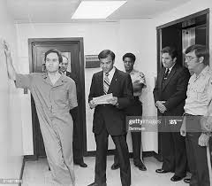
Florida 1978
Margaret Elizabeth Bowman, who was bludgeoned and struggled on January 15th by Buddy as she was asleep in FSU.
Lisa Levy (20), Kathy Kleiner (21), Cheryl Thomas (21), were bludgeoned and struggled by Bundy on January 15th Bundy; however, Karen, Kathy and Cheryl survived (Williams, 2020).
On February 9^{th,} Bundy abducted Kimberly Dianne while in School, and the remains of her body were found next to River State Park.
Notes:
Florida 1978
Ted Buddy was once again linked with rape and abduction cases in Florida. The first victim was Margaret Elizabeth Bowman, who was bludgeoned and struggled on January 15th by Buddy as she was asleep in FSU, specifically in Chi Omega (Williams, 2020). Similar to Margaret's case, Karen Chandler (21), Lisa Levy (20), Kathy Kleiner (21), Cheryl Thomas (21), were bludgeoned and struggled by Bundy on January 15th Bundy; however, Karen, Kathy and Cheryl survived (Williams, 2020). Last Florida's case took place on February 9th that involved Kimberly Dianne, a 12-year-old girl. Bundy abducted her while she was schooling in Lake City Junior School in Florida, and the remains of her body were found next to River State Park.

Slide 10
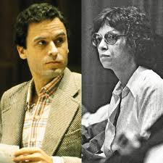
Ted Bundy marriage
Carole Ann Boone wasTed Bundy’s wife, and she existed between 1947 and 2018.
Bundy and Boone met at the workplace where they worked at the same organization in Washington.
Boone did not have much interest in pursuing Bundy’s dark history.
After marriage, Boone always believed that Bundy was innocent until towards the end of his journey before he was executed.
Notes:
Ted Bundy’s wife was Carole Ann Boone, who existed between 1947 and 2018. Bundy and Boone met at the workplace where they worked at the same organization in Washington. The two became best friends since they used to help each other in conducting various activities in the organization (Williams, 2020). Boone did not have much interest in pursuing Bundy’s dark history. For instance, Bundy was on a murder trial in Florida during their courtship, yet Boone did not notice (Williams, 2020). After marriage, Boone always believed that Bundy was innocent until towards the end of his journey before he was executed.

Slide 11
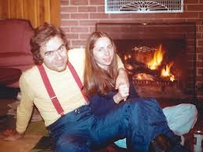
Cont. Ted Bundy marriage
Ted Bundy had a girlfriend, Kendal, and seemed to resemble Boone’s characteristics.
Both single mothers, believed Bundy was innocent and were always behind their backs in providing support (Williams, 2020).
Ted married Boone officially in a courtroom (Williams, 2020).
Bundy opted to marry Boone before the jury intentionally to win their sympathy.
Notes:
Before meeting Boone, Ted Bundy had a girlfriend, Kendal, and both seemed to have similar characteristics. Specifically, they were both single mothers, believed Bundy was innocent and were always behind their backs in providing support (Williams, 2020). Boone and Bundy got their first child, Rosa, in 1981, where she grew to be among his mother’s significant pillars. It was surprising to see Boone acting as Bundy witness for behavioral characteristics, and it was at that moment when both married officially in a courtroom (Williams, 2020). Bundy, former law students, opted to marry Boone before the jury intentionally to win their sympathy.

Slide 12
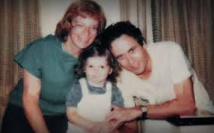
Cont. Ted Bundy marriage
Rose Bundy is the only known biological child of the serial killer Bundy.
Rosa was born while her parents were workmates at the Department of Emergency services.
James is yet another Bundy’s child, but he was born in his mother’s previous marriage (Murray, 2017).
There is little known about Rosa since her mother is believed to have changed their names.
Notes:
Rose Bundy is the only known biological child of the serial killer Bundy. Rosa is now 40 years old, and she was born in late 1980 (Murray, 2017). Rosa was born while her parents were workmates at the Department of Emergency services. James is yet another Bundy child, but he was born in his mother’s previous marriage (Murray, 2017). Rosa went with her mother after she divorced Boone before he was legally executed. There is little known about Rosa since her mother is believed to have changed their names to start a new life while distancing themselves from media cameras.

Slide 13
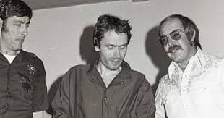
Ted Bundy’s Apprehension
Bundy became hopeless since he knew that the situation he was in would lead to his execution.
He booked interviews with Hugh Aynes to give a confession regarding all murder cases (Murray, 2017).
Bundy ensured that the information was provided in the form of a third person to avoid stigmatization.
Bundy referred to himself as a killer, thief and a rapist, and his career revolved around those three vices (Murray, 2017).
Notes:
After being linked to a series of rape and murder cases attracting a series of trials, Bundy became hopeless since he knew that the situation he was in would lead to his execution. As a result, he booked interviews with Hugh Aynesworth to give a confession regarding all murder cases (Murray, 2017). To avoid the stigma associated with admission, Bundy ensured that the information was provided in the form of a third person. As part of the admission, Bundy referred to himself as a killer, thief and a rapist, and his career revolved around those three vices (Murray, 2017). Bundy reported himself through confession and confirmed that his primary motive for conducting such was the need to possess and kill at the same time.

Slide 14
Ted Bundy’s Apprehension
Bundy booked an interview with William Hagmaier, a special agent at the FBI under the department of Behavioral Analysis Unit (Murray, 2017).
Bundy revealed that murder and rape were part of himself, and nothing could entirely change his situation.
Bundy went ahead and announced that he had a plan to kill more persons in prison, but he did not get the chance.
Notes:
The offender was more than willing to provide comprehensive information regarding his crimes because he booked an interview with William Hagmaier, a special agent at the FBI under the department of Behavioral Analysis Unit (Murray, 2017). During the interview with the special agent, Bundy revealed that murder and rape were part of himself, and nothing could entirely change his situation. Bundy went ahead and announced that he had a plan to kill more persons in prison, but he did not get the chance, although he had assembled all the necessary tools, including a hammer and steal (Murray, 2017). He suggested that the tools were discovered by prison wanders, but the owner was never known.

Slide 15
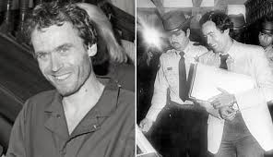
Sentencing and current status
Ted Bundy provided confession to all police departments in Utah, Colorado and Idaho.
Bundy came up with opinions that would trigger a delay in his execution by suggested that he had more cases yet to confess.
Bundy requested more time to cover the entire confession content (Innes, 2017).
Police planned to come up with a strategy to finalize his sentencing.
Notes:
Ted Bundy was provided with enough time to give a confession to all police departments in Utah, Colorado and Idaho, a situation the led the police department to schedule an immediate execution. Bundy came up with opinions that would trigger a delay in his performance by suggested that he had more cases yet to confess, and he requested more time to cover the entire confession content (Innes, 2017). The police demanded he to provide details of the remaining victims, but nothing could be found after pursuing the cases (Innes, 2017). Police officers learned that Bundy wanted to delay the scheduling of his execution further, and they planned to come up with a strategy to finalize his sentencing.

Slide 16
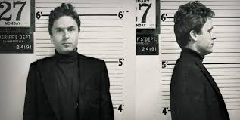
Cont. Sentencing and current status
Authorities saw no need for further Bundy’s confession.
Bundy supporters requested the victim's family and supervisors to ask the court to provide more time to reveal the remaining cases. However, no one was ready to negotiate (Innes, 2017).
Families of the victims believed that their loved ones had already died, and it was confirmed that Bundy was their killer (Innes, 2017).
Bundy died on 4th 1989, at 7: 16 AM in Raiford Electric Chair.
Notes:
It reached a time where the authorities saw no need for further confession. Bundy supporters, through the Florida governor, Bob Martinez, requested the victim's family and supervisors to ask the court to provide more time to reveal the remaining cases; however, no one was ready to negotiate (Innes, 2017). Families of the victims believed that their loved ones had already died, and it was confirmed that Bundy was their killer (Innes, 2017). Ted Bundy was scheduled for an execution that took place on January, 24th 1989, at 7: 16 AM in Raiford Electric Chair. Bundy’s death was celebrated by many by dancing, singing and lighting fireworks.

Slide 17
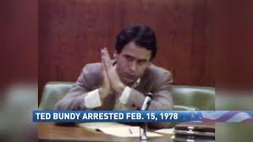
Diagnosis of the offender
Ted Bundy had Bipolar disorder, where the results were based on the serial killer's behavior (Browne, 2016).
Other medical experts intervened in the situation and discovered that tend might be suffering from a series of physiological disorders, including antisocial personality disorder (Browne, 2016).
Bundy suggested that phonographic videos in the media were even worse and baseless than his actions.
Notes:
Ted Bundy was subjected to various psychiatric examinations before his sentencing was initiated. According to the first diagnosis that was conducted in the New York University School of Medicine, Ted Bundy had Bipolar disorder, where the results were based on the serial killer's behavior (Browne, 2016). Other medical experts intervened in the situation and discovered that tend might be suffering from a series of physiological disorders, including antisocial personality disorder (Browne, 2016). According to an interview conducted by James Dobson, a Christian Evangelist, Bundy suggested that phonographic videos in the media were even worse and baseless than his actions.

Slide 18
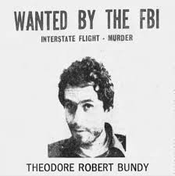
Cont. Diagnosis of the offender
Bundy's interviews revealed that he had a strange way of thinking.
Bundy seemed less concerned and surprised at the same time after he was notified about missing of one of his victims (Browne, 2016).
He believed that America was a place where its residents could not be noticed unless they could do it for themselves.
Bundy did not believe in human beings' relationship since there is much evidence of personal and even government denial (Browne, 2016).
Notes:
The information that was retrieved from Bundy's interviews revealed that he had a strange way of thinking. Bundy seemed less concerned and surprised at the same time after he was notified about missing of one of his victims (Browne, 2016). He believed that America was a place where its residents could not be noticed unless they could do it for themselves. For each murder and rape case Bundy undertook, he associated it with a barrier he created long ago. Again, Bundy did not believe in human beings' relationship since there is much evidence of personal and even government denial (Browne, 2016). Based on the above, it is evident that Bundy had a bipolar disorder that instigated him to commit rape and murder cases.

Slide 19
References
Browne, J. (2016). Devil's Defender: My Odyssey Through American Criminal Justice from Ted Bundy to the Kandahar Massacre. Chicago Review Press.
Innes, B. (2017). Serial Killers: Shocking, Gripping True Crime Stories of the Most Evil Murderers. Quercus Publishing.
Murray, J. L. (2017). The role of sexual, sadistic, and misogynistic fantasy in mass and serial killing. Deviant behavior, 38(7), 735-743.
Williams, D. J. (2020). Is serial sexual homicide a compulsion, deviant leisure, or both? Revisiting the case of Ted Bundy. Leisure Sciences, 42(2), 205-223.

