Slide 1
Telecommunications and the Internet- Threats, Vulnerabilities in the Commerce Sector
Name
Course Title
Institution of Affiliation

Slide 2
Introduction
Telecommunication and the internet has transformed the world into a village.
People can finalize business deals swiftly and without any hindrance.
Commerce has benefitted the most from the advancement with companies such as Amazon operating majorly through the internet.
This has brought new challenges in matters of business safety.
Company’s information systems as well as customers face a myriad of threats and vulnerabilities in the process of doing business.
Notes:
In the world today, telecommunication and the internet rule every facet of life and has produced a global village that is fully interconnected. People are able to finalize business transactions within the blink of an eye with companies such as Amazon relying solely on the internet and ecommerce for their business dealings. However, with this development came new challenges with new threats, risks, and challenges. More often than not, company release reports of their information systems being attacked by hackers and other cyber assaults.

Slide 3
Threats and vulnerabilities in Ecommerce
The vulnerabilities can be viewed from both physical and cyber perspective.
Physical vulnerabilities include theft of hardware that support telecommunication and warehousing and logistics risks.
Cyber threats are the most pronounced and include the following phishing attacks, money thefts, data misuse, hacking, credit card frauds, and unprotected services.
Amazon has faced many of these threats in the past with price manipulation, Wi-Fi eavesdropping, and malicious codes threatening its existence.
Notes:
Amazon, a company in the commerce sector, has its share of vulnerabilities and risks with respect to cyber security. The vulnerabilities can be viewed from both physical and cyber perspective. Physical vulnerabilities include theft of hardware that support telecommunication and warehousing and logistics risks. Cyber threats are the most pronounced and include the following phishing attacks, money thefts, data misuse, hacking, credit card frauds, and unprotected services. Amazon has faced many of these threats in the past with price manipulation, Wi-Fi eavesdropping, and malicious codes threatening its existence.

Slide 4
Physical threats
In its ecommerce business, Amazon has had to deal with systems breakdown resulting from loss of hardware to thieves.
In telecommunications, every hardware is interlinked to the other and disconnection of one of them leads to systems failure.
Ecommerce also faces the risk of running out of a product while orders are coming in.
A product may also be delivered to the wrong customer or there maybe delays and this depict vulnerabilities in warehousing and logistics.
Notes:
Theft of hardware is a threat to the operation of business at Amazon. It sabotages the functioning of systems in the company which are interlinked. There is also the risk of system inefficiency in handling orders with the possibility of product getting depleted while the orders are still coming in. A product may also be delivered to the wrong customer or there maybe delays and this depict vulnerabilities in warehousing and logistics.

Slide 5
Cyber Threats
Price manipulation was one of the greatest vulnerabilities faced by Amazon in the past.
The system is automated right from the point of order all the way to when the customer make a payment and receive a product.
Intruders would slide in and install a different price into the URL and steal all the data.
There is also the risk of data sniffing: an intruder attacks a data packet flow and scans individual data such as credit card numbers among other sensitive information.
Notes:
Manipulation of prices has put Amazon in crises in the past. Since the system is automated right from the point of order all the way to when the customer make a payment and receive a product, intruders slide in and install a different price into the URL and steal customer data. Data sniffing is another threat where an intruder attacks a data packet flow and scans individual data such as credit card numbers among other sensitive information.

Slide 6
Cyber Threats
Human error also poses a threat to the security transactions in the commerce sector.
One may leave sensitive login details in a public computer and this would lead to retrieval of sensitive information such as bank account details.
Password mistakes such as weak passwords or writing them down on post notes also infiltrates the security of the company’s third party sellers.
Misdelivery is another human error that would lead to cyber threat.
Tail gating; unauthorized entry through a secure door or barrier.
Notes:
According to a study by IBM, human error is the main cause of 95% of cyber security breaches. One may leave sensitive login details in a public computer and this would lead to retrieval of sensitive information such as bank account details. Password mistakes such as weak passwords or writing them down on post notes also infiltrates the security of the company’s third party sellers. Misdelivery is another human error that would lead to cyber threat i.e. sending something to the wrong recipient. Tailgating is when an unauthorized person follows someone through a secure door or barrier - usually by simply walking close behind them (Ahola, 2019)

Slide 7
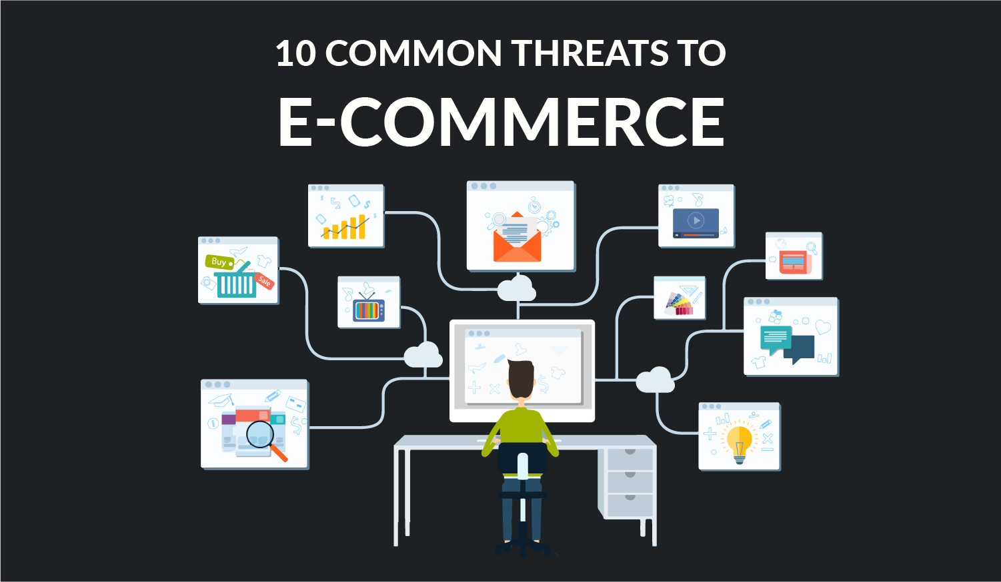
Chapman, 2018
Notes:
Photograph highlights the common tasks in the telecommunication involved in- commerce.

Slide 8
Cyber Threat Cont…
Malicious codes; Trojan horses, worms, and viruses.
Trojan horses are codes programmed to perform a destructive function; attack the computer when downloading something.
Worms places themselves into the computer direct through the internet; can infect millions of computers within a few hours.
Viruses are external threats that corrupt files; destroy information systems and always need a host to facilitate transmission; happens when employees insert their flash disks and hard drives in the company’s systems computers.
Notes:
Malicious codes are another threat to the operation of commercial activities at Amazon and include Trojan horses, worms, and viruses. Trojan horses are codes programmed to perform a destructive function; attack the computer when downloading something. Worms places themselves into the computer direct through the internet; can infect millions of computers within a few hours. Viruses are external threats that corrupt files; destroy information systems and always need a host to facilitate transmission; happens when employees insert their flash disks and hard drives in the company’s systems computers.

Slide 9
Other Security Risks
Amazon is facing fresh security risks owing to change of tactics from the hackers.
Company’s independent and third party sellers are being targeted by hackers.
They post fake deals and steal money directly from some of the accounts.
They change bank deposit information on Amazon accounts of active sellers to steal money from them.
They also take advantage of inactive sellers accounts to post nonexistent merchandise at unbelievable discounts to lure customers.
Notes:
Apart from the previously discussed risks, Amazon is facing new threats with the changing tactics of hackers. They are now posting fake deals and steal money directly from some of the third party sellers. They change bank deposit information on Amazon accounts of active sellers to steal money from them. They also take advantage of inactive sellers accounts to post nonexistent merchandise at unbelievable discounts to lure customers.

Slide 10
Vulnerabilities in the Communication Line
Users of Amazon Echo and Amazon Kindle face new vulnerability as they communicate with the system.
Vulnerable to Key Reinstallation Attacks (KRACK); hackers infiltrate internet devices through Wi-Fi access points.
The hackers position themselves in the middle where they can view and control traffic across a Wi-Fi network.
Vulnerabilities in Amazon Home Assistant; Broadcast Replay Attack.
Notes:
Key Reinstallation Attacks (KRACK) allow an adversary to perform a man in the middle attack–in other words have the ability to view and control traffic–across a Wi-Fi network protected by the standard WPA2. There are also vulnerabilities to Amazon Home Assistant known as Broadcast Replay Attack.

Slide 11
Cascading Effects to Other Sectors
The financial sector is interconnected to commerce.
Security risks in commerce also threaten the financial sector.
Hackers seek to empty bank accounts of their victims.
Banks and other financial institutions need secure verification strategies.
Transactions have to be verified from both ends, especially sellers’ identity.
Phishing attacks steal online banking details as well as human errors; leaving credit cards and passwords exposed.
Notes:
The financial sector is interconnected to commerce. Security risks in commerce also threaten the financial sector. Hackers seek to empty bank accounts of their victims. Banks and other financial institutions need secure verification strategies. Transactions have to be verified from both ends, especially sellers’ identity.
Phishing attacks steal online banking details as well as human errors; leaving credit cards and passwords exposed.

Slide 12
Risk Prioritization and Mitigation Strategies
    Secure Sockets Layer (SSL); encrypts web traffic; makes sure information passing between the customer and the website cannot be read or taken by a third party.
    This prevents someone from “sniffing” your traffic and reading in plain text exactly what you’re doing.
    Obscured header Information; hide the website details from attackers.
    Secure Cookies - Prevents client malware from impersonating the customer.
    Email protocols such as SPF, DKIM and DMARC exist to verify that emails and web addresses are real
Notes:
The first key to good security is making sure information passing between the customer and the website can’t be read or taken by a third party. Secure Sockets Layer (SSL) is a mechanism that encrypts web traffic, meaning that only those in possession of a key (you and the website) can read any of the data.
This prevents someone from “sniffing” your traffic and reading in plain text exactly what you’re doing.
It’s always been the practice for web server software to advertise itself to clients. It’s always been the job of sysadmins to disable that. There are very, very few legitimate reasons a visitor to a website needs to know what version of web server the site runs. But obviously there are many reasons why someone looking to attack a site would want that information. Despite often being the default configuration, these headers should always be obscured to prevent hackers from quickly narrowing down the attack routes. Amazon has all of their headers obscured, but many sites do not.
Email protocols such as SPF, DKIM and DMARC exist for just this reason. These mechanisms put information on the internet that say “mail from Amazon will ONLY come from these servers” and a list of valid source servers. Email purportedly from Amazon but originating from another mail server will be caught immediately for failing the SPF/DMARC check and be rejected as spam. Amazon uses these mechanisms, a good sign for a company that sends so many emails (Upguard).

Slide 13
Conclusion
Companies in the commerce sector face numerous and diverse threats and risks when it comes to information and communication.
Amazon, a company in the ecommerce niche is not an exception to these challenges.
It has reported phishing attacks, malicious codes, credit card fraud, and money theft, among other risks.
With them being an online business, their cyber threats are more pronounced than the physical threats.
As mitigation strategies, they use Secure Sockets Layer, Obscured header Information, and secured cookies, among other risk prioritization strategies.

Slide 14
References
Ahola, M. (2019, October 18). The Role of Human Error in Successful Cyber Security Breaches. Usecure. Retrieved from https://blog.getusecure.com/post/the-role-of-human-error-in-successful-cyber-security-breaches
Salzano, M. (2017, April 10). Report: Amazon Faces Cyber Security Concerns. Home world Business. Retrieved from https://www.homeworldbusiness.com/61455-2/
Upguard. (2020, January 29). How does Amazon handle cybersecurity? Retrieved from https://www.upguard.com/blog/prime-day-how-amazon-handles-cybersecurity

