Slide 1

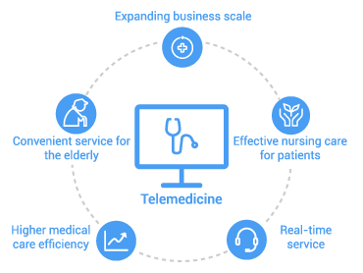
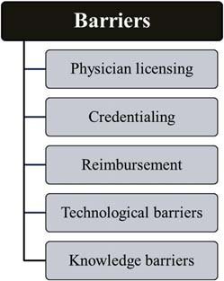
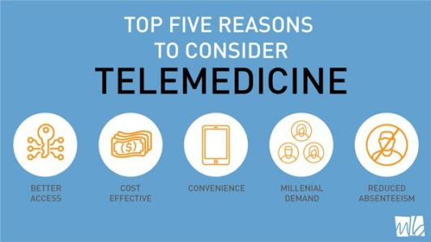
Use of telemedicine in Rural Hospitals
Telemedicine- It refers to the practice of taking care of the patients without physical contact between the patient and the doctor. Through telemedicine technology has enabled the doctor to use tele-confreencing tool to consult the patient.
Benefits of telemedicine in Rural Hospitals
It helps in overcoming the geographical barrier between the patients and the doctors.
The telemedicine has helped in improving the quality of healthcare provided, especially for the patients with both mental and physical health problems.
Reduces the health costs
It helps in facilitating the traditional face to face medicine
Improves the provider satisfaction
It helps in improving provider satisfaction.
Types of Telemedicine
Store and forward
Real time interactive services
Remote monitoring

