Slide 1
Tetanus
Name
Institution
Date

Slide 2
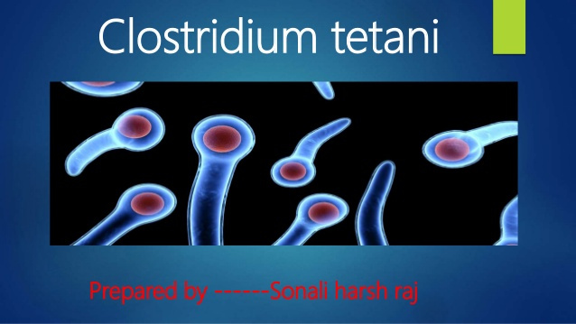
Introduction
There are various microorganisms responsible for causing infections in humans, including bacteria, viruses and fungi.
Bacteria exist almost everywhere on the Earth and are essential in world ecosystems (Thwaites, 2017).
Bacteria lead to bacterial infections in living organisms. The human body has numerous bacteria, approximately more than human cells.
Tetanus is among the bacterial infections that affect humans.
The microorganism causing tetanus is Clostridium tetani.
Notes:
There are various microorganisms responsible for causing infections in humans, including bacteria, viruses and fungi. Bacteria exist almost everywhere on the Earth and are essential in world ecosystems. Bacteria lead to bacterial infections in living organisms. The human body has numerous bacteria, approximately more than human cells (Thwaites, 2017). Tetanus is among the bacterial infections that affect humans. The microorganism causing tetanus is Clostridium tetani.

Slide 3
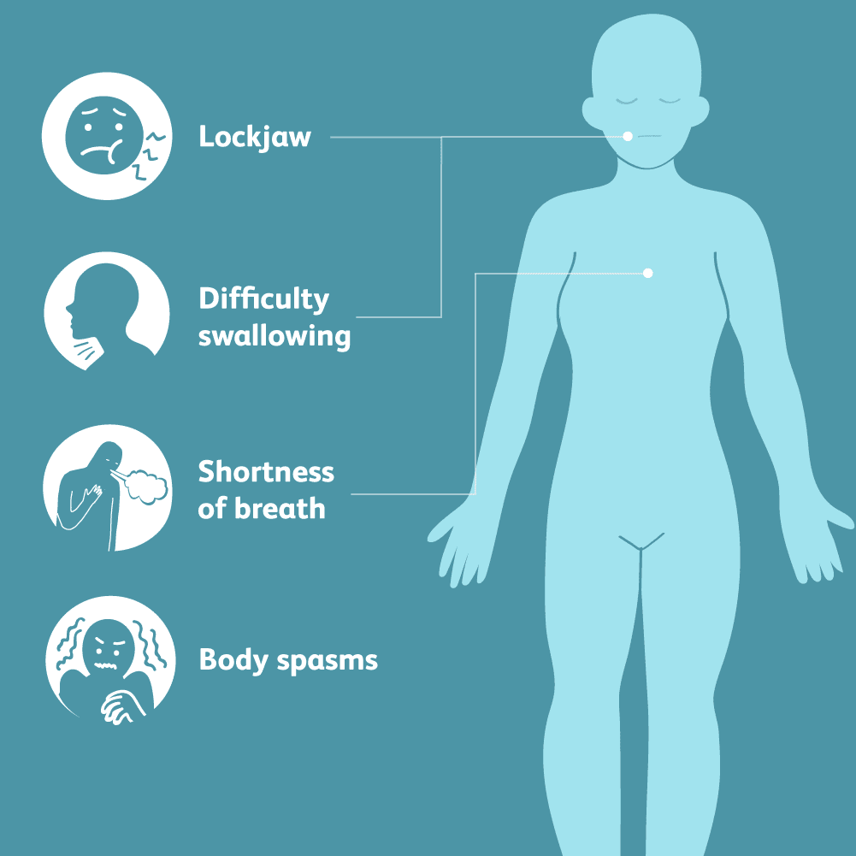
Sign and Symptoms of Tetanus
The normal incubation time for tetanus infections is seven to ten days.
Ripples and rigorousness manifest tetanus in the jaw, stiffness of the neck muscles, and difficulties in swallowing (Baviskar et al., 2021).
Some patients experience stiffness in the abdominal muscles and painful body spasms that happen when triggered by light, loud music, or physical touch.
Tetanus is also manifested by fever, sweating, raised blood pressure, and speedy heart rate.
Notes:
The normal incubation time for tetanus infections is seven to ten days. Ripples and rigorousness manifest tetanus in the jaw, stiffness of the neck muscles, and difficulties in swallowing (Baviskar et al., 2021). Some patients experience stiffness in the abdominal muscles and painful body spasms that happen when triggered by light, loud music, or physical touch. Tetanus is also manifested by fever, sweating, raised blood pressure, and speedy heart rate.

Slide 4
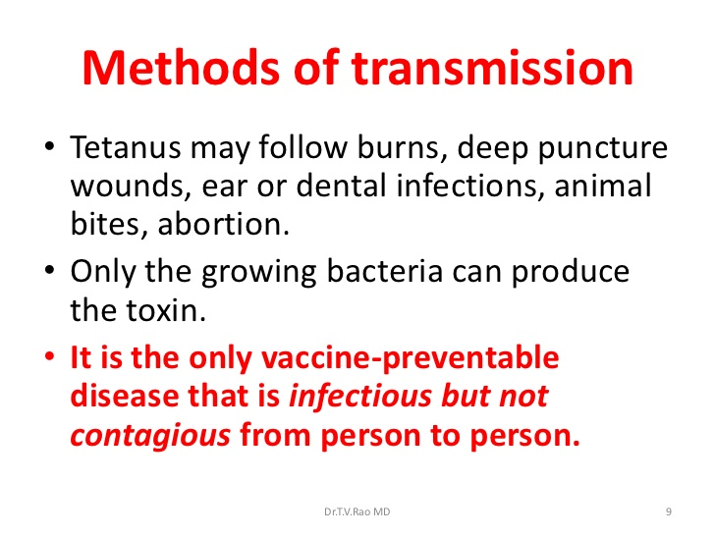
Lifecycle and Transmission of Tetanus
Clostridium tetani have two developmental stages, sporular phase and vegetative phase. The vegetative stage is anaerobic bacterial that is incapable of surviving in open-air exposure and thus survives in the soil till maturity.
The sporular stage can withstand oxygen and other environmental extremes. The spore of tetanus can survive for more than 40 years in the soils in infectious form (Baviskar et al., 2021).
The Clostridium tetani are hosted within the human colon when in the human body.
Transmission of the spores happens in spores to open wound on the skin and get deeper into the body for oxygen (Baviskar et al., 2021). This is followed by germination and the production of toxins that enter the bloodstream.
The target place of Clostridium tetani is within the central nervous system, where it establishes infection.
Besides, Clostridium tetani can be transmitted by injecting drug use and street dust humans face during abdominal surgery.
Notes:
Clostridium tetani have two developmental stages, sporular phase and vegetative phase. The vegetative stage is anaerobic bacterial that is incapable of surviving in open-air exposure and thus survives in the soil till maturity. The sporular stage can withstand oxygen and other environmental extremes. The spore of tetanus can survive for more than 40 years in the soils in infectious form. The Clostridium tetani are hosted within the human colon when in the human body. Transmission of the spores happens in spores to open wound on the skin and get deeper into the body for oxygen. This is followed by germination and the production of toxins that enter the bloodstream (Baviskar et al., 2021). The target place of Clostridium tetani is within the central nervous system, where it establishes infection. Besides, Clostridium tetani can be transmitted by injecting drug use and street dust humans face during abdominal surgery.

Slide 5
Epidemiology of Tetanus
The case fatality of tetanus ranges from 10-80%, and its prevalence is much pronounced among the children and elderly (Center for Disease Control and Prevention, 2018).
Tetanus has been almost eradicated in the United States, but immigrants have been exposing American to the infections through sharing infected equipment.
The average fatality caused by tetanus is approximately 10% to 30%. The infection is much prevalent in Africa and Asia, where immunization has not been well established.
In 2019, England recorded only four cases, and this reduction in infections has been associated with an effective childhood vaccination program (Baviskar et al., 2021).
Two exotoxins describe the virulence factors of Clostridium tetani, tetanolysin and tetanospasmin, encoded by plasmid bone genes. The neurotoxin tetanospasmin is somewhat comparable with toxin botulinum toxin in structure and the manner of action although they affect different part of the target nervous system.
Notes:
The fatality of tetanus ranges from 10-80%, and its prevalence is pronounced among the children and elderly. Tetanus has been almost eradicated in the United States, but immigrants have been exposing American to the infections through sharing infected equipment. The average fatality caused by tetanus is approximately 10% to 30%. The infection is much prevalent in Africa and Asia, where immunization has not been well established. In 2019, England recorded only four cases, and this reduction in infections has been associated with an effective childhood vaccination program (Baviskar et al., 2021). Two exotoxins describe the virulence factors of Clostridium tetani, tetanolysin and tetanospasmin, encoded by plasmid bone genes. The neurotoxin tetanospasmin is somewhat comparable with toxin botulinum toxin in structure and the manner of action although they affect different part of the target nervous system.

Slide 6
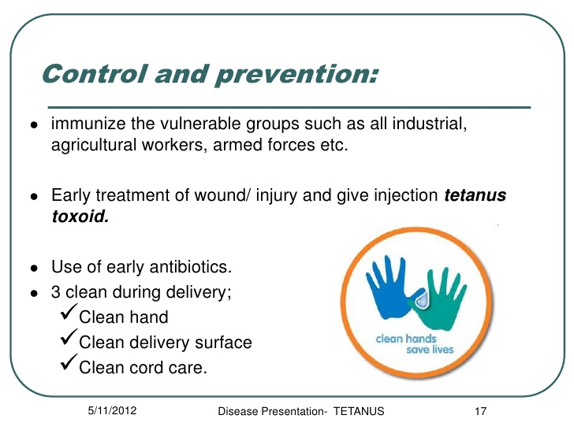
Treatment, Control and Prevention
Tetanus is getting less pronounced in recent days due to the vaccination offered to children. Vaccination is the primary way of preventing infection.
The trusted medication that can be offered for patients with the infection includes antitoxins, sedatives, and antibiotics to fight the infections (Center for Disease Control and Prevention, 2018).
The infection can be managed by controlling bleeding to prevent exposure to the pathogen.
Keeping the wounds cleans by rinsing the wound and cleaning it thoroughly.
The wound covering and dressing helps in speeding the healing, nevertheless bandages can preserve the wound clean and prevent the entry of damaging bacteria (World Health Organization, 2017).
Lastly, the surgical tools and the piercing tools should be sterilized to kill the Clostridium tetani.
Notes:
Tetanus is getting less pronounced in recent days due to the vaccination offered to children. Vaccination is the primary way of preventing infection. The trusted medication that can be offered for patients with the infection includes antitoxins, sedatives, and antibiotics to fight the infections. The infection can be managed by controlling bleeding to prevent exposure to the pathogen (World Health Organization, 2017). Keeping the wounds cleans by rinsing the wound and cleaning it thoroughly. The wound covering and dressing helps in speeding the healing, nevertheless bandages can preserve the wound clean and prevent the entry of damaging bacteria. Lastly, the surgical tools and the piercing tools should be sterilized to kill the Clostridium tetani.

Slide 7
Facts, Statistics and Histories of Tetanus
Tetanus was first discovered in 1884 in animals.
The infection is not associated with vectors and has no direct human transmission.
In 2001, the estimated deaths related to tetanus were 282,000, and the incidences were much pronounced in Asia and many parts of the African continent (World Health Organization, 2017).
The tetanus toxoid immunization was produced in 1924, which led to a decline in the incidence of infection by 70%.
Tetanus patients can survive the infection with better medication; however, older adults and infants have a higher death rate due to weak immunity.
Notes:
Tetanus was first discovered in 1884 in animals. The infection is not associated with vectors and has no direct human transmission. In 2001, the estimated deaths related to tetanus were 282,000, and the incidences were much pronounced in Asia and many parts of the African continent. The tetanus toxoid immunization was produced in 1924, which led to a decline in the incidence of infection by 70% (World Health Organization, 2017). Tetanus patients can survive the infection with better medication; however, older adults and infants have a higher death rate due to weak immunity.

Slide 8
References
Baviskar, P. S., Ahuja, S. A., Natarajan, S., & Bagchi, P. R. (2021). Tetanus of suspected dental causality. Journal of stomatology, oral and maxillofacial surgery, 122(1), 115-118.
Center for Disease Control and Prevention. (2018). Causes and Transmission. Retrieved from https://www.cdc.gov/tetanus/about/causes-transmission.html#:~:text=Tetanus%20is%20an%20infection%20caused,when%20they%20enter%20the%20body.
Thwaites, C. L. (2017). Botulism and tetanus. Medicine, 45(12), 739-742.
World Health Organization. (2017). Tetanus Disease Epidemiology. Retrieved from; http://www.emro.who.int/health-topics/tetanus/disease-and-epidemiology.html

