Slide 1

Module 4 Quality
Lecture by
Dr. Kathleen Healy-Collier

Slide 2
Introduction to Healthcare
Quality Management
Improvement Project Teams

Slide 3
Improvement Project Team
A group of people working together to implement an improvement or solve a problem
The team consists of:
  Team sponsor
  Team leader
  Team members
  Facilitator
  Recorder
  Timekeeper

Slide 4
Team Sponsor
Charters the improvement team
Provides initial improvement goals
Monitors team progress
Supports the team and clears away barriers

Slide 5
Team Leader
Often the process owner
  Organizes the project
  Chairs team discussions
  Keeps the project focused on goals
  Establishes the meeting schedule
  Serves as a liaison between the team and the team sponsor

Slide 6
Team Members
Five to ten people with personal and detailed knowledge of some part of the performance problem
Share responsibility in achieving improvement goals
  Participate in discussions, decision making, and other team tasks

Slide 7
Other Team Positions
Some improvement teams include
  Facilitator (helps manage discussions about the process during team meetings)
  Recorder (captures ideas, decisions, action items, and assignments in writing)
  Timekeeper (keeps track of time during project meetings)

Slide 8
Team Meetings
First meeting
  Review goals and project charter
  Establish ground rules
  Define time schedule for project completion
Subsequent meetings
  Advance through the improvement model to achieve project goals

Slide 9
Stages of Team Development
Stage 1: Forming
Characteristics of forming:
  Interactions are polite and superficial; open conflict is rare.
  Group thinking (conformity of opinion) tends to dominate.
  Members rely on the leader for direction.
  Project goals are not clear.
Role of team leader:
  Introduce members to project goals and the timeline for completion.
  Help members become acquainted.
  Allow time for members to get comfortable with one another while still moving the project along.
  Establish ground rules.

Slide 10
Stage 2: Storming
Characteristics of storming:
  Participation increases; members want some influence on the project.
  Group thinking decreases; open conflict increases.
  Members are more critical and question how and why decisions are made.
  Members may challenge the team leader directly or indirectly.
Role of team leader:
  Clarify team’s role in achieving project goals.
  Address conflicts as they surface; review and enforce ground rules.
  Revisit purpose of the improvement project.
  If necessary, engage project sponsor in resolving conflicts.

Slide 11
Stage 3: Norming
Characteristics of norming:
  Members are more friendly, more supportive of one another.
  Ground rules that may have been overlooked in the beginning are now taken more seriously.
  Subgroups may be formed to move the project along faster.
  Conflict is handled openly and constructively.
Role of team leader:
  Encourage members to spend less time generating ideas and more time making decisions.
  Keep the team on track toward the improvement goals.
  Provide time for discussion and feedback.

Slide 12
Stage 4: Performing
Characteristics of performing:
  All contributions are recognized and appreciated.
  Members develop a sense of cohesiveness and team identity.
  Project goals are achieved; the team may look for additional improvement opportunities.
Role of team leader:
  Take a less directive and more supportive role.

Slide 13
Improvement Teams
Teams of people are personally involved in improving performance.
The team environment must foster interaction and open communication.
  Such an environment promotes generation of new ideas and continuous improvement.

Slide 14
Introduction to Healthcare
Quality Management
Continuous Improvement

Slide 15
Continuous Improvement
Analyzing performance of various processes and improving them repeatedly to achieve quality objectives
  Some performance problems can be resolved quickly, but in other situations an in-depth evaluation may be required.

Slide 16
The Improvement Step
Find and fix the cause of unfavorable performance.
Two factors influence the decision to initiate improvement:
  Results of performance assessment
  Improvement priorities

Slide 17
Common Steps of Performance Improvement
Define the improvement goal
Analyze current practices
Design and implement improvements
Measure success

Slide 18
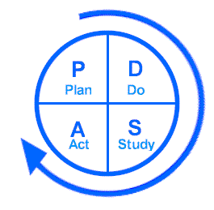
Improvement Models
Walter A. Shewhart
W. Edwards Deming
Act
Plan
Check
Do

Slide 19
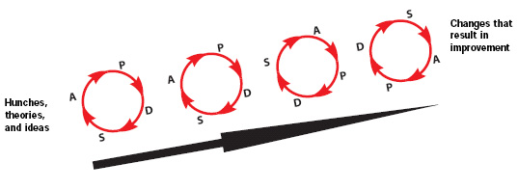
Improvement Models
Rapid Cycle Improvement

Slide 20
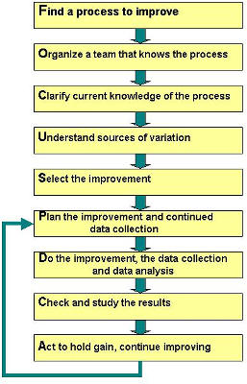
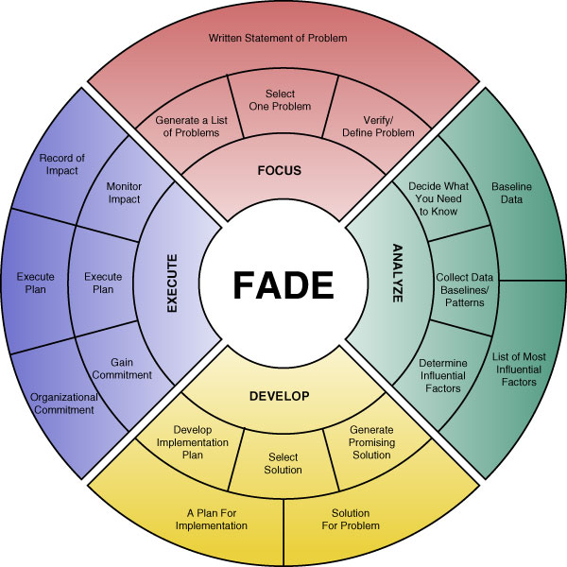
Improvement Models
FOCUS-PDCA
FADE

Slide 21
Improvement Models: Lean
Lean: Eliminate inefficiencies adversely affecting performance.
Lean’s project goal is to minimize waste.

Slide 22
Types of Waste (Muda)
Movement
Waiting
Overprocessing
Defects
Inventories
Transportation
Design
Overproduction

Slide 23
Lean Project Steps
  Performance problem identified
  Evaluate current work processes
  Identify areas of opportunity
  Find root causes of problems
  Design better way of working
  Create implementation plan
  Identify expected improvements
  Make process changes and measure results
Notes:
Kaizen event: A focused, short term project aimed at improving a particular process
5

Slide 24

Lean Improvement Techniques
5S methodology
Kanban
Mistake-proofing
Value stream map
Visual control

Slide 25
Improvement Models: Six Sigma
Six Sigma: Reduce performance variability
  Goal: Create processes that operate within Six Sigma quality.
  The higher the sigma level, the lower the defect rate.
    1 sigma = 32% defect rate
    2 sigma = 5% defect rate
    6 sigma = 99.999% defect rate (near perfect)

Slide 26
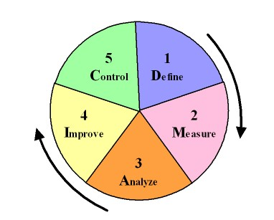
Six Sigma Project Steps

Slide 27
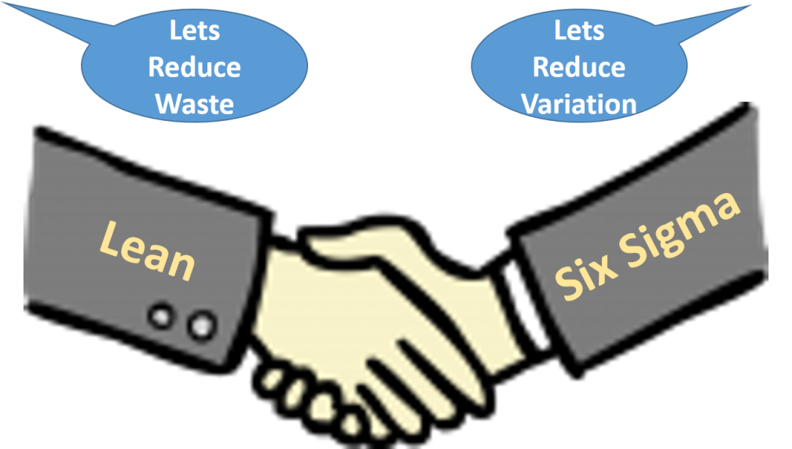
Improvement Models:
Lean Six Sigma
Lean Six Sigma: Eliminate waste and reduce process variation

Slide 28
Performance Improvement Models
Organizations don’t choose one approach to the exclusion of the others.
The approach most likely to achieve improvement goals for a particular project is used.

Slide 29
Continuous Improvement
Various improvement models are used to improve healthcare quality.
The different models share a common thread of analysis, implementation, and review.

Slide 30
Introduction to Healthcare
Quality Management
Improving Patient Safety

Slide 31
Patient Safety Improvement
Protecting patients from unintended harm has always been a high priority for healthcare professionals.
Traditional methods of ensuring patient safety:
  Ensure competency of physicians and staff.
  Define systems and processes.
  Conduct performance measurement and improvement activities.

Slide 32
System Improvements Are Needed
The 2000 IOM report To Err Is Human highlighted the need for a more organized systems approach to preventing medical errors that harm patients.
Even the most competent professionals can make mistakes.
  People are “set up” by the system to make a mistake 99.9% of the time.

Slide 33
Patient Safety: A Component of Quality Management
Safety of patient care is measured, measurement results are assessed, and improvements are made.

Slide 34
Measures of Patient Safety
Topic of Interest | Measure
How often do patients develop an infection as a result of surgery? | Number of surgical cases in which patients developed an infection following surgery per 100 procedure days
How often do patients develop an infection as a result of a central venous catheter insertion? | Average number of hospital-wide central venous catheter infections per 1,000 catheter line days
How often do patients develop pneumonia as a result of being on a ventilator? | Rate of pneumonia detected per 1,000 ventilator days in the intensive care units
How often do patients fall? | Number of falls per 10,000 adjusted patient days
How often do patients experience a medication error? | Number of medication errors per 1,000 doses of medication

Slide 35
Common Data Source
Caregivers document occurrence of patient incidents.
Examples of reportable events:
  Error that occurs during the delivery of patient care (e.g., medication administration mistake, treatment error)
  Patient develops condition seemingly unrelated to his or her disease (e.g., infection, pressure ulcer)
  Serious injury or unexpected death of a patient
  Patient fall

Slide 36
Data from Incident Reports
Monitor incident trends
Identify common factors that contribute to incidents
Number of Incidents for the Month of July
14
12
10
8
6
4
2
0
Anesthesia
Equipment-
Fall
Event
IV/Blood
Medication
Misc.
Event
Self-Injury
Event
Treatment-
Event
Related Event
Event
Event
Related Event

Slide 37
State and National Incident Databases
Several states require providers to report harmful patient incidents to the health department.
In 2005, Congress enacted legislation creating patient safety organizations.
  Purpose: Gather and analyze information about patient incidents from providers in all states.

Slide 38
Improving Patient Safety
Common improvement model steps are followed for some safety improvement projects:
  Define the improvement goal.
  Analyze current practices.
  Design and implement improvements.
  Measure success.

Slide 39
Improving Patient Safety
Some projects use specialized patient safety improvement models:
  Failure mode and effects analysis
  Root cause analysis

Slide 40

Failure Mode and Effects Analysis
An improvement model used by a team to proactively improve the safety of a process
The team uses a scoring scheme to prioritize failures for elimination.

Slide 41
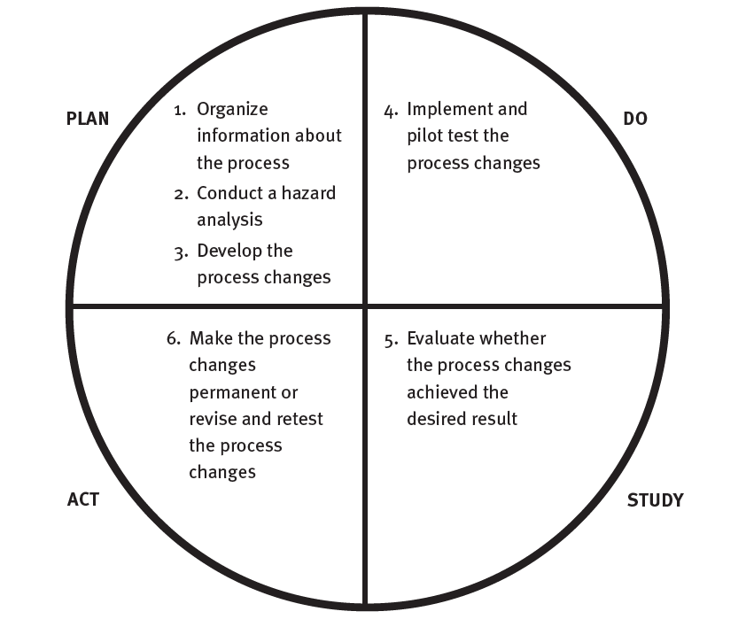
FMEA Steps
Similar to PDSA improvement model

Slide 42
Completed FMEA
Process: Collecting patient demographic and insurance information
Process Step | Potential Failure Mode | Potential Effect | Severity of Effect | Probability of Failure | Detection of Failure | Criticality Score
Verify patient’s mailing address and phone number | Registration clerk does not verify address and phone number | Billing statement is sent to the wrong address; physician is unable to contact patient if necessary after patient leaves clinic. | 4 | 4 | 5 | 80
 | Registration clerk enters demographic information incorrectly | Billing statement is sent to the wrong address; physician is unable to contact patient if necessary after patient leaves clinic. | 4 | 3 | 5 | 60
 | Patient gives registration clerk incorrect information | Billing statement is sent to the wrong address; physician is unable to contact patient if necessary after patient leaves clinic. | 4 | 3 | 5 | 60
Verify patient’s insurance information | Wrong insurance company is billed | Payment delay | 5 | 3 | 3 | 45
 | Registration clerk does not perform verification of insurance benefits | Payment delay | 5 | 4 | 3 | 60
Severity rating scale 1 = No effect 2 = Minimal effect 3 = Moderate, short-term effect 4 = Significant, long-term effect 5 = Catastrophic | Probability rating scale 1 = Highly unlikely/ never happened before 2 = Low/relatively few failures 3 = Moderate/occasional failures 4 = High/repeated failures 5 = Very high/failure almost inevitable | Detection rating scale 1 = Almost certain to be detected and corrected 2 = High likelihood of being detected and corrected 3 = Moderate likelihood of being detected and corrected 4 = Low likelihood of being detected and corrected 5 = Remote likelihood of being detected and corrected

Slide 43
Completed FMEA (cont.)
Critical Failure | Root Causes | Actions Intended to Eliminate or Reduce Failure or Mitigate Effects | Measures of Success
Registration clerk does not verify address and phone number. | Clerks are not trained and do not receive continuing education on use of address verification capabilities of registration computer system. | Provide address verification training for registration staff Educate registration staff on importance of address verification and demonstrate correct way to document that verification was performed | Percentage of billing statements returned because of invalid address
Registration clerk does not verify insurance benefits. | Management does not hold registration clerks accountable for insurance verification. | Implement policies and procedures that hold registrars accountable for verifying patients’ insurance Continue to educate registration staff on importance of insurance verification Implement incentives for registration staff to verify insurance benefits | Percentage of accounts for which registration clerk does not verify patient insurance benefits Percentage of accounts with incorrect insurance identification and group numbers Percentage of accounts billed to wrong insurance company

Slide 44
Root Cause Analysis (RCA)
An improvement model used to find and fix the fundamental system deficiencies that led to a sentinel or adverse event
  The goal is to identify and fix root causes to prevent recurrence of the event.
Joint Commission standards and some state regulations require RCA after harmful patient incidents.

Slide 45
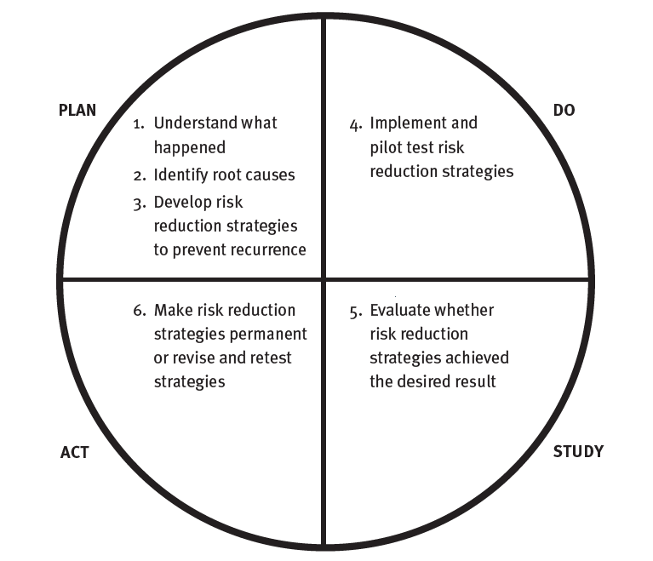
RCA Steps
Similar to PDSA improvement model

Slide 46
Understand What Happened and Identify Root Causes
Dig deeper to find the root causes—the most fundamental reasons the event occurred.

Slide 47
Look for the Underlying System Problems
Dig deeper to find the root causes—the most fundamental reasons the event occurred.
Why? Why? Why? Why?
Root causes
Causal factors
Adverse
event
Causes that, if corrected, would prevent recurrence of this and similar events
(usually no more than four)
Situations, circumstances, or conditions that, collectively with other causes, increased the likelihood of the adverse event

Slide 48
Design & Implement Corrective Actions
Action Category | Examples of Corrective Actions
Eliminate the chance of failure | Change the process to prevent failures Restructure tasks so that error-inducing behavior is no longer performed Automate the process to reduce the role of human involvement Purchase error-proof equipment
Help people perform their jobs correctly | Create visible displays of acceptable actions Conduct pre-action inspections using checklists or other reminders Educate staff and monitor compliance Standardize the process Reduce the number of steps in the process, thus reducing the chance of error Make ergonomic changes (e.g., improve lighting, reduce workplace clutter) Maintain equipment according to manufacturers' recommendations (e.g., regularly monitor compliance with routine maintenance schedules)
Help people identify and correct mistakes before the patient is harmed | Train people to better recognize and deal with unusual situations Create specialized teams of people who are coordinated and prepared to deal with unusual situations

Slide 49
Patient Engagement in Safety
To Err Is Human (2000): Patients themselves can provide a major safety check in most hospitals, clinics, and practices.
  Patients should be encouraged to speak up, ask questions, and report concerns about safety.
  Some providers are actively involving patients, family members, and laypersons in safety improvement initiatives.

Slide 50
Patient Safety Improvement
Patient safety improvement is a subset of an organization’s overall quality management system.
  Measures of patient safety
  Evaluation of safety data to identify improvement opportunities
  Safety improvement using familiar and specialized improvement models

Slide 51
Introduction to Healthcare
Quality Management
Organizing for Quality

Slide 52
Quality Does Not Happen by Accident
Every healthcare organization must create a framework for accomplishing quality activities.
Trustees and senior leaders must champion an environment that supports continuous improvement.

Slide 53
Board Has Ultimate Responsibility
Legal and moral responsibility for the quality of patient care and services lies with the governing board.
Personal involvement by board members is a key factor in high-performing organizations.

Slide 54
Quality Management System
Organizational framework that defines and guides all measurement, assessment, and improvement activities
Varies according to the type and size of the organization, available resources, externally imposed quality requirements, and internal improvement priorities
Often documented in a quality management (QM) plan

Slide 55
Groups Involved in QM
Board of Trustees
Administration/Senior Leaders
Coordinating Committee/Individual
Organized Medical Staff
Departments within the Organization
Quality Support Services

Slide 56
Common Board Responsibilities
Create a mission statement that defines the commitment to continuous improvement
Prioritize organizational quality goals
Consider QM results in strategic planning
Learn improvement approaches
Provide financial support for QM activities
Promote continuous improvement
Evaluate progress toward achieving quality goals
Review effectiveness of the QM program

Slide 57
Common Administration Responsibilities
Define QM infrastructure, assign QM responsibilities, and hold people accountable for fulfilling them
Allocate necessary resources
Encourage participation in QM activities
Promote education about QM concepts and techniques
Use performance data for strategic planning and new program design
Identify improvement opportunities and help achieve improvements
Keep board informed of quality and patient safety issues

Slide 58
Common Coordinating Committee Responsibilities
Meet periodically to oversee and direct QM activities
Set QM expectations, develop plans, and ensure implementation
Oversee evaluation of the QM program’s effectiveness
Communicate QM activities to the board
Ensure that QM structure and activities meet accreditation and regulatory requirements
In a small healthcare organization—such as a clinic—coordinating functions may be done by one person.

Slide 59
Hospital Medical Staff Structure
In a hospital, the medical staff is an organized entity with bylaws, rules and regulations, and a structure for conducting clinical QM activities.
  Joint Commission standards require hospitals to have a medical staff executive committee.
  No other committees are required; however, committees are often used to conduct specific QM functions (e.g., pharmacy and therapeutics committees).

Slide 60
Common Medical Staff Responsibilities
Oversee physician-related QM activities
Measure, assess, and improve clinical aspects of care
Evaluate competence of physicians and others who care for patients independently in the organization
Identify improvement opportunities and help achieve improvements
Report results of QM activities to the medical staff, oversight committees, and the board
If there is no organized medical staff, the medical director or governing board assumes these responsibilities.

Slide 61
Common Department Manager Responsibilities
Provide leadership oversight for departmental QM activities
Measure, assess, and improve clinical and operational performance
Ensure competence of people working in the department
Identify opportunities to improve performance and help achieve these improvements
Report results of departmental QM activities to departmental staff, oversight committees, and the board

Slide 62
Quality Support Services
Common support positions (which vary among organizations):
Quality director
Patient safety coordinator
Physician quality adviser
Case manager/utilization reviewer
Patient advocate
Risk manager
Infection control coordinator
Compliance officer
Data analysts
The quality support workforce is growing in response to the increasing scope and volume of QM activities.

Slide 63
QM Plan
Document describing the organization’s structure and process for measuring, assessing, and improving performance
  Required by some accreditation standards and regulatory mandates
  May have one organization-wide plan
  May have an organization-wide plan and plans in each department

Slide 64
QM Plan: Quality Statement
Describes the goal to which all quality management activities are directed
  Example: The major objective is to obtain patient outcomes of the highest quality and to provide services that meet or exceed the expectations of our customers.

Slide 65
QM Plan: Infrastructure
Describes major stakeholders and committee structure
May include illustrations of QM structure or information flow
Flow of Performance Information in a Hospital

Slide 66
QM Plan: Measurement, Assessment, and Improvement Activities
May include general statements about QM requirements
  Some plans detail the system-level, department-specific, and physician measures of performance.
May include improvement model(s) to be used
May include improvement priorities and goals for the upcoming year

Slide 67
QM Plan: Effectiveness Evaluation
Coordinating committee periodically evaluates:
  Is the quality infrastructure effective at accomplishing goals?
  Are quality goals being met?
  Are QM program changes needed to better meet quality goals?
  Should new quality goals be set for the upcoming year?
In the absence of a coordinating committee, this evaluation should be done by the board of trustees.

Slide 68
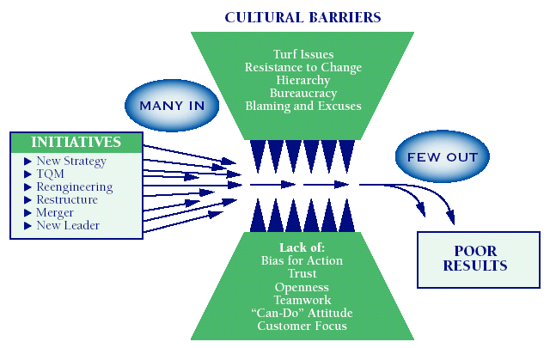
The “Jaws of Culture” Often Disrupt Change Initiatives (including QM)

Slide 69
Hospitable Environment
In a culture committed to quality…
  senior leaders and managers lead by example and encourage an environment of open, candid dialogue and continuous improvement;
  people who do the work are actively involved, and management seeks their views and listens to what they have to say;
  everyone is clear on the expected level of performance and receives feedback on progress;
  people are acknowledged and recognized for their efforts in furthering quality goals; and
  people trust and have confidence in leadership’s determination to continuously improve organizational performance.

Slide 70
Joint Commission Leadership Standards
Leaders must:
  Regularly evaluate the organization’s culture of safety and quality
  Define and encourage acceptable work behaviors that support a culture of safety and quality
  Identify and manage behaviors that undermine a culture of safety and quality

Slide 71
Leaders’ Contribution to a Supportive Culture
Demonstrate a leadership style that has an appropriate balance between caring and controlling
Be visibly interested in performance excellence
Encourage employees to have a questioning attitude regarding performance issues

Slide 72
Leaders’ Contribution (cont.)
Monitor performance trends to determine whether objectives are being achieved
Take a genuine interest in performance improvements and recognize those who make them
Take personal responsibility for directly improving aspects of performance in their area of responsibility

Slide 73
Turning Around the Culture
Understand the severity and spread of the cultural issues affecting quality and safety.
  Conduct baseline and follow-up surveys.
  Expect culture changes to take time (three to five years).
Determine critical work–culture components that will adversely affect future performance.
  Concentrate change efforts on these components.

Slide 74
Quality Does Not Happen by Accident
Effective framework for accomplishing QM activities
Culture supportive of continuous improvement

