Slide 1

Module 5 Quality
Lecture by
Dr. Kathleen Healy-Collier

Slide 2
Introduction to Healthcare
Quality Management
Improving Patient Safety

Slide 3
Patient Safety Improvement
Protecting patients from unintended harm has always been a high priority for healthcare professionals.
Traditional methods of ensuring patient safety:
  Ensure competency of physicians and staff.
  Define systems and processes.
  Conduct performance measurement and improvement activities.

Slide 4
System Improvements Are Needed
The 2000 IOM report To Err Is Human highlighted the need for a more organized systems approach to preventing medical errors that harm patients.
Even the most competent professionals can make mistakes.
  People are “set up” by the system to make a mistake 99.9% of the time.

Slide 5
Patient Safety: A Component of Quality Management
Safety of patient care is measured, measurement results are assessed, and improvements are made.

Slide 6
Measures of Patient Safety
Topic of Interest | Measure
How often do patients develop an infection as a result of surgery? | Number of surgical cases in which patients developed an infection following surgery per 100 procedure days
How often do patients develop an infection as a result of a central venous catheter insertion? | Average number of hospital-wide central venous catheter infections per 1,000 catheter line days
How often do patients develop pneumonia as a result of being on a ventilator? | Rate of pneumonia detected per 1,000 ventilator days in the intensive care units
How often do patients fall? | Number of falls per 10,000 adjusted patient days
How often do patients experience a medication error? | Number of medication errors per 1,000 doses of medication

Slide 7
Common Data Source
Caregivers document occurrence of patient incidents.
Examples of reportable events:
  Error that occurs during the delivery of patient care (e.g., medication administration mistake, treatment error)
  Patient develops condition seemingly unrelated to his or her disease (e.g., infection, pressure ulcer)
  Serious injury or unexpected death of a patient
  Patient fall

Slide 8
Data from Incident Reports
Monitor incident trends
Identify common factors that contribute to incidents
Number of Incidents for the Month of July
14
12
10
8
6
4
2
0
Anesthesia
Equipment-
Fall
Event
IV/Blood
Medication
Misc.
Event
Self-Injury
Event
Treatment-
Event
Related Event
Event
Event
Related Event

Slide 9
State and National Incident Databases
Several states require providers to report harmful patient incidents to the health department.
In 2005, Congress enacted legislation creating patient safety organizations.
  Purpose: Gather and analyze information about patient incidents from providers in all states.

Slide 10
Improving Patient Safety
Common improvement model steps are followed for some safety improvement projects:
  Define the improvement goal.
  Analyze current practices.
  Design and implement improvements.
  Measure success.

Slide 11
Improving Patient Safety
Some projects use specialized patient safety improvement models:
  Failure mode and effects analysis
  Root cause analysis

Slide 12

Failure Mode and Effects Analysis
An improvement model used by a team to proactively improve the safety of a process
The team uses a scoring scheme to prioritize failures for elimination.

Slide 13
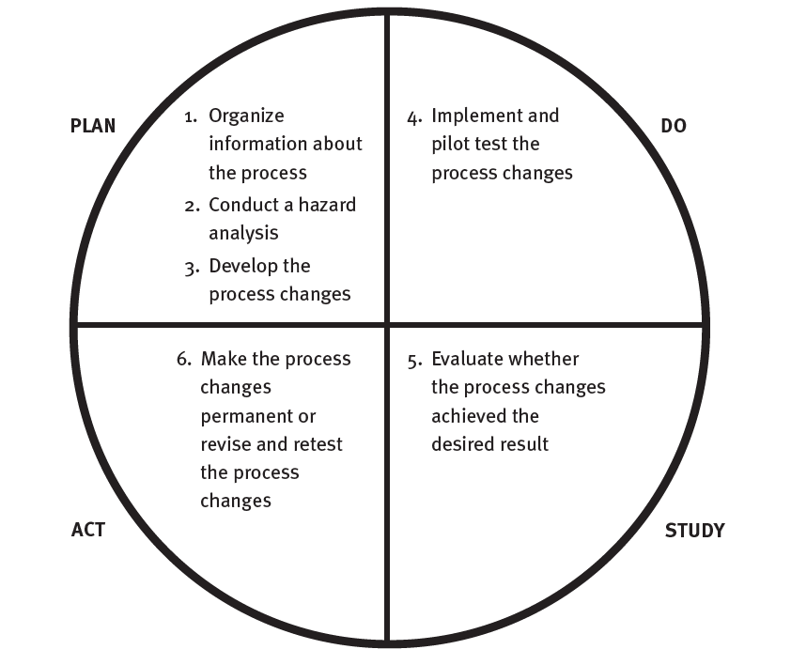
FMEA Steps
Similar to PDSA improvement model

Slide 14
Completed FMEA
Process: Collecting patient demographic and insurance information
Process Step | Potential Failure Mode | Potential Effect | Severity of Effect | Probability of Failure | Detection of Failure | Criticality Score
Verify patient’s mailing address and phone number | Registration clerk does not verify address and phone number | Billing statement is sent to the wrong address; physician is unable to contact patient if necessary after patient leaves clinic. | 4 | 4 | 5 | 80
 | Registration clerk enters demographic information incorrectly | Billing statement is sent to the wrong address; physician is unable to contact patient if necessary after patient leaves clinic. | 4 | 3 | 5 | 60
 | Patient gives registration clerk incorrect information | Billing statement is sent to the wrong address; physician is unable to contact patient if necessary after patient leaves clinic. | 4 | 3 | 5 | 60
Verify patient’s insurance information | Wrong insurance company is billed | Payment delay | 5 | 3 | 3 | 45
 | Registration clerk does not perform verification of insurance benefits | Payment delay | 5 | 4 | 3 | 60
Severity rating scale 1 = No effect 2 = Minimal effect 3 = Moderate, short-term effect 4 = Significant, long-term effect 5 = Catastrophic | Probability rating scale 1 = Highly unlikely/ never happened before 2 = Low/relatively few failures 3 = Moderate/occasional failures 4 = High/repeated failures 5 = Very high/failure almost inevitable | Detection rating scale 1 = Almost certain to be detected and corrected 2 = High likelihood of being detected and corrected 3 = Moderate likelihood of being detected and corrected 4 = Low likelihood of being detected and corrected 5 = Remote likelihood of being detected and corrected

Slide 15
Completed FMEA (cont.)
Critical Failure | Root Causes | Actions Intended to Eliminate or Reduce Failure or Mitigate Effects | Measures of Success
Registration clerk does not verify address and phone number. | Clerks are not trained and do not receive continuing education on use of address verification capabilities of registration computer system. | Provide address verification training for registration staff Educate registration staff on importance of address verification and demonstrate correct way to document that verification was performed | Percentage of billing statements returned because of invalid address
Registration clerk does not verify insurance benefits. | Management does not hold registration clerks accountable for insurance verification. | Implement policies and procedures that hold registrars accountable for verifying patients’ insurance Continue to educate registration staff on importance of insurance verification Implement incentives for registration staff to verify insurance benefits | Percentage of accounts for which registration clerk does not verify patient insurance benefits Percentage of accounts with incorrect insurance identification and group numbers Percentage of accounts billed to wrong insurance company

Slide 16
Root Cause Analysis (RCA)
An improvement model used to find and fix the fundamental system deficiencies that led to a sentinel or adverse event
  The goal is to identify and fix root causes to prevent recurrence of the event.
Joint Commission standards and some state regulations require RCA after harmful patient incidents.

Slide 17
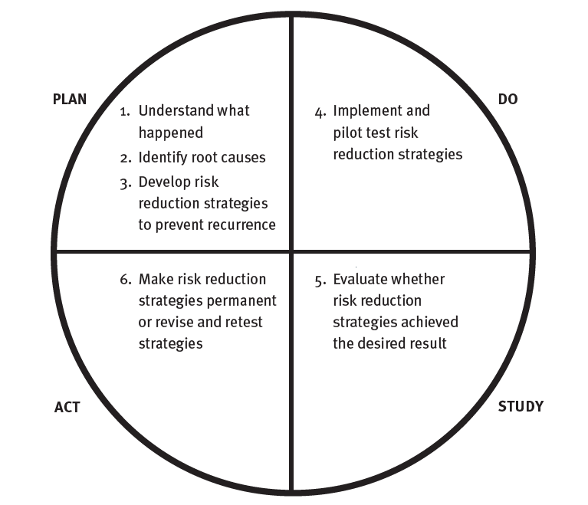
RCA Steps
Similar to PDSA improvement model

Slide 18
Understand What Happened and Identify Root Causes
Dig deeper to find the root causes—the most fundamental reasons the event occurred.

Slide 19
Look for the Underlying System Problems
Dig deeper to find the root causes—the most fundamental reasons the event occurred.
Why? Why? Why? Why?
Root causes
Causal factors
Adverse
event
Causes that, if corrected, would prevent recurrence of this and similar events
(usually no more than four)
Situations, circumstances, or conditions that, collectively with other causes, increased the likelihood of the adverse event

Slide 20
Design & Implement Corrective Actions
Action Category | Examples of Corrective Actions
Eliminate the chance of failure | Change the process to prevent failures Restructure tasks so that error-inducing behavior is no longer performed Automate the process to reduce the role of human involvement Purchase error-proof equipment
Help people perform their jobs correctly | Create visible displays of acceptable actions Conduct pre-action inspections using checklists or other reminders Educate staff and monitor compliance Standardize the process Reduce the number of steps in the process, thus reducing the chance of error Make ergonomic changes (e.g., improve lighting, reduce workplace clutter) Maintain equipment according to manufacturers' recommendations (e.g., regularly monitor compliance with routine maintenance schedules)
Help people identify and correct mistakes before the patient is harmed | Train people to better recognize and deal with unusual situations Create specialized teams of people who are coordinated and prepared to deal with unusual situations

Slide 21
Patient Engagement in Safety
To Err Is Human (2000): Patients themselves can provide a major safety check in most hospitals, clinics, and practices.
  Patients should be encouraged to speak up, ask questions, and report concerns about safety.
  Some providers are actively involving patients, family members, and laypersons in safety improvement initiatives.

Slide 22
Patient Safety Improvement
Patient safety improvement is a subset of an organization’s overall quality management system.
  Measures of patient safety
  Evaluation of safety data to identify improvement opportunities
  Safety improvement using familiar and specialized improvement models

