Slide 1
The Wanderer
By W.H. Auden

Slide 2
“Doom is dark and deeper than any sea-dingle”
doom: God’s judgment
Dingle: abyss

Slide 3
“In spring, day-wishing flowers appearing,”
“No cloud-soft hand can hold him, restraint by women;
"Day-wishing" and "cloud-soft"
are reminiscent of Old English poetic compounds
And so are “rock-face,” “place-keepers”

Slide 4
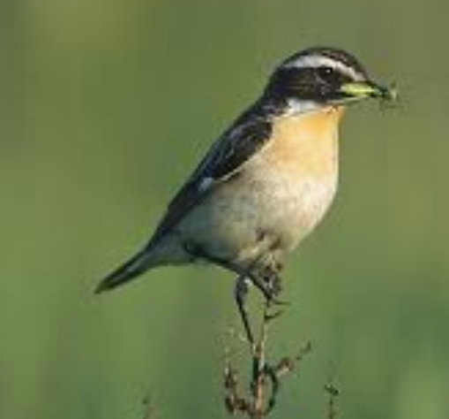
“Or lonely on fell as chat,”
Fell: an upland pasture, moor, or thicket; a highland plateau. A moorland ridge OR waste land
Chat: a warbler

Slide 5
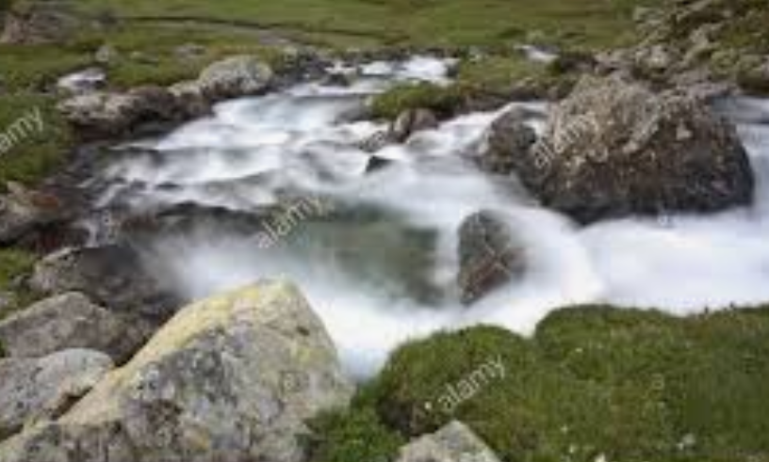
By pot-holed becks
becks: brook….stony brooks

Slide 6
“Houses for fishes, suffocating water”
“House for fishes” is example of a kenning
  fish don’t have houses, neither do wanderers
‘kenning’, that is, an oblique and metaphorical epithet for referring to a subject indirectly;
Example: ‘lake of hawks’ is a kenning-like reference to the sky,

Slide 7
Theme 1: Compulsive Exile/ journey/quest
“no cloud-soft hand can hold him, restraint by women”
“But ever that man goes”

Slide 8
Theme 2: punishment or providential directive
Punishment because the Wanderer suffers with a very real possibility that he might never find his house/his home again or that if he did find a home it would be taken away from him. That his sexuality precludes such homecoming.
Providential directive: compulsion to go on a journey which turns out to be good thing…

Slide 9
Theme 3: Corrupt Society dooms us all
In a corrupt and corrupting society, we are all equally doomed. Despite the prayer for a new dawn with which the poem ends, it is ‘gradual ruin spreading like a stain’ in an ‘anxious house where days are counted’ in which this poetry revels (Sharpe 37)
Auden’s vision of contemporary Britain.

Slide 10
Theme 4: Contemplates a homosexual coming out OR retreats from it
“Of new men making another love.”
The impossibility for “The Wanderer” of “Kissing of wife under single sheet”
The poem diverges here from the Old English and continues: “…; through doorway voices / Of new men making another love.”
But the poem does not recommend this new (homosexual?) love; it hopes for the “joy” and “day of his returning” to the home he left, and for a “lucky” and “leaning dawn.”

