Slide 1
The Waste Land
Section I:
The Burial of the Dead
T.S. Eliot

Slide 2
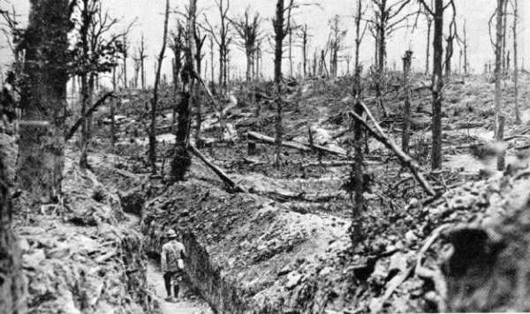
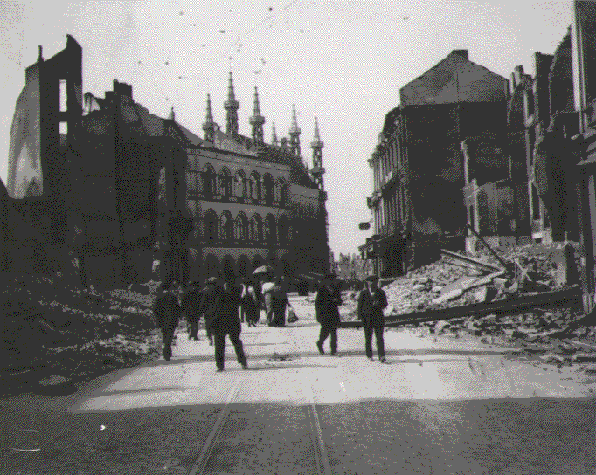
The Waste Land

Slide 3
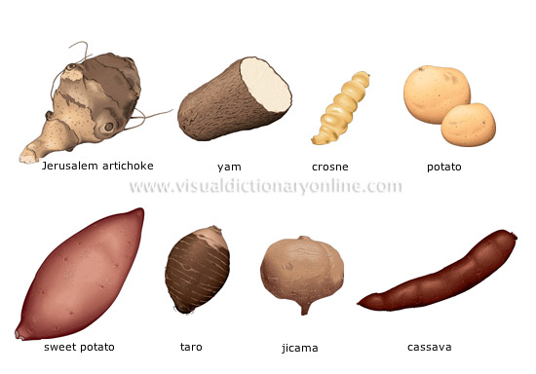
“A little life with dried tubers”

Slide 4
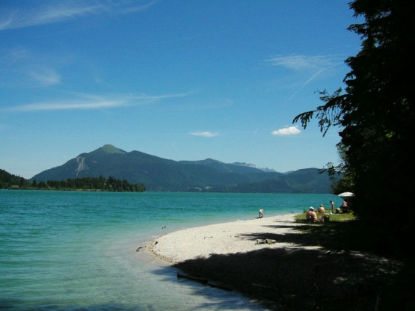
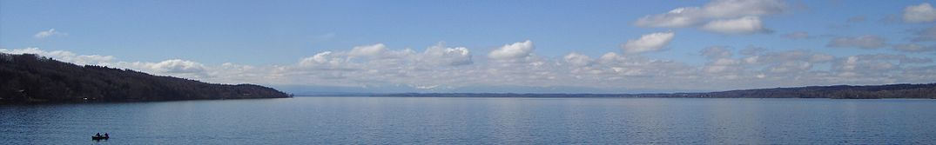
“Summer surprised us, coming over the Starnbergersee” [a lake south of Munich]

Slide 5
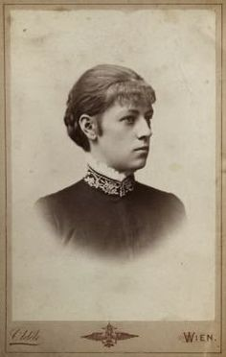
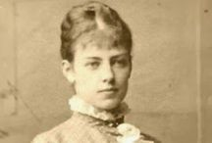
Countess Marie Larisch von Moennich--the niece and confidante of the Austrian Empress Elizabeth

Slide 6
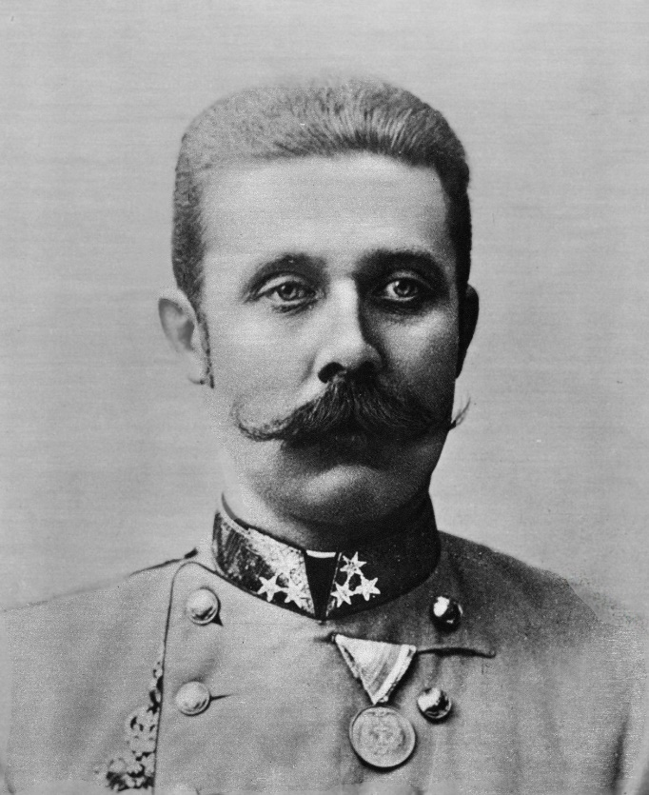
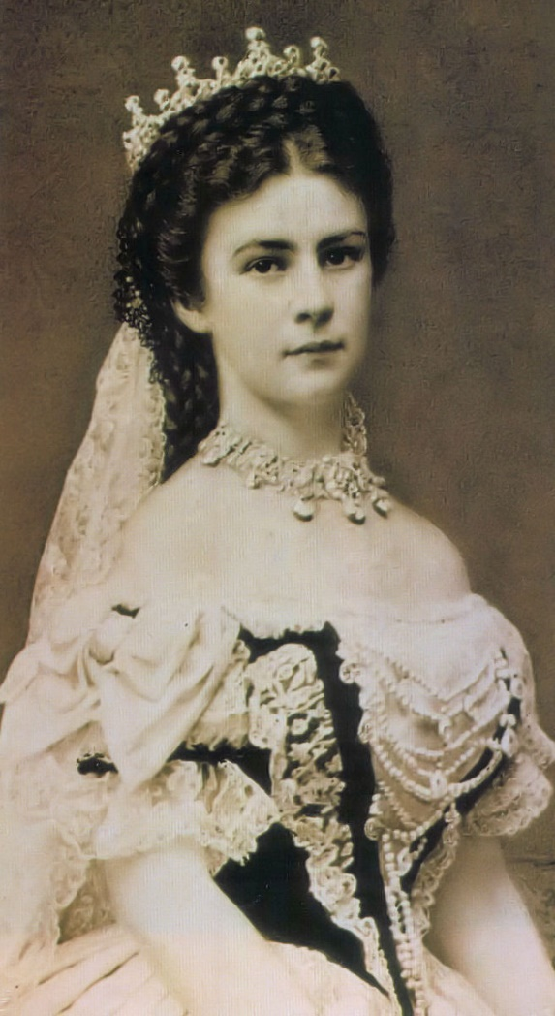
Austrian Empress Elizabeth and Archduke

Slide 7
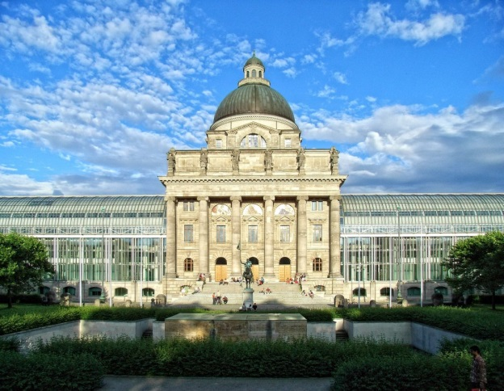
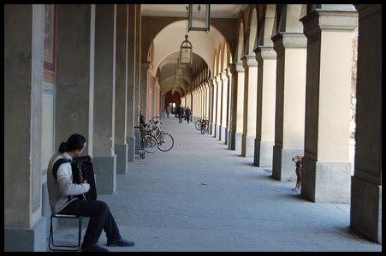
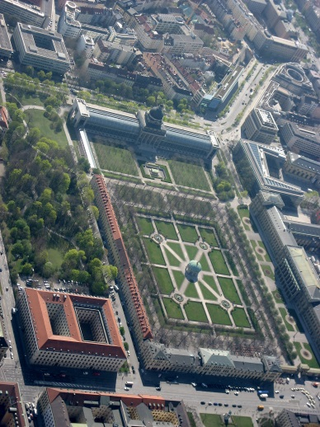
“And went on in sunlight, into the Hofgarten”

Slide 8
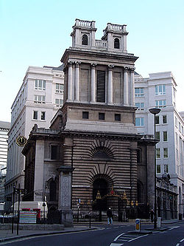
“To where Saint Mary Woolnoth kept the hours”

Slide 9
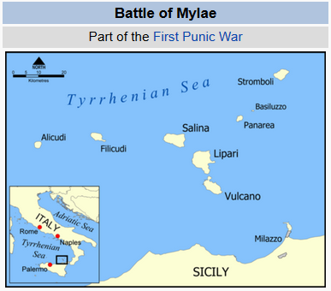
“You who were with me in the ships at Mylae!”
Sicilian seaport; at the battle of Mylae (260 B.C.E.), the Romans defeated the Carthaginians. A battle in the first Punic War between Rome and Carthage [Roman victory of Mylae (present-day Milazzo)]

Slide 10
Plot Summary of Section I The Burial of the Dead of the poem The Waste Land
Stanza 1 (lines 1-7): Winter preferable over Spring
For renewal and recovery (of European Civilization)
ORDINARY Spring season (spring rain) will not suffice. No quick fix.
(The State of European culture and civilization) perhaps is moribund
(dying or dead already). It is probably best to forget the recent past
and accept the current state of winter. [speaker of lines 1-7 : possibly Marie
or the protagonist of the poem]
Stanza 1 (lines 8-18): Dissolution of Austro-Hungarian Empire
An example of declining state of European civilization:
the recent destruction/dismantling of Austro-Hungarian Empire because of
WWI. Poet/main protagonist has coffee with Marie (the niece and
confidante of the Austrian Empress Elizabeth). Conversation involving a
childhood memory. [speaker of lines 8-18: possibly Marie]

Slide 11
Plot Summary of Section I The Burial of the Dead of the poem The Waste Land
Stanza 2(lines 19-30): A solution to problem of death and the decay of Europe
SPEAKER: biblical desert prophetic voice.
A solution to stop the decay European Civilization:
a return to the Christian church (“red rock”) PLUS this return to
the roots of European civilization also dispels the fear of death.
Stanza 2(lines 31-34): sailor’s song from Wagner’s opera
Perhaps, a transitional lines indicate change of topic from
Christianity to the subjects of desire/love and relationship.
Stanza 2(lines 35-41): impossibility of love in the modern era
Two Speakers: young woman (first 2 lines) and young man (rest of the
lines)
Stanza 2(line 42): alienation/separation/isolation/emptiness

Slide 12
Plot Summary of Section I The Burial of the Dead of the poem The Waste Land
Stanza 3: In contrast to stanza 2 lines 19-30, we are given an example of
the debased spiritual and religious landscape of the modern era.
[SKIP stanza 3. We will not be reading it.]
Stanza 4: Gives voice to the WWI dead.
the dead soldiers returning and tracing their footsteps back to the
ghettos. Possibility renewal explored. Persistence of violence in
human affairs noted.

Slide 13
Theme 1: Overall VISION OF THE POEM: a call to restore the authority and place of Christianity in European civilization
The only way out of the despair and dissolution created by Modernity
(Industrial Scale War, soulless men and women, loveless
couples, broken marriages, spiritual vacuity, materialism,
cultural philistinism, high art and culture replaced by tawdry
mass entertainment)
IS to go back to the Christian European traditions before they were so utterly disrupted by modernity/science/rationality.

Slide 14
Theme 2: Crumbling empires
WWI: Austro-Hungarian Empire is destroyed
Dislocated Aristocrats from dissolution of the Austro-Hungarian Empire
  Arch-duke
  Baroness Marie
WWI: British Empire barely survives the conflation. Eliot worries/is concerned about future of the British Empire.

Slide 15
Theme 3: Debasement of traditional European culture and spiritual values
REPLACED BY:
Modern Industrial society with its
Mass men and women

Slide 16
Theme 4: War—World War One
WWI –the poem gives voice to the war dead

Slide 17
Theme 5: Displacement of position and authority of Christianity in the West by Modernity, Science, Rationality
AND IT’S CONSEQUENCES:
Moral vacuity and spiritual dissolution

Slide 18
Theme 6: Sacral fertility VERSUS modern sexuality
Undermining of institution of marriage in the west
Broken marriages, failed relationships

