Slide 1
CHAPTER 7 Strategies for Competing in International Markets
©McGraw-Hill Education. All rights reserved. Authorized only for instructor use in the classroom. No reproduction or further distribution permitted without the prior written consent of McGraw-Hill Education.
©alice-photo/Shutterstock.com
Notes:
This chapter focuses on strategy options for expanding beyond domestic boundaries and competing
in the markets of either a few or a great many countries.

Slide 2
Learning Objectives
This chapter will help you understand:
The primary reasons companies choose to compete in international markets.
How and why differing market conditions across countries influence a company’s strategy choices in international markets.
The differences among the five primary modes of entry into foreign markets.
The three main strategic approaches for competing internationally.
How companies can to use international operations to improve overall competitiveness.
The unique characteristics of competing in developing-country markets.
Notes:
In the process of exploring these options, we introduce such concepts as the Porter diamond of national competitive advantage; and discuss the specific market circumstances that support the adoption of multidomestic, transnational, and global strategies. The chapter also includes sections on cross-country differences in cultural, demographic, and market conditions; strategy options for entering foreign markets; the importance of locating value chain operations in the most advantageous countries; and the special circumstances of competing in developing markets such as those in China, India, Brazil, Russia, and eastern Europe.

Slide 3
Why Companies Decide to Enter Foreign Markets
To gain access to new customers
To achieve lower costs through economies of scale, experience, and increased purchasing power
To gain access to low-cost inputs of production
To further exploit its core competencies
To gain access to resources and capabilities located in foreign markets
Notes:
A company may opt to expand outside its domestic market for any of five major reasons.

Slide 4
Why Competing Across National Borders Makes Strategy Making More Complex
1. Different countries with different home-country advantages in different industries.
2. Location-based value chain advantages for certain countries
3. Differences in government policies, tax rates, and economic conditions
4. Currency exchange rate risks
5. Differences in buyer tastes and preferences for products and services
Notes:
Crafting a strategy to compete in one or more countries of the world is inherently more complex for five reasons. Differing market conditions across countries influence a company’s strategy choices in international markets.

Slide 5
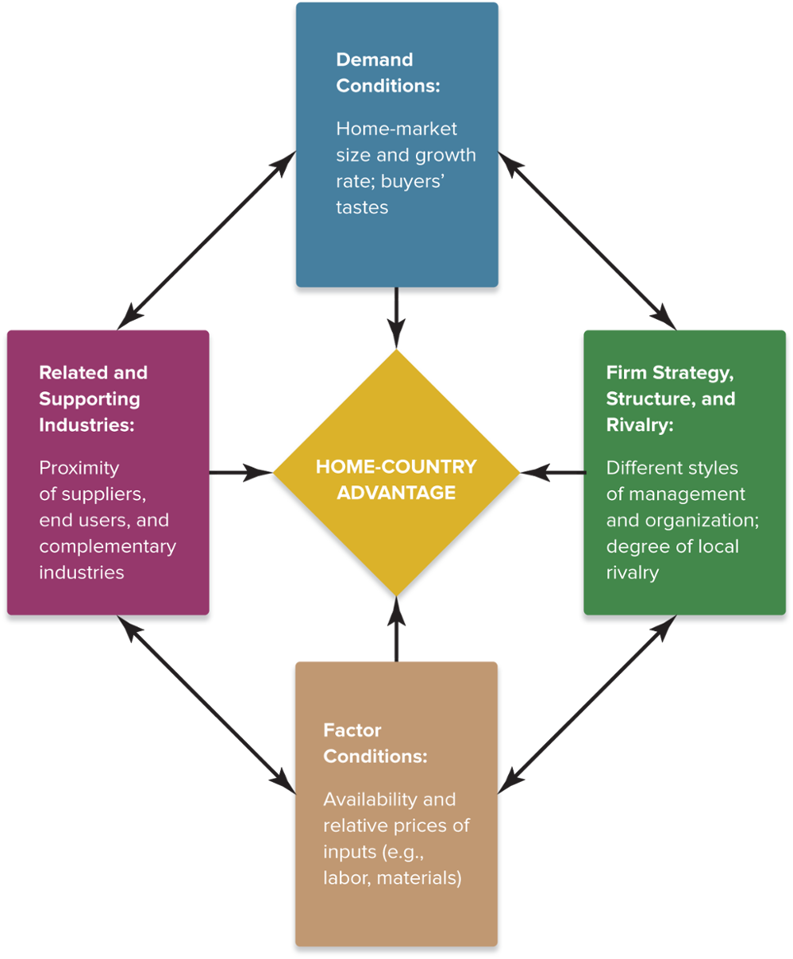
FIGURE 7.1 The Diamond of National Advantage
Source: Adapted from Michael E. Porter, “The Competitive Advantage of Nations,” Harvard Business Review, March-April 1990, pp. 73-93.
Copyright ©McGraw-Hill Education. Permission required for reproduction or display.
Access the text alternative for these images.
Notes:
Figure 7.1 summarizes the four major factors in a framework developed by Michael Porter and known as the Diamond of National Competitive Advantage.

Slide 6
The Diamond Framework
The Diamond Framework can be used to:
Predict from which countries foreign entrants are most likely to come.
Decide which foreign markets to enter first.
Choose the best country location for different value chain activities.
Notes:
Where industries are more likely to develop competitive strength depends on a set of factors that describe the nature of each country’s business environment and vary from country to country. Because strong industries are made up of strong firms, the strategies of firms that expand internationally are usually grounded in one or more these factors. Thus, the diamond framework is an aid to deciding where to locate different value chain activities most beneficially.

Slide 7
Opportunities for Location-Based Advantages
Lower wage rates
Higher worker productivity
Lower energy costs
Fewer environmental regulations
Lower tax rates
Lower inflation rates
Proximity to suppliers and technologically related industries
Proximity to customers
Lower distribution costs
Available or unique natural resources
Notes:
Increasingly, companies are locating different value chain activities in different parts of the world to exploit location-based advantages that vary from country to country. Differences in wage rates, worker productivity, energy costs, etc., create sizable variations in manufacturing costs from country to country.

Slide 8
The Impact of Government Policies and Economic Conditions in Host Countries
Positives
  Tax incentives
  Low tax rates
  Low-cost loans
  Site location and development
  Worker training
Negatives
  Environmental regulations
  Subsidies and loans to domestic competitors
  Import restrictions
  Tariffs and quotas
  Local-content requirements
  Regulatory approvals
  Profit repatriation limits
  Minority ownership limits
Notes:
Cross-country variations in government policies and economic conditions affect both the opportunities available to a foreign entrant and the risks of operating within the host country.
Political risks stem from instability or weaknesses in national governments and hostility to foreign business. Economic risks stem from the stability of a country’s monetary system, economic and regulatory policies, and the lack of property rights protections.

Slide 9
The Risks of Adverse Exchange Rate Shifts
Effects of exchange rate shifts:
  Exporters experience a rising demand for their goods whenever their currency grows weaker relative to the importing country’s currency.
  Exporters experience a falling demand for their goods whenever their currency grows stronger relative to the importing country’s currency.
Notes:
Fluctuating exchange rates pose significant economic risks to a firm’s competitiveness in foreign markets.
Exporters are disadvantaged when the currency of the country where goods are being manufactured grows stronger relative to the currency of the importing country.
Domestic companies facing competitive pressure from lower-cost imports benefit when their government’s currency grows weaker in relation to the currencies of the countries where the lower-cost imports are being made.

Slide 10
Thinking Strategically
What effects has the adoption of the euro had on the ability of European Union (EU) countries and firms to respond to changes in intra-national economic and trade conditions, given that they now share a common currency?
What should an EU firm do to respond to an adverse currency exchange rate shift in a non-EU country?
How will exiting the EU affect the United Kingdom’s ability to compete in world markets?
Notes:
Instructors may want to discuss the current and collateral effects of tariffs on international trade relationships between and among EU members and other major trading countries (e.g., the United States and China.)

Slide 11
Cross-Country Differences in Demographic, Cultural, and Market Conditions
Key Strategic Considerations
  Whether to customize offerings in each country market to match the tastes and the preferences of local buyers
  Whether to pursue a strategy of offering a mostly standardized product worldwide
Notes:
Buyer tastes for a particular product or service sometimes differ substantially from country to country. While making products that are closely matched to local tastes makes them more appealing to local buyers, customizing a company’s products country by country may raise production and distribution costs. The tension between the market pressures to localize a company’s product offerings country by country and the competitive pressures to lower costs is one of the big strategic issues that participants in foreign markets have to resolve.

Slide 12
Primary Modes of Entry into
Foreign Markets
Maintain a home country production base and export goods to foreign markets.
License foreign firms to produce and distribute the firm’s products abroad.
Employ a franchising strategy in foreign markets.
Establish a subsidiary in a foreign market via acquisition or internal development.
Rely on strategic alliances or joint ventures with foreign companies.
Notes:
Once a company decides to expand beyond its domestic borders, it must consider the question of how to enter foreign markets. There are five primary modes of entry. The modes vary considerably regarding the level of investment required and the associated risks—but higher levels of investment and risk generally provide the firm with the benefits of greater ownership and control.

Slide 13
Export Strategies
Advantages
  Low capital requirements
  Economies of scale in utilizing existing production capacity
  No distribution risk
  No direct investment risk
Disadvantages
  Maintaining relative cost advantage of home-based production
  Transportation and shipping costs
  Exchange rates risks
  Tariffs and import duties
  Loss of channel control
Notes:
Using domestic plants as a production base for exporting goods to foreign markets is an excellent initial strategy for pursuing international sales. It is a conservative way to test the international waters. Unless an exporter can keep its production and shipping costs competitive with rivals’ costs, secure adequate local distribution and marketing support of its products, and effectively hedge against unfavorable changes in currency exchange rates, its success will be limited.

Slide 14
Licensing and Franchising Strategies
Advantages
  Low resource requirements
  Income from royalties and franchising fees
  Rapid expansion into many markets
Disadvantages
  Maintaining control of proprietary know-how
  Loss of operational and quality control
  Adapting to local market tastes and expectations
Notes:
Using a licensing strategy as a mode of entry makes sense when a firm with valuable technical know-how, an appealing brand, or a unique patented product has neither the internal organizational capability nor the resources to enter foreign markets. While licensing works well for manufacturers and owners of proprietary technology, franchising is often better suited to the international expansion efforts of service and retailing enterprises.

Slide 15
Foreign Subsidiary Strategies
Advantages
  High level of control
  Quick large-scale market entry
  Avoids entry barriers
  Access to acquired firm’s skills
Disadvantages
  Costs of acquisition
  Complexity of acquisition process
  Integration of the firms’ structures, cultures, operations, and personnel
Notes:
Companies that want to participate directly in the performance of all essential value chain activities typically establish a wholly owned subsidiary, either by acquiring a local company or by establishing its own new operating organization from the ground up.

Slide 16
Using a Greenfield Strategy for Developing a Foreign Subsidiary
A greenfield strategy is appealing when:
  Creating an internal startup is cheaper than making
  an acquisition.
  Adding new production capacity will not adversely impact the supply-demand balance in the local market.
  A startup subsidiary has the ability to gain good distribution access.
  A startup subsidiary will have the size, cost structure, and resource strengths to compete head-to-head against local rivals.
Notes:
A greenfield venture is a subsidiary business that is established by setting up the entire operation from the ground up. Entering a new foreign country via a greenfield venture makes sense when a company already operates in several countries, has experience in establishing new subsidiaries and overseeing their operations, and has a sufficiently large pool of resources and capabilities to rapidly equip a new subsidiary.

Slide 17
Pursuing a Greenfield Strategy
Advantages
  High level of control over venture
  “Learning by doing”
  in the local market
  Direct transfer of the firm’s technology, skills, business practices, and culture
Disadvantages
  Capital costs of initial development
  Risks of loss due to political instability or lack of legal protection of ownership
  Slowest form of entry due to extended time required to construct facility
Notes:
Greenfield ventures in foreign markets can also pose problems, just as other entry strategies do. They represent a costly capital investment, subject to a high level of risk. They require numerous other company resources as well, diverting them from other uses. They do not work well in countries without strong, well-functioning markets and institutions that protect the rights of foreign investors and provide other legal protections.

Slide 18
Benefits of Alliance and
Joint Venture Strategies
Gaining partner’s knowledge of local market conditions
Achieving economies of scale through joint operations
Gaining technical expertise and local market knowledge
Sharing distribution facilities and dealer networks and mutually strengthening each partner’s access to buyers
Directing competitive energies more toward mutual rivals and less toward one another
Establishing working relationships with key officials in the host country government
Notes:
Collaborative strategies involving alliances or joint ventures with foreign partners are a popular way for companies to edge their way into the markets of foreign countries. Cross-border alliances enable a growth-minded firm to widen its geographic coverage and strengthen its competitiveness in foreign markets; at the same time, they offer flexibility and allow a firm to retain some degree of autonomy and operating control.

Slide 19
Walgreens Boots Alliance, Inc.: Entering Foreign Markets via Alliance Followed by Merger
Did industry consolidation provoke Walgreens to make its strategic international acquisition?
What strategic advantages does the alliance between Walgreens and Alliance Boots bring to both partners?
What internal problems could the merger create for Walgreens as it strives to integrate and adjust to the risks of entry into international markets?
Notes:
Alliances may also be used to pave the way for an intended merger; they offer a way to test the value and viability of a cooperative arrangement with a foreign partner before making a more permanent commitment. Illustration Capsule 7.1 shows how Walgreens pursued this strategy with Alliance Boots in order to facilitate its expansion abroad.

Slide 20
The Risks of Strategic Alliances with Foreign Partners
Outdated knowledge and expertise of local partners
Cultural and language barriers
Costs of establishing the working arrangement
Conflicting objectives and strategies or deep differences of opinion about joint control
Differences in corporate values and ethical standards
Loss of legal protection of proprietary technology or competitive advantage
Overdependence on foreign partners for essential expertise and competitive capabilities
Notes:
Alliances and joint ventures with foreign partners have their pitfalls, however. One of the lessons about cross-border partnerships is that they are more effective in helping a company establish a beachhead of new opportunity in world markets than they are in enabling a company to achieve and sustain global market leadership.

Slide 21
International Strategy: The Three Main Approaches (1 of 2)
Competing Internationally
Multidomestic Strategy
Global Strategy
Transnational Strategy
Notes:
An international strategy is a strategy for competing in two or more countries simultaneously.

Slide 22
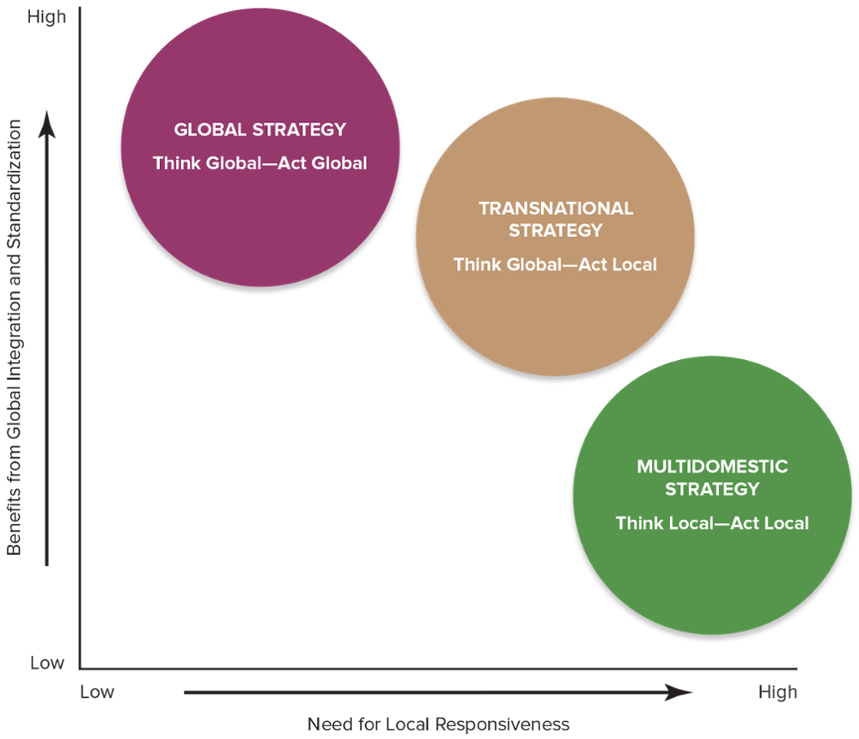
FIGURE 7.2 Three Approaches for Competing Internationally
Access the text alternative for these images.
Copyright ©McGraw-Hill Education. Permission required for reproduction or display.
Notes:
Figure 7.2 shows a company’s three options for resolving this issue: choosing a multidomestic, global, or transnational strategy.
A multidomestic strategy is one in which a company varies its product offering and competitive approach from country to country in an effort to be responsive to differing buyer preferences and market conditions.
A transnational strategy is a think-global, act-local approach that incorporates elements of both multidomestic and global strategies.
A global strategy is one in which a company employs the same basic competitive approach in all countries where it operates, sells standardized products globally, strives to build global brands, and coordinates its actions worldwide with strong headquarters control. It represents a think-global, act-global approach.

Slide 23
TABLE 7.1 Advantages and Disadvantages of a Multidomestic Strategy
Multidomestic | (think local, act local)
Advantages | Disadvantages
Can meet the specific needs of each market more precisely | Hinders resource and capability sharing or cross-market transfers
Can respond more swiftly to localized changes in demand | Has higher production and distribution costs
Can target reactions to the moves of local rivals | Is not conductive to a worldwide competitive advantage
Can respond more quickly to local opportunities and threats
Notes:
Table 7.1 provides a summary of the pluses and minuses of the multidomestic approach to competing internationally.

Slide 24
TABLE 7.1 Advantages and Disadvantages of a Global Strategy
Global | (think global, act global)
Advantages | Disadvantages
Has lower costs due to scale and scope economies | Cannot address local needs precisely
Can lead to greater efficiencies due to the ability to transfer best practices across markets | Is less responsive to changes in local market conditions
Increases innovation from knowledge sharing and capability transfer | Involves higher transportation costs and tariffs
Offers the benefit of a global brand and reputation | Has higher coordination and integration costs
Notes:
Table 7.1 provides a summary of the pluses and minuses of the global approach to competing internationally.

Slide 25
TABLE 7.1 Advantages and Disadvantages of Transnational Strategy
Transnational | (think global, act local)
Advantages | Disadvantages
Offers the benefits of both local responsiveness and global integration | Is more complex and harder to implement
Enables the transfer and sharing of resources and capabilities across borders | Entails conflicting goals, which may be difficult to reconcile and require trade-offs
Provides the benefits of flexible coordination | Involves more costly and time consuming implementation
Notes:
Table 7.1 provides a summary of the pluses and minuses of the transnational approach to competing internationally.

Slide 26
Four Seasons Hotels: Local Character, Global Service
Why has Four Seasons Hotels been so successful in expanding its hospitality operations into a broad diversity of countries?
How should local hotel competitors respond to Four Seasons Hotels’ continued expansion into their markets?
Why has the global economic slowdown not dampened demand for the Four Seasons luxury hotel offerings?
Notes:
Illustration Capsule 7.2 explains how Four Seasons Hotels has been able to compete successfully based on a transnational strategy.

Slide 27
International Strategy: The Three Main Approaches (2 of 2)
Build Competitive Advantage in International Markets
Use international location to lower cost or differentiate product
Share resources and capabilities across country borders
Gain cross-border coordination benefits
Notes:
An international strategy is a strategy for competing in two or more countries simultaneously.

Slide 28
Using Location to Build
Competitive Advantage
Key Location Issues
  To customize offerings in each country market to match tastes and preferences of local buyers
  To pursue a strategy of offering a mostly standardized product worldwide
Notes:
Companies that compete internationally can pursue competitive advantage in world markets by locating their value chain activities in whatever nations prove most advantageous.

Slide 29
When to Concentrate Activities in a
Few Locations
The costs of manufacturing or other activities are significantly lower in some geographic locations than in others.
There are significant scale economies in production or distribution.
There are sizable learning and experience benefits associated with performing an activity in a single location.
Certain locations have superior resources, allow better coordination of related activities, or offer other valuable advantages.
Notes:
It is advantageous for a company to concentrate its activities in a limited number of locations for the reason of costs, scale, learning and experience, and availability of resources.

Slide 30
When to Disperse Activities across Many Locations
Buyer-related activities can be conducted at a distance.
There are high transportation costs.
There are diseconomies of large size.
Trade barriers make a central location too expensive.
Dispersing activities reduces exchange rate risks.
Dispersion helps prevent supply interruptions.
Dispersion helps avoid adverse political developments.
Dispersion allows for location-based technology and production cost competitive advantages.
Notes:
In some instances, dispersing activities across locations is more advantageous than concentrating them when costs and business risks can be lowered through localization of activities.

Slide 31
Sharing and Transferring Resources and Capabilities across Borders to Build Competitive Advantage
Building a resource-based competitive advantage requires:
  Using powerful brand names to extend a differentiation-based competitive advantage beyond the home market.
  Coordinating activities for sharing and transferring resources and production capabilities across different countries’ domains to develop market dominating depth in key competencies.
Notes:
When a company has competitively valuable resources and capabilities, it may be able to leverage them further by expanding internationally. If its resources retain their value in foreign contexts, then entering new foreign markets can extend the company’s resource-based competitive advantage over a broader domain. Sharing and transferring resources and capabilities across country borders may also contribute to the development of broader or deeper competencies and capabilities— helping a company achieve dominating depth in some competitively valuable area.

Slide 32
Cross-Border Strategic Moves
Offensive strategic options:
  Based on international competitor’s strong or protected market position in more than one country
Cross-market subsidization
  Supporting competitive offensives in one market with resources and profits diverted from operations in another market—a powerful competitive weapon
Defensive Strategic Moves:
  A defensive action involving multiple markets
Notes:
Firms can choose either offensive or defensive options for conducting strategic operations when competing in international markets.

Slide 33
Dumping as a Strategy
Dumping
  This involves selling goods in foreign markets at prices that are either below normal home market prices or below the full costs per unit.
Dumping is NOT a fair-trade practice.
  Governments can be expected to retaliate against such practices by foreign competitors.
  The World Trade Organization (WTO) actively polices dumping to discourage such practices.
Notes:
When taken to the extreme, cut-rate pricing attacks by international competitors may draw charges of unfair “dumping.” A company is said to be dumping when it sells its goods in foreign markets at prices that are (1) well below the prices at which it normally sells them in its home market or (2) well below its full costs per unit.

Slide 34
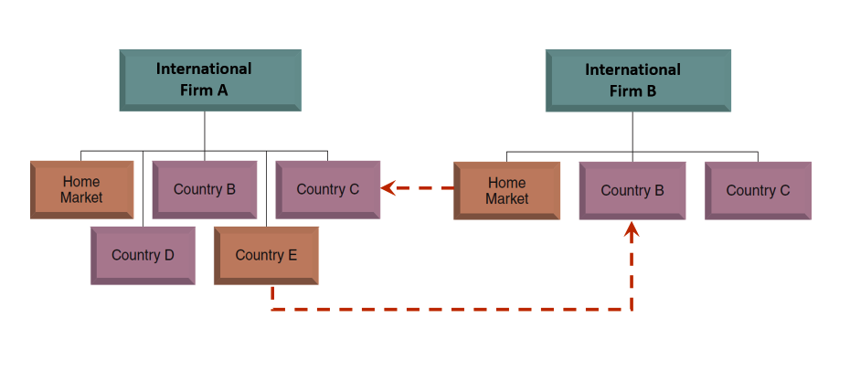
Defending Against International Rivals
Firm A moves against Firm B in Country B
Firm B counters with a response in Country C
Notes:
Cross-border tactics involving multiple country markets can be used as a means of defending against the strategic moves of rivals with multiple profitable markets of their own. If a company finds itself under competitive attack by an international rival in one country market, one way to respond is to conduct a counterattack against the rival in one of its key markets in a different country—preferably where the rival is least protected and has the most to lose.
When the same companies compete against one another in multiple geographic markets, the threat of cross-border counterattacks may be enough to deter aggressive competitive moves and encourage mutual restraint among international rivals.

Slide 35
Strategies for Competing in the Markets of Developing Countries
Prepare to compete based on low price.
Prepare to modify the firm’s business model or strategy to accommodate local circumstances.
Try to change the local market to better match the way the firm does business elsewhere.
Stay away from developing markets where it is impractical or uneconomical to modify the company’s business model to accommodate local circumstances.
Notes:
Companies racing for global leadership must consider competing in developing-economy markets like China, India, Brazil, Indonesia, Thailand, Poland, Mexico, and Russia—countries where the business risks are considerable but where the opportunities for growth are huge, especially as their economies develop and living standards climb toward levels in the industrialized world. There are several options for tailoring a company’s strategy to fit the sometimes unusual or challenging circumstances presented in developing-country markets.

Slide 36
Defending against Global Giants: Strategies for Local Companies in Developing Countries
Develop a business model that exploits shortcomings in local distribution networks or infrastructure.
Utilize knowledge of local customer needs and preferences to create customized products or services.
Take advantage of aspects of the local workforce with which large multinational firms may be unfamiliar.
Use acquisition and rapid-growth strategies to defend against expansion-minded internationals.
Transfer company expertise to cross-border markets and initiate actions to contend on an international level.
Notes:
Profitability in developing markets rarely comes quickly or easily—new entrants must adapt their business models to local conditions and be patient in earning a profit. When opportunity-seeking, resource-rich international companies seek to enter developing-country markets; studies of local companies in developing markets have disclosed five strategies that have proved themselves in defending against globally competitive companies.

Slide 37
WeChat’s Strategy for Defending against International Social Media Giants in China
What were the key elements of WeChat’s business model that allowed it to successfully fend off the entry of major international rivals in its market?
What changes in WeChat’s external competitive environment will eventually threaten its continued success?
How could the Diamond of National Competitive Advantage be useful to WeChat in predicting the likelihood of its continued success in China?
Notes:
WeChat has been able to surpass international rivals, because by better understanding local Chinese customer needs, it can anticipate their desires. WeChat added features that allow users to check traffic cameras during rush hour, purchase tickets to movies, and book doctors’ appointments all on the app. Due to common scheduling difficulties, booking doctors’ appointments is a feature that is wildly popular with the Chinese customer base. Essentially, WeChat created its own distribution network for sought-after information and goods in busy Chinese cities.

Slide 38
APPENDIX: IMAGE DESCRIPTIONS FOR UNSIGHTED STUDENTS

Slide 39
Appendix 1 Figure 7.1 The Diamond of National Advantage, Text Alternative
The four factors that influence each other and a company's home-country advantage are:
  Demand conditions: home-market size and growth rate; buyers' tastes
  First strategy, structure, and rivalry: different styles of management and organization; degree of local rivalry
  Factor conditions: availability and relative prices of inputs (for example, labor, materials)
  Related and supporting industries: proximity of suppliers, end users, and complementary industries
Return to slide containing original image.

Slide 40
Appendix 2 Figure 7.2 Three Approaches for Competing Internationally, Text Alternative
A grid is shown. The vertical axis, Benefits from Global Integration and Standardization, is labeled “high” at the top and “low” at the bottom. The horizontal axis, Need for Local Responsiveness, is labeled “low” on the left side and “high” on the right. Three strategies are charted on the graph:
  Global strategy: think global, act global. High benefits; low need for local responsiveness.
  Transnational strategy: think global, act local. Mid-high benefits; mid-high need for local responsiveness.
  Multidomestic strategy: think local, act local. Low benefits; high need for local responsiveness.
Return to slide containing original image.

