Slide 1
CHAPTER 12 Corporate Culture and Leadership: Keys to Good Strategy Execution
©McGraw-Hill Education. All rights reserved. Authorized only for instructor use in the classroom. No reproduction or further distribution permitted without the prior written consent of McGraw-Hill Education.
©alice-photo/Shutterstock.com
Notes:
In this chapter, we explore the two remaining managerial tasks that contribute to good strategy execution: creating a corporate culture that supports good strategy execution and leading the strategy execution process.
12-1

Slide 2
Learning Objectives
This chapter will help you understand:
The key features of a company’s corporate culture and the role of a company’s core values and ethical standards in building corporate culture
How and why a company’s culture can aid the drive for proficient strategy execution
The kinds of actions management can take to change a problem corporate culture
What constitutes effective managerial leadership in achieving superior strategy execution

Slide 3
Instilling a Corporate Culture Conducive to Good Strategy Execution
Corporate culture:
  Is the meshing of shared values, beliefs, business principles, and traditions that imbues a firm’s operating style, behavioral norms, ingrained attitudes, and work atmosphere.
  Is important because it influences the firm’s actions and approaches to conducting business.
Notes:
Corporate culture refers to the shared values, ingrained attitudes, core beliefs and company traditions that determine norms of behavior, accepted work practices, and styles of operating.

Slide 4
Strong Guiding Principles Drive the High-Performance Culture at Epic
What actions does Epic take to foster the high-performance culture that is so important to its success?
How do Epic’s 10 Commandments relate to its stated principles?
Is there a relationship between development of unique cultures and the subsequent growth and success of focused or niche businesses?

Slide 5
The High-Performance Culture at Epic
Epic’s 10 Commandments
Do not go public.
Do not be acquired.
Software must work.
Expectations = reality.
Keep commitments.
Focus on competency. Do not tolerate mediocrity.
Have standards. Be fair to all.
Have courage. What you put up with is what you stand for.
Teach philosophy and culture.
Be frugal. Do not take on debt for operations.
Epic’s Principles
Make our products a joy to use.
Have fun with customers.
Design in collaboration with users.
Make it easy for users to do the right thing.
Improve the patient’s health and healthcare experience.
Generalize to benefit more.
Follow processes. Find root causes. Fix processes.
Dissent when you disagree; once decided, support.
Do what is difficult for us if it makes things easier for our users.
Escalate problems at the start, not when all hell breaks loose.

Slide 6
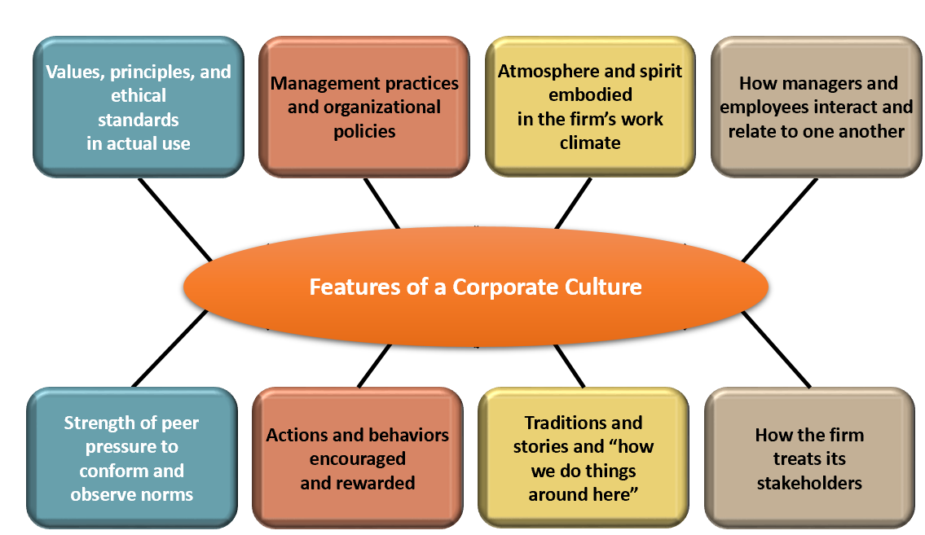
Identifying the Key Features of a Company’s Corporate Culture
Access the text alternative for these images.
Notes:
Eight key features of a company's corporate culture are:
Values, principles, and ethical standards in actual use
Management practices and organizational policies
Atmosphere and spirit embodied in the firm's work climate
How managers and employees interact and relate to one another
Strength of peer pressure to conform and observe norms
Actions and behaviors encouraged and rewarded
Traditions and stories and "how we do things around here"
How the firm treats its stakeholders

Slide 7
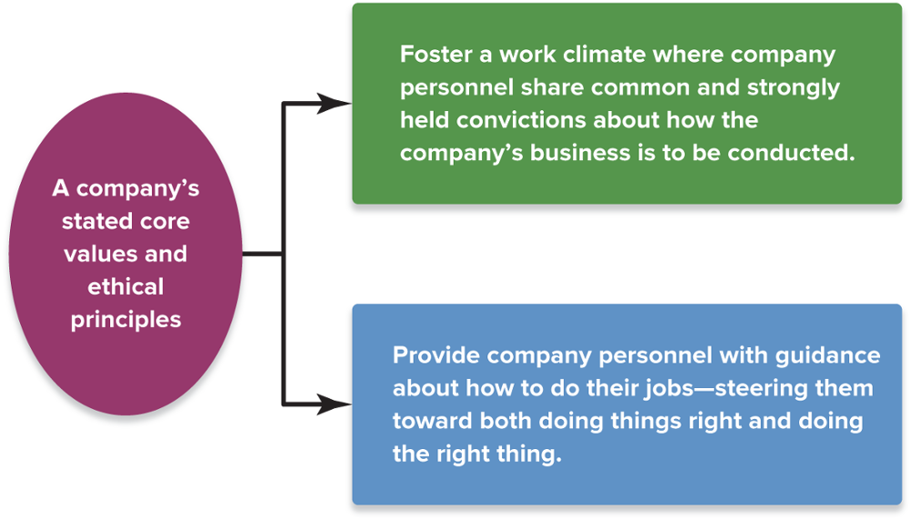
FIGURE 12.1 The Two Culture-Building Roles of a Company’s Core Values and Ethical Standards
Access the text alternative for these images.
Copyright ©McGraw-Hill Education. Permission required for reproduction or display.
Notes:
A company’s culture is grounded in and shaped by its core values and ethical standards. A company's stated core values and ethical principles (1) foster a work climate where company personnel share common and strongly held convictions about how the company's business is to be conducted and (2) provide company personnel with guidance about how to do their jobs —steering them toward both doing things right and doing the right thing.

Slide 8
Embedding Cultural Norms in the Organization and Perpetuating the Culture (1 of 2)
Screen applicants and hire those who will mesh well with the culture.
Incorporate discussions of the firm’s culture and its behavioral norms into orientation programs for new employees and training courses for managers and employees.
Have senior executives frequently reiterate the importance and role of the firm’s values and ethical principles at the firm’s events and in internal communications to employees.
Expect managers at all levels to be cultural role models and exhibit advocated cultural norms in their own behavior.
Notes:
A company’s values statement and code of ethics communicate expectations of how employees should conduct themselves in the workplace.

Slide 9
Embedding Cultural Norms in the Organization and Perpetuating the Culture (2 of 2)
Make the display of cultural norms a factor in evaluating each person’s job performance, granting compensation increases, and offering promotions.
Stress that line managers all the way down to first-level supervisors give ongoing attention to explaining the desired cultural traits and behaviors in their areas and clarifying why they are important.
Encourage company personnel to exert strong peer pressure on co-workers to conform to expected cultural norms.
Hold periodic ceremonies to honor people who excel in displaying the company values and ethical principles.
Notes:
To deeply ingrain the stated core values and high ethical standards, firms must turn them into strictly enforced cultural norms.

Slide 10
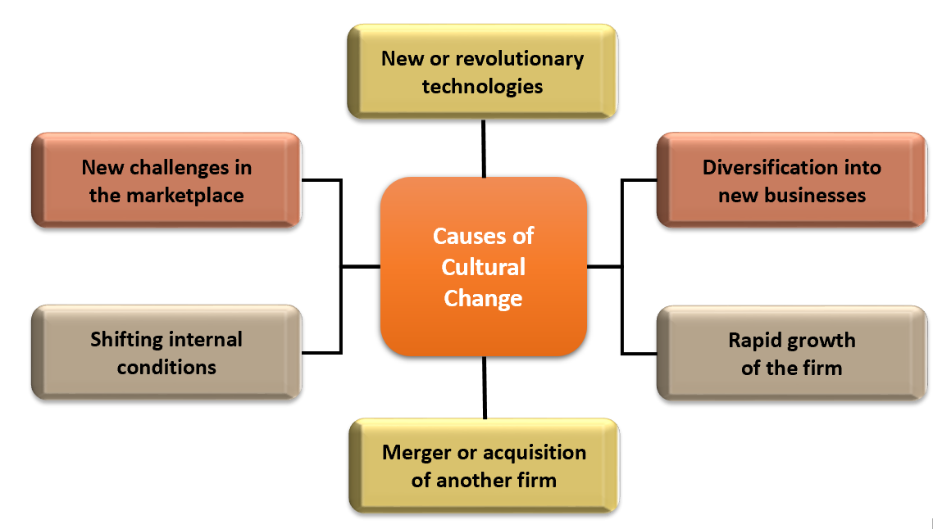
Forces that Cause a Firm’s Culture to Evolve
Access the text alternative for these images.
Notes:
Causes of cultural change can be new or revolutionary technologies, diversification into new businesses, rapid growth of the firm, a merger or acquisition of another firm, shifting internal conditions, and new challenges in the market place.

Slide 11
Strong Versus Weak Cultures
Strong-culture firm
  Has deeply rooted widely-shared values, behavioral norms, and operating approaches
  Insists that its values and principles be reflected in the decisions and actions taken by all company personnel
Weak-culture firm
  Lacks values and principles that are consistently preached or widely shared
  Has few or no traditions, beliefs, values, common bonds, or behavioral norms
Notes:
In a strong-culture company, deeply rooted values and norms of behavior are widely shared and regulate how it conducts its business.

Slide 12
Development of a Strong Culture
Closely aligning corporate culture with the requirements for proficient strategy execution merits the full attention of senior executives.
Strong Culture
Commitment by the firm to ethical behavior
Founder or strong leader with strong values
Notes:
A strong culture is developed by a founder or strong leader with strong values, as well as commitment by the firm to ethical behavior. A strong culture that encourages actions, behaviors, and work practices that are in sync with the chosen strategy and conducive to good strategy execution is a valuable ally in the strategy execution process.

Slide 13
Why Corporate Cultures Matter to the Strategy Execution Process
A culture that is well matched to the chosen strategy and the requirements of the strategy execution effort focuses the attention of employees on what is most important to this effort.
Culture-induced peer pressure further induces personnel to do things in a manner that aids the cause of good strategy execution.
A culture that is consistent with the requirements for good strategy execution can energize employees, deepen their commitment to execute the strategy flawlessly, and enhance worker productivity.
Notes:
It is in management’s best interest to dedicate considerable effort to establishing a corporate culture that encourages behaviors and work practices conducive to good strategy execution.

Slide 14
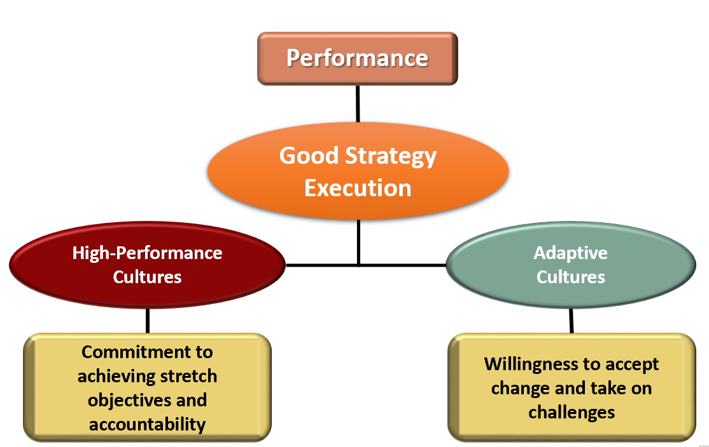
Healthy Cultures That Aid
Good Strategy Execution
Access the text alternative for these images.
Notes:
High-performance cultures have a commitment to achieving stretch objectives and accountability. Adaptive cultures have a willingness to accept change and take on challenges. Both contribute to good strategy execution and performance. As a company’s strategy evolves, an adaptive culture is a definite ally in the strategy-implementing, strategy-executing processes as compared to cultures that are resistant to change.

Slide 15
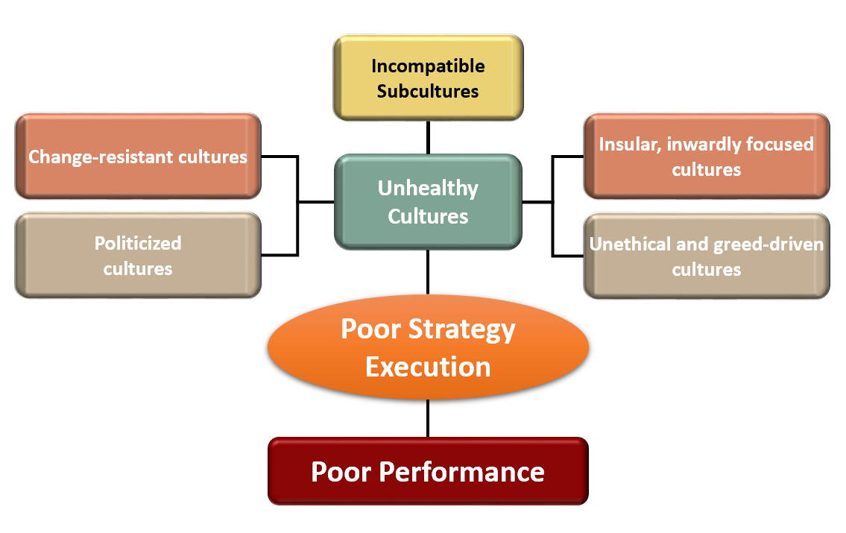
Unhealthy Cultures That Impede
Good Strategy Execution
Access the text alternative for these images.
Notes:
Unhealthy cultures include politicized cultures; change-resistant cultures; incompatible subcultures; insular, inwardly focused cultures; unethical and greed-driven cultures. These types of cultures lead to poor strategy execution and poor performance.

Slide 16
Changing a Problem Culture:
The Role of Leadership
A strong, out of sync, or unhealthy culture must be changed in order to execute strategy successfully.
Competent leadership at the top is necessary for culture-change efforts to succeed.

Slide 17
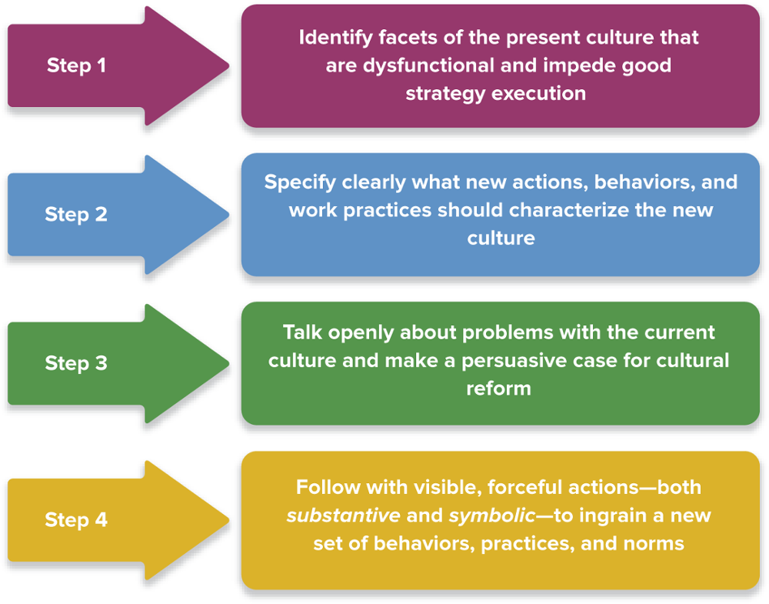
FIGURE 12.2 Changing a Problem Culture
Access the text alternative for these images.
Copyright ©McGraw-Hill Education. Permission required for reproduction or display.
Notes:
Step 1: Identify facets of the present culture that are dysfunctional and impede good strategy execution.
Step 2: Specify clearly what new actions, behaviors, and work practices should characterize the new culture.
Step 3: Explain why the current culture poses problems and make a persuasive case for cultural reform.
Step 4 : Follow with visible, forceful actions, both substantive and symbolic, to ingrain a new set of behaviors, practices, and norms.

Slide 18
Making a Compelling Case for
Culture Change
Selling the change
  Explain why and how certain behavioral norms and work practices are obstacles to good execution of strategic initiatives.
  Explain how new behaviors and work practices will produce better results.
  If the need for cultural change is due to a change in strategy, cite reasons why the current strategy has to be modified.

Slide 19
Substantive Culture-Changing Actions
Replace key executives who are resisting or obstructing needed organizational and cultural changes.
Promote individuals who support cultural shifts and can serve as role models for the cultural behavior.
Appoint outsiders with the desired cultural attributes to high-profile positions.
Screen all candidates for positions carefully, hiring only those who appear to fit in with the new culture.
Mandate that all personnel attend culture-training.
Design compensation incentives that boost the pay of teams and individuals who support culture change.
Revise policies and procedures to drive cultural change.

Slide 20
Symbolic Culture-Changing Actions
Changing the Culture of an Organization
Top executive and upper management behaviors
Ceremonial events to honor exemplary employees
Physical symbols that represent the new culture
Notes:
The culture of an organization can be changed by top executive and upper management behaviors, by ceremonial events to honor exemplary employees, and by physical symbols that represent the new culture.

Slide 21
How Long Does It Take to Change a Problem Culture?
Changing a problem culture is never a short-term exercise.
A sustained and persistent effort to reinforce the culture at every opportunity through word and deed is required.
It takes time for a new culture to emerge and prevail; it takes even longer for it to become deeply embedded.
Fixing a problem culture and instilling a new set of attitudes and behaviors can take 2 to 5 years.

Slide 22
Driving Cultural Change at Goldman Sachs
What steps did the Chief Learning Office take to begin the cultural transformation at Goldman Sachs?
What steps did top managers take to demonstrate their commitment to the new culture and to reinforce the personnel and process changes they implemented?
Which actions are likely to cause the most pronounced cultural change in an organization?

Slide 23
Leading the Strategy Execution Process
Leading strategy execution requires:
  Staying on top of what is happening and closely monitoring progress
  Putting constructive pressure on the organization to execute the strategy well and achieve operating excellence
  Initiating corrective actions to improve strategy execution and achieve the targeted performance results

Slide 24
Staying on Top of How Things Are Going
Management by Walking Around (MBWA):
  Is used by leaders to stay informed about how well the strategy execution process is progressing.
  Involves spending time with people at company facilities, asking questions, listening to their opinions and concerns, and gathering firsthand information about how well aspects of the strategy execution process are going.
Notes:
Management by walking around (MBWA) is one of the techniques that effective leaders use to stay informed about how well the strategy execution process is progressing.

Slide 25
Mobilizing the Effort for Excellence in Strategy Execution
Treat employees as valued partners.
Foster an esprit de corps that energizes members.
Use empowerment to create a fully engaged workforce.
Set stretch objectives that require personnel to give their best in achieving performance targets.
Use benchmarking, reengineering, TQM, and Six Sigma tools to focus attention on continuous improvement.
Use motivational techniques and compensation incentives to inspire, nurture a results-oriented work climate, and enforce high standards.
Celebrate individual, group, and company successes.

Slide 26
Leading the Process of Making Corrective Adjustments
Making Corrective Actions Successfully Requires
A thorough analysis of the situation
Good business judgment in deciding what actions to take
Good implementation of the corrective actions
Notes:
The culture of an organization can be changed by top executive and upper management behaviors, by ceremonial events to honor exemplary employees, and by physical symbols that represent the new culture.

Slide 27
A Final Word on Leading the Process of Crafting and Executing Strategy
It is difficult to separate leading the process of executing strategy from leading the strategy process.
Crafting, implementing, and executing strategy is a continuous process that requires much adjusting and fine-tuning of the strategy to fit changing circumstances.
The tests of strategic leadership are whether the firm has a good strategy and business model, whether its strategy is competently executed, and whether the firm is achieving its performance targets.
If these three conditions exist, then the firm has good strategic leadership and is a well-managed enterprise.

Slide 28
APPENDIX: IMAGE DESCRIPTIONS FOR UNSIGHTED STUDENTS

Slide 29
Appendix 1 Identifying the Key Features of a Company’s Corporate Culture, Text Alternative
Eight key features of a company's corporate culture are:
  Values, principles, and ethical standards in actual use
  Management practices and organizational policies
  Atmosphere and spirit embodied in the firm's work climate
  How managers and employees interact and relate to one another
  Strength of peer pressure to conform and observe norms
  Actions and behaviors encouraged and rewarded
  Traditions and stories and "how we do things around here"
  How the firm treats its stakeholders
Return to slide containing original image.

Slide 30
Appendix 2 Figure 12.1 The Two Culture-Building Roles of a Company’s Core Values and Ethical Standards, Text Alternative
A company's stated core values and ethical principles (1) foster a work climate where company personnel share common and strongly held convictions about how the company's business is to be conducted and (2) provide company personnel with guidance about how to do their jobs —steering them toward both doing things right and doing the right thing.
Return to slide containing original image.

Slide 31
Appendix 3 Forces that Cause a Firm’s Culture to Evolve, Text Alternative
Causes of cultural change can be new or revolutionary technologies, diversification into new businesses, rapid growth of the firm, a merger or acquisition of another firm, shifting internal conditions, and new challenges in the marketplace.
Return to slide containing original image.

Slide 32
Appendix 4 Healthy Cultures that Aid Good Strategy Execution, Text Alternative
High-performance cultures have a commitment to achieving stretch objectives and accountability.
Adaptive cultures have a willingness to accept change and take on challenges.
Both contribute to good strategy execution and performance.
Return to slide containing original image.

Slide 33
Appendix 5 Unhealthy Cultures that Impede Good Strategy Execution, Text Alternative
Unhealthy cultures include politicized cultures; change-resistant cultures; incompatible subcultures; insular, inwardly focused cultures; unethical and greed-driven cultures. These types of cultures lead to poor strategy execution and poor performance.
Return to slide containing original image.

Slide 34
Appendix 6 Figure 12.2 Changing a Problem Culture, Text Alternative
Step 1: Identify facets of the present culture that are dysfunctional and impede good strategy execution.
Step 2: Specify clearly what new actions, behaviors, and work practices should characterize the new culture.
Step 3: Talk openly about problems with the current culture and make a persuasive case for cultural reform.
Step 4: Follow with visible, forceful actions, both substantive and symbolic, to ingrain a new set of behaviors, practices, and norms.
Return to slide containing original image.

