Slide 1
Fascism And Antifascism:
A comparative view between WWII era and Modern movements.
By Thomas Casteel

Slide 2
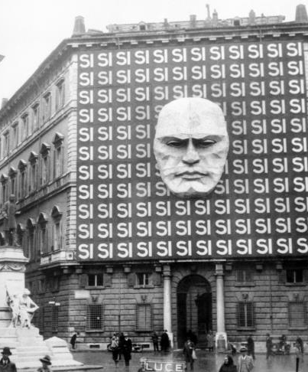
WWII Era Fascism
Fascism, a term coined by Mussolini, had its beginning in Italy in 1919 when he founded the National Fascist Party.
Fascist regimes came to exists soon after in Austria, Hungary, Romania, Portugal, Spain, and Croatia.
However the era is typified by the regimes in Italy and Germany and the respective cults of personality
Notes:
Pictured Is the National Fascist Party building in Italy

Slide 3
WWII Era Fascism
Fascism is characterized by state-supported nationalism with the goal of establishing a Nation State.
Ultra-nationalism that commonly features: anticonservatism, a myth of ethnic or national renewal, and the concept of a nation in crisis.
Promoted the establishment of an organic social order
Heavily influenced by Social Darwinism.
Promotion of a Totalitarian or Authoritarian government.
Grew out of a fear of communism and the crises of the capitalist economic system.
Strong, charismatic leader who led a one-party, militarized political system
Notes:
Myth of ethnic or national renewal= ethnically homogeneous community
Nation in Crises = economy, education and press served and largely controlled by the state.
Social Darwinism = Stress on male dominance and exaltation of youth and eugenics programs
Anti-Semitism Central In Nazism but not in Italian Facsism

Slide 4
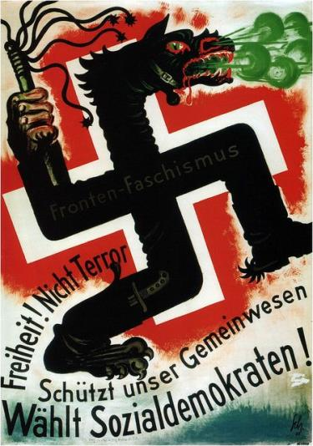
WWII Era AntiFascism
Collectively referred to as “the resistance", various antifascist groups were formed to oppose fascist ideology and actions.
Many were remnants of disbanded political parties.
Included the German Social Democratic Party and the “Red Strike Troops”, German Communist Party, The White Rose, Edelweiss Pirates, The European Union, and the Red Orchestra.
Notes:
Also prominent were Christian churches, university campuses, youth groups, industrial workers, and former trade unionist
European Union, not to be confused with todays Confederation

Slide 5
WWII ERA AntiFascism
‘The Resistance” was not one organized group, and there was little to no coordinated activity between organizations.
Referred to as a “resistance without people” as the number of people involved was comparatively very small
The antifascist movement was largely ineffective in its efforts.
Many leaders and participants were discovered and consequently arrested, tried, and executed or sent to camps.
Fascist regimes were too popular within most countries to incite any kind of counter-revolution among the populace.

Slide 6
WWII Era
Political Violence
Fascism
“The Resistance”
Largely relied on establishment violence against individuals and groups.
Supported direct action.
Opponents were ‘enemies of the people/State”.
Violence ensured the goals of the State would be met.
Purging of the weak to promote the strong.
Irredentism
Largely Individual/Group against the State.
Organized strikes or sabotaged factory equipment.
Sabotaged infrastructure.
Incited both violent and civic disobedience.
Assisted in the escape of those hunted in eugenics programs.
Established espionage programs to gather intelligence for the Allies and the support of assassination attempts.
Sought to overthrow the fascist regime.
Notes:
Largely Nazism, Irredentism is A political, typically nationalistic movement that intends to reclaim the land that they consider “lost”, “stolen”, “or unredeemed”.

Slide 7
WWII ERA
Political Socialization
Fascism
“The Resistance”
Attempted to control all agents of political socialization in the promotion of the Nation State.
The educational system, culture, religion, peer groups, and media were all actively controlled by the State.
Robust integration of cinema and propaganda.
Youth groups were especially courted by fascist regimes.
Hostile towards autonomous religion.
“Sought to impose uniformity of thought and action by force or through regulation and social pressure”- Jonah Goldberg
Largely relied on independent media, peer groups, and events to promote their political outlook.
Published and distributed thousands of underground newspapers and leaflets that described abuses of power, called for the overthrow of the regime, recalled worker abuse, and urged intellectuals to unite against the regime.
Notes:
Peer groups – Hitler Youth
Film Industry was heavily influence by government supported propaganda Leni Riefensthal
Paul Joseph Gobbels

Slide 8
WWII ErA
The Elite and Classes
Fascism
“The Resistance”
Has been stated to have arose from the threat of a revolution by the masses
Rejected the Marxist concept of class conflict
Encouraged class collaboration.
The natural inequality among individuals is beneficial and promotes the harmony of government and society
Both lower and upper classes should accept their roles and perform their respective duties as their social standing is necessary for a stable society.
The Nation State was superior to the individual
Disdain for decadence and bourgeois values
Varied outlook as there were numerous groups, each with different political ideologies.
Concerned for the rights of the individual.
Opposed anti-Semitism,, euthanasia, and the disallowance of traditions and customs.
Some called for class conflict and others for the establishment of a unified socialist Europe.
Notes:
Peer groups – Hitler Youth
Film Industry was heavily influence by government supported propaganda Leni Riefensthal
Paul Joseph Gobbels

Slide 9
“ No political ideology has had a greater impact on modern history than fascism. It has been widely identified with totalitarianism, state terror, fanaticism, orchestrated violence, and calculated atrocities on an unimaginable scale”. – Roger Griffin on Fascism

Slide 10


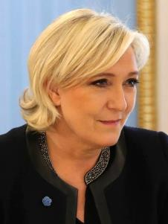
Modern era Fascism
Fascism, today, has become a pejorative applied to political actions/leaders/philosophy.
Frequently used to describe political candidates or officers that espouse populist, anti-immigration, or nationalistic views.
Recently used to describe politicians such as Donald Trump, Marine Le Pen, and Norbert Hofer
Aside from mislabeling politicians as fascists, there is truly a neo-fascist movement around the globe today.

Slide 11
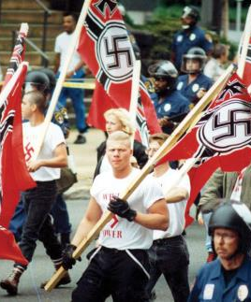

Modern era Fascism
Neo-fascism is represented by a number of relatively small, separate movements that advocate the value of power, supremacy, and ethnic purity.
In contrast to WWII Era fascism, Neo-fascism is not so clearly defined and is largely composed of loosely organized cells.
They often promote violence against other groups and the state, examples including the 1995 Oklahoma City bombing and the Charlotte Riots.
Motives appear largely to be free floating violence and aggression meant to shock rather than represent deep political conviction.
Golden Dawn, a political party in Greece, is one of the few neo-fascist groups to have organized and have a state platform, having even won a number of seats in the Greek Parliament.

Slide 12
Modern era Antifascism
In response to the radical right, a modern anti-fascist movement has emerged, commonly referred to has Antifa.
Espouse a militant anti-fascist, radical political view of far left politics aimed at fighting the far right.
The 2011 Occupy Wall Street protest was an early antecedent to the current Antifa movement
Many support disenfranchised populations and protest the amassing of wealth by corporations and the elite.
Most groups are largely composed of socialist, communist, and anarchists.
There are many cells worldwide, but there is no official leader, headquarters, or interconnected organizations.
Some view violence as an acceptable and effective strategy in stopping neo-fascists from gaining a platform to spread their views and to protect nonviolent protest. Ex. the Charlottesville Riots, and the numerous instances at Berkeley.
Other members view violence as harming the fight against extremism, and instead serves to equate both sides.
Adherents express a disdain for mainstream liberal politics because they see it as inadequately muscular: advocating direct action instead of relying on government order maintenance.

Slide 13
WWII & Modern
Fascism & Neo-Facism
Historic fascism had at its core a commitment to creating an ethnically pure nation state headed by a dictator who sought territorial expansion, controlled industry, and the suppression of all opposition.
Neo-Fascism consists largely of small groups that are not organized under either an autocratic leader or around a nation state. These groups do promote racism, anti-Semitism, and anti-immigration, but have not had a significant impact on society
Violence is seen as acceptable to promote both of their ideologies, but Neo-Fascist do not largely promote an anti-democratic or anti-capitalistic ideology.

Slide 14
WWII & Modern
“The Resistance” & Antifa
Both movements are composed of various groups not united under a solitary goal, however, many opposed discrimination, the abuse of power and human rights.
Both use violence, the dissemination of information, and the disruption of events to further their cause.
Antifa groups largely protest against racism, corruption, and elitism in government and society.
“The Resistance” were seeking to fight against invasion, provided humanitarian aid to victims of the regime, and attempted to overthrow fascist leaders and the regime through espionage or assassination.
Notes:
Largely Nazism, Irredentism is A political, typically nationalistic movement that intends to reclaim the land that they consider “lost”, “stolen”, “or unredeemed”.

