Slide 1
Toxoplasmosis

Slide 2
Clinical Presentation
Patient is a 29 year-old woman from South America, Goiania-GO, Brazil. At the moment of reporting, the patients reports to be on her second trimester of pregnancy. Admitted at Goiania Gastrico hospital, the patient reported having flu like symptoms including headache, fever, muscle aches, and drowsiness.
On physical examination, mental status changes are observed which includes seizure, alteration of consciousness, and cranial nerve palsies. The patient reports her preference for meat and admits domesticating a cat which occasionally defecates within the household.
Blood sample was taken and tested for IgG antibodies which tested positive showing possibility of past or current toxoplasmosis infection.

Slide 3
Clinical Presentation
Further test of IgM antibodies was done establishing that the infection is a current one and occurred after 16 weeks of pregnancy.
Amniocentesis –technique where amniotic fluid is removed from the amniotic sac- was done and the baby tested negative. The patient was given a combination of pyrimethamine and sulfadiazine and folinic acid to be taken for 4 to 6 weeks.
The patient was continually evaluated, and she reported disappearance of the symptoms after 4 weeks of treatment. The hospital visits, however, continues to assess the patient and the unborn’s condition.

Slide 4
What is Toxoplasmosis
Toxoplasmosis is a parasitic disease caused by one of the Worlds most common parasite, Toxoplasma gondii.
The parasites causes infection when one; eats undercooked meat, drinks contaminated water, is exposed to infected cat feces, or when a child contracts the parasite from the mother during pregnancy.
Also, though very rare, one can contract the parasite by receiving infected organ or blood during transplant and transfusion, respectively.
Whereas Toxoplasmosis does not show distinct symptoms in several people it affects, it may often cause flu-like symptoms.
It may cause serious complications to pregnant women and immunocompromised patients, however.

Slide 5
Clinical Manifestation
Signs and Symptoms of Toxoplasmosis
Reinstated, a significant number of infected individuals does not show signs and symptoms.
Some people, however, show flu like symptoms, and muscle aches, or swollen lymph glands lasting for a month or more.
When severe, the infection can cause damage to eyes, brain, or other organs. Occasionally, the infections becomes severe if it’s either reoccurring in a person or the individual has compromised immune system.
Notably, majority of infants infected while in the womb shows no signs of the disease, however, they develop them at their teens or a later stage in life.

Slide 6
Clinical Manifestation Cont.
Congenital Toxoplasmosis
Seizures
Enlarged liver and spleen
Severe eye infections
Jaundice
Ocular Toxoplasmosis
Reduced vision
Pain
Redness of the eye
Tearing of the eye
Severe Toxoplasmosis
Headache
Confusion
Poor coordination
Seizures
Lung problems

Slide 7
Initial Diagnosis
Often, Toxoplasmosis is difficult to diagnose because it is asymptomatic, and when it presents signs and symptoms, they are similar to mononucleosis and flu symptoms.
The common diagnostic method is the serologic testing.
Misdiagnosis, particularly false-positive, can create a false perception that one has been immunized against the infection and, therefore, stop preventive measures.
  On the surface, this increasing risks to the infection.
Through continuous research over the recent years, researchers have developed the testing kits accuracy.
For instance, a study on Toxo IgG assay by Abbot Laboratories in North Chicago showed sensitivities and specifities ranging from 92.1% to 99.7% and 99.1% to 99.85, respectively.

Slide 8
Diagnostic Tests
Diagnosis of toxoplasmosis can be highlighted as:
  Presence of parasites in a patient’s specimen
  Health provider isolating parasite from blood or other body fluids through inoculation or tissue culture. When inoculated in a mice, the mice should be tested 6 to 10 days post inoculation for presence of Toxoplasma organism in its peritoneal fluid. Should the results be negative, serology to be performed 4 to 6 weeks post inoculation.
  For detecting congenital infection in the utero, PCR genetic material test to be used.
Toxoplasma-specific antibodies detection is the primary diagnosis of toxoplasma infection; the most commonly tested antibodies are the IgM and IgG antibodies.

Slide 9
Final Diagnosis
The tests is done by several laboratories using commercial kits. The specificity and sensitivity of the kits may widely vary, however.
An individual is first tested for IgG Toxoplasma-specific antibodies to identify their immune status.
In the interpretation, a positive IgG test indicates a previous infection by the toxoplasma organism.
To determine the time of infection, the individual is further subjected to IgM capture EIA, a minimal nonspecific reactions procedure.
Whereas a negative IgM test would mean no recent infection, a positive IgM test would be complicated because IgM antibodies can always be detected by EIA for up to 18 months after acute infection.
Notably, IgG antibodies levels in AIDs patients are low.
Because of difficulty in interpreting tests results, CDC recommends all positive cases be confirmed in Toxoplasmosis specializing laboratory.

Slide 10
Treatment
Majority of healthy individuals recover from toxoplasmosis without treatment.
Notwithstanding, individuals developing complications can be treated with combination of drugs not limited to the following;
  Pyrimethamine (Daraprim)
  Sulfadiazine
  Folinic acid (leucovorin)
  Clindamycin (Cleocin)
Although they can be treated, the parasite may not be eliminated completely in infants, newborns, and pregnant women.

Slide 11
Transmission
Toxoplasma gondii, a parasite only excreted in cat feces, can be transmitted through;
  Eating undercooked animal meat harboring tissue cysts.
  Consuming cat-feces contaminated food or water
  Mother to child during pregnancy
  Infected organ transplant or blood transfusion

Slide 12
Etiology
Toxoplasmosis is an infection caused by an intracellular protozoan parasite, Toxoplasma gondii, that infects several warm blooded animals, including human beings.
With cats as the only known definitive host, the parasite is only excreted in their feces in the form of oocysts and become infective after 1 to 5 days.

Slide 13
Toxoplasma gondii and how it causes Toxoplasmosis
After being excreted by cats, the oocyst sporulate in the environment and become infective.
When humans ingest the toxoplasma gondii through any of the routes earlier stated, the parasite penetrates intestinal wall consequently invading body cells.
It forms tissue cysts, majorly in the skeletal muscle, brain, eyes, and myocardium.
For individuals in a healthy state, the cysts may remain in their body in an inactive form for their entire life. However, for individuals with weakened immune system, the infection can lead to severe complications.
Its virulence and infectivity not only depends on the parasites genotypes, but also factors controlling parasite-host cell interaction or the host immune response.

Slide 14
Pathology
The infection is usually asymptomatic in healthy persons.
Approximately 10-20% of individuals with acute infection develops enlarged lymph nodes.
Besides, one may develop headache, fever, and muscle pain.
Immunocompromised patients may develop heart and lung complications. Categorically, AIDs patients may develop lesions in the brain.
Severe illness may result into blindness as sarcocysts in the eye may rapture infected cells.
Congenital infections may result into severe birth defects or stillbirths.

Slide 15
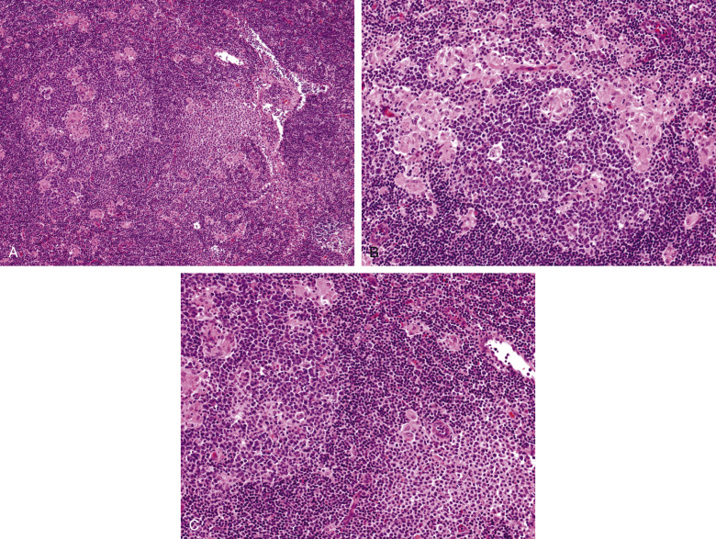
Pathology
A, Low power imaging of reactive follicle with small epithelioid histiocytes clusters around and in follicle centers. B, reactive follicle center surrounded by epithelioid histiocytes clusters. C, epithelioid histiocytes clusters adjacent aggregate monocytoid B cells.

Slide 16
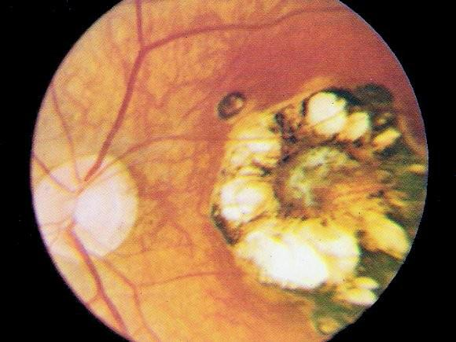
Pathology
Image of the inflammation of the retina

Slide 17
Epidemiology
According to CDC, serologic prevalence data of toxoplasmosis indicates that it is one of the most common infection worldwide.
Worldwide, approximately 30% of human beings are chronically infected with T. gondii.
Seroprevalence can be affected by climatic factors affecting oocysts survival in the environment.
Researchers have related high prevalence in France to high preference for eating raw or undercooked meat.
On the other hand, pieces of research has related high prevalence in Central America to the frequency of stray cats increasing oocysts survival and soil exposure.
Recently, data from NHANES between 2009-2010 depicts that seroprevalence among under 6 years was at 12.4%, whereas among women aged 15-44 years was at 9.1%

Slide 18
References
1. Mayo Clinic, 2020. Toxoplasmosis - Symptoms And Causes. [online] Mayo Clinic. Available at: <https://www.mayoclinic.org/diseases-conditions/toxoplasmosis/symptoms-causes/syc-20356249> [Accessed 3 May 2020].
2. Center for Disease Control and Prevention, 2020. CDC - Toxoplasmosis. [online] Cdc.gov. Available at: <https://www.cdc.gov/parasites/toxoplasmosis/> [Accessed 3 May 2020].
3. Simon, L., Fillaux, J., Guigon, A., Lavergne, R. A., Villard, O., Villena, I., ... & Pomares, C. (2020). Serological diagnosis of Toxoplasma gondii: analysis of false-positive IgG results and implications. Parasite, 27.

Slide 19
References
4. Liu, Q., Wang, Z. D., Huang, S. Y., & Zhu, X. Q. (2015). Diagnosis of toxoplasmosis and typing of Toxoplasma gondii. Parasites & vectors, 8(1), 292.
5. Dubremetz, Jean & Lebrun, Maryse. (2012). Virulence factors of Toxoplasma gondii. Microbes and Infection. 14. 1403-1410. 10.1016/j.micinf.2012.09.005.
6. Robert-Gangneux, F., & Dardé, M. L. (2012). Epidemiology of and Diagnostic Strategies for Toxoplasmosis. Clinical microbiology reviews, 25(2), 264-296. https://cmr.asm.org/content/cmr/25/2/264.full.pdf
7. Torgerson, P. and Mastroiacovo, P., 2013. WHO | The Global Burden Of Congenital Toxoplasmosis: A Systematic Review. [online] Who.int. Available at: <https://www.who.int/bulletin/volumes/91/7/12-111732/en/> [Accessed 4 May 2020].

