Slide 1
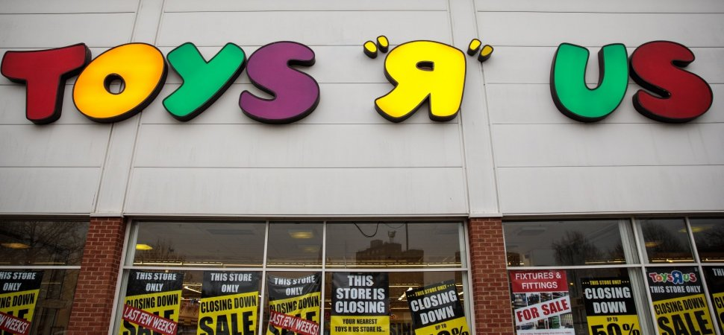
Toys R Us Current Downfall and Solutions
Presented by:

Slide 2
The History And Process That Led The Organization To Its Current State
The company had huge debts, right from it’s privatization phase, in 2005. Which totaled up to $5 billion in liabilities towards its closure in 2017, (Bomey, 2018).
Secondly, the company filled one of their main downfall whys and wherefores as extreme competition from Amazon, Walmart and Target. The competitors had attractive discounts on toys during the holidays and their products surpasses innovations in Toy R Us, (Willis, 2018).
According to Nathan Bomey (2018), the company declared it’s liquidation state before the holidays began. This was somewhat wrong and a factor to hinder redemption during toy season. It would have been better, if the exit was scheduled after the holidays, it is likely the narrative would have been different.
Notes:
The current state of Toy R Us has been a progressive trend since it’s privatization period. The trend is however, fueled by competition dynamics and lack of innovation. The three factors being managed properly could execute better market status than the competitors, since the organization had toys as their prime product unlike competitors.

Slide 3
Innovative Solutions That Toys R Us Can Use To Solve Its Current Downfall.
The first alternative was to recover from their long-term loans through selling assets. Some of viable assets are the numerous established stores, which could be absorbed as an online store. Other means to raise capital would be equity crowdfunding, where capital is raised from selling equity.
The second option would be investing heavily on innovation. Being at the top of research and technology in making modern toys, is a perfect strategy to solve the downfall. On the line of innovation, the company should opt for an online store and supply chain to maximize the market space dominated by competitors.
Notes:
The solutions suggested can be effective if the management team is credible to execute them diligently. Toy R Us current situation, is an overall pre-determined status, solely controlled by a series of managerial decisions, and not necessarily external factors.

Slide 4
References
Bomey, 2018. 5 Reasons Toys R Us Failed To Survive Bankruptcy. Retrieved from; https://www.usatoday.com/story/money/2018/03/18/toys-r-us-bankruptcy-liquidation/436176002/
Willis, 2018. Toys R Us Failed. Here Are the Main Reasons Why. Retrieved from; https://www.ezdia.com/toys-r-us-failed-here-are-the-main-reasons-why/

