Slide 1
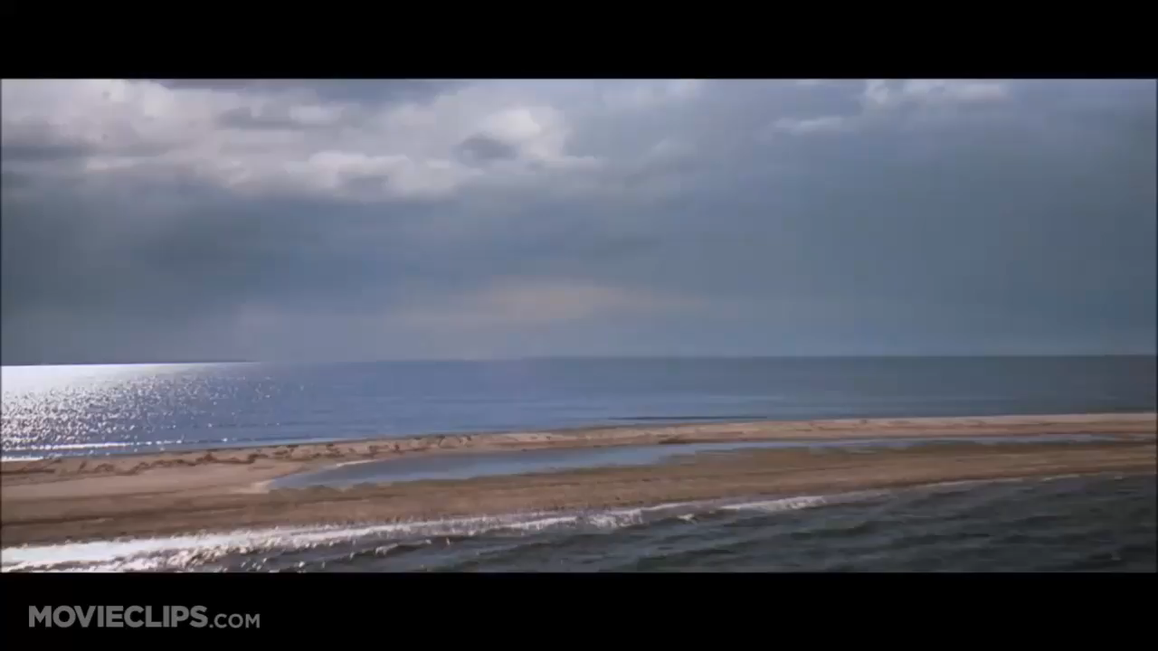
Running Head: TSUNAMI 1
Tsunami
Name of Student
Institutional Affiliation

Slide 2
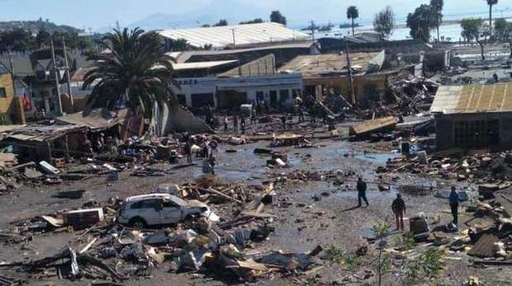
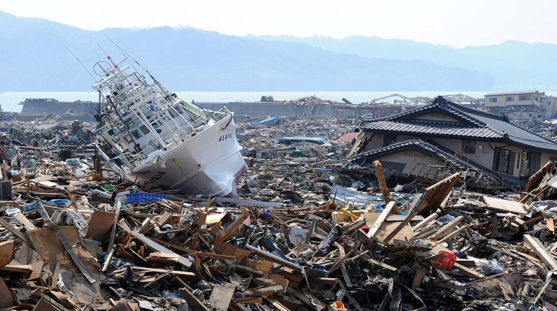
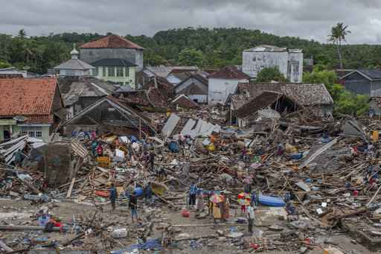
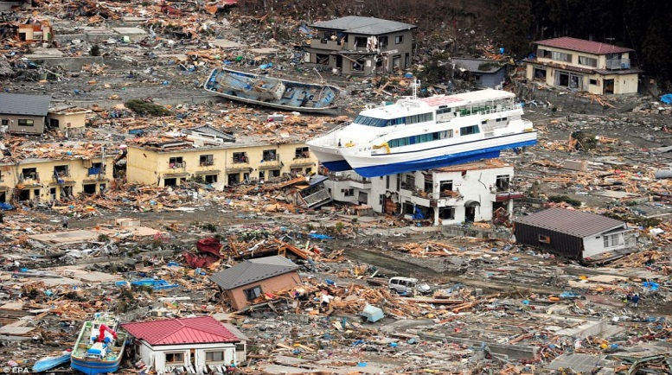
TSUNAMI 3
Thesis Statement
There have been several incidences of Tsunami reported worldwide. Even though there are several conspiracy theories surrounding the cause of theses gigantic ocean waves, earthquakes which occur at the ocean floors have always been considered the leading cause of these waves. An earthquake which occurs at the ocean floor leads to vertical displacement of a water leading to generation of a wave whose height increases as it approaches the shoreline. Other less common but possible causes include collision of continental plates, and submarine landslides.
Introduction
Tsunamis are ocean waves which result from a spontaneous disturbance of the ocean (Yeh, Barbosa, and Mason, 2015, p. 1-27). Most Tsunamis are brought about by displacement of the coseismal ocean floor. An earthquake must be of a significant magnitude for it to generate a tsunami. The wavelengths of a tsunami is usually long since it only results from large displacement of the ocean floor. The tsunami wave height is usually less than a meter high but the height keeps increasing as the wave approaches the shore.
Images of Tsunami aftermath

Slide 3
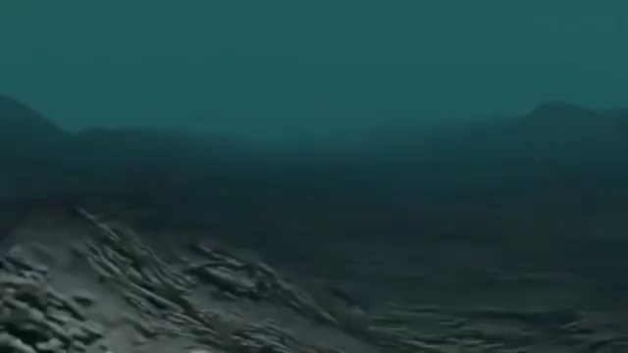
TSUNAMI 4
Facts about Tsunamis
They are caused by earthquakes which occur underwater, volcanic eruption or landslide which lead to substantial vertical displacement of water. The heights of these waves can reach up to 100 feet. ("Tsunami Facts and Information," 2018)
A majority of tsunamis occur within the Pacific Ocean specifically around the ‘Pacific Ring of Fire’ ("Tsunami Facts and Information," 2018).
The first tsunami wave is not usually the strongest. However, the succeeding waves are larger and stronger("NOAA's National Weather Service," 2009).
Tsunamis can travel at high speeds of up to 805 kilometers per hour("NOAA's National Weather Service," 2009).
Scientists can precisely tell the time a tsunami will arrive at any place in the world using calculations based on ocean depth, the time the underwater earthquake occurred and the distance of a place from the epicenter ("NOAA's National Weather Service," 2009).
Movement of a Tsunami wave

Slide 4
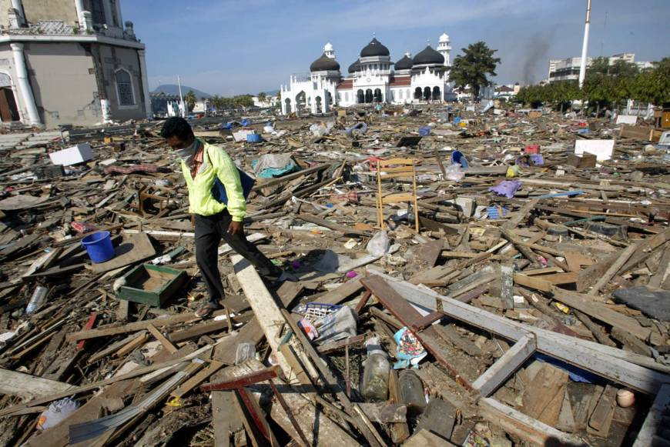
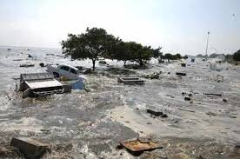
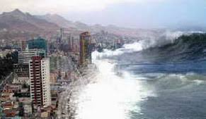
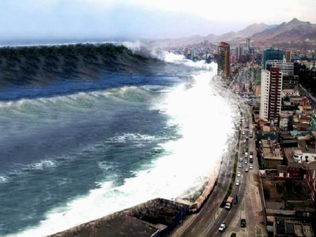
TSUNAMI 6
Pictures from the tsunami in Indonesia in 2004
Explanation of the Indonesian 2004 tsunami
On December the 26th 2004, at 7:59 am. Local time, a 9.1 magnitude earthquake shook the coastline of Sumatra- an Indonesian Island. Within the next seven hours after the quake, a series of huge ocean waves resulting from the earthquake spread across the Indian ocean striking the coastal areas within its reach. The wave was so powerful that it caused extensive damage to coastal areas as far as East Africa. In some areas, wave heights of up to 30 feet were experienced ("Indian Ocean tsunami of 2004 | Facts & Death Toll," 2018). In Indonesia alone, the wave led to a death toll in excess of 200,000. The worst hit part of Indonesia was the northern Sumatra’s province of Aceh. The earthquake caused serious devastation to villages, farmland and fishing grounds. Additionally, the wave water demolished buildings, deposited debris and human bodies and brought plant killing salty sea water inland.

Slide 5
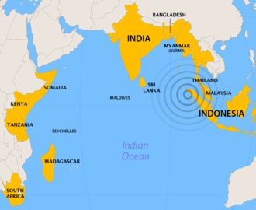

Map showing the Epicenter of the Earthquake
Effects of the Earthquake
It led to damage of buildings and power outages in Banda Aceh city due to violent shaking of the ground. Several buildings which were more than three stories high collapsed.
The earthquake also led to tectonic subsidence of the earths crust beneath the Aceh province by between 20cm to 100 cm. This extended for approximately 280 km along the northwestern coastline of Aceh.
The rapturing of the fault line led to uplifting of the ocean floor which resulted to release of a series of huge ocean waves. The devastating effects of these waves were felt in coastline of 12 countries.

Slide 6
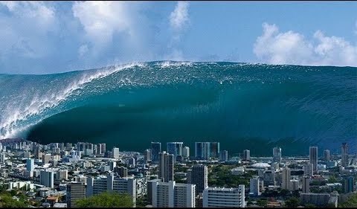
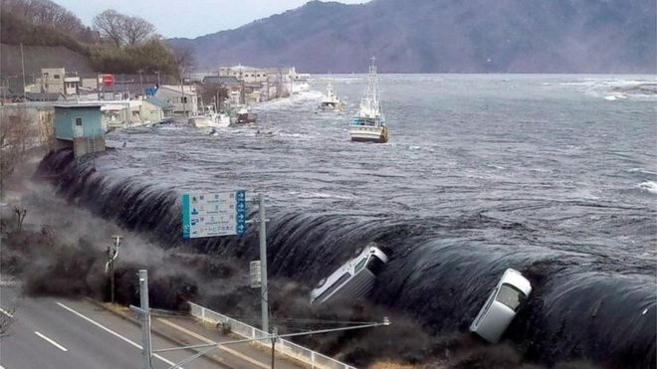
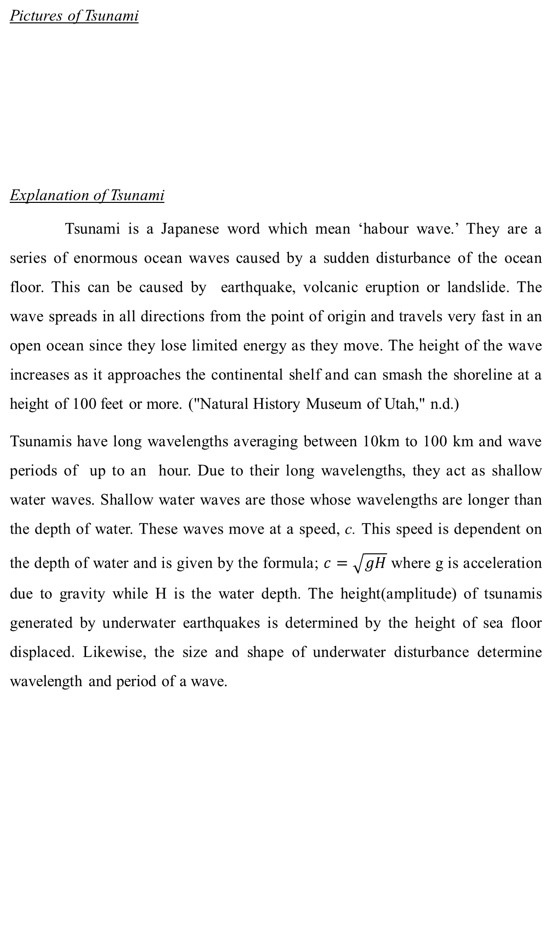
TSUNAMI 7
Pictures of Tsunami
Explanation of Tsunami
Tsunami is a Japanese word which mean ‘habour wave.’ They are a series of enormous ocean waves caused by a sudden disturbance of the ocean floor. This can be caused by earthquake, volcanic eruption or landslide. The wave spreads in all directions from the point of origin and travels very fast in an open ocean since they lose limited energy as they move. The height of the wave increases as it approaches the continental shelf and can smash the shoreline at a height of 100 feet or more. ("Natural History Museum of Utah," n.d.)
Tsunamis have long wavelengths averaging between 10km to 100 km and wave periods of up to an hour. Due to their long wavelengths, they act as shallow water waves. Shallow water waves are those whose wavelengths are longer than the depth of water. These waves move at a speed, c. This speed is dependent on the depth of water and is given by the formula; $c=\sqrt{gH}$ where g is acceleration due to gravity while H is the water depth. The height(amplitude) of tsunamis generated by underwater earthquakes is determined by the height of sea floor displaced. Likewise, the size and shape of underwater disturbance determine wavelength and period of a wave.

Slide 7
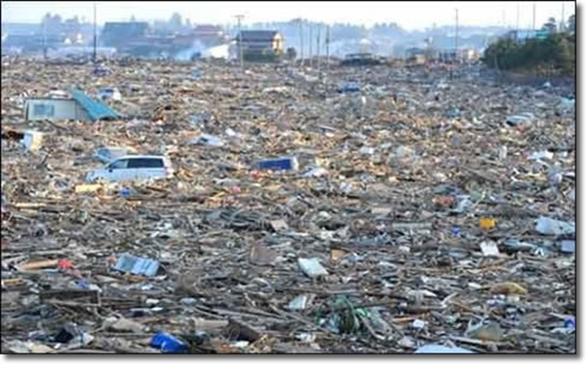
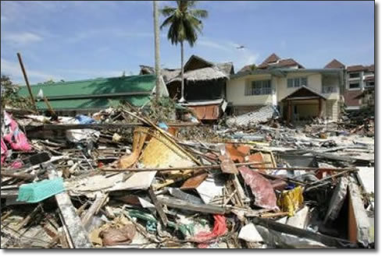
TSUNAMI 7
Pictures of damage cause by tsunami
Effects of tsunamis
Destruction:- A tsunami can cause serious damage when it strikes land due to the huge amount of energy it has. The wave is so powerful that is destroys virtually everything along its path. The destruction is caused by the smashing action of the water moving at high speeds and the debris it carries and deposits along its path.
Death:- This is one of the worst effects of tsunami. Whenever the waves hit a specific place, chances of survival are very minimal. People staying in coastal regions are at the highest risk of death since they waves hit them at a very high speeds as it juts into land. The waves cause death by drowning, debris and electrocution.
Water borne diseases:- the large amounts of ocean water moving at high speeds are very destructive to infrastructure such as sewerage system. Contamination of drinking water by sewerage contents can lead to water borne diseases in areas hit by tsunamis.
Other effects include damage to plant and animal life and huge costs incurred in rebuilding the damaged structures and clearing the debris.

Slide 8
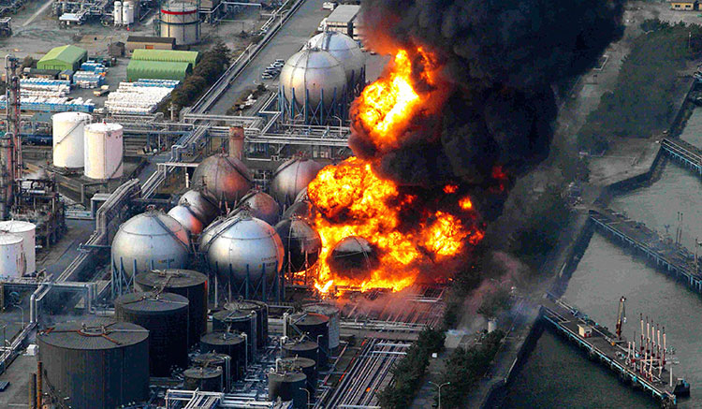
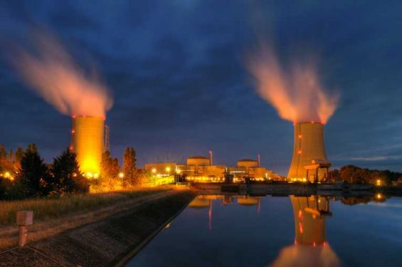
TSUNAMI 8
Fukushima Daiichi Nuclear Plant Failure and Explosion
On March 11th 2011, a nuclear accident rated 7 on the INES scale struck Fukushima Daiichi nuclear plant leading to release of high radioactive radiation for more than four days. The failure of the powerplant was precipitated by a 15 meter earthquake-induced tsunami which disabled the cooling and power supply of the plant’s three reactors("Fukushima Daiichi Accident - World Nuclear Association," 2018). The damage led to melting of the plant’s three cores.
Two weeks after the accident, unit 1-3 were stabilized through addition of water and by July, the reactors were being cooled using recycled water obtained from the new treatment plant. In mid December, an official cold shutdown was announced. The main tasks apart from cooling have been preventing the release of poisonous radioactive materials into the environment.

Slide 9
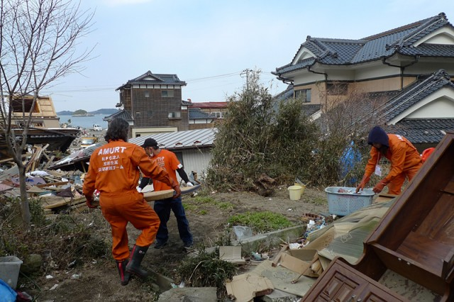
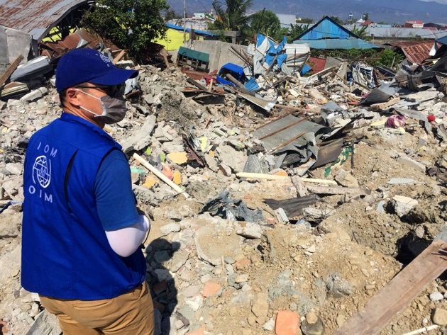
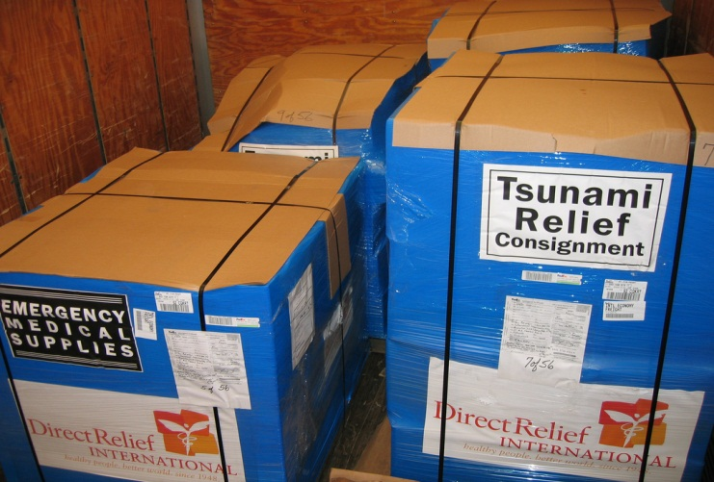
TSUNAMI 8
Conclusion
Tsunamis cause serious devastating effects wherever and whenever they occur. Not only can they cause to damage of property and lives but also lead other serious disasters such as outbreak of diseases and nuclear accidents like the Fukushima Daiichi accident. prompt disaster management response should be employed to avert excessive damage to different forms of life and property. Additionally, measures should be put in place to avert accidents which may be triggered by tsunamis such as nuclear disasters. Besides, hose who have been affected by tsunami should be accorded appropriate medical care and psychological support to enable them continue leading their normal lives. Doing these will ensure that lives and properties are protected from the damaging effects of tsunami.

Slide 10
TSUNAMI 8
References
Fukushima Daiichi Accident - World Nuclear Association. (2018, October). Retrieved from http://www.world-nuclear.org/information-library/safety-and-security/safety-of- plants/fukushima-accident.aspx
Indian Ocean tsunami of 2004 | Facts & Death Toll. (2018, December 19). Retrieved from https://www.britannica.com/event/Indian-Ocean-tsunami-of-2004
NOAA's National Weather Service. (2009, November 25). Retrieved from http://ptwc.weather.gov/faq.php
Natural History Museum of Utah. (n.d.). Retrieved from https://nhmu.utah.edu/sites/default/files/attachments/All%20About%20Tsunamis
Tsunami Facts and Information. (2018, January 23). Retrieved from http://environment.nationalgeographic.com/environment/natural-disasters/tsunami-profile/
Tsunami Facts and Information. (n.d.). Retrieved from http://www.bom.gov.au/tsunami/info/
Doocy, S., Daniels, A., Dick, A., & Kirsch, T. D. (2013). The Human Impact of Tsunamis: a Historical Review of Events 1900-2009 and Systematic Literature Review. PLoS Currents. doi:10.1371/currents.dis.40f3c5cf61110a0fef2f9a25908cd795
Yeh, H., Barbosa, A., & Mason, B. H. (2015). Tsunamis Effects in Man-Made Environment. Encyclopedia of Complexity and Systems Science, 1-27. doi:10.1007/978-3-642-27737-5_623-1

