Slide 1
Communicating Across Cultures
Chapter 8
University of Colorado Denver

Slide 2
Intercultural Communication
Intercultural contact is a fact of life in today’s world
  Migration (232 million migrants in 2013)
  Traveling for pleasure
Although it can be enriching, it can also bring challenges and misunderstandings. It does not always lead to increased liking
  Difference is often seen as threatening to our sense of identities and way of life
  Recognizing that engaging with difference does not have to mean adoption of different values, and can also lead to growth
    Enhanced business effectiveness
    Improved intergroup relations across nations – peacebuilding
    Enhanced self-awareness
Diversity in the U.S.
Technology

Slide 3
What is intercultural communication?
Intercultural communication refers to the communication that occurs in interactions between people who are culturally different
  Occurs on a continuum (nationality, ethnicity, race, gender, age, religion, sexual orientation, physical ability, etc.)
Culture: learned patterns of perceptions, beliefs, values, and behaviors shared by a group of people
  It is dynamic, heterogeneous, and influenced by sociopolitical structures

Slide 4
Cultural Hybridity/Border Dwellers
Individuals that experience contradictory cultural patterns, and have to move between ethnicities, races, religions, languages, SESes, and or sexual orientations
  Travel
  Socialization
  Intercultural relationships

Slide 5
Cultural Hybridity/Border Dwellers
Travel
  Culture shock – disorientation and discomfort due to unfamiliarity with environment and other individuals; frustration, anger, hopelessness
  Reverse culture shock/reentry shock
    Social support, empathy, active listening, and adapting
Voluntary short-term e.g. study abroad | Voluntary long-term e.g. immigrants
Involuntary short-term e.g. refugees | Involuntary long-term e.g. diasporic groups

Slide 6
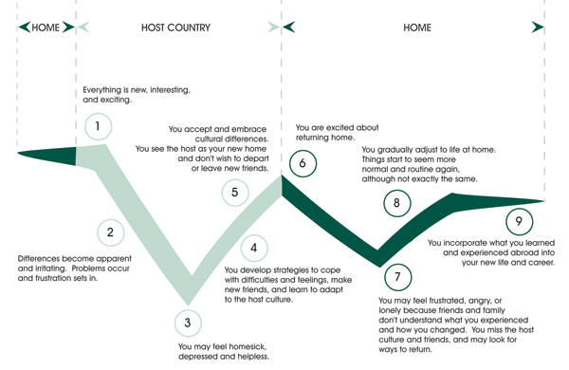
http://muisss.files.wordpress.com/2011/09/culture_shock-2.jpg

Slide 7
Cultural Hybridity/Border Dwellers
Socialization
  Asian-Americans, Arab-Americans, born to Jewish and Christian parents, bi/multi-racial, bisexual, etc.
  Multiple cultural realities, located “in-between”
    Neither here nor there, both and neither, reside in a contested space full of cultural tensions
    Defy frameworks of singularity and conformity

Slide 8
Cultural Hybridity/Border Dwellers
Relationships
  Communication plays an integral role for successful intercultural relationships
    Communicating about differences helped promote growth, understanding, appreciation—integration of similarities and differences

Slide 9
Cultural Hybridity/Border Dwellers
Encapsulated marginal people
  Feel disintegrated by having to shift cultures, have difficulty making decisions, feel pressure from both groups, never feel at home
  “Chronic homelessness”
Constructive marginal people
  Thrive on their “border,” while recognizing its challenges
  Cultural liaisons, find support in other hybrids

Slide 10
Cultural Taxonomies
Cultural theorists: Edward Hall and Geert Hofstede
Cultural taxonomies describe patterns (values, norms, social practices) on a cultural, not individual, level.
Cultural dimensions are interrelated.

Slide 11
Cultural Dimensions
High-context and low-context
Collectivism and individualism
Preferred personality – doing vs. being
Power distance
Uncertainty-avoidance
Time-orientation

Slide 12
Cultural Dimensions
These dimensions are there to show that cultural “standards” aren’t universal standards
It helps us recognize and be cognizant of difference
It also helps us better understand which cultures we are a part of (and move between), and how our cultures affect us
A dialectic approach emphasizes the fluid, complex, and often contradictory nature of intercultural interactions

Slide 13
Difference
Differences are not inherently problematic
There is much evidence of instances where people and groups have cohabited (and do cohabit) harmoniously with others who are “different” in some way
So why is difference perceived, and treated as, a threat?

Slide 14
Difference
It is the symbolic values that are assigned to differences that make it “threatening”
  Uncertainty reduction: familiar values create predictability, stability, security
  Erasure of self, community: “Our culture provides us with a sense of symbolic immortality, and hence if we feel that our culture is threatened, then we react with a fear that is similar to fear of mortality.”
    This does explain, to some extent, the passion and fervor with which people defend the core values of their culture—even to the point of violence.
  Conditions of stress caused by competition over scarce resources

Slide 15
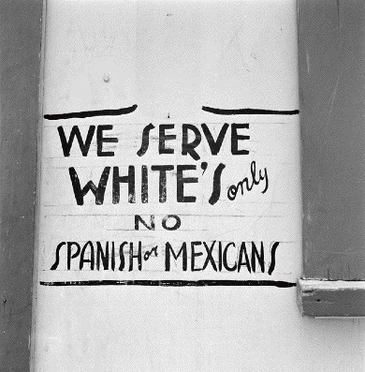
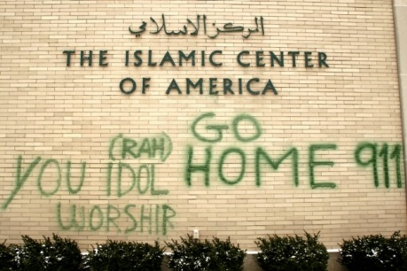
Difference
The moment we perceive that “different” is “dangerous” or “wrong,” then we may be in danger of the function to exert our “rightness,” even by violent means
  “Difference” has been used as a tool for division
  Labels and hierarchies of social identity groups are products of their time

Slide 16
Intercultural Communication Influences
Political and historical forces
  9/11
  Slavery
  Black Lives Matter
  Muslim ban protests
  Women`s march
  Parkland shooting`s activists
Social hierarchies of power
  Privileged and marginalized identities – whose cultural values will be respected and followed.
  Co-cultures: assimilate, accommodate, separate

Slide 17
Ethical Intercultural Communication
1) Increase self-reflexivity and knowledge about others/Be mindful
  Monitor your thoughts, attitudes, and feelings
  Ask yourself if you are relying on stereotypes or making assumptions about social identity groups
  Notice when you have negative or emotional responses to images, phrases, words, and objects related to social identity groups
  Also, be aware of when you judge people who belong to the same groups as you
  Be honest with yourself

Slide 18
Ethical Intercultural Communication
Avoid ethnocentrism, reductionism, and dehumanization
Understand how difference works
  Perceived difference is often at the root of conflict…But uniformity does not have to be a prerequisite for unity
  Color blindness is not the answer!
Consider your motivation, or lack thereof, to engage in meaningful intercultural communication
Notes:
Harmony:
If we do not mix spices, we cannot make tasty soup.
Without different sounds, there is no music.
Without different colors, there are no paintings.

Slide 19
Ethical Intercultural Communication
Recognize benefit of cultural diversity – harmony
  Through similarity, we build solid mutual foundations. Through difference, we harmoniously enrich one another.
Intercultural communication is not just learning about, but also learning from
  Engaging with difference does not require an adoption of difference
  Each person has a right to their cultural values. It is about understanding, not judging or enforcing
    As a Muslim, I accept that some people are atheists. I do not need to become an atheist.

