Slide 1
COMM 1011-
Fundamentals of Communication
Chapter 9
Communicating in Close
Relationships

Slide 2
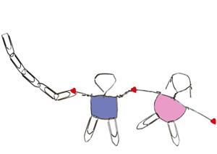
Importance of Close Relationships
Sense of belonging
Alleviate loneliness
Psychological and physical health
Notes:
Lack of close relationships associated with depression, anxiety, and weakened immune systems – cyberbullying, feeling alone, solitary confinement - Castaway

Slide 3
Theories of Relationship Development - Initiation
Attraction Theory
  Proximity
  Attractiveness
    matching hypothesis
    physical, social, task attractiveness
  Similarity

Slide 4
Theories of Relationship Development - Initiation
Uncertainty Reduction Theory
  To initiate new relationships, must communicate in ways that help others reduce their uncertainty in positive and pleasant manner
Predicted Outcome Value Theory
  Reducing uncertainty can lead to attraction or repulsion
  Predictions of future interactions
Notes:
Uncertainty: More certainty - > more liking
Predicted outcome value theory – self sabotage

Slide 5
Theories of Relationship Development - Development
Social Exchange Theory
    Rewards and costs
Equity Theory
  Under-benefitted and over-benefitted
  Equity vs. equality ( Equity is giving everyone what they need to be successful. Equality is treating everyone the same._
Notes:
Social Exchange: People attempt to maximize rewards and minimize costs
Equity Theory: People are most satisfied in relationships they perceive as fair

Slide 6
Models of Relationships Development (romantic or platonic)
Social Penetration
  Self-disclosure
Knapps Stage model
  Relationship development as staircase
Turning point model

Slide 7
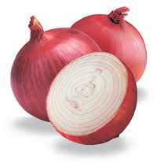
Social Penetration Theory
Self-disclosure
  Breadth
  Depth
  Frequency

Slide 8
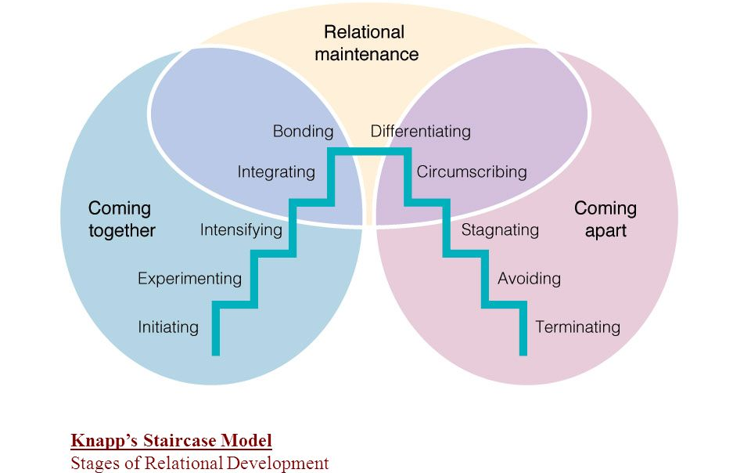
Knapp’s Stage Model

Slide 9
Knapp’s Stage Model
Stage | Goal | Example
Initiating | Appear pleasant | “Hi! I like your car.”
Experimenting | Learn about each other | “Do you like to travel?”
Intensifying | Increase intimacy | “I can’t imagine being with anyone else.”
Integrating | Establish as a couple | “I love you.”
Bonding | Public commitment | “Will you marry me.”
Differentiating | Increase distance | “You can come if you want.”
Circumscribing | Discuss safe topics | “Did you do the laundry?”
Stagnating | Prevent change | “Let’s not talk about it now, ok?”
Avoiding | Decline to interact | “I’m busy, I’ll get back to you later.”
Terminating | Ending the relationship | “It’s over.”

Slide 10
Turning Point Model for Romantic Relationships
Couples can turn toward or away from commitment at various times
A model for turning points in friendships also exists, with different turning points than in a romantic context
Turning Point | Description
Get-to-know | Getting to know other - Increases commitment
Quality time | Occasions for appreciation – Increases commitment
Physical separation | Time apart – Little effect on commitment
External competition | Competing for attention – Decreases commitment
Reunion | Coming back together after separation – Increases commitment
Sacrifice | Providing support/gifts – Increases commitment

Slide 11
Maintaining Relationships
Relational Dialectics Theory
  Dialectic—the tension people experience when they have opposing but continual needs.
    Autonomy/connection
    Expressiveness/privacy
    Change/predictability
Relational Maintenance Strategies
  Positivity, openness, assurances, sharing tasks, social networks, joint activities, avoidance, humor, etc.
Notes:
1- shared yet also separate social circles
2 – someone who shares too much (i.e. where they are all the time) – you are capable – ma ye7taj

Slide 12

Aversive Communication Behaviors in Relationships
Deception
Jealousy
Infidelity
  Sexual/emotional
Interpersonal violence

Slide 13
How does one manage relational transgressions?
Getting a relationship back on track after a serious transgression or conflict can be difficult
There are three dimensions to this:
  How one responds to the transgression
  How one corrects behavior in response to the transgression – remedial strategies
  How one rebuilds the relationship & forgiveness (if invested)

Slide 14
Healing – Remedial Strategies
Apologies and concessions (admitting guilt)
Appeasement and compensation (complementing, attentive, affirmation, gifts, etc.)
Explanations, excuses, and justifications (minimize responsibility)
Denials
Avoidance and evasion
Relationship talk

Slide 15
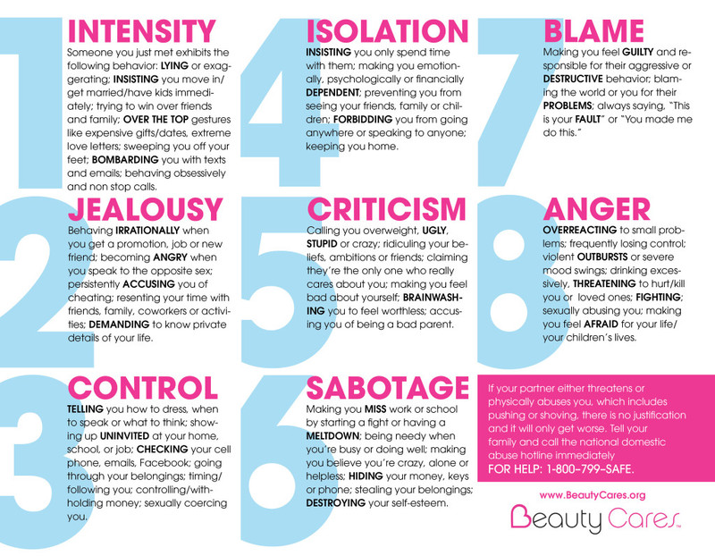

Slide 16
Maintaining Relationships
Be ware of your, and the other individual’s, self-esteem and need for validation
Be mindful of the language you use to communicate
Practice active listening and empathy
Recognize when its necessary to work on a relationships, and when it’s time to end the relationship

Slide 17
The Phoenix Center
How to contact The Phoenix Center at Auraria
  Tivoli Student Center, suite 227
  Office Hours: Monday to Friday 8:30am-4:30pm
  For Appointments: 303-556-6011
  24/7 Free and Confidential Helpline: 303-556-CALL (2255) (information on interpersonal violence, referrals, options, and next steps)
  Email: pcauraria@gmail.com

