Slide 1
Unprofessional Profile–Bella Swan

Slide 2
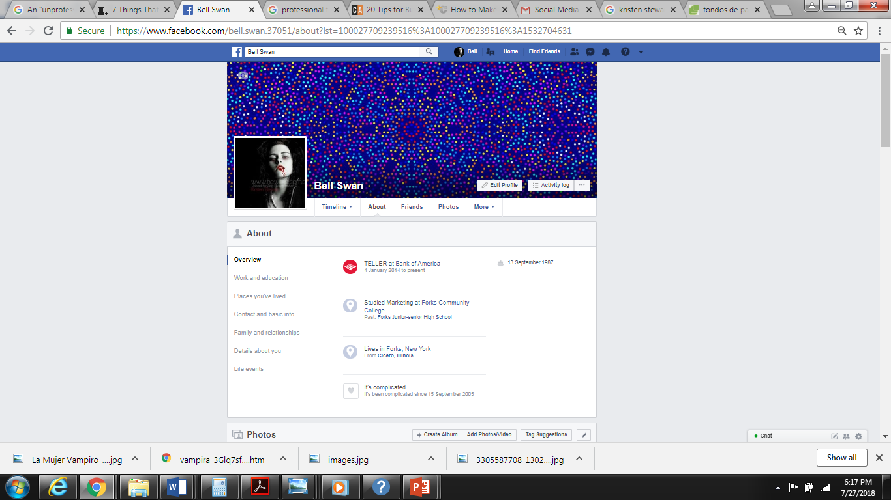

Slide 3
