Slide 1

VHF COMMUNICATION SYSTEM
2
+
2
+
Presented by:

Slide 2
Introduction
Very High Frequency (VHF), is a communication frequency ranging between 118MHz and 137 MHz and is capable of hosting both voice and data transmission. The technique has been long used for aircraft and ground communications, and is expected to consistently advance over time, (Tooley & Wyatt, 2011).
Some of the key areas where VHF is highly dependable include air traffic control (ATC), arrival and departure information, transfer of meteorological data, ground handling of aircraft, corporation communications, and for the Aircraft Communications and Reporting System (ACARS).
In this presentation, the focus will be to elaborate the different components of the VHF system and how they work as entities of the communication structure.

Slide 3
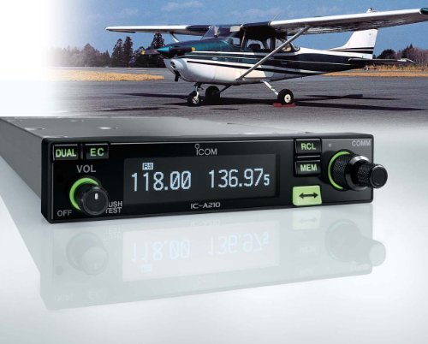
Different components of vhf system
VHF Range and Propagation.
Double Sideband Modulation, (DSB).
Channel Spacing.
Depth of Modulation.
Compression.
Squelchy.
Data Modes.

Slide 4
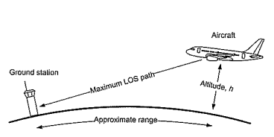
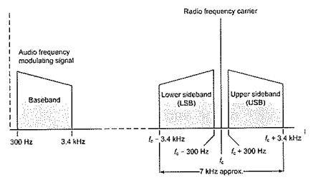
1. VHF Range and Propagation.
The range of 30MHz to 300MHz, propagate as direct-line of sight (LOS) through reflection and diffraction processes. In other instances, depending on the solar activity and the frequency preference, sky waves propagation occurs, even at the lower ranges of up to 50MHz. The maximum line-of-sight (LOS) distance in nautical miles, between an aircraft and a ground station, is given by the relationship: d =1. 1 √h.
2. Double Sideband Modulation, (DSB).
The double sideband modulation, simply means the ability of VHF to transmit voice and data using its three separate constituents. The constitutes of transfer are namely, the RF Carrier, Lower side frequency and Higher side frequency.

Slide 5
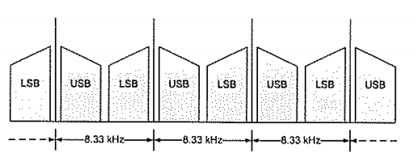
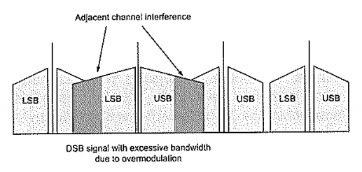
3. Channel Spacing.
For a successful VHF communication, the channels are often spaced proportionally at given wavelengths. Initially, the VHF’s were spaced at 200 kHz breaks, but as the channels increase to met the demand, the intervals have reduced significantly up to 8.3kHz supporting a frequency range of 118-137 MHz.
4. Depth of Modulation.
The depth of modulation is expressed as the percentage modulation, ranging between 0% ; unmodulated RF carrier, and 100%; modulated RF carrier. Modulated carries, results into clear signals. Instances of over modulation, projects to interruptions in the nearby channels.

Slide 6
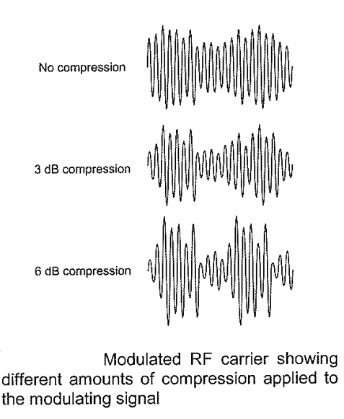
5. Compression.
VHF communication signals, undergo a compression phase within the speech amplify, where the low voice signals are boosted and high voice signals are minimized. Ultimately, both signals achieve an middling modulation depth.
6. Squelchy.
Squelchy, commonly known as noise operated squelch, is a specialized system that detects noise at outputs and uses the signal to noise ratio, as a control technique to noisy signal. The component is considered a loftier alternative to compression services.

Slide 7
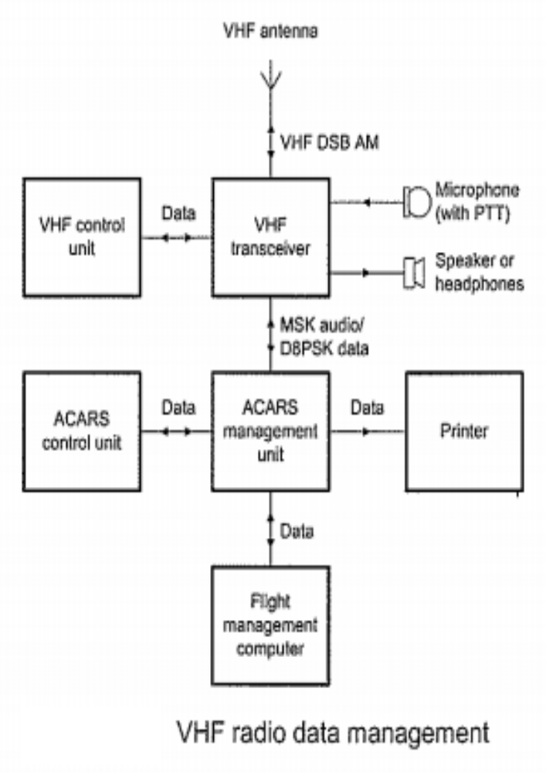
7. Data Modes.
Data Modes are the data links provided by VHF in transferring information, alongside voice transmitters. Currently, the aircrafts use the Aircraft Communications Addressing and Reporting System (ACARS), as their data link. Precisely, the ACARS are always three in number, where two are obligated to do voice communication, while the other one is the data link, (VHF data link, VDL).
Some of the information carried through by the autonomous data link, include; traveler loads; departure and arrival intelligences, fuel information and engine status of the aircraft, (Tooley & Wyatt, 2011).

Slide 8
CONCLUSION
From the highlighted components of VHF, it is patent that the communication system has reshaped approaches of both data and communication transmissions. Evidently, the technique has evolved year after year, where adoptions of the system by aircrafts and business, has significantly reduced its channel spacing right from 200kHz to 8.3kHz, making it ideal for heavy data carriage in different multiple fields.

Slide 9
REFERENCE
Tooley, M., & Wyatt, D. (2011). Aircraft Communications and Navigation Systems (2nd ed., pp. 61-72). New York: Routledge.

Slide 10


2
+
The End

