Slide 1
Vitamins
Vitamins are nutrients obtained by our bodies from foods taken or through taking multi-vitamins. This is because the human body does not make it’s own vitamins (Tyśkiewicz et al., 2018).
Vitamins help in boosting human health besides helping the body in other several functions.
Student’s Full Name
Department & University
Course Number & Name
Instructor Name
Assignment Due Date

Slide 2
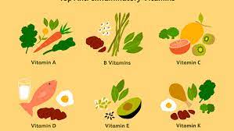
Types of Vitamins
Fat Soluble
Water Soluble
Stored in body’s liver and fat tissues.
Their absorption process is similar with the one for normal fats.
They can last for up to 6 months until when they are needed by the body.
They include A,D,E & K.
They are directly absorbed in to the blood stream.
Excess water soluble vitamins are eliminated through urine.
They should be quickly replenished as they don’t last in the body.

Slide 3
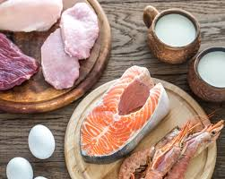
Water Soluble - B1 Thiamin
Help to produce energy from Carbohydrates.
Important for appetite.
They promote muscle and body growth (Mozafar, 2018).
Used to produce ATP.
Sources
Legumes
Nuts
Pork
Cereals
Liver
Fish
Deficiency
Poor appetite
Lack of quality sleep.
Weight loss
Exhaustion
Heart related illnesses.

Slide 4
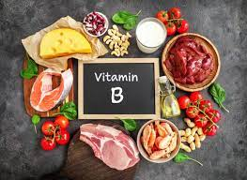
Vitamin B-2 Riboflavin
They help in good sight.
Provide energy to the body.
They help in metabolism of fats, proteins and carbohydrates.
Boost immune system.
Deficiency
Lack of Vitamin B-2 causes skin disease.
Blood shot eyes is also a deficiency sign.
Issues with digestion system.
Cracked lips.
Itching eyes.
Sources
Enriched grains.
Green vegetables
Dairy and dairy products.
Meat.
Eggs.

Slide 5
Vitamin B-3 Niacinamide & Niacin
They help in maintaining the nervous system.
Improves digestive track’s health.
Helps in energy production.
Aids in skin maintenance.
Sources
Niacin is toxic in large quantities.
Niacinamide does not regulate cholesterol
Deficiency
Causes a disease called Pellagra
Causes loss of appetite.
Causes fatigue and body aches.
Can cause depression.

Slide 6
Vitamin B-12 Cobalamin
Helps in DNA reproduction.
Fights anemia.
Helps in proper functioning of the nerve system.
Helps to produce energy.
Deficiency can cause anemia.
It can lead to damages to the verves.
The skin becomes hypersensitive.

Slide 7
Fat Soluble – Vitamin A
Maintains good vision
Helps in growth of stronger bones.
Helps in reproduction.
It improves the immune system.
Animal sources
  Liver
  Kidney
  Cheese
  Meat
  Eggs
Plant sources
  Carrots
  Spinach
  Broccoli
Deficiency
Blindness at night.
Reduced immune system.
Dry skin and loss of hair.

Slide 8

Vitamin D – Sunshine Vitamins
Encourages cell differentiation while supporting normal cell proliferation.
Immune system modulator with a lot of power.
When there is an increase in insulin demand, it plays a function in insulin secretion.
Important in the control of blood pressure via the renin-angiotensin system.
Calcium and phosphorus absorption are made easier.
Deficiency
Poor bone health
Poor calcium absorption.

Slide 9

Vitamin E
Protects cell membranes and other fat-soluble components of the body from oxidation (LDL cholesterol)
Promotes the production of normal red blood cells.
It works as an anti-clotting agent (Kuksis, 2018).
Contributes to the body's capacity to metabolize glucose.
It's also been shown to help in wound healing.
Sources
Vegetable oils
Nuts and seeds.
Whole grains
Fruits and vegetables.

Slide 10
Vitamin K
Essential for blood clotting.
Promotes bone health.
Sources
Figs
Dairy products
Blueberries

Slide 11
References
Mozafar, A. (2018). Plant vitamins: agronomic, physiological, and nutritional aspects. CRC press.
Tyśkiewicz, K., Dębczak, A., Gieysztor, R., Szymczak, T., & Rój, E. (2018). Determination of fat‐and water‐soluble vitamins by supercritical fluid chromatography: a review. Journal of separation science, 41(1), 336-350.
Kuksis, A. (2018). Absorption of fat-soluble vitamins. In Fat absorption (pp. 65-86). CRC Press.

