Slide 1
What happens to “old media” when it dies?
Presented by:

Slide 2
Walkman
Walkman is a Sony brand tradename, originally used for portable audio cassette players from the late 1970s onwards. In later years, it has been used by Sony to market digital portable audio/video MP3 players, as well as a line of Sony Ericsson mobile phones introduced in 2005.

Slide 3
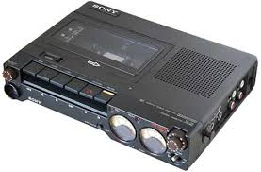
The original prototype was built from a heavily modified Sony Pressman, (a lightweight, compact tape recorder designed for journalists) by replacing the recording head with a playback head and the speaker with an amplifier.
Picture of Sony Pressman

Slide 4
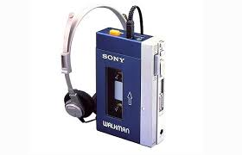
Sony engineers were able to combine the portability of the Pressman with the stereo experience of the TC-D5.(Sony's existing portable player ). Later The player was released in Japan in 1979 as the "Walkman“.
Original Sony Walkman TPS-L2 from 1979

Slide 5
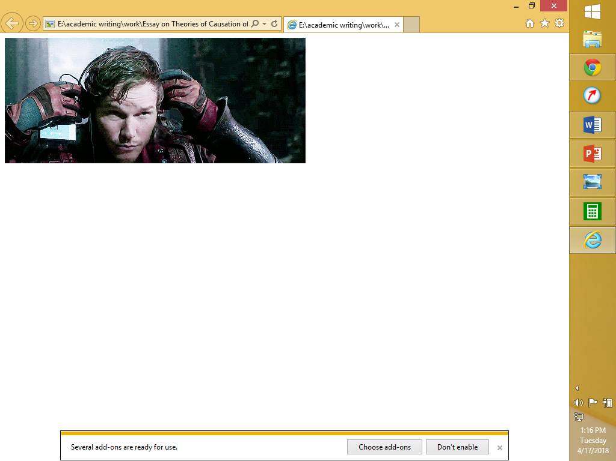
History of Walkman.
The history of Walkman dates well between 1980 and 1999, the Sony Walkman really did change the way people listened to music. It wasn’t just about it being portable and offering big stereo quality sound.
Despite major advancements in music technology a few upgrades on Walkman managed to penetrate the 21st Century market.

Slide 6
The Walkman progressions were as follows
Walkman Professional - 1982.
CD Walkman (Discman) - 1984.
Video Walkman (Video 8 format tape cassette) - 1989.
Minidisc Walkman - 1992.
Network Walkman - 1999.
Walkman Video (H.264/MPEG-4 AVC format) & MP3 Player - 2003.
Sony Ericsson Mobile phones - 2005.

Slide 7
Absorption of Walkman
After the runaway success of Apple's hard-drive-based iPod, Sony lost much and its market to the portable digital audio ; the iPod and similar devices from other companies.
Sony's latest attempt to revive the Walkman brand involved a series of music-centered mobile phones marketed under the former Sony Ericsson brand.
In 2011 Sony Ericsson released their last Walkman branded phone, the Sony Ericsson Live with Walkman. Since Sony acquired Ericsson's 50% stake forming Sony Mobile Communications in 2012.
In March 2015, Sony retired the Walkman brand for Android, renaming their embedded app "Music".

Slide 8
BIG QUESTION
With the diverse technological advancements ,do you think retiring Walkman brand was the best decision in 21st Century?

Slide 9
The end

