Slide 1
WORLD WAR I
1914-1918

Slide 2
Results of the War
Destroyed Hapsburg (Austria/Central Europe) and Ottoman (Turkey/Middle East) Empires
Altered Hohenzollern and Romanov (Russia) Empires beyond recognition
Gave birth to a slew of new states
Fomented Communist revolution in Russia
Twice as many people killed as in all the wars of the previous two centuries combined (15 million)

Slide 3
BACKGROUND
Franco-Prussian War of 1870-1871
Resignation of Bismarck in 1890 (who had pursued a restrained foreign policy)
Decline of British power, or “hegemony”
Increase in British/German rivalry
Decline in power of Austro-Hungarian empire, leading them to try to assert themselves in former territorial possessions, like Serbia.

Slide 4
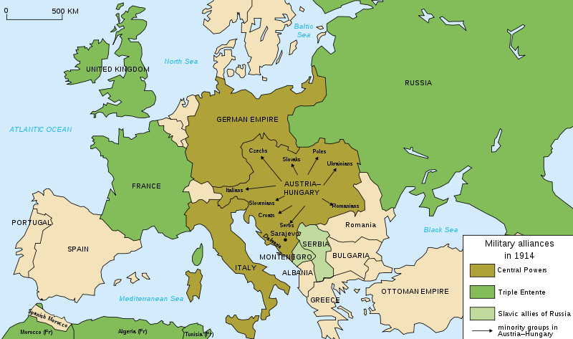

Slide 5
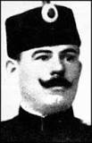

SARAJEVO AND START OF THE WAR
Terrorist Organization (“The Black Hand”) wants to Arch-Duke (Prince) Franz Ferdinand to protest Austrian control over Serbia. One of the assassins is a Lt. Colonel in the Serbian army by the name of Dragutin Dimitrijevic.

Slide 6
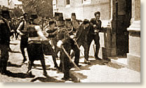
ASSASSINATION: June 28, 1914
Gavrilo Princip shoots Ferdinand and his wife Sopherl (Sophie)

Slide 7


EMOTIONAL REACTIONS OF GERMAN AND AUSTRIAN LEADERS: “NIBELUNGENTREUE”
Kaiser Wilhelm (Germany)

Slide 8
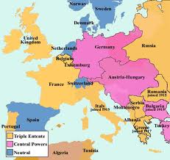
The Big Five:
Britain, France and Russia vs.
Germany and Austria

Slide 9
JULY DIPLOMACY
July 23: Austrian ultimatum: Within 48 hours, Serbia had to agree to dissolve nationalist groups, arrest leading political figure and dismiss key military leaders
July 25: Serbia agrees with minor reservations.
Because of reservations, Austria declares response inadequate, withdraws diplomats.

Slide 10
KAISER WILHELM REALIZES IMPLICATIONS OF NIBELUNGENTREUE
July 28, Wilhelm finally reads response of Serbians, and feels that Austria has achieved their goals. But Austria has already been mobilizing for war for three days.
When Wilhelm realizes this, he realizes that he now has a potential problem with Russia

Slide 11
RUSSIA GETS WORRIED
Russian foreign minister: “Austria is seeking an excuse to gobble up Serbia, but in that case Russia will make war on Austria”
To make matters worse, Austria who was concerned about a Russian intervention, had mobilized half of their army (8 out of 16 divisions) to the Russian border to keep the Russians from intervening.

Slide 12
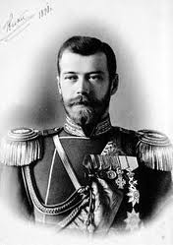
KAISER WILHELM REACHES OUT TO CZAR NICHOLAS
Kaiser Wilhelm
Czar Nicholas

Slide 13
Willy-Nicky Telegrams
Willy: “I am exerting [my] utmost influence to induce the Austrians to arrive at a satisfactory solution with you [the Russians]. I confidently hope that you will help me in my efforts”
Nicky: “I beg you in the name of our old friendship to do what you can to stop your allies from going too far”

Slide 14
German Mobilization
On July 30, Germany learns that Russia has secretly countermobilized against the Austrian mobilization. Fearing that Czar Nicholas has been using the Willy-Nicky telegrams to deceive him while Russia prepares for a sneak attack, Wilhelm orders German mobilization against Russia: the “Schlieffen Plan”

Slide 15
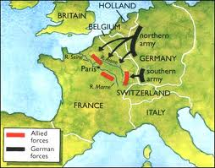
SCHLIEFFEN PLAN

Slide 16
Entry of Britain, United States
Britain enters in 1914 in the face of “German Aggression” and US enters reluctantly in 1917.

Slide 17
MOBILIZATION AS REASON
“Mobilization is a declaration of war. To mobilize is to oblige one’s neighbor to do the same. Mobilization causes the carrying out of strategic transport and concentration. Otherwise, to allow a million men to mobilize on one’s frontiers without at once doing the same oneself is to forfeit all possibility of following suit, is to put oneself in the position of an individual with a pistol in his pocket who allows his neighbor to point a weapon at his head without reaching for his own”

Slide 18
Example of One German Corps
(out of 40)
170 railway cars for officers
965 for infantry
2960 for cavalry
1915 for artillery and supply wagons
6010 cars altogether- these cars all must arrive at the same destination, from different starting points, at the same time.

