Slide 1
LEADUP TO WORLD WAR II
Interwar Period 1919-1939

Slide 2
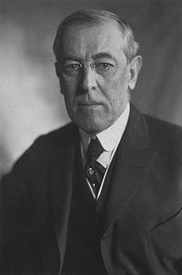
Treaty of Versailles
1. Created League of Nations
Established League of Nations
But although this was the idea of the US President (Woodrow Wilson) the US Congress never approved the treaty, so the US did not join the league.
Woodrow Wilson>

Slide 3
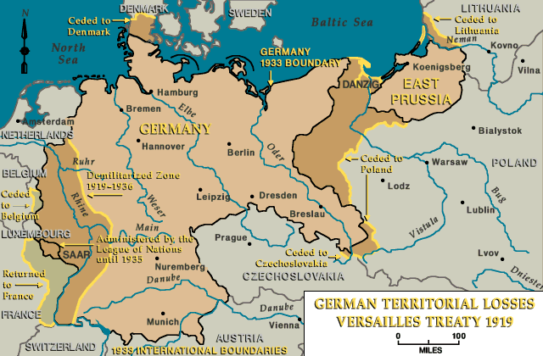
2. German Territorial Losses
          Imposed territorial penalties on Germany (gave territory to Denmark, Czechoslovakia, Poland, North Sleswig to Belgium, Alsace-Lorraine to France), also stripped of colonies.

Slide 4
3. Restrictions on German Military
German army limited to 100,000 troops
Manufacture, import and export of munitions forbidden
Navy was reduced
Air force outlawed
Rhineland (western Germany) to be occupied by League of Nations, and thereafter permanently demilitarized.

Slide 5
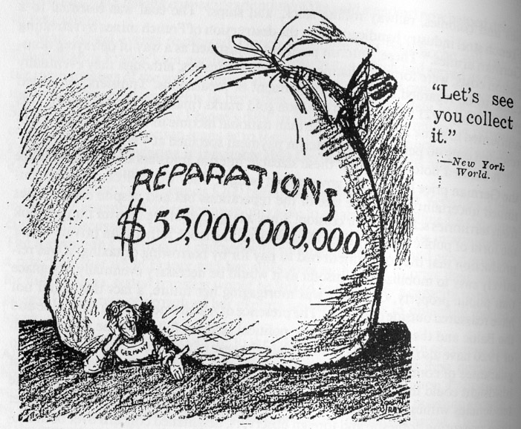
4. Germany forced to pay Economic Reparations

Slide 6
HEGEMON
A hegemon is the world leader
They set the rules, they enforce the rules, they resolve the problems and they establish the key cultural norms
A hegemon is the strongest country militarily, culturally, politically, technologically, diplomatically. But overall, the one factor that tends to be most decisive in the long run is international economic supremacy.

Slide 7
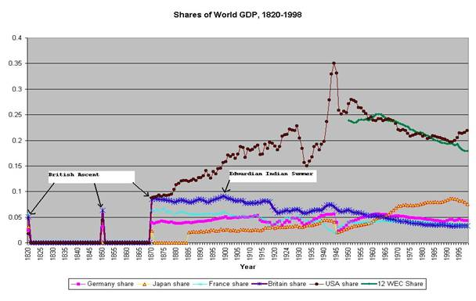
Decline of British Power

Slide 8
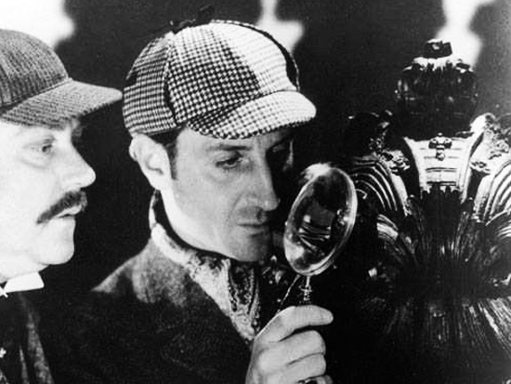
US HEGEMONY (leadership):
The dog that didn’t bark

Slide 9
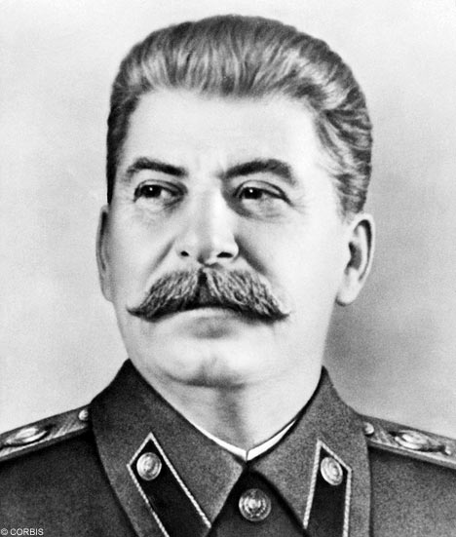
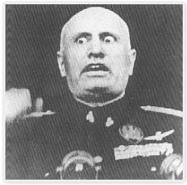
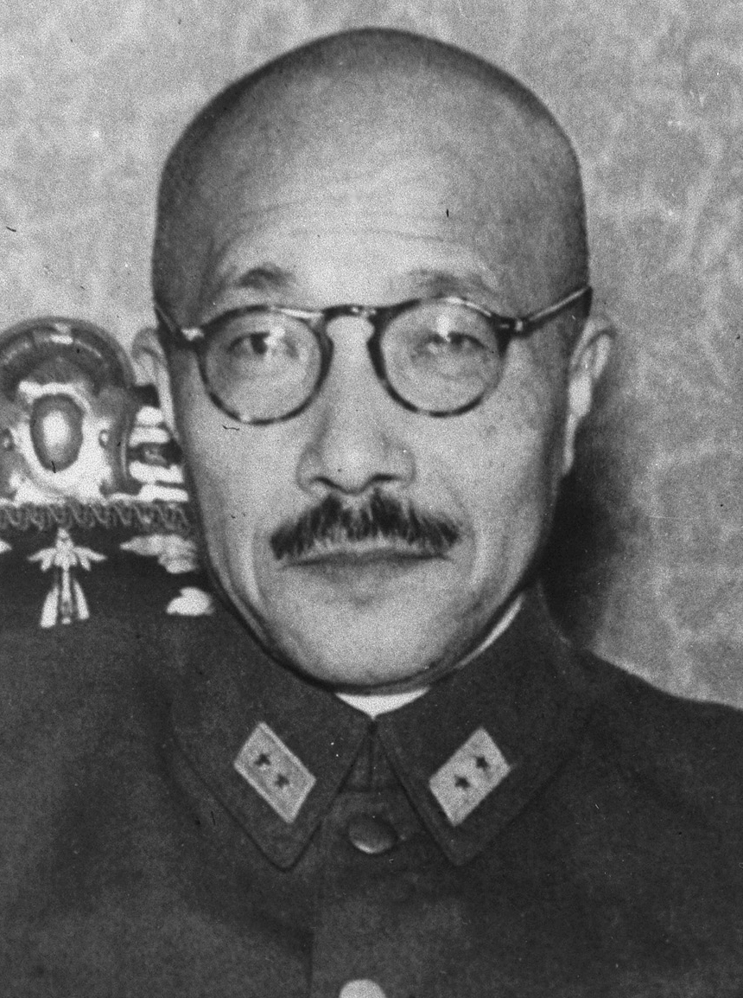
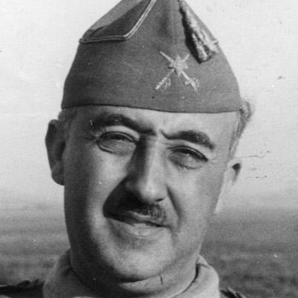
Challengers to the global system:
Soviet Union (Stalin); Italy (Mussolini); Japan (Tojo);
Spain (Franco)

Slide 10
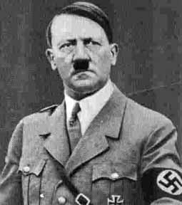

Slide 11
Challenges to the Global Rules
1923: Italians bomb Greek Port of Corfu
1931: Japan invades and conquers Chinese province of Manchuria
1936: Italy invades and conquers the independent country of Abyssinia (Ethiopia)
In each of these cases, neither the United States, Britain, nor the League of Nations responds other that to issue a rhetorical critique.

Slide 12
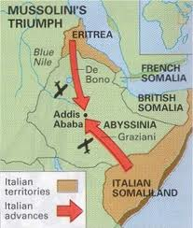
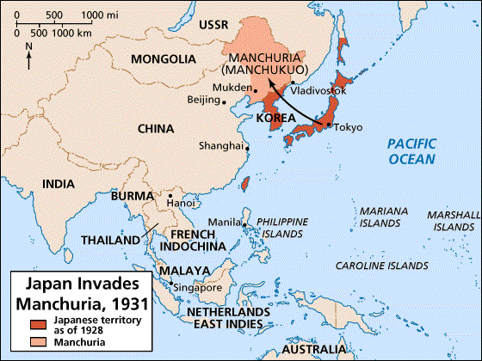
Invasion of Manchuria (1931)
Invasion of Abyssinia (1935)

Slide 13
GERMANY CHALLENGES THE RULES
1933: Germany withdraws from conference on rearmament restrictions in Treaty of Versailles, and also resigns League.
When there are not penalties imposed, Hitler gloats: “The situation has developed as expected. Threatening steps against Germany have neither materialized, nor are they to be expected…the critical moment has probably passed”

Slide 14
1935: REPUDIATION OF REARMAMENT CLAUSES IN T.V.
Hitler repudiates the rearmament clauses, while pledging to continue to respect the territorial provisions. Allies do not take action against Germany

Slide 15
1936: Re-Militarization of Rhineland
The Treaty of Versailles mandated that Western Germany would be permanently demilitarized. When Hitler sent troops back in on March 7, 1936, his military were very nervous. Hitler had to pledge that at the first sign of resistance, he would pull back. As Hitler predicted however, the allies do nothing.

Slide 16
1938: Anschluss (invasion of Austria)
In violation of Treaty of Versailles, Hitler invades Austria. There is no serious resistance, but this is a violation of international law and the Treaty of Versailles. While it precipitates an international crisis, once again allies take no action.

Slide 17
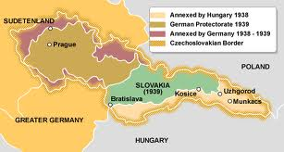
CZECHOSLOVAKA CRISIS

Slide 18
APPEASEMENT AND MUNICH
The idea behind appeasement is that if Hitler’s concerns about the international system/rules could be addressed, he would become a supporter of the rules instead of a challenger. He would be inside the tent.

Slide 19
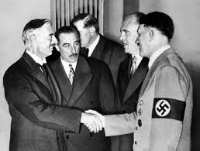
Munich: September 1938
In order to get Hitler’s support for the international system, Chamberlain goes to Munich and offers Hitler the “Sudetenland”, the western part of Czechoslovakia. The Czech government is not included in this meeting. Hitler accept.

Slide 20
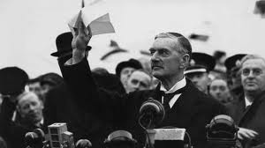
Chamberlain: “This is the second time that there has come back from Germany to Downing Street peace with honour. I believe it is peace for our time”

Slide 21
Was Hitler Persuaded to Support the Rules/International System?
March 1939: Hitler invades western Czechoslovakia.
September 1939: Hitler invades Poland. Britain and France declare war, World War II starts.

