Slide 1
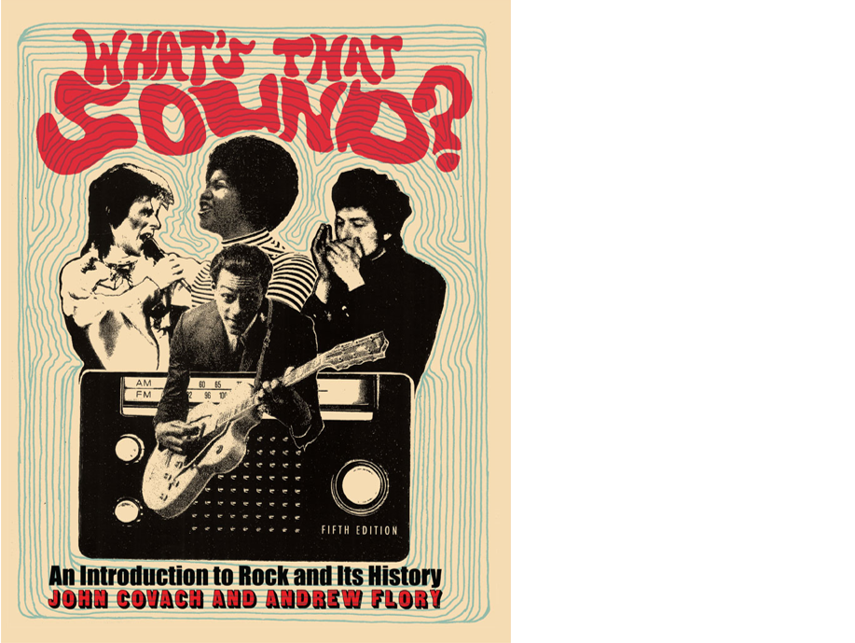
What’s That Sound?
An Introduction to Rock and Its History
Art Slides
Fifth Edition
Text By John Covach and Andrew Flory

Slide 2
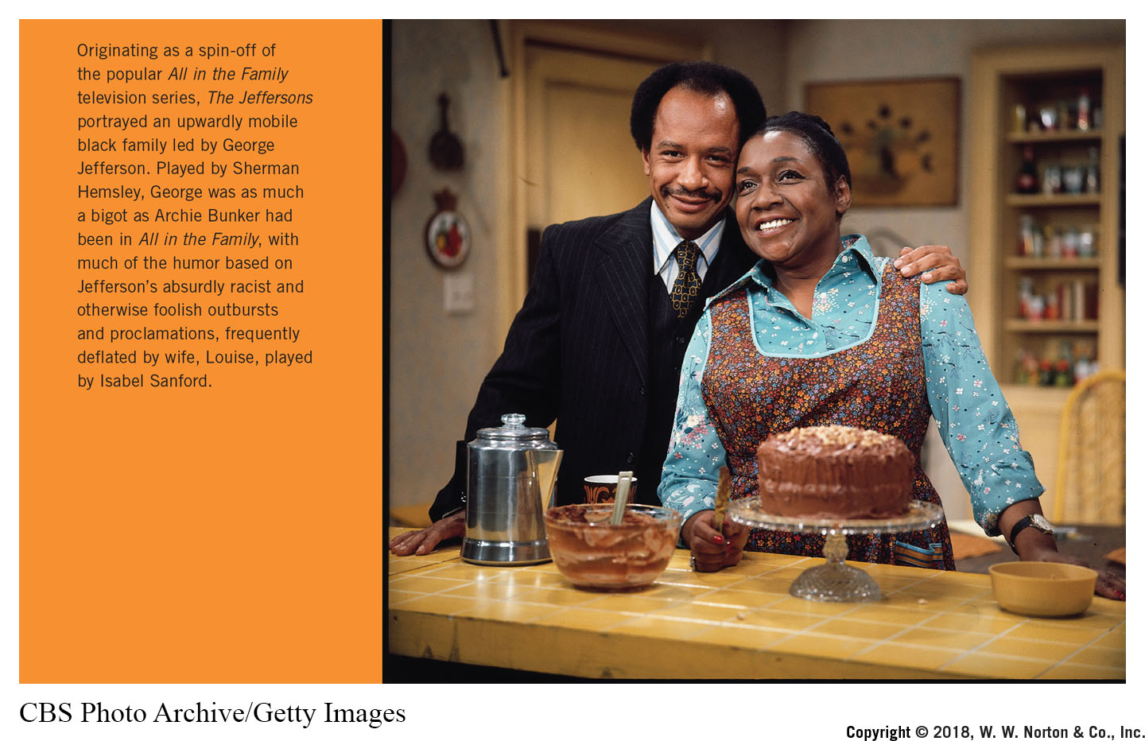
Notes:
Originating as a spin-off of the popular All in the Family television series, The Jeffersons portrayed an upwardly mobile black family led by George Jefferson. Played by Sherman Hemsley, George was as much a bigot as Archie Bunker had been in All in the Family, with much of the humor based on Jefferson’s absurdly racist and otherwise foolish outbursts and proclamations, frequently deflated by wife, Louise, played by Isabel Sanford.
Credit: CBS Photo Archive/Getty Images

Slide 3
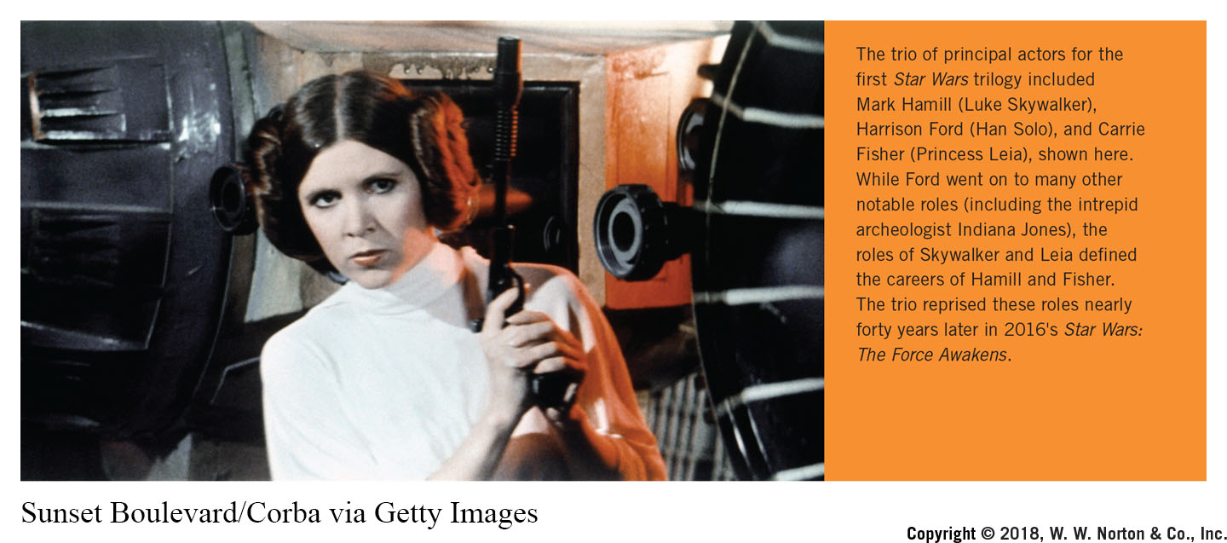
Notes:
The trio of principal actors for the first Star Wars trilogy included Mark Hamill (Luke Skywalker), Harrison Ford (Han Solo), and Carrie Fisher (Princess Leia), shown here. While Ford went on to many other notable roles (including the intrepid archeologist Indiana Jones), the roles of Skywalker and Leia defined the careers of Hamill and Fisher. The trio reprised these roles nearly forty years later in 2016's Star Wars: The Force Awakens.
Credit: Sunset Boulevard/Corba via Getty Images

Slide 4
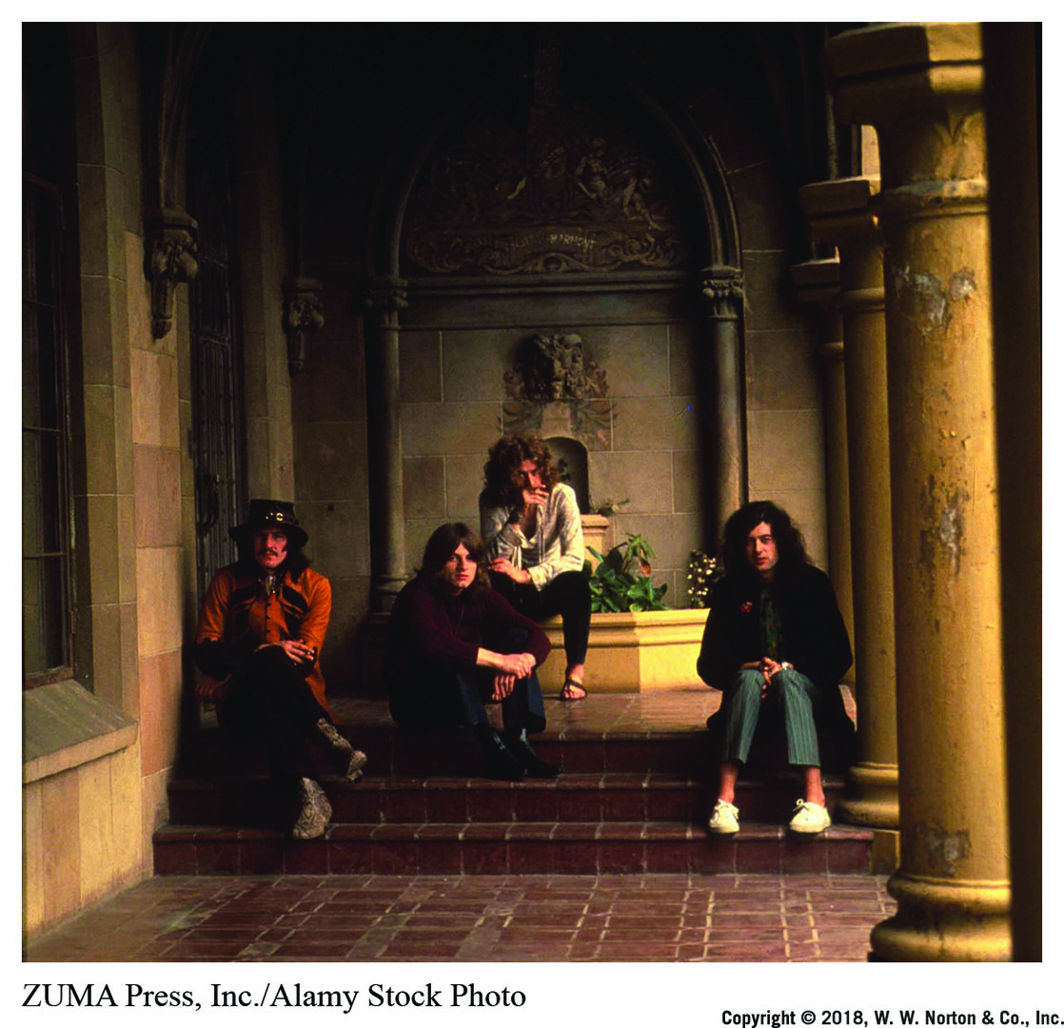
Notes:
Though Led Zeppelin is usually considered primarily a blues-based band, their music at times incorporates classical elements as well. “Stairway to Heaven” uses a quasi-classical guitar introduction accompanied by a recorder ensemble, while “The Rain Song” and “Kashmir” both employ (sometimes simulated) orchestral strings.
Credit: ZUMA Press, Inc./Alamy Stock Photo

Slide 5
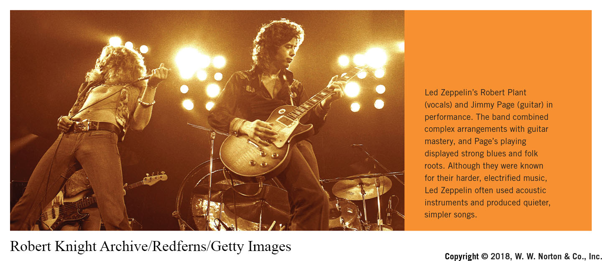
Notes:
Led Zeppelin’s Robert Plant (vocals) and Jimmy Page (guitar) in performance. The band combined complex arrangements with guitar mastery, and Page’s playing displayed strong blues and folk roots. Although they were known for their harder, electrified music, Led Zeppelin often used acoustic instruments and produced quieter, simpler songs.
Credit: Robert Knight Archive/Redferns/Getty Images

Slide 6
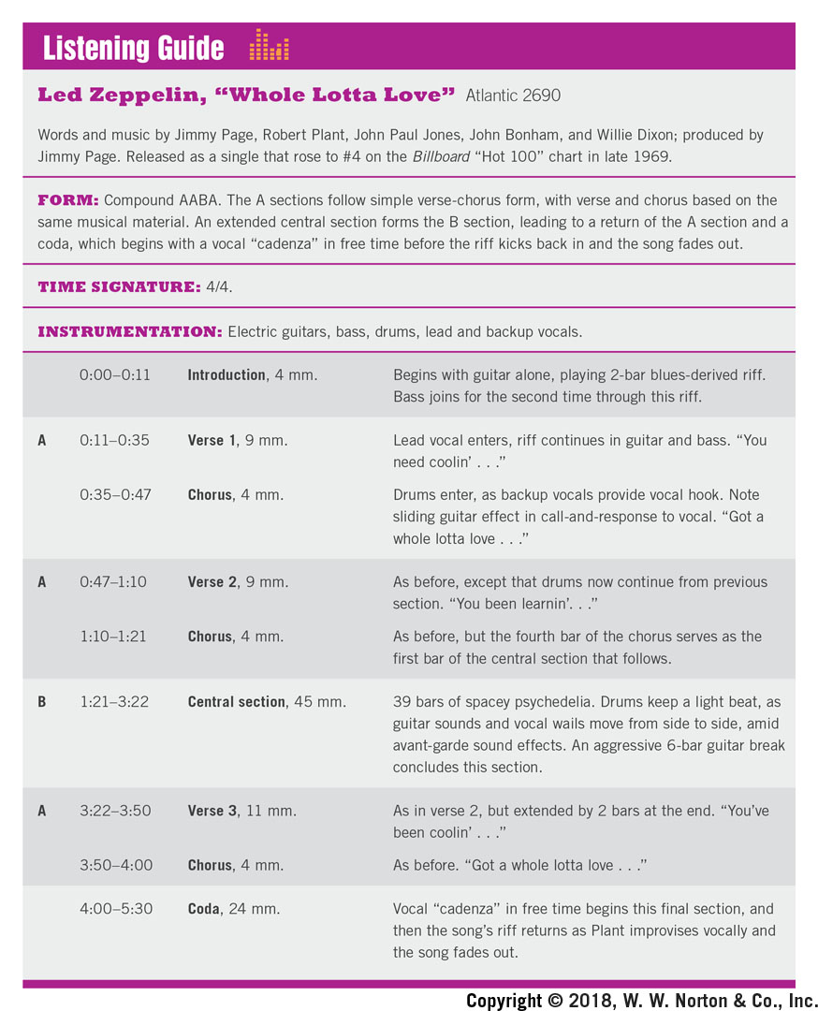
Time Frame | Parts | Description
0:00-0:11 | Introduction, 4 mm. | Begins with guitar alone, playing 2-bar blues-derived riff. Bass joins for the second time through this riff.
0:11-0:35 | A-Verse 1, 9 mm. | Lead vocal enters, riff continues in guitar and bass. "You need coolin' . . ."
0:35-0:47 | Chorus, 4 mm. | Drums enter, as backup vocals provide vocal hook. Note sliding guitar effect in call-and-response to vocal. "Got a whole lotta love . . ."
0:47-1:10 | A-Verse 2, 9 mm. | As before, except that drums now continue from previous section. "You been learnin'. . ."
1:10-1:21 | Chorus, 4 mm. | As before, but the fourth bar of the chorus serves as the first bar of the central section that follows.
1:21-3:22 | B-Central section, 45 mm. | 39 bars of spacey psychedelia. Drums keep a light beat, as guitar sounds and vocal wails move from side to side, amid avant-garde sound effects. An aggressive 6-bar guitar break concludes this section.
3:22-3:50 | A-Verse 3, 11 mm. | As in verse 2, but extended by 2 bars at the end. "You've been coolin' . . ."
3:50-4:00 | Chorus, 4 mm. | As before. "Got a whole lotta love . . ."
4:00-5:30 | Coda, 24 mm. | Vocal "cadenza*¹ in free time begins this final section, and then the song's riff returns as Plant improvises vocally and the song fades out.

Slide 7
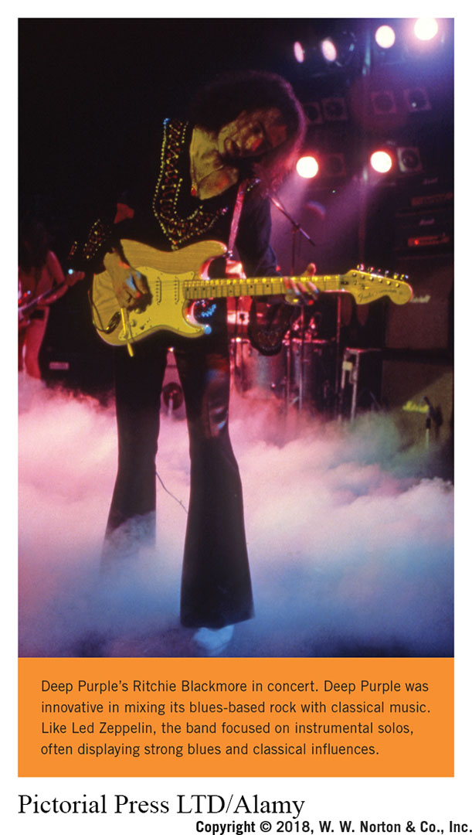
Notes:
Deep Purple’s Ritchie Blackmore in concert. Deep Purple was innovative in mixing its ­blues-based rock with classical music. Like Led Zeppelin, the band focused on instrumental solos, often displaying strong blues and classical influences.
Credit: Pictorial Press LTD/Alamy

Slide 8
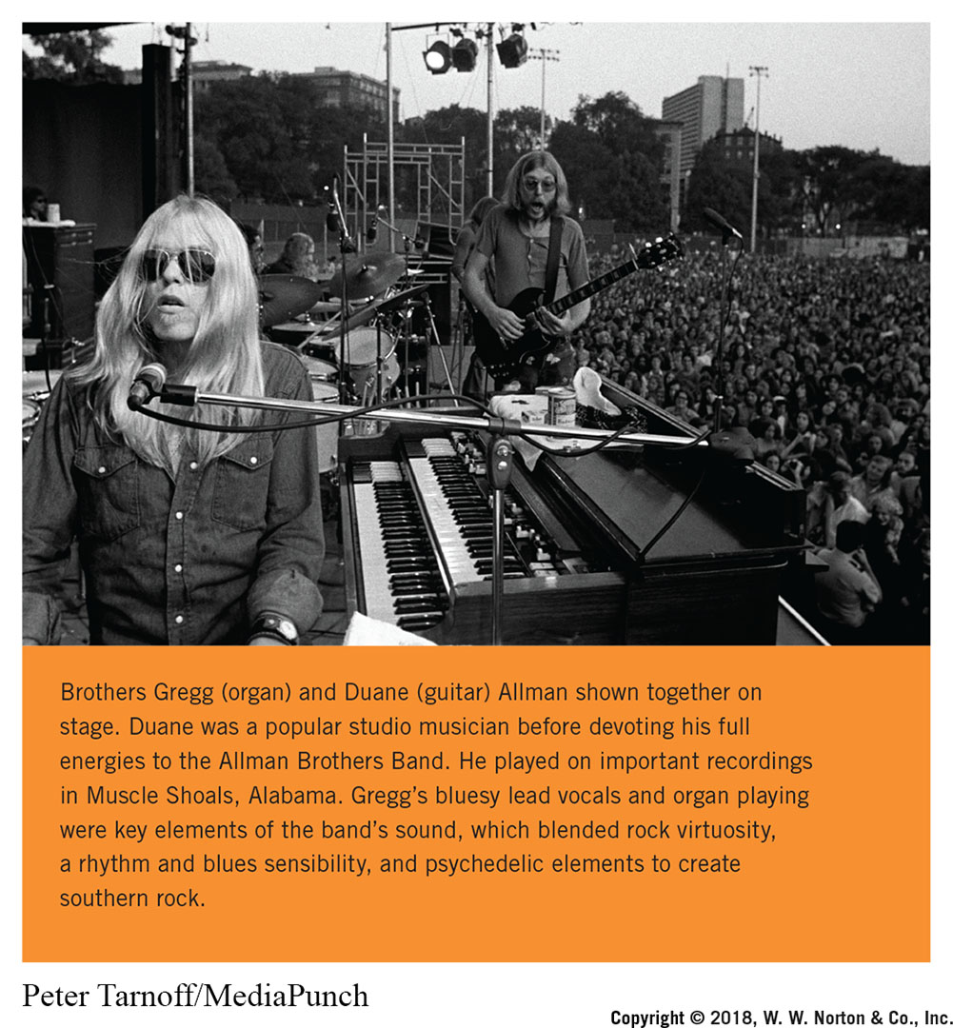
Notes:
Brothers Gregg (organ) and Duane (guitar) Allman shown together on stage. Duane was a popular studio musician before devoting his full energies to the Allman Brothers Band. He played on important recordings in Muscle Shoals, Alabama. Gregg’s bluesy lead vocals and organ playing were key elements of the band’s sound, which blended rock virtuosity, a rhythm and blues sensibility, and psychedelic elements to create southern rock.
Credit: Peter Tarnoff/MediaPunch

Slide 9
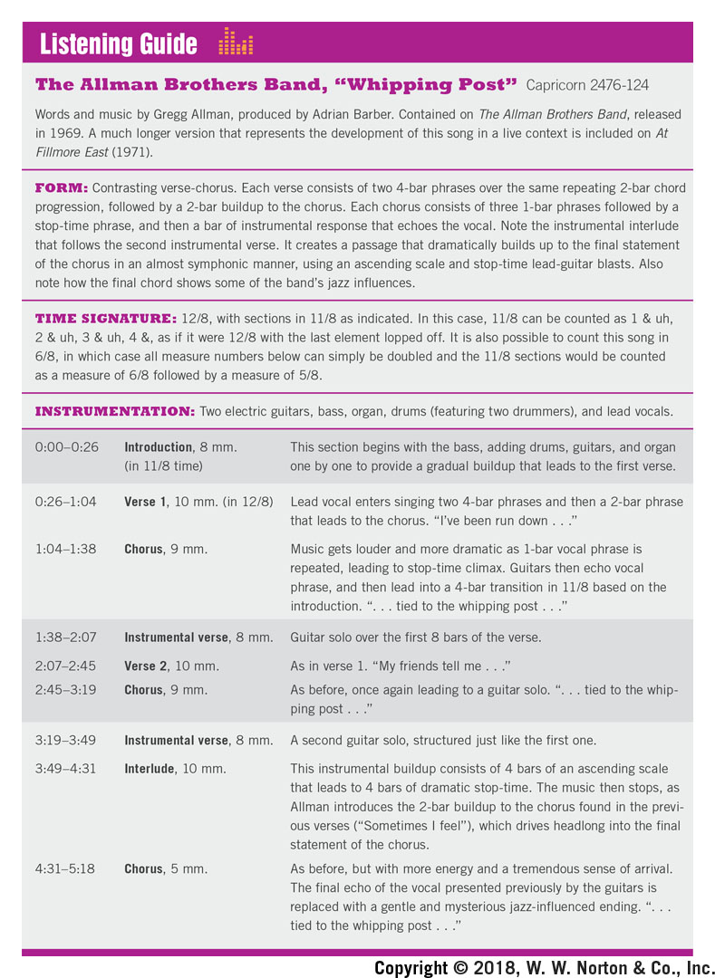
Time Frame | Parts | Description
0:00-0:26 | Introduction, 8 mm. (in 11/8 time) | This section begins with the bass, adding drums, guitars, and organ one by one to provide a gradual buildup that leads to the first verse.
0:26-1:04 | Verse 1, 10 mm. (in 12/8) | Lead vocal enters singing two 4-bar phrases and then a 2-bar phrase that leads to the chorus. "I've been run down . . ."
1:04-1:38 | Chorus, 9 mm. | Music gets louder and more dramatic as 1-bar vocal phrase is repeated, leading to stop-time climax. Guitars then echo vocal phrase, and then lead into a 4-bar transition in 11/8 based on the introduction. ". . . tied to the whipping post .. ."
1:38-2:07 | Instrumental verse, 8 mm. | Guitar solo over the first 8 bars of the verse.
2:07-2:45 | Verse 2, 10 mm. | As in verse 1. "My friends tell me . . ."
2:45-3:19 | Chorus, 9 mm. | As before, once again leading to a guitar solo. ., tied to the whip­ping post. . ."
3:19-3:49 | Instrumental verse, 8 mm. | A second guitar solo, structured just like the first one.
3:49-4:31 | Interlude, 10 mm. | This instrumental buildup consists of 4 bars of an ascending scale that leads to 4 bars of dramatic stop-time. The music then stops, as Allman introduces the 2-bar buildup to the chorus found in the previ­ous verses ("Sometimes I feel"), which drives headlong into the final statement of the chorus.
4:31-5:18 | Chorus, 5 mm. | As before, but with more energy and a tremendous sense of arrival. The final echo of the vocal presented previously by the guitars is replaced with a gentle and mysterious jazz-influenced ending. . . tied to the whipping post..."

Slide 10
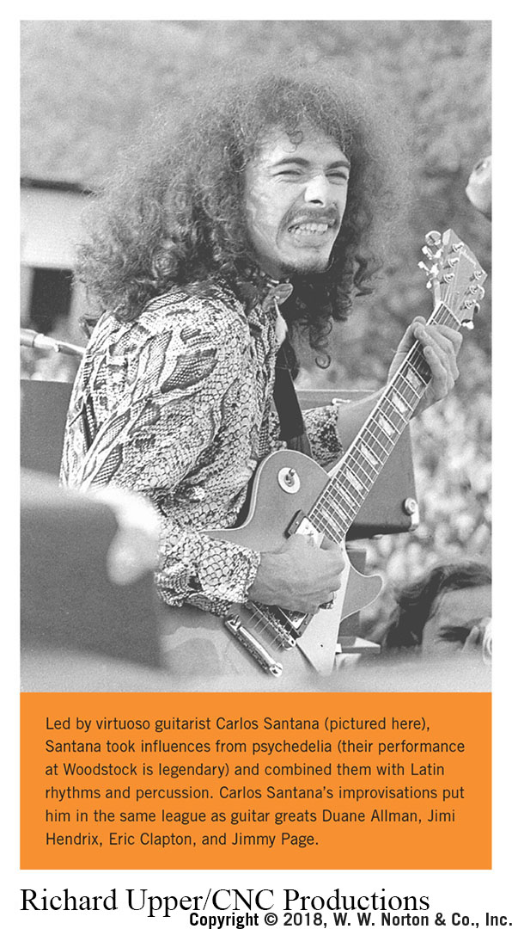
Notes:
Led by virtuoso guitarist Carlos Santana (pictured here), Santana took influences from psychedelia (their performance at Woodstock is legendary) and combined them with Latin rhythms and percussion. Carlos Santana’s improvisations put him in the same league as guitar greats Duane Allman, Jimi Hendrix, Eric Clapton, and Jimmy Page.
Credit: RichardUpper/CNC Productions

Slide 11
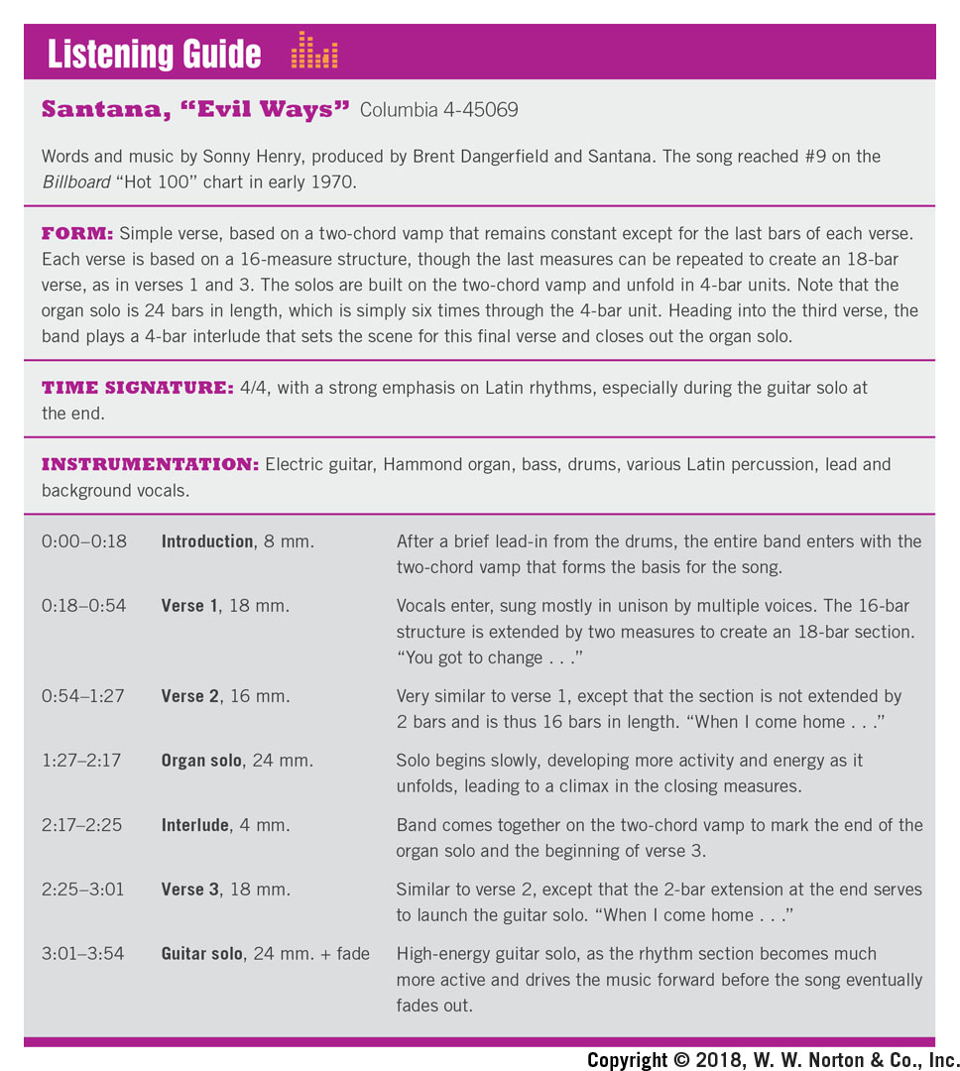
Time Frame | Parts | Description
0:00-0:18 | Introduction, 8 mm. | After a brief lead-in from the drums, the entire band enters with the two-chord vamp that forms the basis for the song.
0:18-0:54 | Verse 1, 18 mm. | Vocals enter, sung mostly in unison by multiple voices. The 16-bar structure is extended by two measures to create an 18-bar section. "You got to change .. ."
0:54-1:27 | Verse 2, 16 mm. | Very similar to verse 1, except that the section is not extended by 2 bars and is thus 16 bars in length. "When I come home . . ."
1:27-2:17 | Organ solo, 24 mm. | Solo begins slowly, developing more activity and energy as it unfolds, leading to a climax in the closing measures.
2:17-2:25 | Interlude, 4 mm. | Band comes together on the two-chord vamp to mark the end of the organ solo and the beginning of verse 3.
2:25-3:01 | Verse 3, 18 mm. | Similar to verse 2, except that the 2-bar extension at the end serves to launch the guitar solo. "When I come home . . ."
3:01-3:54 | Guitar solo, 24 mm. + fade | High-energy guitar solo, as the rhythm section becomes much more active and drives the music forward before the song eventually fades out.

Slide 12
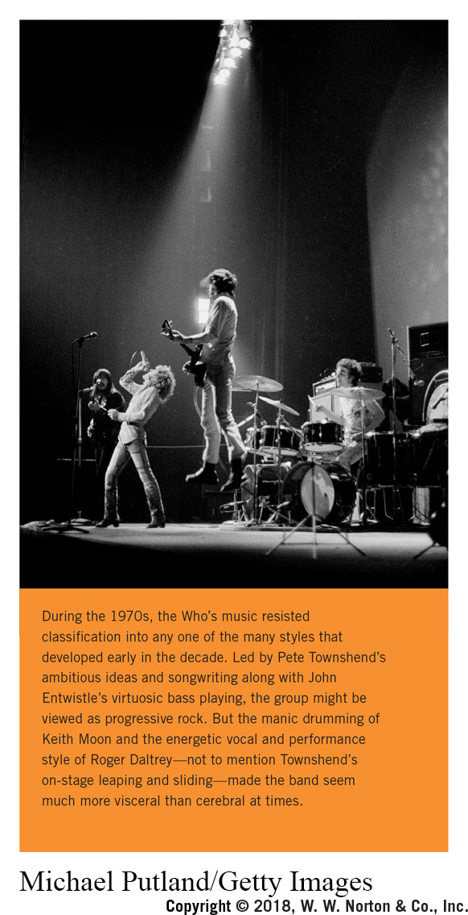
Notes:
During the 1970s, the Who’s music resisted classification into any one of the many styles that developed early in the decade. Led by Pete Townshend’s ambitious ideas and songwriting along with John Entwistle’s virtuosic bass playing, the group might be viewed as progressive rock. But the manic drumming of Keith Moon and the energetic vocal and performance style of Roger Daltrey—not to mention Townshend’s ­on-stage leaping and sliding—made the band seem much more visceral than cerebral at times.
Credit: Michael Putland/Getty Images

Slide 13
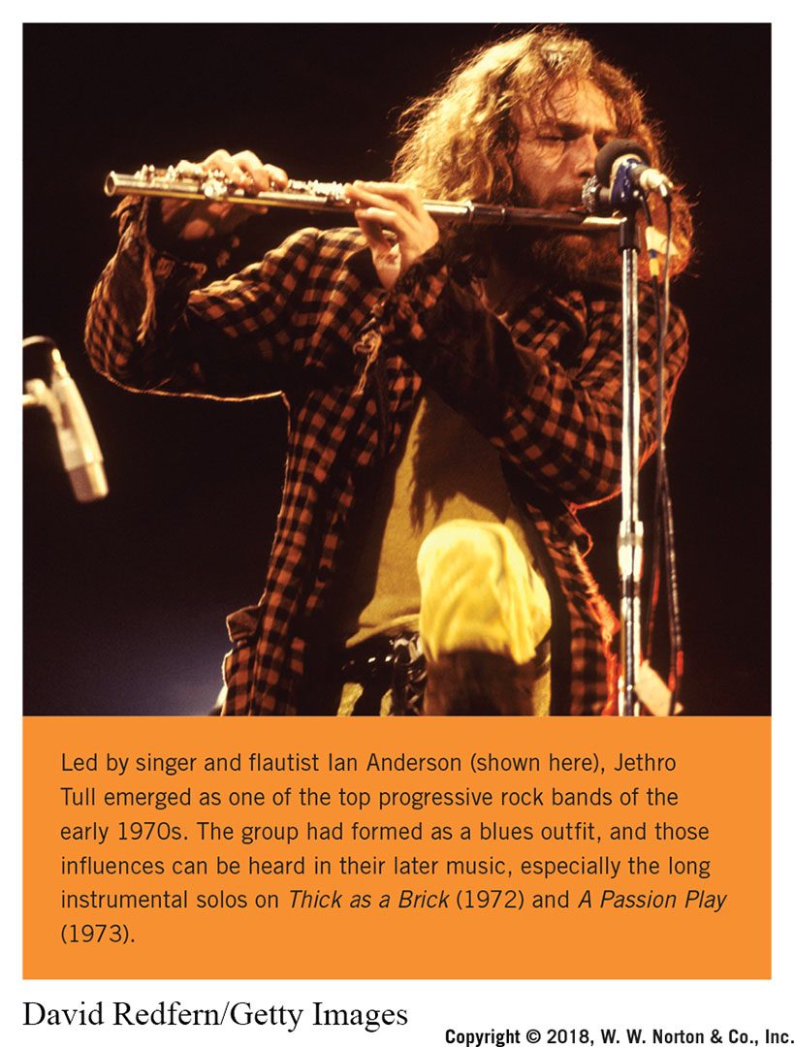
Notes:
Led by singer and flautist Ian Anderson (shown here), Jethro Tull emerged as one of the top progressive rock bands of the early 1970s. The group had formed as a blues outfit, and those influences can be heard in their later music, especially the long instrumental solos on Thick as a Brick (1972) and A Passion Play (1973).
Credit: David Redfern/Getty Images

Slide 14
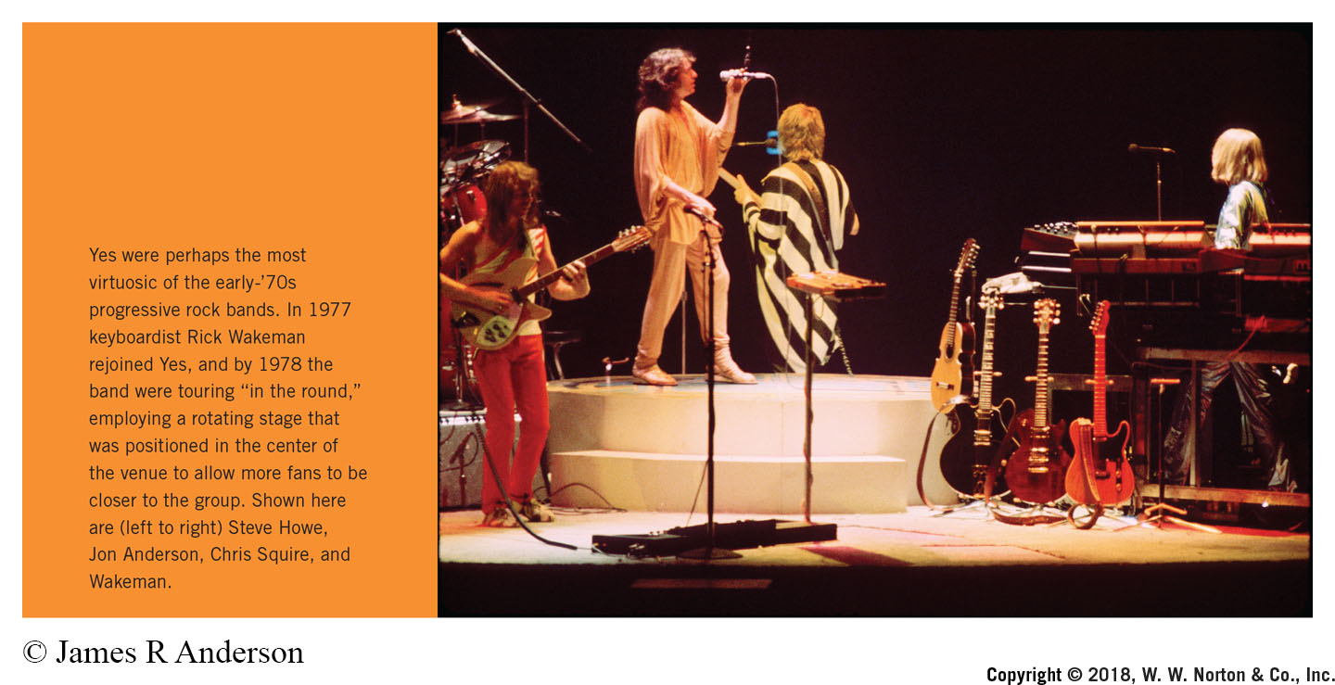
Notes:
Yes were perhaps the most virtuosic of the early-’70s progressive rock bands. In 1977 keyboardist Rick Wakeman rejoined Yes, and by 1978 the band were touring “in the round,” employing a rotating stage that was positioned in the center of the venue to allow more fans to be closer to the group. Shown here are (left to right) Steve Howe, Jon Anderson, Chris Squire, and Wakeman.
Credit: © James R Anderson

Slide 15
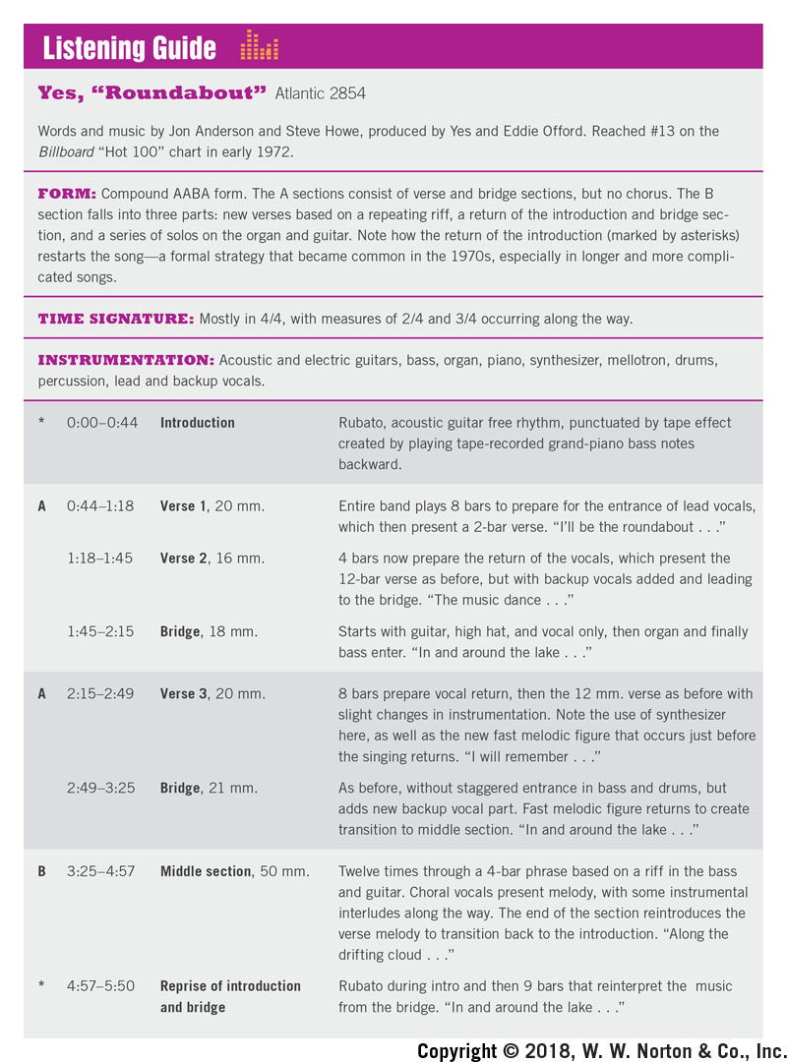
Time Frame | Parts | Description
0:00-0:44 | * Introduction | Rubato, acoustic guitar free rhythm, punctuated by tape effect created by playing tape-recorded grand-piano bass notes backward.
0:44-1:18 | A-Verse 1, 20 mm. | Entire band plays 8 bars to prepare for the entrance of lead vocals, which then present a 2-bar verse. "I'll be the roundabout. . ."
1:18-1:45 | Verse 2, 16 mm. | 4 bars now prepare the return of the vocals, which present the 12-bar verse as before, but with backup vocals added and leading to the bridge. "The music dance .. ."
1:45-2:15 | Bridge. 18 mm. | Starts with guitar, high hat, and vocal only, then organ and finally bass enter. "In and around the lake . . ."
2:15-2:49 | A-Verse 3, 20 mm. | 8 bars prepare vocal return, then the 12 mm. verse as before with slight changes in instrumentation. Note the use of synthesizer here, as well as the new fast melodic figure that occurs just before the singing returns. "I will remember. . ."
2:49-3:25 | Bridge, 21 mm. | As before, without staggered entrance in bass and drums, but adds new backup vocal part. Fast melodic figure returns to create transition to middle section. "In and around the lake . .."
3:25-4:57 | B-Middle section, 50 mm. | Twelve times through a 4-bar phrase based on a riff in the bass and guitar. Choral vocals present melody, with some instrumental interludes along the way. The end of the section reintroduces the verse melody to transition back to the introduction. "Along the drifting cloud . .."
4:57-5:50 | * Reprise of introduction and bridge | Rubato during intro and then 9 bars that reinterpret the music from the bridge. "In and around the lake . . ."

Slide 16
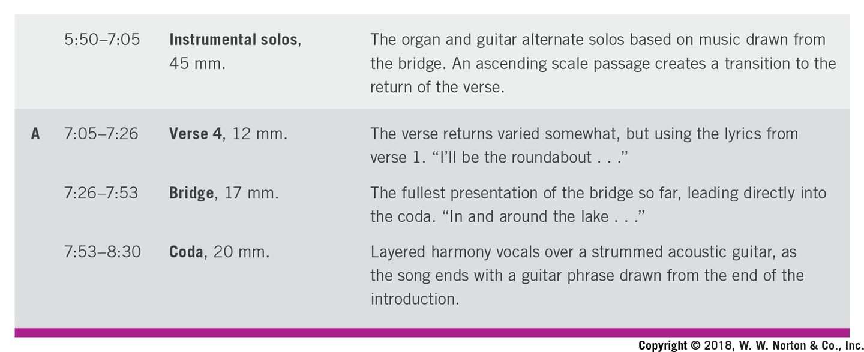
Time Frame | Parts | Description
5:50-7:05 | Instrumental solos, 45 mm. | The organ and guitar alternate solos based on music drawn from the bridge. An ascending scale passage creates a transition to the return of the verse.
7:05-7:26 | A-Verse 4, 12 mm. | The verse returns varied somewhat, but using the lyrics from verse 1. "I'll be the roundabout. . ."
7:26-7:53 | Bridge, 17 mm. | The fullest presentation of the bridge so far, leading directly into the coda. "In and around the lake . . ."
7:53-8:30 | Coda, 20 mm. | Layered harmony vocals over a strummed acoustic guitar, as the song ends with a guitar phrase drawn from the end of the introduction.

Slide 17
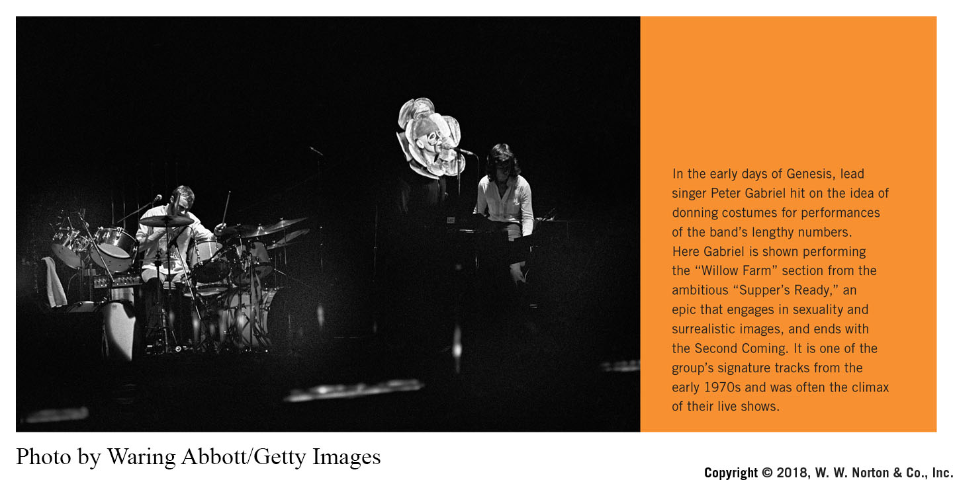
Notes:
In the early days of Genesis, lead singer Peter Gabriel hit on the idea of donning costumes for performances of the band’s lengthy numbers. Here Gabriel is shown performing the “Willow Farm” section from the ambitious “Supper’s Ready,” an epic that engages in sexuality and surrealistic images, and ends with the Second Coming. It is one of the group’s signature tracks from the early 1970s and was often the climax of their live shows.
Credit: Photo by Waring Abbott/Getty Images

Slide 18
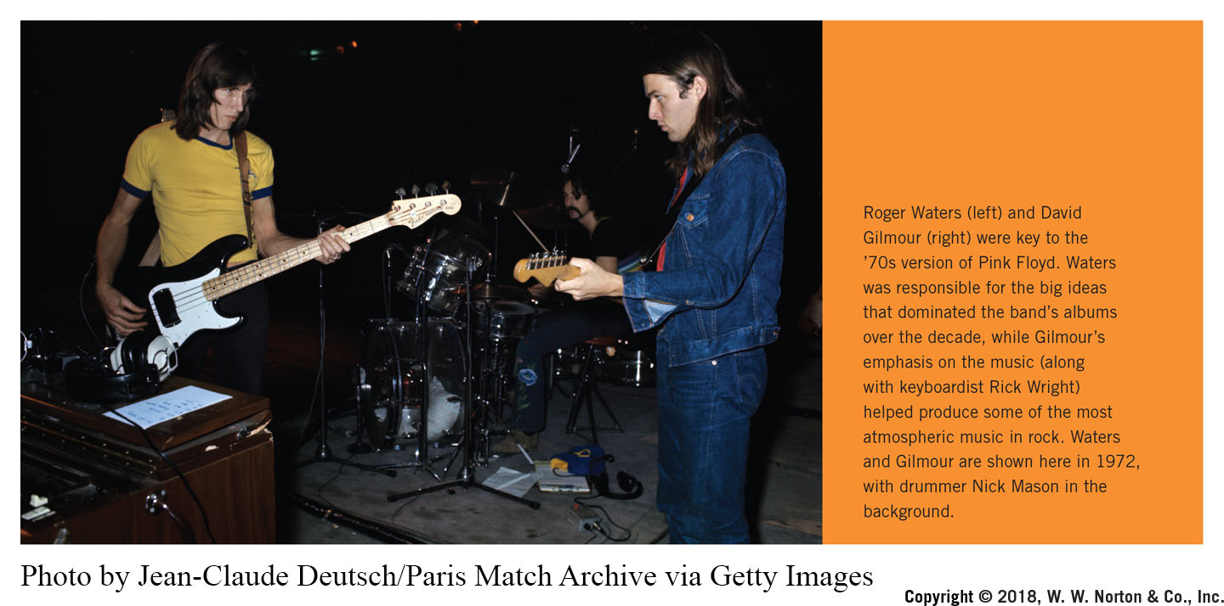
Notes:
Roger Waters (left) and David Gilmour (right) were key to the ’70s version of Pink Floyd. Waters was responsible for the big ideas that dominated the band’s albums over the decade, while Gilmour’s emphasis on the music (along with keyboardist Rick Wright) helped produce some of the most atmospheric music in rock. Waters and Gilmour are shown here in 1972, with drummer Nick Mason in the background.
Credit: Photo by Jean-Claude Deutsch/Paris Match Archive via Getty Images

Slide 19
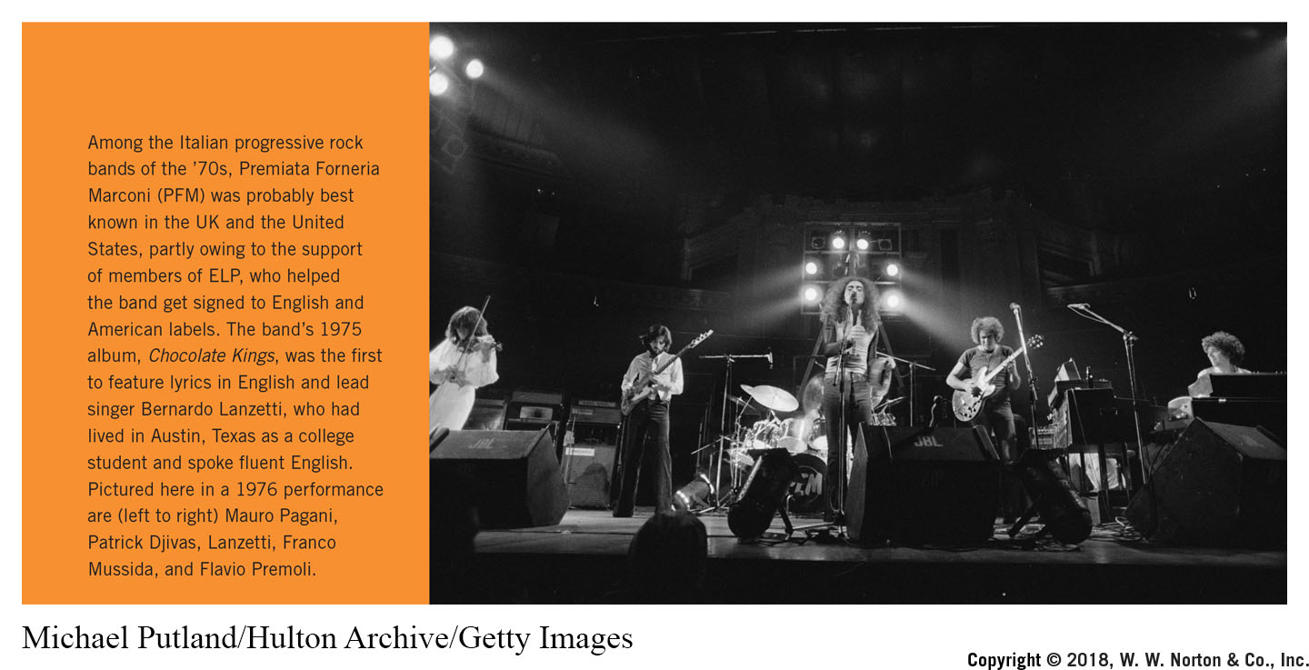
Notes:
Among the Italian progressive rock bands of the ’70s, Premiata Forneria Marconi (PFM) was probably best known in the UK and the United States, partly owing to the support of members of ELP, who helped the band get signed to English and American labels. The band’s 1975 album, Chocolate Kings, was the first to feature lyrics in English and lead singer Bernardo Lanzetti, who had lived in Austin, Texas as a college student and spoke fluent English. Pictured here in a 1976 performance are (left to right) Mauro Pagani, Patrick Djivas, Lanzetti, Franco Mussida, and Flavio Premoli.
Credit: Michael Putland/Hulton Archive/Getty Images

Slide 20
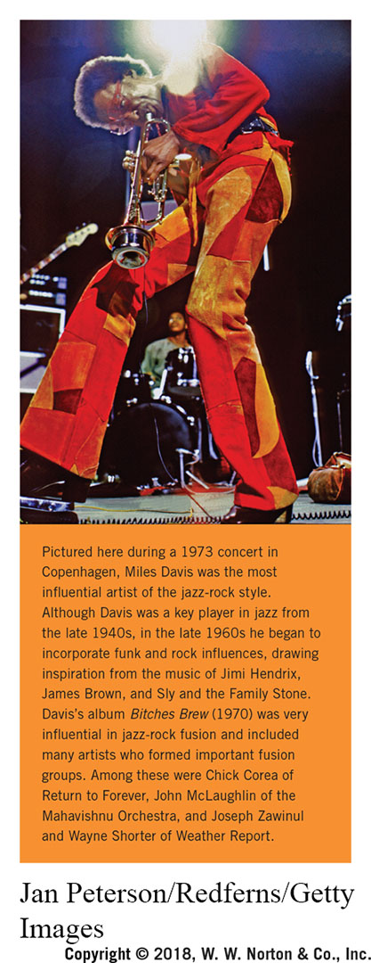
Notes:
Pictured here during a 1973 concert in Copenhagen, Miles Davis was the most influential artist of the ­jazz-rock style. Although Davis was a key player in jazz from the late 1940s, in the late 1960s he began to incorporate funk and rock influences, drawing inspiration from the music of Jimi Hendrix, James Brown, and Sly and the Family Stone. Davis’s album Bitches Brew (1970) was very influential in ­jazz-rock fusion and included many artists who formed important fusion groups. Among these were Chick Corea of Return to Forever, John McLaughlin of the Mahavishnu Orchestra, and Joseph Zawinul and Wayne Shorter of Weather Report.
Credit: Jan Peterson/Redferns/Getty Images

Slide 21
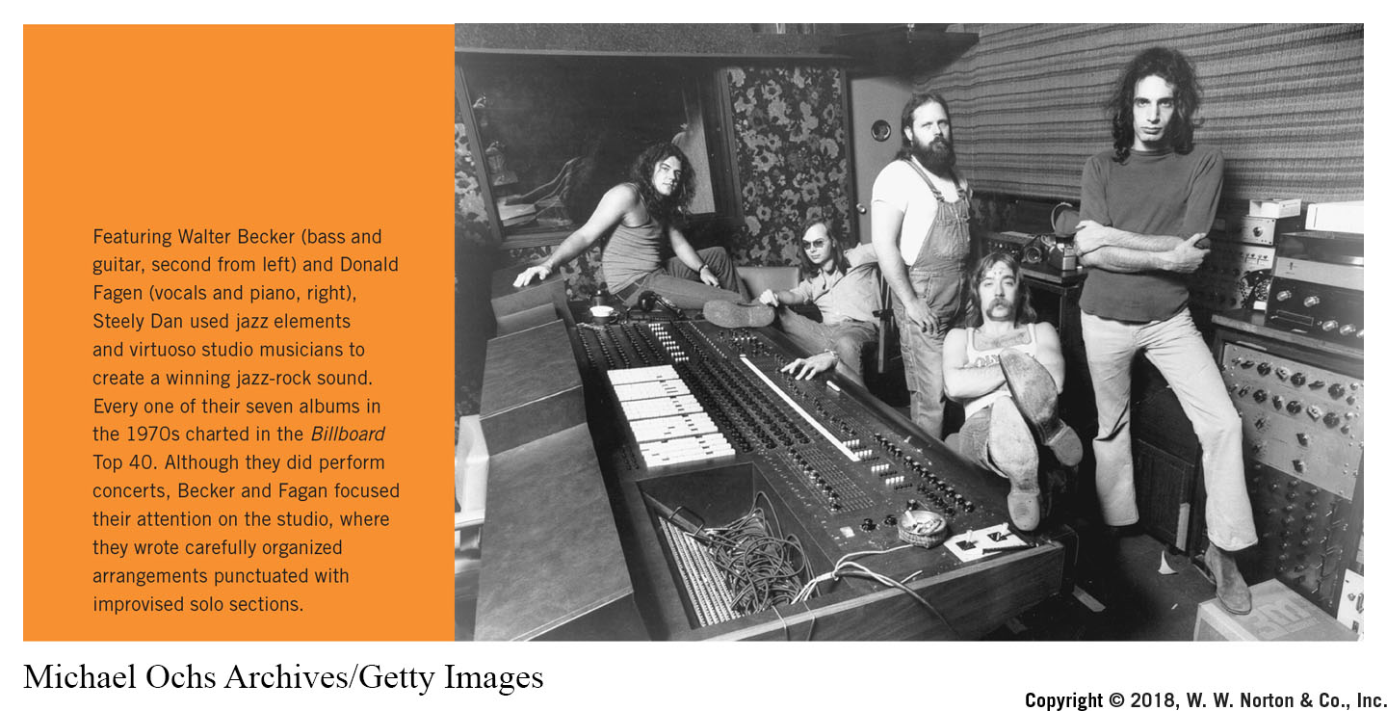
Notes:
Featuring Walter Becker (bass and guitar, second from left) and Donald Fagen (vocals and piano, right), Steely Dan used jazz elements and virtuoso studio musicians to create a winning ­jazz-rock sound. Every one of their seven albums in the 1970s charted in the Billboard Top 40. Although they did perform concerts, Becker and Fagan focused their attention on the studio, where they wrote carefully organized arrangements punctuated with improvised solo sections.
Credit: Michael Ochs Archives/Getty Images

Slide 22
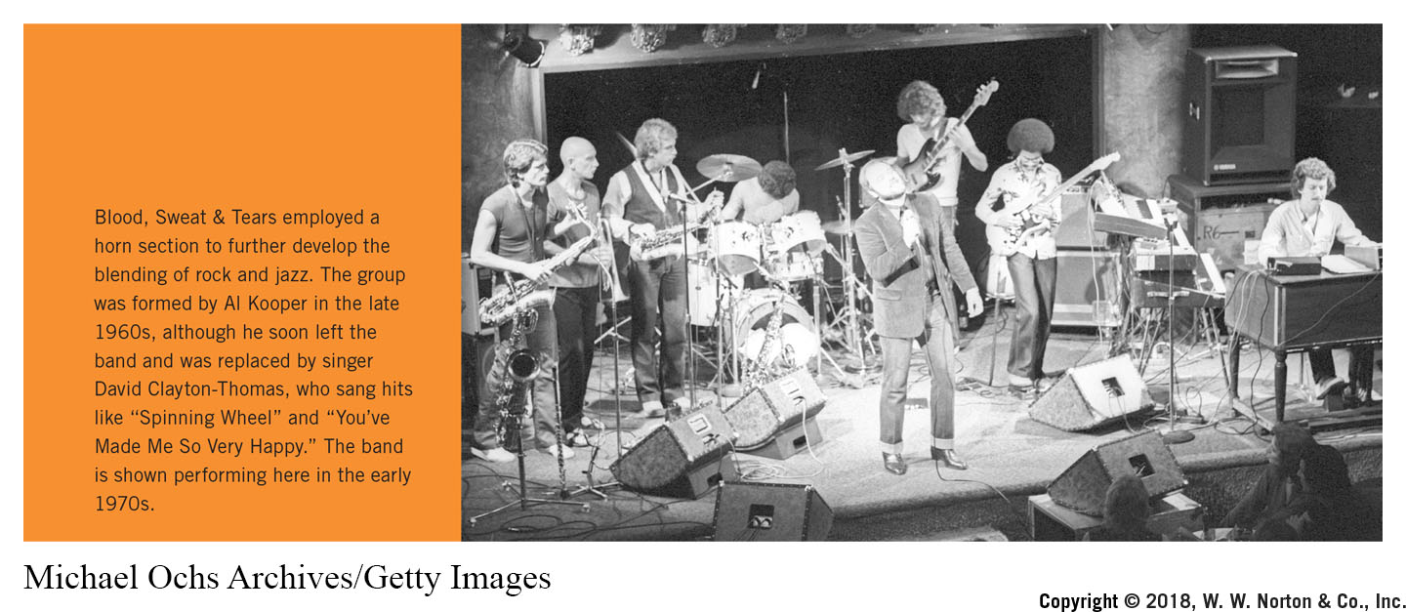
Notes:
Blood, Sweat & Tears employed a horn section to further develop the blending of rock and jazz. The group was formed by Al Kooper in the late 1960s, although he soon left the band and was replaced by singer David Clayton-Thomas, who sang hits like “Spinning Wheel” and “You’ve Made Me So Very Happy.” The band is shown performing here in the early 1970s.
Credit: Michael Ochs Archives/Getty Images

Slide 23
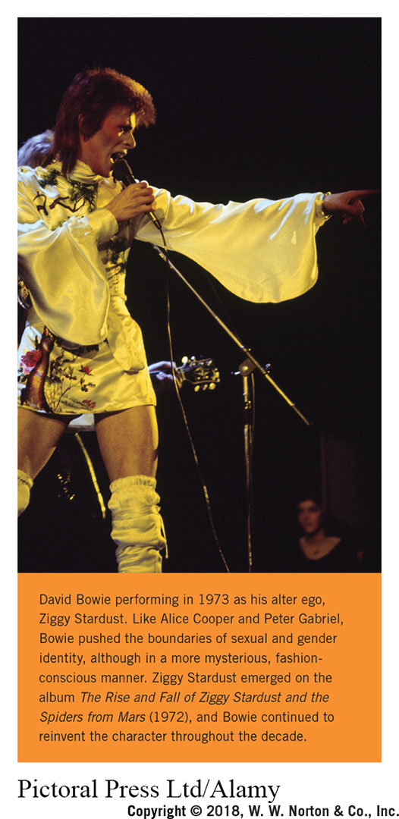
Notes:
David Bowie performing in 1973 as his alter ego, Ziggy Stardust. Like Alice Cooper and Peter Gabriel, Bowie pushed the boundaries of sexual and gender identity, although in a more mysterious, fashion-conscious manner. Ziggy Stardust emerged on the album The Rise and Fall of Ziggy Stardust and the Spiders from Mars (1972), and Bowie continued to reinvent the character throughout the decade.
Credit: Pictoral Press Ltd/Alamy

Slide 24
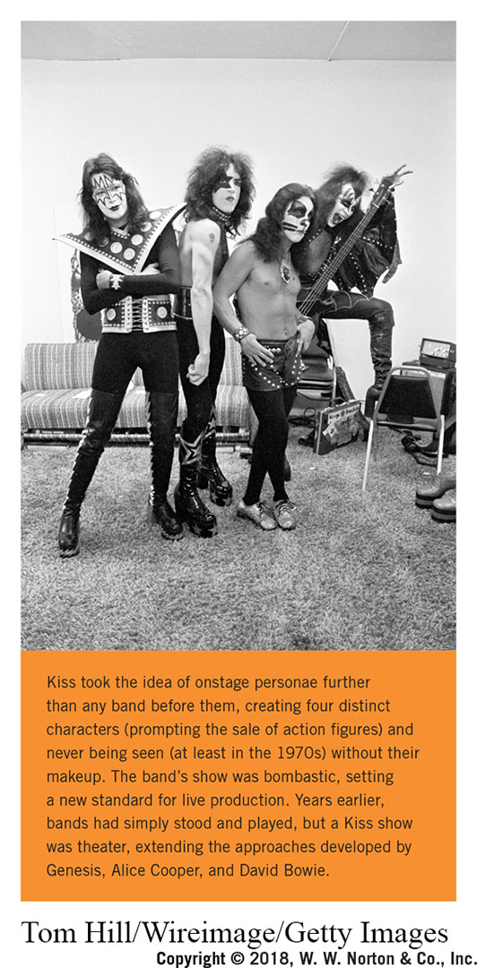
Notes:
Kiss took the idea of onstage personae further than any band before them, creating four distinct characters (prompting the sale of action figures) and never being seen (at least in the 1970s) without their makeup. The band’s show was bombastic, setting a new standard for live production. Years earlier, bands had simply stood and played, but a Kiss show was theater, extending the approaches developed by Genesis, Alice Cooper, and David Bowie.
Credit: Tom Hill/Wireimage/Getty Images

Slide 25
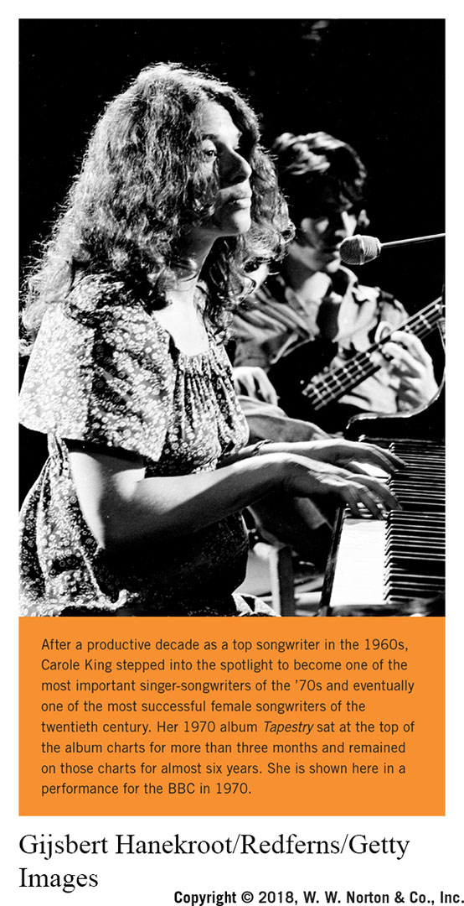
Notes:
After a productive decade as a top songwriter in the 1960s, Carole King stepped into the spotlight to become one of the most important singer-songwriters of the ’70s and eventually one of the most successful female songwriters of the twentieth century. Her 1970 album Tapestry sat at the top of the album charts for more than three months and remained on those charts for almost six years. She is shown here in a performance for the BBC in 1970.
Credit: Gijsbert Hanekroot/Redferns/Getty Images

Slide 26
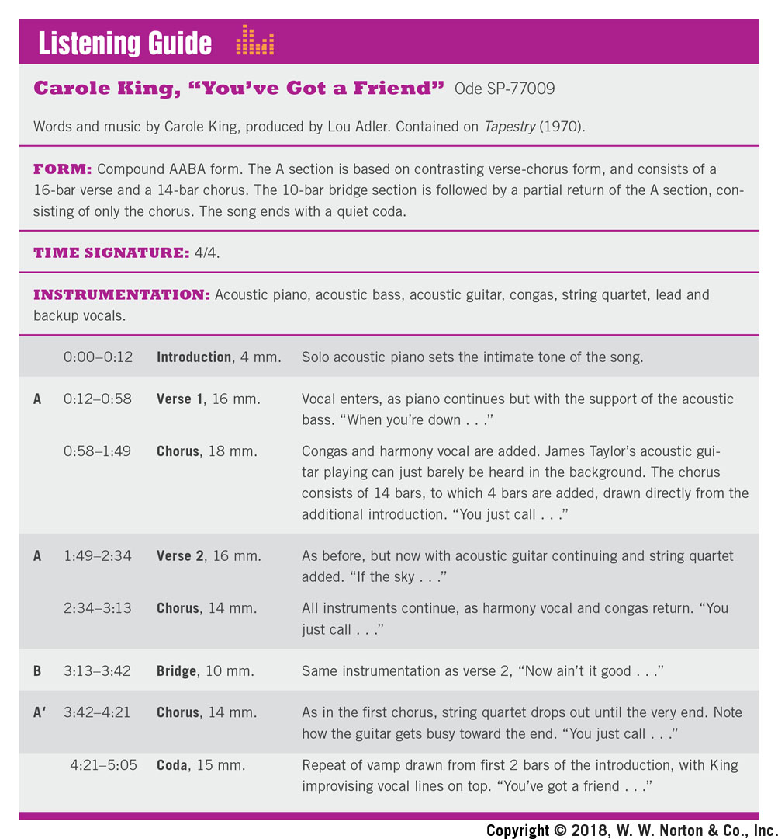
Time Frame | Parts | Description
0:00-0:12 | Introduction, 4 mm. | Solo acoustic piano sets the intimate tone of the song.
0:12-0:58 | A-Verse 1, 16 mm. | Vocal enters, as piano continues but with the support of the acoustic bass. "When you're down . . ."
0:58-1:49 | Chorus, 18 mm. | Congas and harmony vocal are added. James Taylor's acoustic gui­tar playing can just barely be heard in the background. The chorus consists of 14 bars, to which 4 bars are added, drawn directly from the additional introduction. "You just call . . ."
1:49-2:34 | A-Verse 2, 16 mm. | As before, but now with acoustic guitar continuing and string quartet added. "If the sky ..."
2:34-3:13 | Chorus, 14 mm. | All instruments continue, as harmony vocal and congas return. "You just call . . ."
3:13-3:42 | B-Bridge, 10 mm. | Same instrumentation as verse 2, "Now ain't it good . . ."
3:42-4:21 | A'-Chorus, 14 mm. | As in the first chorus, string quartet drops out until the very end. Note how the guitar gets busy toward the end. "You just call . . ."
4:21-5:05 | Coda, 15 mm. | Repeat of vamp drawn from first 2 bars of the introduction, with King improvising vocal lines on top. "You've got a friend . . ."

Slide 27
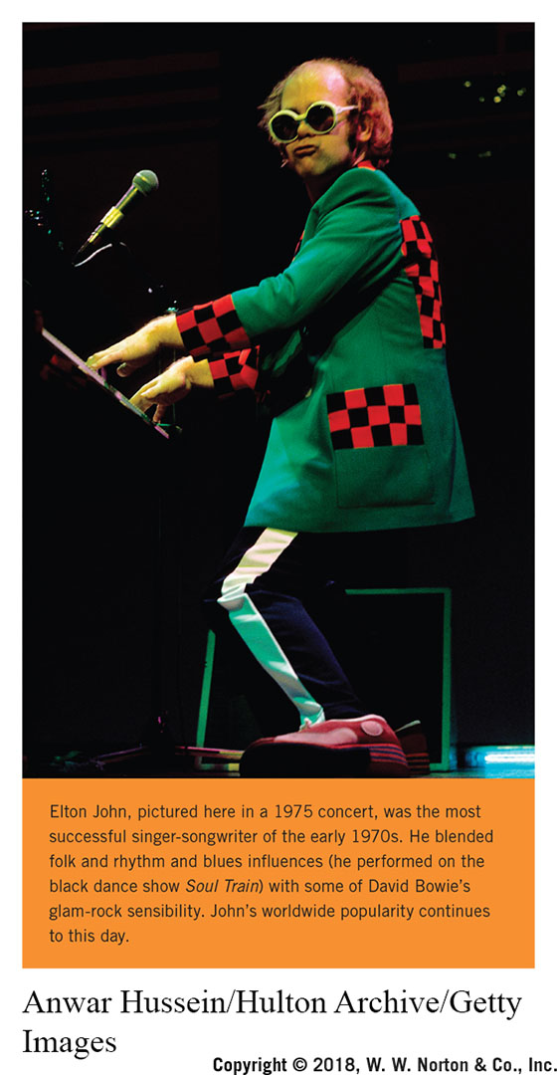
Notes:
Elton John, pictured here in a 1975 concert, was the most successful singer-songwriter of the early 1970s. He blended folk and rhythm and blues influences (he performed on the black dance show Soul Train) with some of David Bowie’s glam-rock sensibility. John’s worldwide popularity continues to this day.
Credit: Anwar Hussein/Hulton Archive/Getty Images

Slide 28
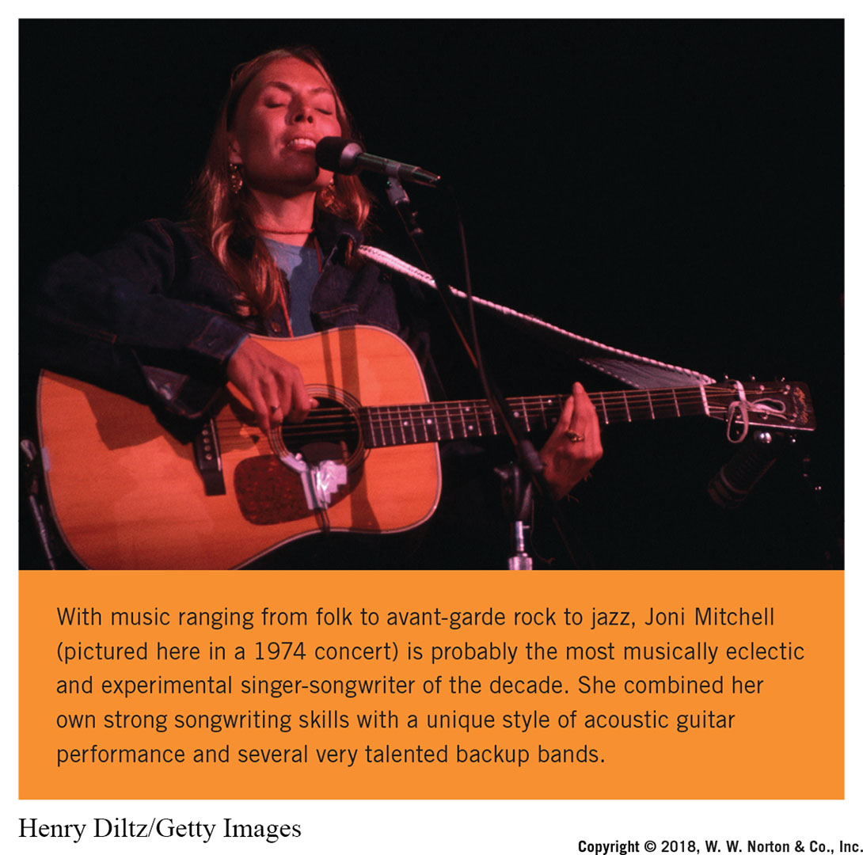
Notes:
With music ranging from folk to avant-garde rock to jazz, Joni Mitchell (pictured here in a 1974 concert) is probably the most musically eclectic and experimental singer-songwriter of the decade. She combined her own strong songwriting skills with a unique style of acoustic guitar performance and several very talented backup bands.
Credit: Henry Diltz/Getty Images

Slide 29
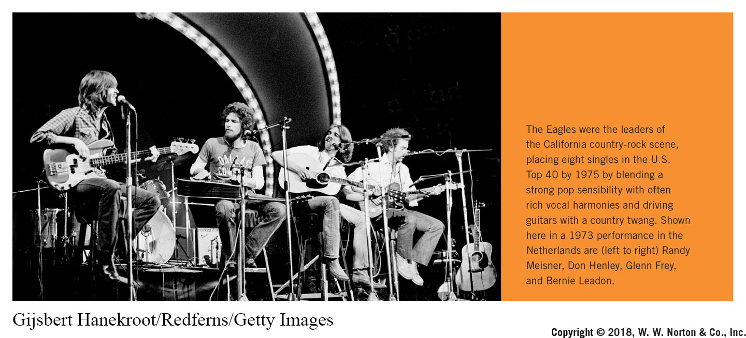
Notes:
The Eagles were the leaders of the California country-rock scene, placing eight singles in the U.S. Top 40 by 1975 by blending a strong pop sensibility with often rich vocal harmonies and driving guitars with a country twang. Shown here in a 1973 performance in the Netherlands are (left to right) Randy Meisner, Don Henley, Glenn Frey, and Bernie Leadon.
Credit: Gijsbert Hanekroot/Redferns/Getty Images

Slide 30
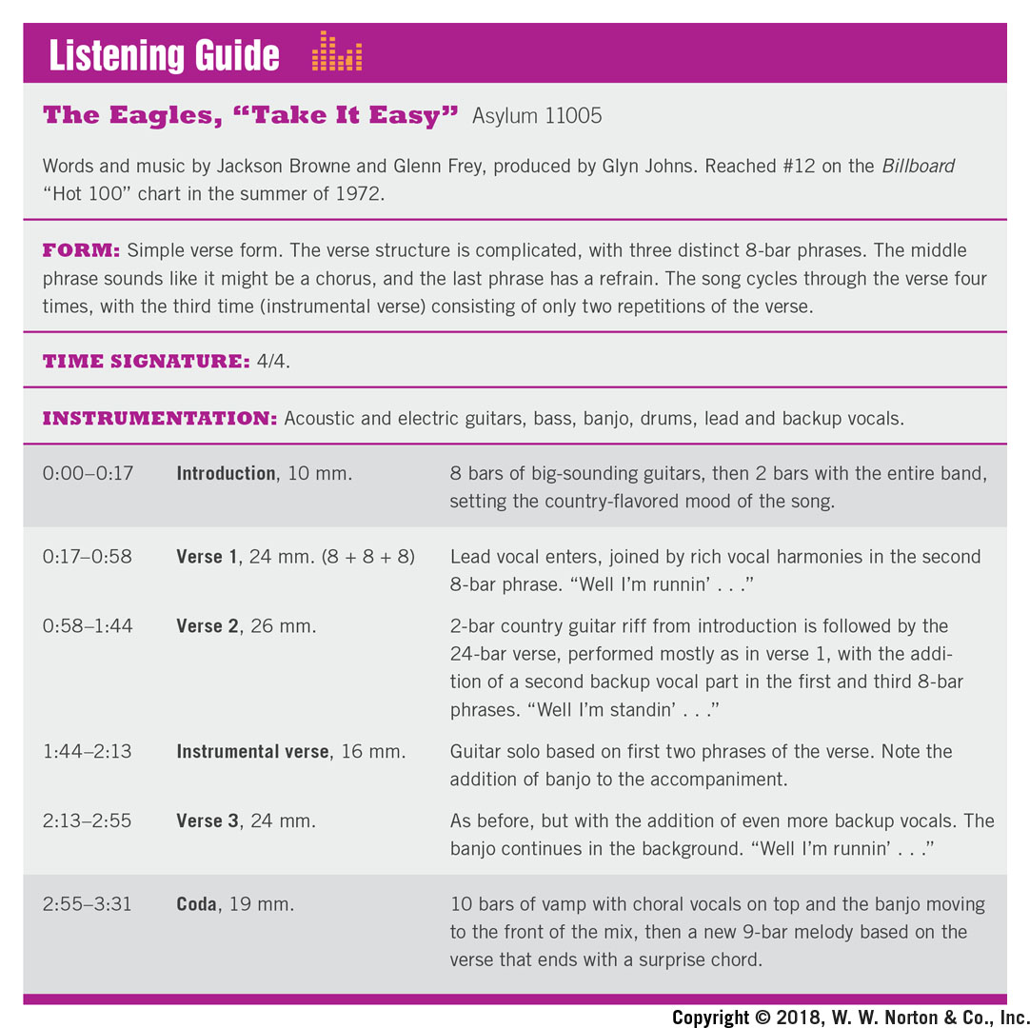
Time Frame | Parts | Description
0:00-0:17 | Introduction, 10 mm. | 8 bars of big-sounding guitars, then 2 bars with the entire band, setting the country-flavored mood of the song.
0:17-0:58 | Verse 1, 24 mm. (8 + 8 + 8) | Lead vocal enters, joined by rich vocal harmonies in the second 8-bar phrase. "Well I'm runnin' . . ."
0:58-1:44 | Verse 2, 26 mm. | 2-bar country guitar riff from introduction is followed by the 24-bar verse, performed mostly as in verse 1, with the addi­tion of a second backup vocal part in the first and third 8-bar phrases. "Well I'm standin' . . ."
1:44-2:13 | Instrumental verse, 16 mm. | Guitar solo based on first two phrases of the verse. Note the addition of banjo to the accompaniment.
2:13-2:55 | Verse 3, 24 mm. | As before, but with the addition of even more backup vocals. The banjo continues in the background. "Well I'm runnin' . . ."
2:55-3:31 | Coda, 19 mm. | 10 bars of vamp with choral vocals on top and the banjo moving to the front of the mix, then a new 9-bar melody based on the verse that ends with a surprise chord.

Slide 31
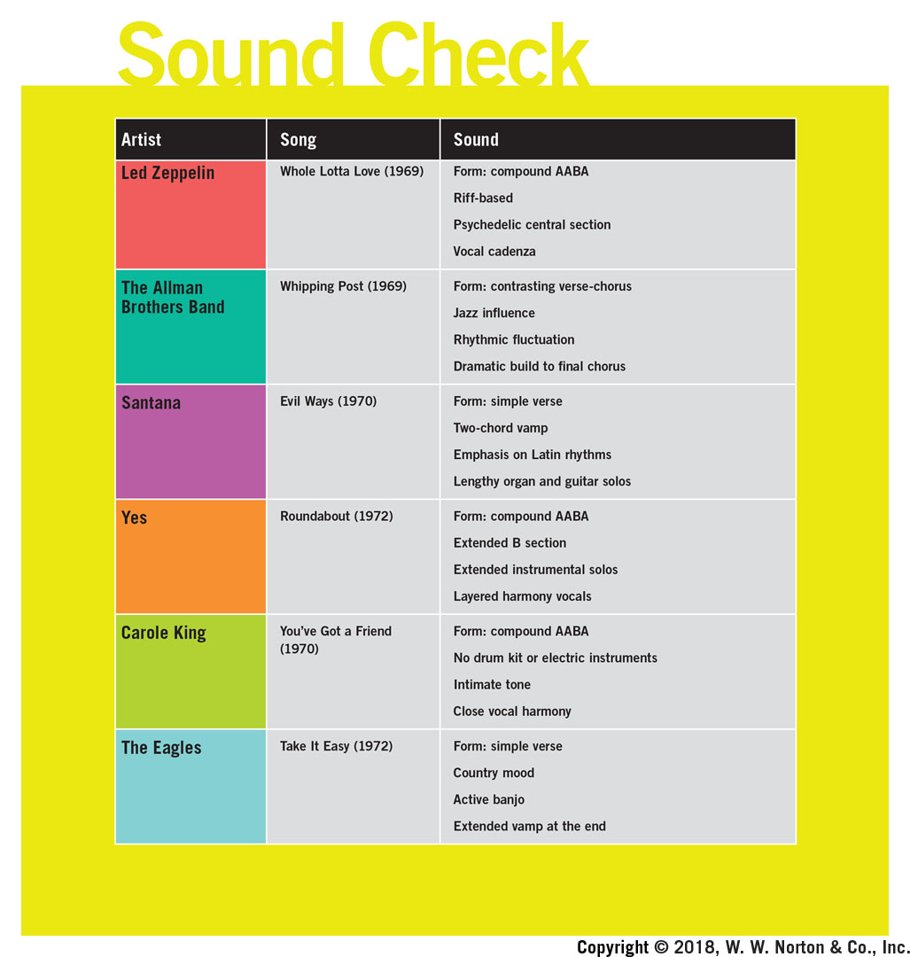
Artist | Song | Sound
Led Zeppelin | Whole Lotta Love (1969) | Form: compound AABA Rift-based Psychedelic central section Vocal cadenza
The Allman Brothers Band | Whipping Post (1969) | Form: contrasting verse-chorus Jazz influence Rhythmic fluctuation Dramatic build to final chorus
Santana | Evil Ways (1970) | Form: simple verse Two-chord vamp Emphasis on Latin rhythms Lengthy organ and guitar solos
Yes | Roundabout (1972) | Form: compound AABA Extended B section Extended instrumental solos Layered harmony vocals
Carole King | You've Got a Friend (1970) | Form: compound AABA No drum kit or electric instruments Intimate tone Close vocal harmony
The Eagles | Take It Easy (1972) | Form: simple verse Country mood Active banjo Extended vamp at the end

Slide 32
What’s That Sound?
An Introduction to Rock and Its History
Art Slides
Fifth Edition
Text By John Covach and Andrew Flory
digital.wwnorton.com /whatsthatsound5

