Slide 1
Newark NJ SDoHs
To improve population health, research has found it important to address the social, economic, and environmental factors that are deemed to influence health.
The factors are known as social determinants of health (SDoHs).
Although there lacks consensus on which factors comprise these“ social determinants”
This section offers data for Newark on some of these determinants.

Slide 2
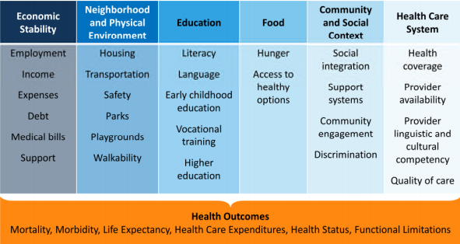
Social Determinants of Health

Slide 3
Economic stability
This address issues like income, employment expenses, debt, medical bills and support.
  Income;
There are a number of income factors that are considered for this case, e.g. median household income and per capita. A summary of this is depicted by the figure below.

Slide 4
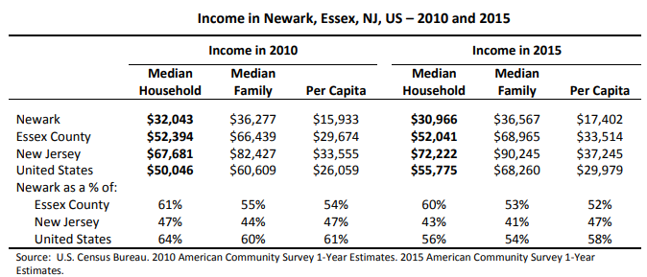

Slide 5
  Employment;
Employment relates to the socioeconomic factors that determine income.
2015, Newark civilian labor force ranged from 116,697 to 134,542. The same year, a range of 8,321- 20,447 was unemployed. Unemployment in Newark were higher than New Jersey and the United States.
This factor is important for health planning because employment is the chief source of health insurance.
Higher rates of unemployment (lower rates of employment) mean relatively less employer-provided health insurance.
Families and individuals who face unemployment issues are forced to rely on other sources like government insurance programs or get along without health insurance. Accessing healthcare is directly affected by this.
Affordable Care Act of 2010 and Medic aid Expansion in New Jersey helped offset the lack of employer provided health insurance.

Slide 6
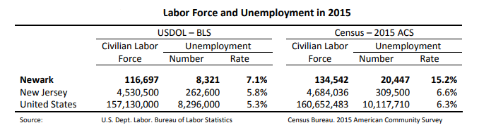

Slide 7
Education
75% of Newark residents of >25 years are higher school graduates or higher.
16% have bachelor’s degrees or higher
The percent with higher education is half of the New Jersey and U.S. rates.
See the figure below

Slide 8
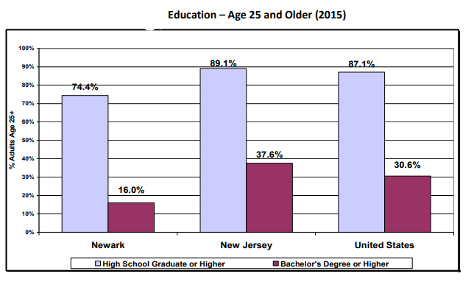

Slide 9
What does this mean?
Education leads to more accurate health beliefs and knowledge. This means better lifestyle choices, but also to better skills and greater self-advocacy. Education improves skills such as literacy, develops effective habits, and may improve cognitive ability.

Slide 10
Health Care System
There seems to be adequate supply of health resources within the 26 sq. miles of Newark City.
Lack of health insurance:
In2014, nearly 30% of Newark adults’ age18-64 reported lack of health insurance– twice as high as NJ and US. In 2014 New Jersey implemented Medicaid Expansion to insure low income adults, adoption available in the Affordable Care Act (ACA). The uninsured percentage in Newark may decline in 2015.

Slide 11
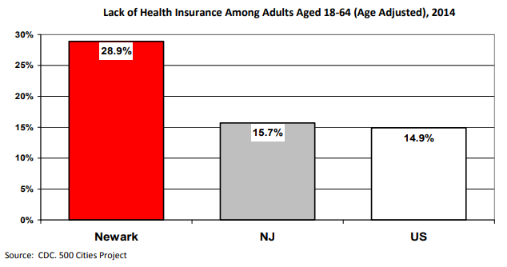

Slide 12
Action Plan
An action plan should be customized to fit the prevailing circumstances. This three-point action plan is purposed to address the unemployment issue as an SDoH.
Point 1: Set and keep a regular schedule
Unemployment is many cases is unexpectedly complicated by nothingness.
Employment wraps people into fixations and schedules that last as long as the employment does.
Unemployment brings about idleness and lack of direction in life. Employment tables a structure that enable people move on with life.
This idea is basically to create and maintain a momentum (especially for people that have lost jobs) that keeps you moving forward. This point seeks to create a new form of regimentation.

Slide 13
Cont…
Point 2: Reposition yourself as a Problem Solver
You need a job, right? But your need won’t impress an employer.
With so many prospects seeking out every job, the only way to get noticed is to position yourself as an answer to the employer’s biggest problems. Few employers are looking for generalists anymore.
Start by asking yourself these questions:
  What are the biggest problems common to most businesses?
  What are the biggest problems in your industry?
  What are the biggest problems for a specific employer?

Slide 14
Conti…
Point 3: Do something new everyday
Unemployment is a time to experiment, to try things you didn’t have time for when you were working.
Think of self-discovery.
This isn’t a flight of fancy either, but part of the attempt to reinvent yourself for another charge up the mountain of life.
It’s often during these free periods that we find that we have hidden talents and interests that can take us in entirely different directions.

Slide 15
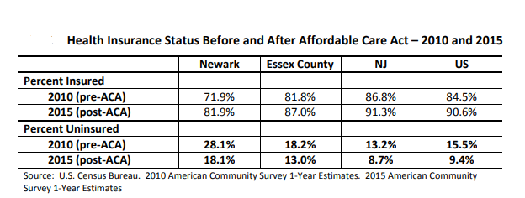
Visually document photographs on unemployment

Slide 16
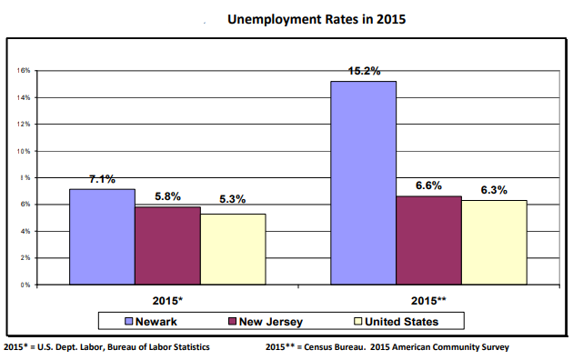
Cont…
Employment and unemployment rates are related to the socioeconomic factors of income and education above.
In 2015, the civilian labor force in Newark ranged from 116,697 to 134,542. A range of 8,321 to 20,447 Newark residents in the labor force were unemployed in2 015.

Slide 17
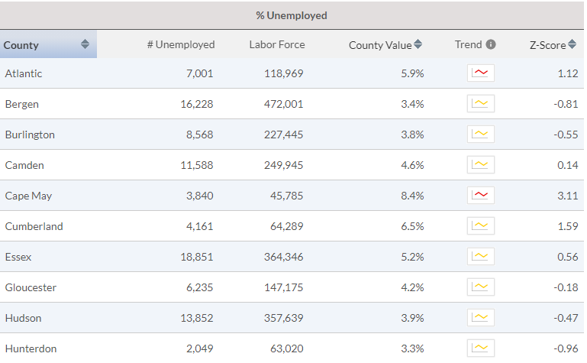
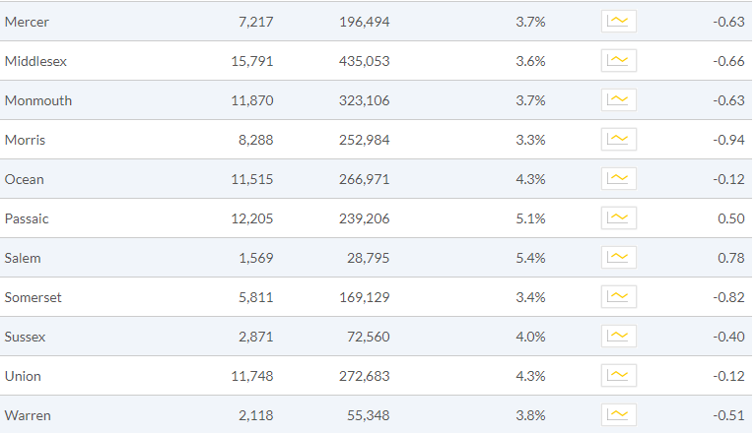
Cont…

Slide 18
New Jersey Summary Information
Unemployment is the percentage of the county’s civilian labor force, ages 16 and older that is unemployed but seeking work.
Top U.S. Performers: | 2.6% (10th percentile)
Range in New Jersey (Min-Max): | 3.3-8.4%
Overall in New Jersey: | 4.1%

Slide 19
Conclusion
There are numerous community partners and healthcare providers which are available to Newark residents. These are summarized below.
• Hospitals/healthcare systems. There are three acute care hospitals in Newark, within three major state healthcare systems. These system shave inpatient and outpatient clinic services, including family healthcare services.

Slide 20
References
Indexes, C. P. (2014). US Bureau of labor statistics.
Labor, U. D. (2017). US Bureau of Labor Statistics. Retrieved from.
Community health assessment 2017. (2020). Retrieved 3 November 2020, from https://www.naccho.org/uploads/downloadable-resources/Newark-CHA-2017-FINAL.pdf.

