Slide 1
Week 1 Powerpoints

Slide 2
Psychopharmacology

Slide 3
Knowledge of Psychopharmacology
When to refer
Inadequate/partial response
> Wrong medication
> Dosing problems
Compliance issues
Provide realistic expectations
Talking with the physician

Slide 4
Decision Making:
Psychiatric Treatment
Research: 75% funded by
drug companies
Practice guidelines
Marketing to physicians
Marketing to consumers

Slide 5
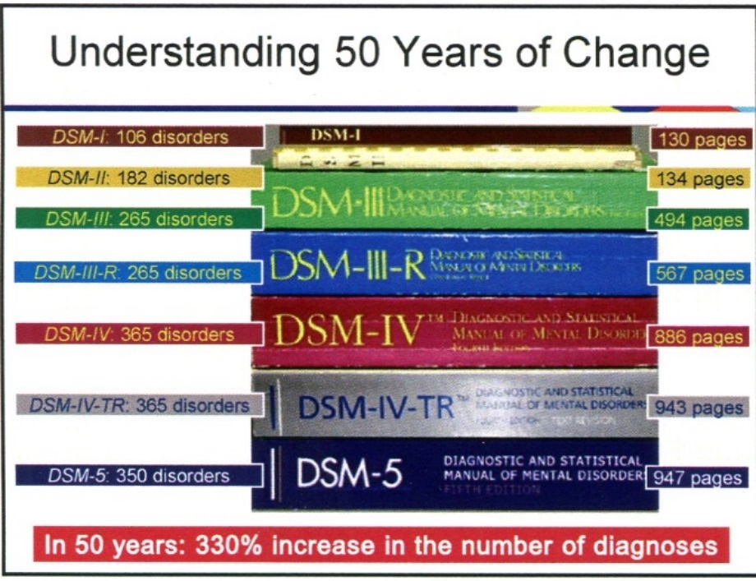

Slide 6
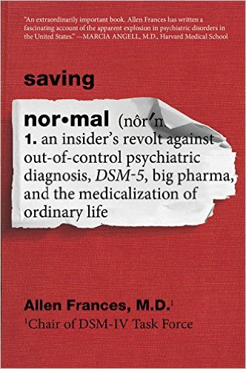

Debates about Diagnosis
The DSM process (political; economic)
“Behavior is overdetermined.” —S. Freud
See Allen Frances, Saving Normal: An Insider’s Revolt Against Out-of-Control Psychiatric Diagnosis, DSM-5, Big Pharma, and the Medicalization of Ordinary Life, and Daniel Carlat, Unhinged: The Trouble with Psychiatry—A Doctor’s Revelations about a Profession in Crisis

Slide 7
A Changing Landscape
Most people in the United States treated for depression only receive antidepressant medications.

Slide 8

Drug facts
21% of Americans
take psychiatric medications,
but only 3.8% are in
psychotherapy

Slide 9
Depression facts
Treated for Depression: 1998
Medications: 74%
Therapy: 75%

Slide 10
Depression facts
Treated for Depression: 2016
Medications: 75%
Therapy: 43%

Slide 11
Who Prescribes
85% of prescriptions written
by primary care physicians
48% psychiatrists over 60
Fewer MDs entering psychiatry

Slide 12
Prescriptions in Primary Care
Average length of appointment:
7-17 minutes
Average amount of time
explaining prescriptions:
49 seconds

Slide 13
Success: Primary care
Treating depression
30% never fill Rx for first prescription
25-33% stop within first 30 days
40% stop within 4 months
(62% didn’t tell their doctor)
Simon; Katon; Lin

Slide 14
254 new mental health and psychiatry articles each day on MedLine

Slide 15
Abbreviations
Dx: diagnosis
Hx: history
Tx: treatment
Rx: prescription
Sx: symptoms
WNL: within normal limits

Slide 16
The Nervous System:
Molecular and
Cellular Level

Slide 17
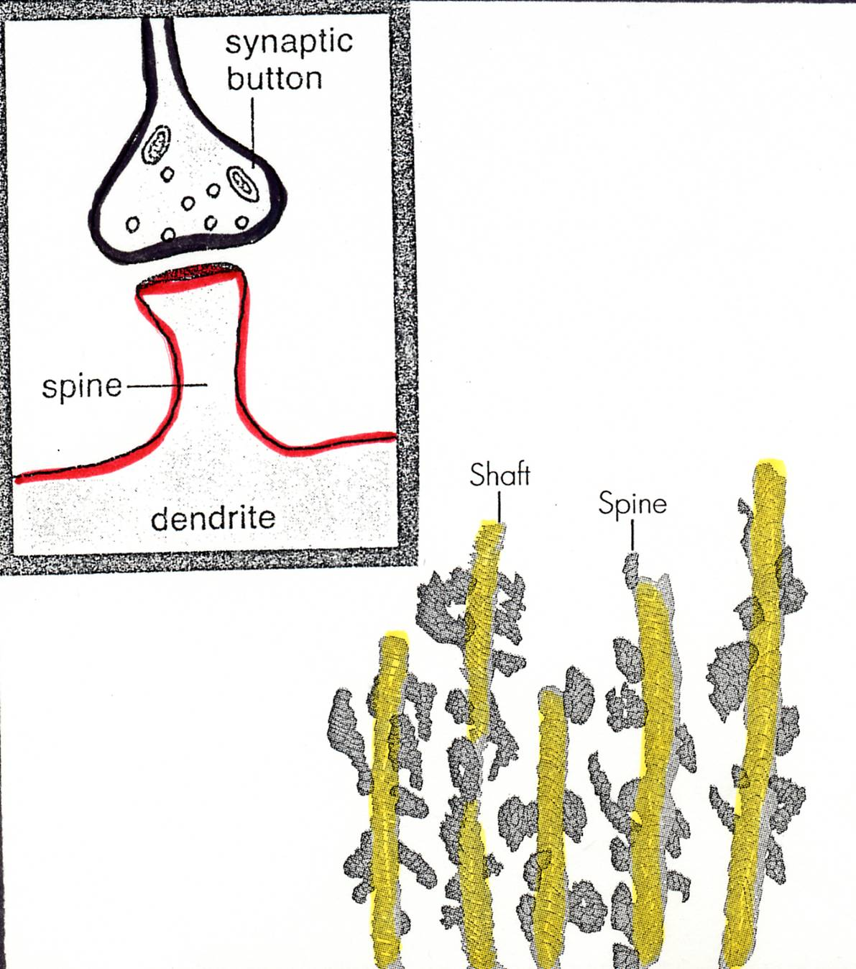
DENDRITE SPINES & SYNAPSES
Dynamic

Slide 18
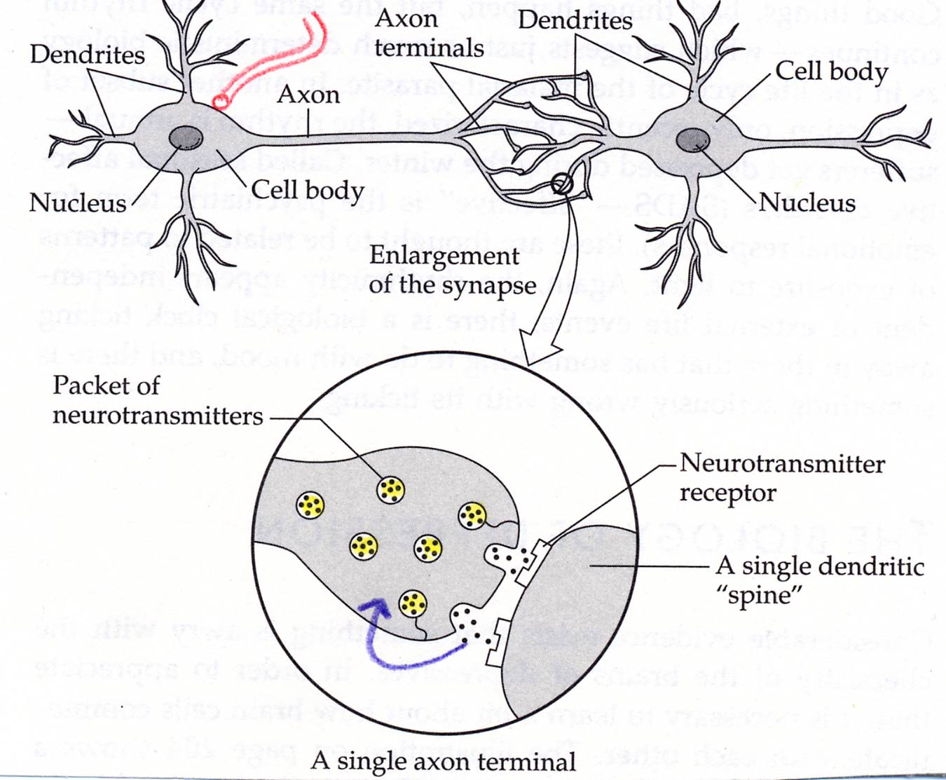
Nutrients to the Neuron

Slide 19
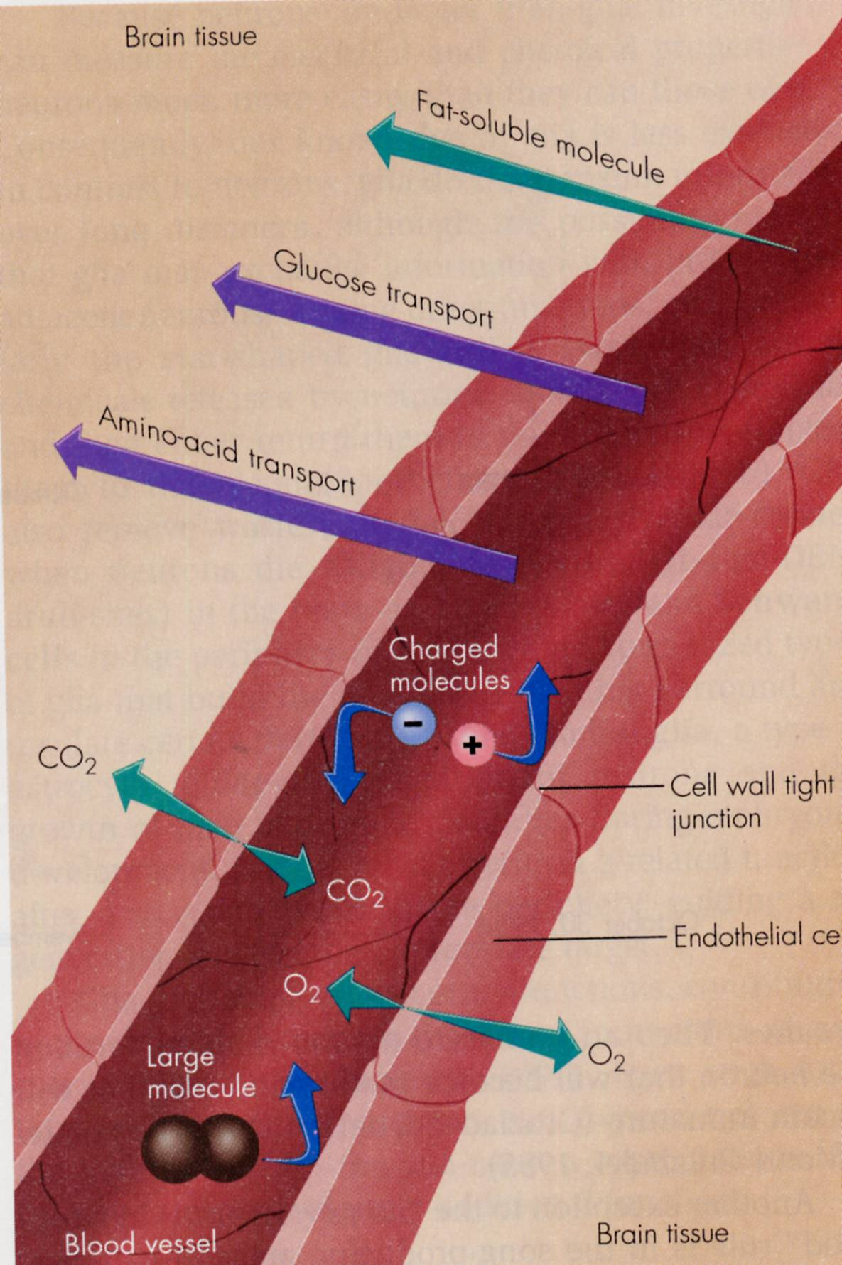
Blood-Brain
Barrier

Slide 20
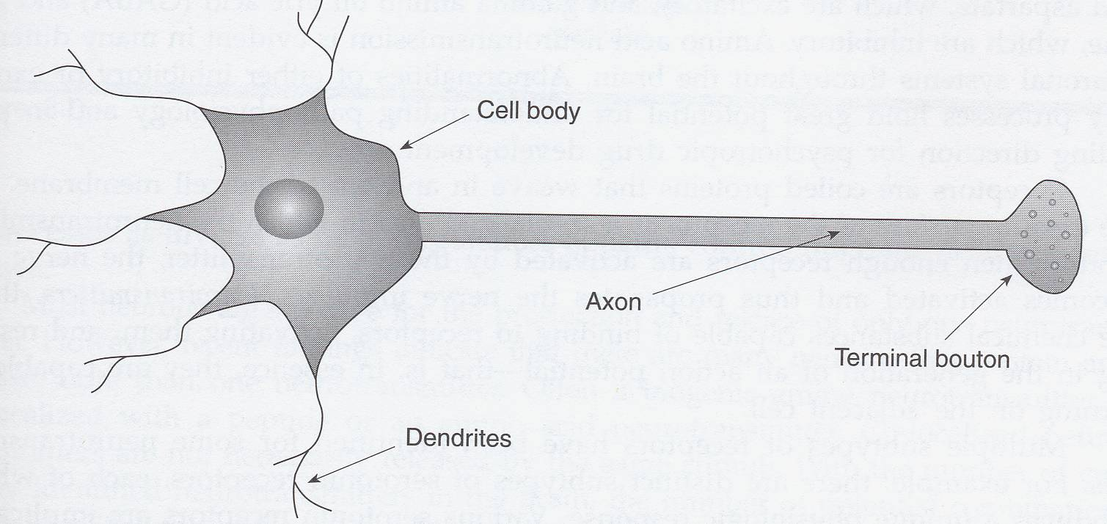
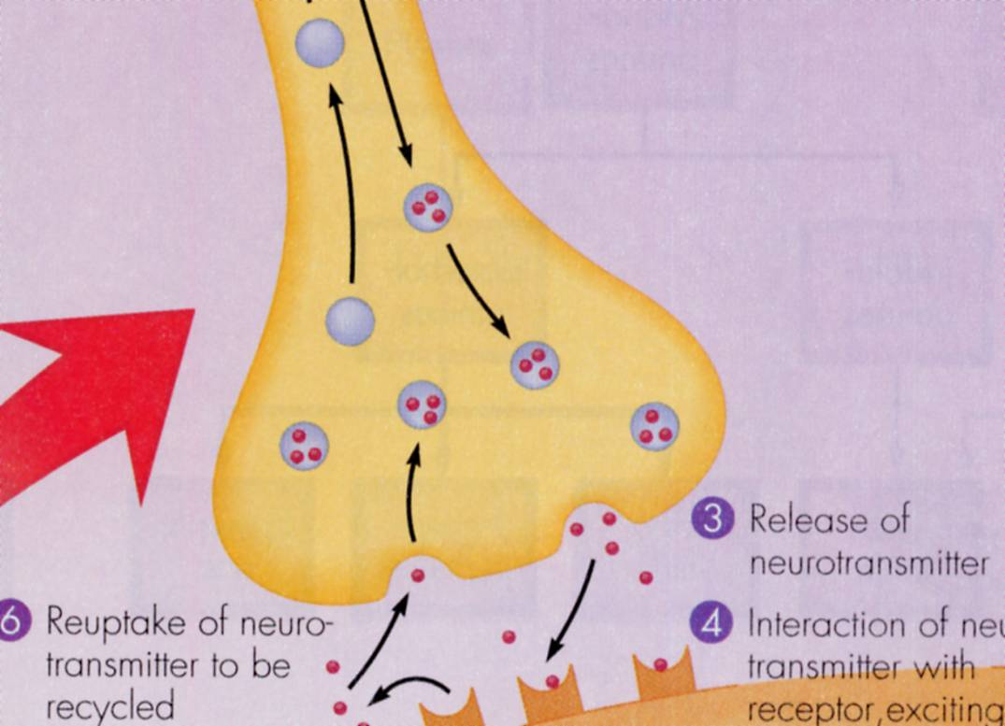
NCAM
Nerve Impulse

Slide 21
Classification of Receptors
Pre or Post- Synaptic
Inhibitory vs.
Excitatory
Ionic vs. Metabotropic
Intracellular

Slide 22
Gene Silencing

Slide 23
More on Neurotransmitters
Lock and key: activate specific
receptors
Agonists and antagonists

Slide 24
Neurotransmitter Actions
Glutamate: Excitatory
GABA: Inhibitory
85%
Others: depends on what
receptors are activated

Slide 25
Up and Down
Regulation

Slide 26
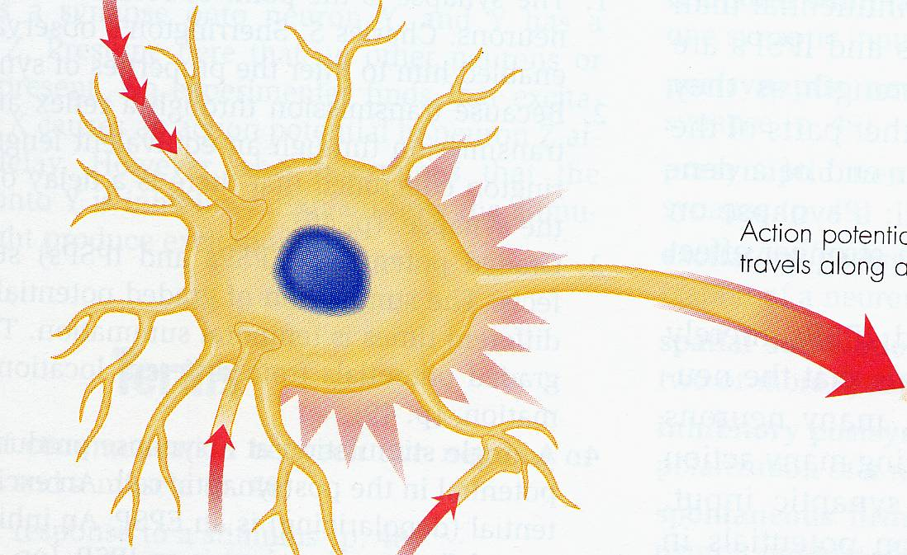
Sympathetic Nervous System
Norepinephrine

Slide 27
Parasympathetic Nervous System
Acetylcholine

Slide 28
Top-Down Control

Slide 29
Four
Primary
Circuits

Slide 30
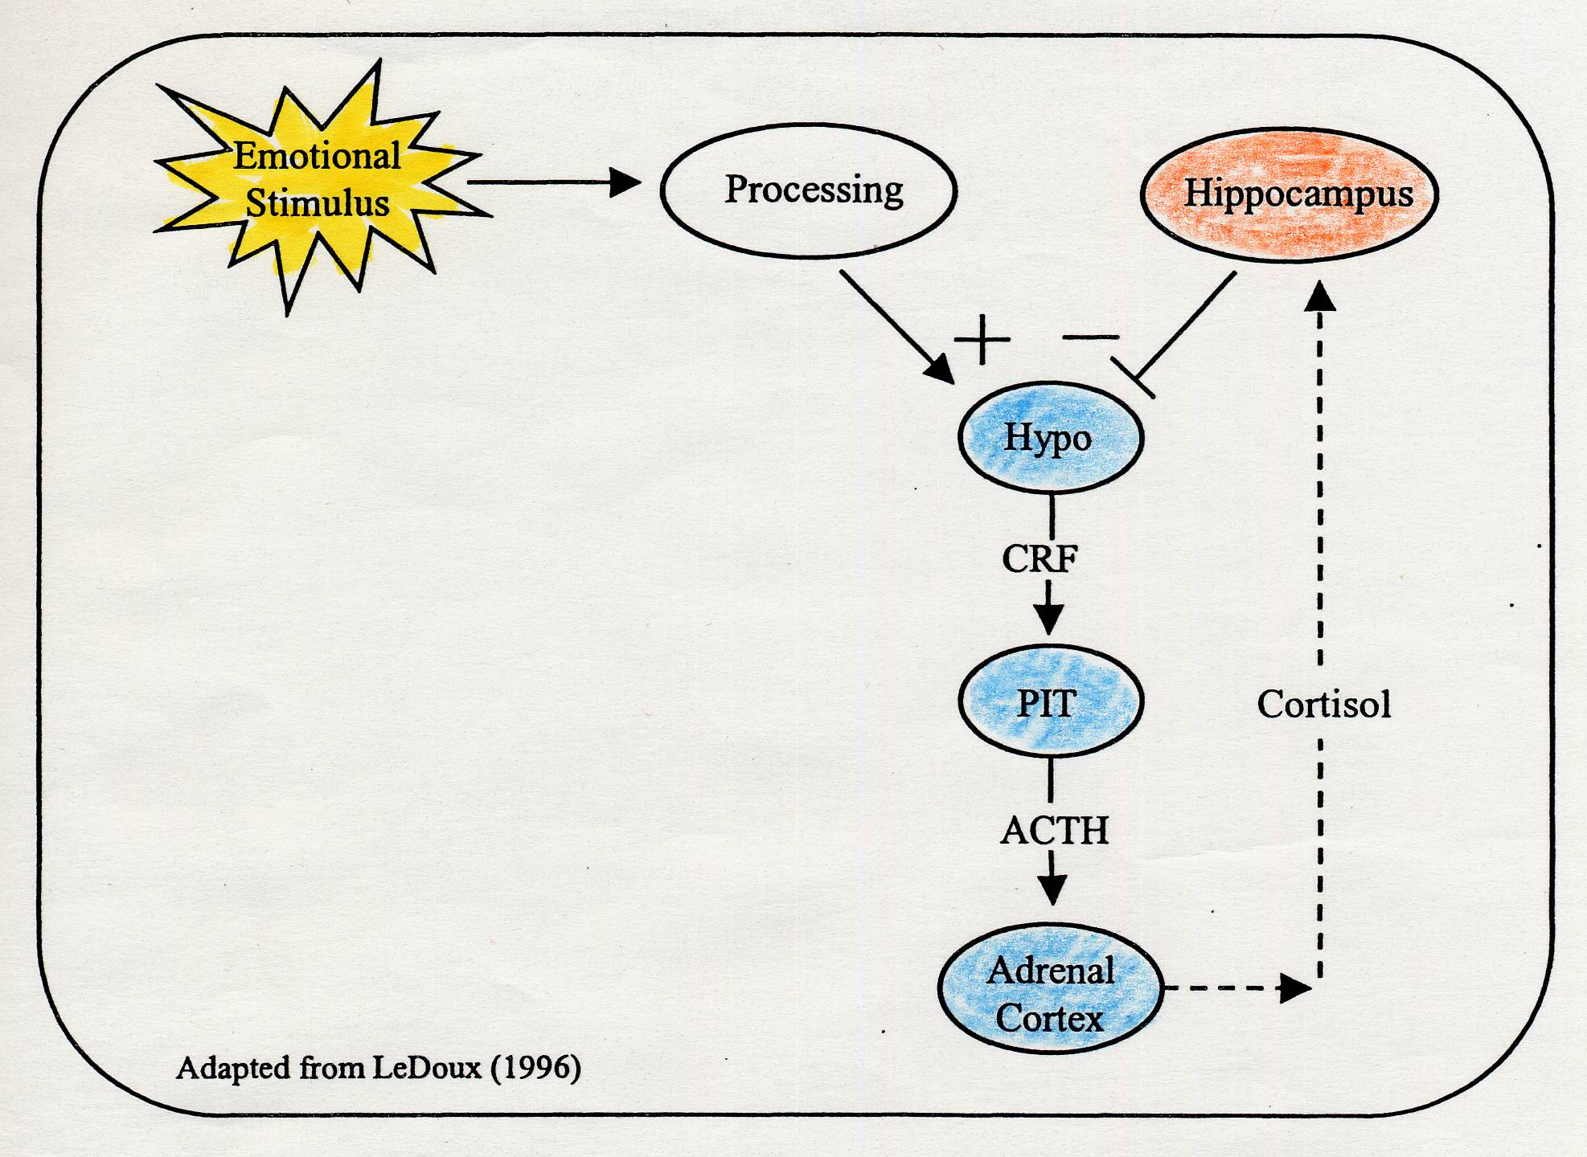
Corticotropin Releasing Factor
CRF

Slide 31
Beneficial Effects of Cortisol
↑ Glucose
↑ Cardiac Output
Affect regulation
(HPA Axis)

Slide 32
Excessive CRF corticotropin releasing factor
Depression
Anxiety
Sleep disturbances
(↓ slow wave sleep)

Slide 33
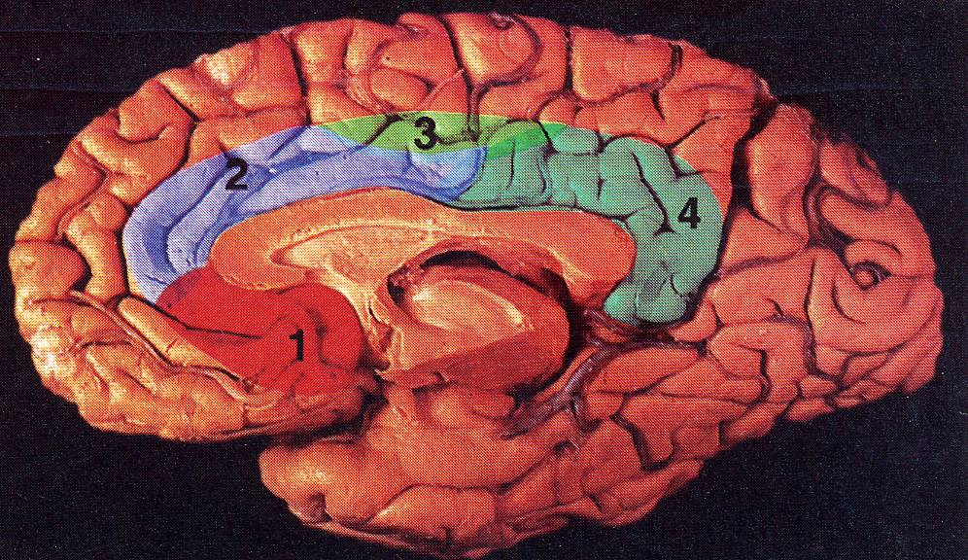
The Role of the
Anterior Cingulate

Slide 34
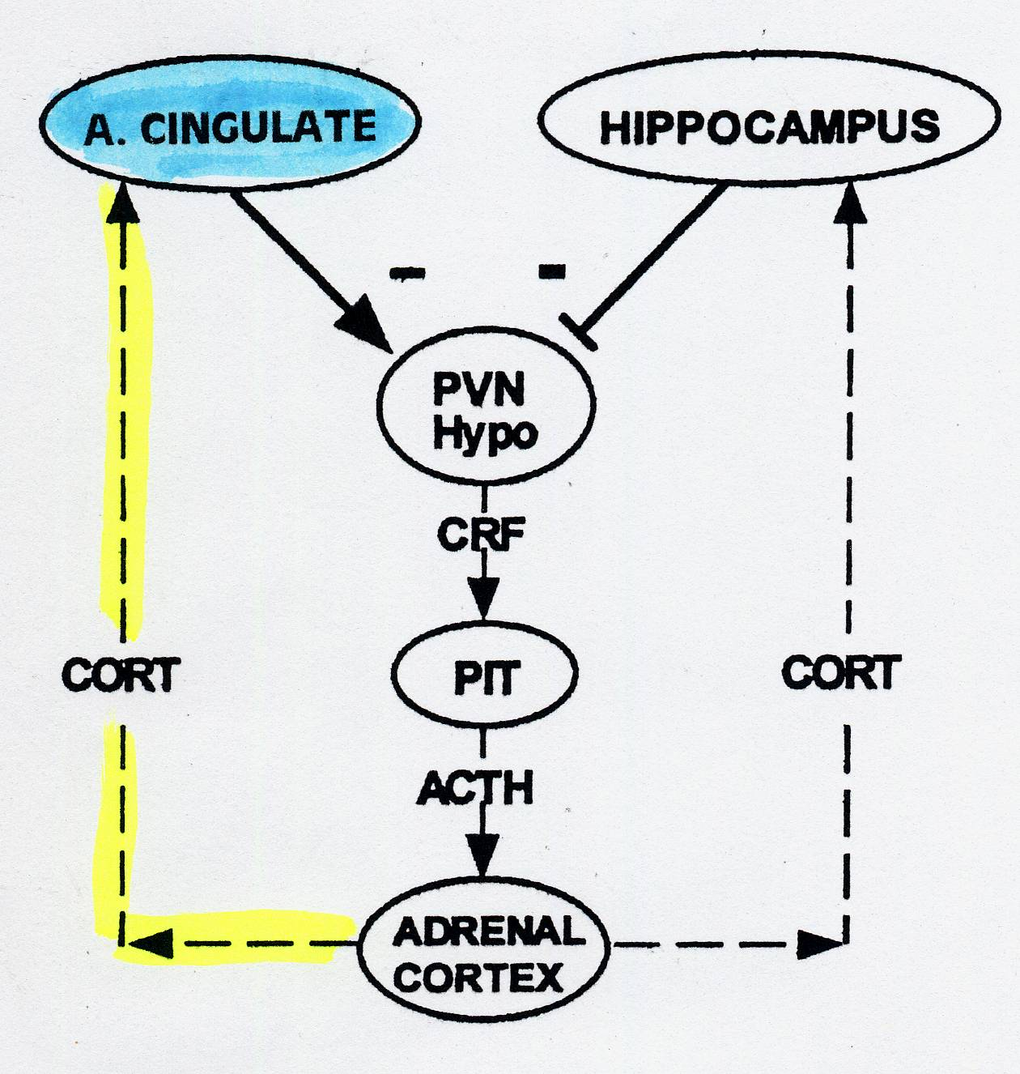

Slide 35
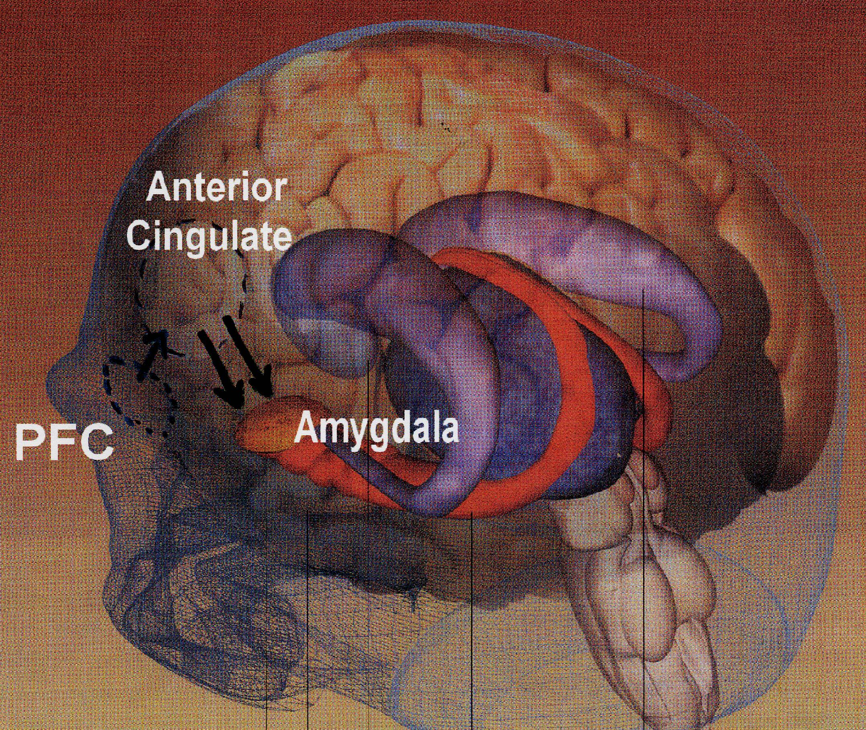
Anterior Cingulate…
Amygdala Circuit

Slide 36
Neuro-endocrine connections
# 4

Slide 37
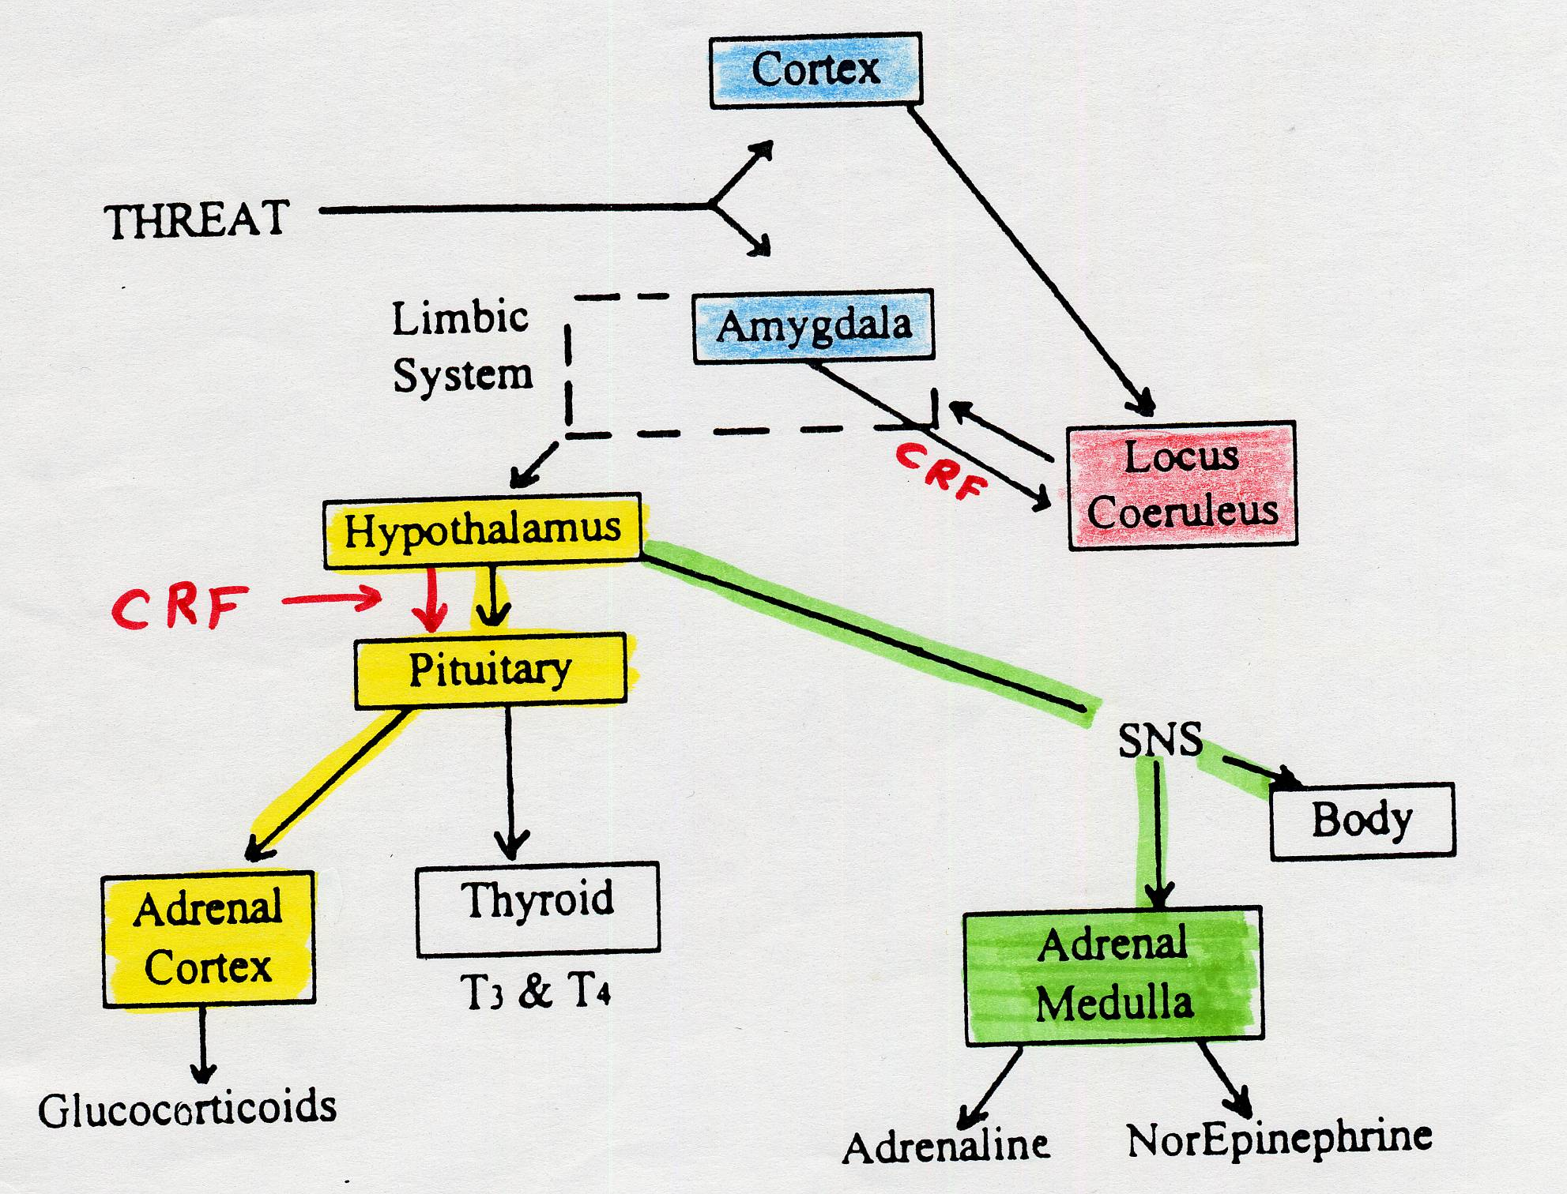
SNS
Thyroid

Slide 38
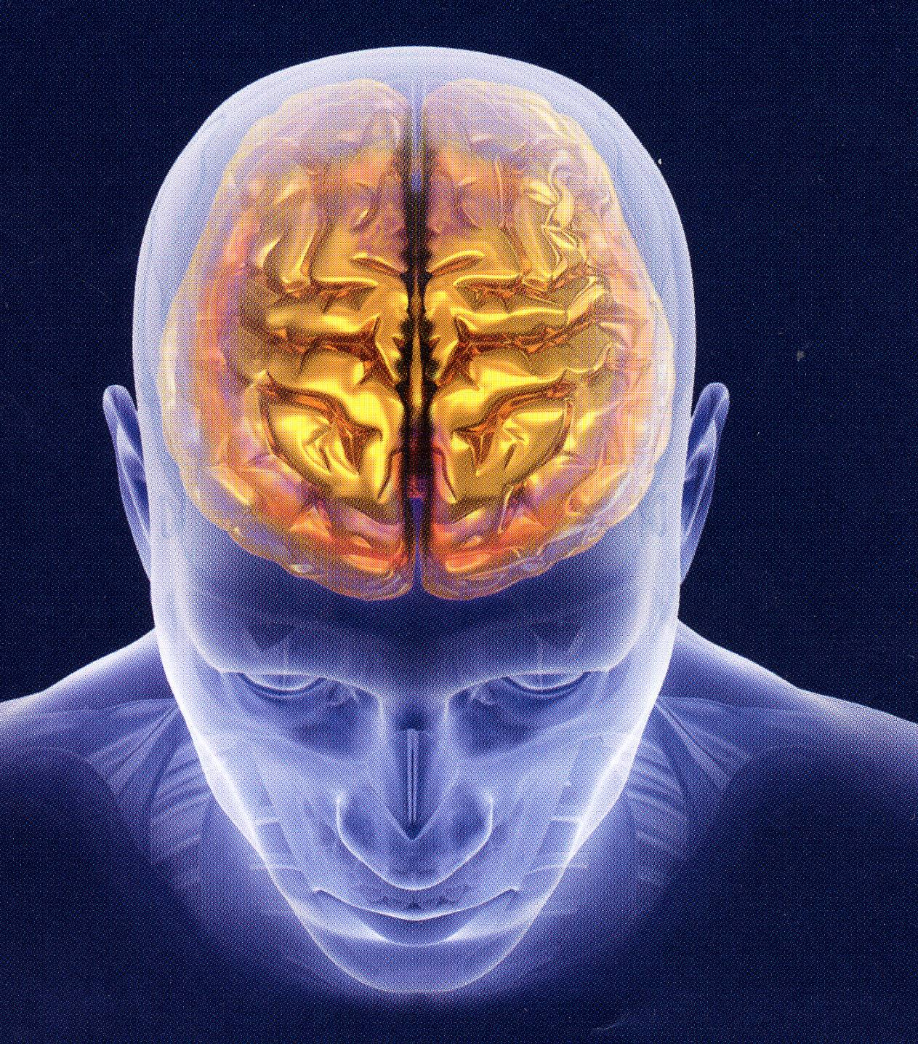
Frontal
Lobes

Slide 39
Frontal Lobes: % of total brain
Humans: 30%
Chimps: 12%
Dogs 6%
Cats 3%

Slide 40
Neurological Damage and
Neuro-Protection
Treatment implications

Slide 41
The Culprits
Toxic levels of:
> Cortisol
(depression and very severe stress)
> Glutamate (mania)
> Intra-cellular calcium (bipolar disorder)
> Glycogensynthase kinase (bipolar)
> Oxidative stress (mania and depression)
> Inflammation

Slide 42
Decreased availability of protective proteins
In addition….

Slide 43
HYPER-CORTISOLEMIA:
INCIDENCE
MAJOR DEPRESSIVE EPISODES
(unipolar or bipolar)
majority have elevated cortisol levels
% WITH HYPER-CORTISOL
60%
Neuro-toxicity

Slide 44
HYPER-CORTISOLEMIA:
INCIDENCE
Chronic steroid use
Cushing’s disease
Severe, inescapable, chronic stress

Slide 45
Measuring
Cortisol levels

Slide 46
Hypercortisolemia
Neurotoxic Effects

Slide 47
> Synapses disconnect
> Spines Shrink
> Dendrites wither
> Nerve cells die

Slide 48
Main Sites of Atrophy
Hippocampus
Anterior cingulate Gyrus

Slide 49

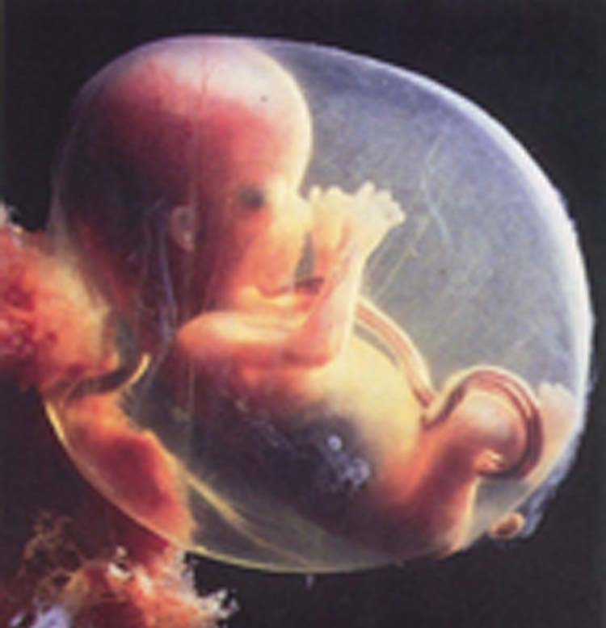
Hypercortisolemia

Slide 50
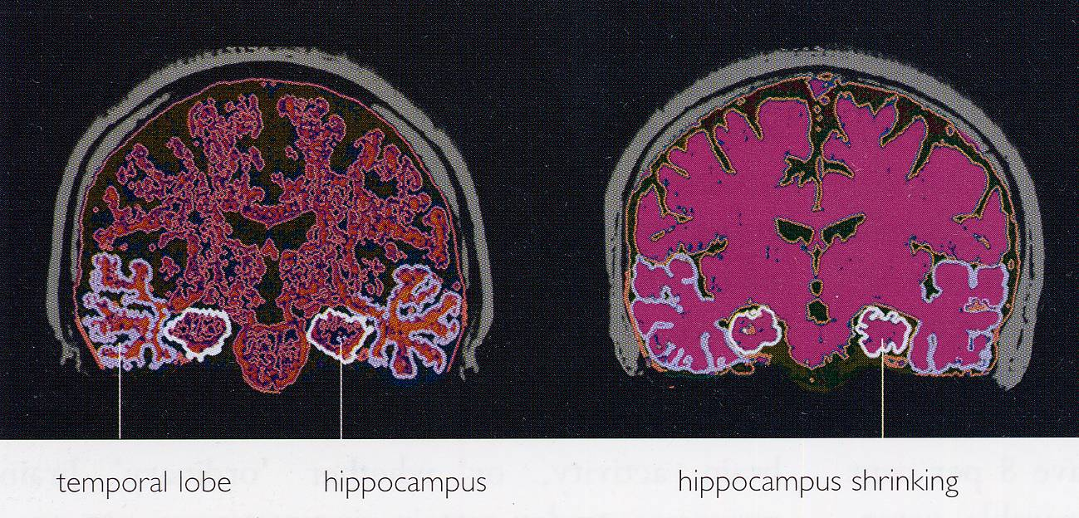
Hippocampal Progressive Atrophy

Slide 52
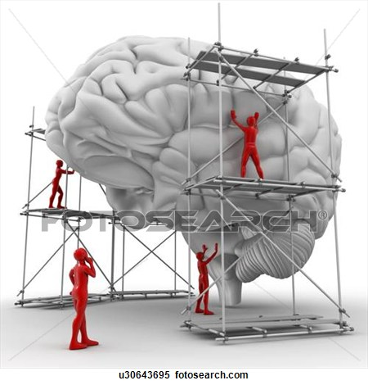
Brain Repair

Slide 53
BDNF: revisited
Protecting and healing the brain
Can protect the brain
Dendrites and strengthen synapses
Can activate “neurogenesis”
(the birth of new nerve cells in
the hippocampus)
R

Slide 54
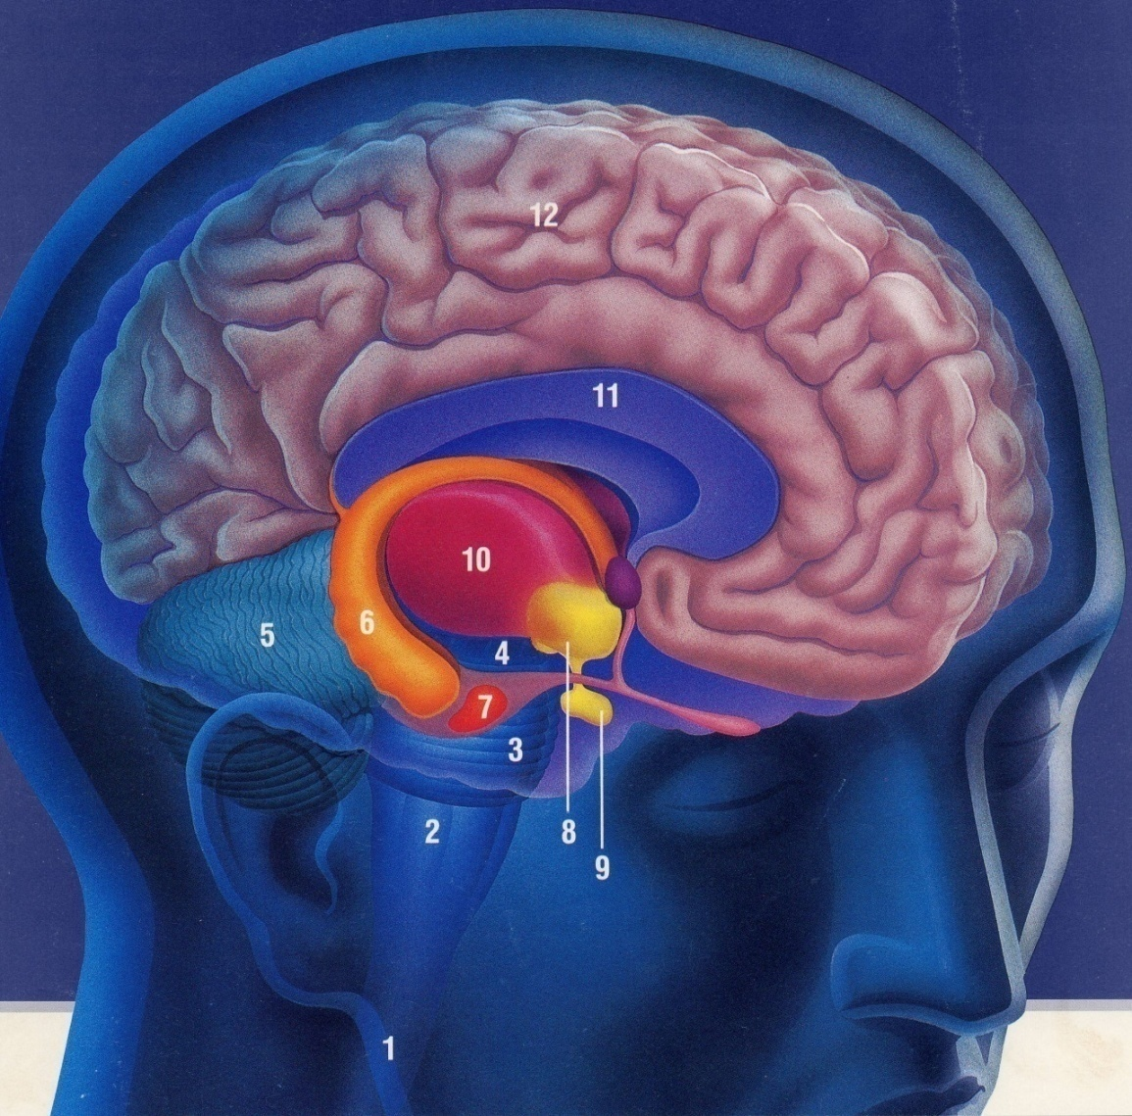
Anterior
Cingulate
Hippocampus
Good News…Bad News

Slide 55
Neuro-Protection and
Repair of the
Nervous System

Slide 56
BDNF
Brain-derived neurotropic factor: Protein
ESSENTIAL for CELL REPAIR
REDUCES TOXIC EFFECT of
CORTISOL
NEUROGENESIS
CELL GROWTH

Slide 57
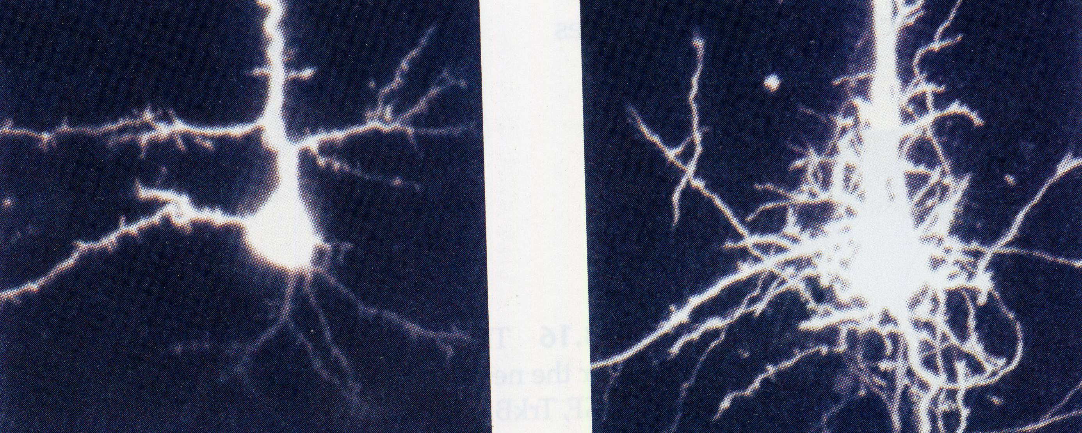
Dendrite growth: 24 hours

Slide 58
BDNF
Brain-derived neurotropic factor: Protein
Amount influenced by genetics
REDUCED GENE EXPRESSION in
MAJOR DEPRESSION &
HELPLESNESS
Can be measured in serum

Slide 59
BDNF
Brain-derived neurotropic factor
MAY BE RESTORED BY:
* Antidepressants
* Lithium, Depakote,
Tegretol, Lamictal
* Seroquel, Abilify, Latuda,
Lamictal, Saphris
* Exercise

Slide 60
Apoptosis
Programmed
cell death

Slide 61
Bipolar Disorder and
Hyperactive Intra-cellular
Calcium Signaling
↑ cellular calcium thru-out body
(platelets)
Too much: mania
More: depression
Even more: cell death

Slide 62
Treatment Implications
Lithium and Tegretol (Equetro)
↓ intracellular calcium
thru-out body
Calcium channel blockers:
e.g. Verapamil

Slide 63
DISCUSSING MEDICATION
ISSUES WITH CLIENTS:
--------------------------------
Legal and Ethical Aspects

Slide 64
Not Allowed
Stopping Medications
Changing the Dose

Slide 65
OK To Discuss
Treatment options and recommendations
What to Expect: Sx improvement
Time to Response
Side Effects
Compliance Issues

Slide 66
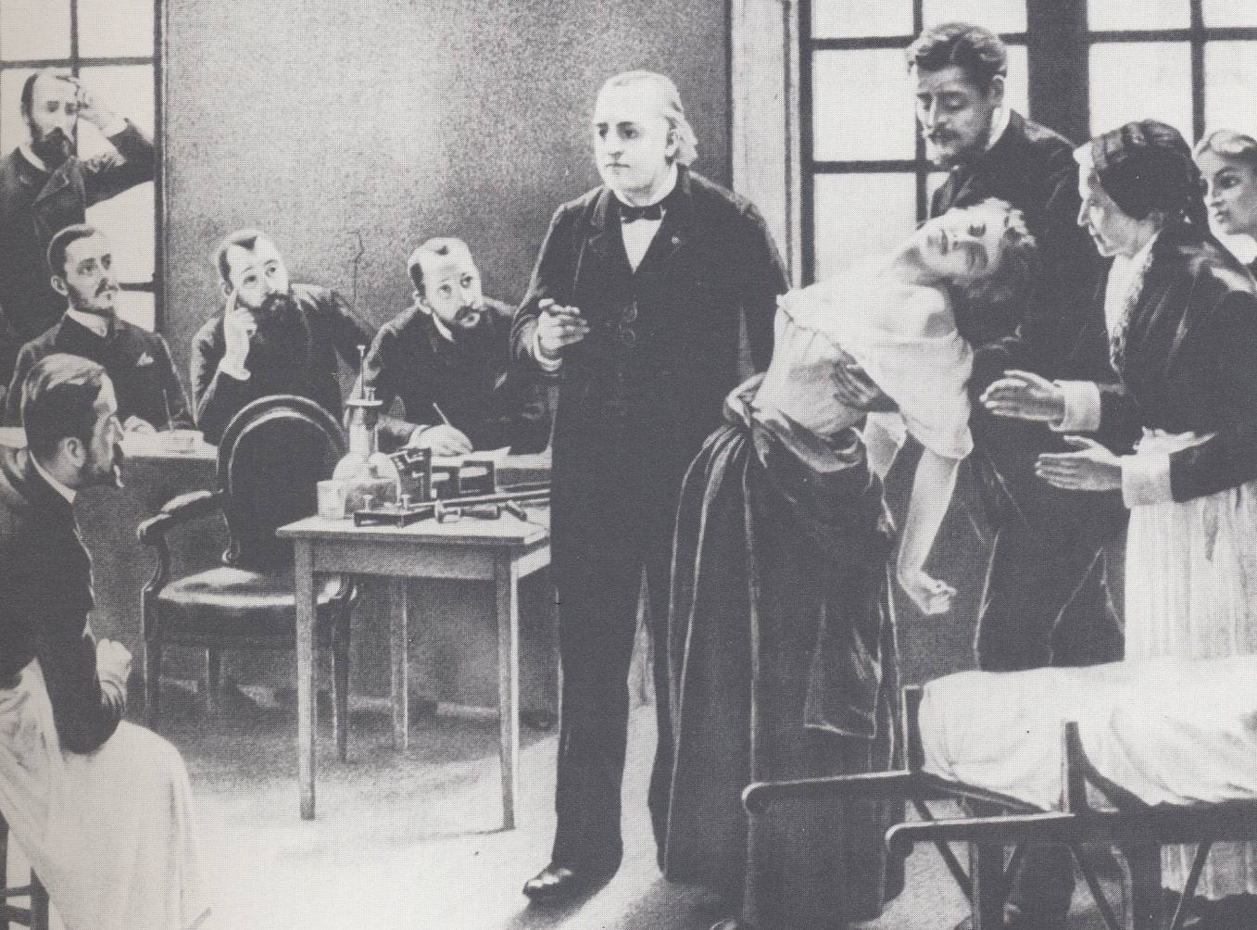
Basic Foundations

Slide 67
Cultural Considerations
Keys: establish respect, trust and
maintain dignity
Avoid alienating clients
Spending time to understand
any particular beliefs or
biases about medical treatment

Slide 68
Cultural Considerations
Early Studies:
> Impact of lithium side effects
> Chinese and Westerners
> Polydipsia and polyuria
> 1990s: Latinos and Asians
generally expect more rapid
relief from medications

Slide 69
Cultural Considerations
Bottom Lines:
> extremely diverse ethnic
populations….
> the need to talk and listen a lot
to their beliefs and traditions
(use of alcohol, smoking, use of herbals, beliefs about causes )
R

Slide 70
Cultural Considerations
These issues often are often the
make it or break it of treatment
outcomes
“I have a few personal questions that I ask all of my patients…”

Slide 71
Cultural Considerations
Ethno-pharmacology

Slide 72

Basic Pharmacology

Slide 73
Pharmaco-kinetics and
Pharmaco-dynamics

Slide 74
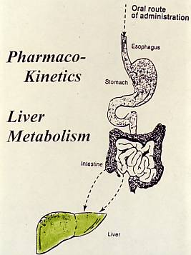

Slide 75
↑ Gastric Motility
Anxiety and agitation
Bulimia
AD induced diarrhea

Slide 76
Liver
Metabolism
Rapid and slow metabolizers: impact if not addressed

Slide 77
Rates of Metabolism
Rapid…………low blood levels
…….little response
Average
Slow…………..high blood levels
……side effects; toxicity

Slide 78
Special risks with
Slow metabolism
Anxiety disorders
Depression in general
Agitated depression

Slide 79
Variables Affecting Metabolic Rate
Not related to general body
metabolic rate
Age
Ethnic variations
Individual Differences
Liver Disease
Impact of Substances

Slide 80
Poor and Rapid Metabolizers
2D6 Caucasians:
Poor: 7-10%
Rapid: 1%
Asian and African:
Poor: up to 33%
Start slow

Slide 81
Impact of Substances
Induce (↑) Liver Enzymes:
↓ blood levels
inadequate response
Inhibit (↓) Liver Enzymes:
↑ blood levels
higher initial side effects

Slide 82
Codeine, Oxycodone, and
Hydrocodone
2D6 metabolism: required to convert to
morphine
Fluoxetine, paroxetine, bupropion:
produce 2-15 x lower morphine levels
i.e. analgesic failure
Sindrup, SH (1996) J. Clin. Pharm., 49, 503-509.

Slide 83
Pharmaco-
Dynamics

Slide 84
Re-Uptake and
Re-Uptake Inhibition

Slide 85
ONSET of ACTIONS:
PSYCHOTROPIC MEDICATIONS*
FAST ACTING: (30-45 minutes)
> Benzodiazepines (e.g. Xanax)
> Stimulants (e.g. Ritalin)
SLOWER ONSET OF ACTION: (weeks)
> Antidepressants (one exception)
> Mood Stabilizers
> Antipsychotics

Slide 86
MEDICATION EFFECTS
PHARMACOLOGIC
SIDE EFFECTS
IDIOSYNCRATIC EFFECTS
ALLERGIC REACTIONS
TOXICITY

Slide 87
EVALUATING OUTCOME
EFFICACY vs. EFFECTIVENESS
SSRIs in OCD: 65% have 50% ↓ Sx
Beta Blockers for Aggression: 10%
cont.

Slide 88
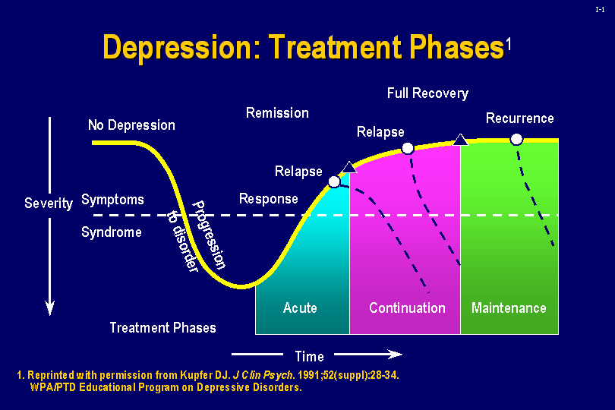
Notes:
This slide graphically presents the treatment phases in the management of depressive disorders: relapse, remission, recovery, and recurrence.
In many cases, depressive disorders are recurrent. Thus, their treatment is viewed in three phases—acute, continuation, and maintenance.
A view of the phases of depressive disorders across the spectrum of treatment and relapse underscores the need for maintenance therapy in many patients.

Slide 89
Inhibit symptoms while
Waiting for the underlying episode to cycle out

Slide 90
Clinical Aspects of Remission
Return of functioning
Optimism
Vigor
Self-confidence
General sense of well being
Return to one’s usual self

Slide 91
Habit-Forming ?
Addiction vs. Dependency
Potentially Addictive: (abuse)
> Stimulants; Benzodiazepines
No Evidence of Addiction Potential:
> Antidepressants, Mood
Stabilizers, Antipsychotics
Wellbutrin….?
No evidence of Dependency Potential
BuSpar, Provigil (?)

Slide 92
Pregnancy

Slide 93
FDA RATINGS:
USE DURING PREGNANCY
A: No Risk. Well controlled studies
B: No Evidence of Risk
C: Risk Cannot Be Ruled Out
D: Positive Evidence of Risk
X: Contraindicated in Pregnancy

Slide 94
Possible
Pregnancy-Related Risks
Decreased likelihood of Conception
Miscarriage/Spontaneous Abortion
Teratogenicity
Behavioral Teratogenicity
Fetal Side Effects
Fetal Withdrawal

Slide 95
Psychopharmacology for Children and
Adolescents

Slide 96
Issues in the Pharmacologic Treatment of Children
No True Informed Consent
The Meanings of Taking Medicine
Parental Fears
“The Drug Will Fix It All” Mentality

Slide 97
The Importance of
Appropriate Medication Treatment
Sets the Stage for Attitudes about Psychiatric Medication Treatment
Kindling Effects

Slide 98
Possible Negative Consequences
↓ Suffering…stay in toxic relationship
Distance people from their humanity
Help people live up to cultural
expectations →

Slide 99
“Neurosis is always a substitute for legitimate suffering”
Carl Jung

Slide 100
Counter-Arguments
Free up access to Emotions
Eliminate Anhedonia
Mobilize Adaptive Behavior
Help maintain Interpersonal
Contact

Slide 101
Long-Term Treatments
Lack of Research
Risks vs Benefits

Slide 102
First things first
“Do no harm”

Slide 103
First things first anticipate and deal with factors that can derail treatment

Slide 104
Monitor for:
*Noting Early changes,
*Enhancing Motivation and Compliance,
*Measuring subtle
Residual Symptoms

Slide 105
Data provided by
Significant other:
History, collaboration, early warning signs

Slide 106
The Role of the Family
Supporting medication treatment;
address fears
Help with taking medications
Family involvement:
reducing relapses
“Early warning signs”

Slide 107
Early Warning Signs List
Physical Symptoms
Change in daily activities
Activity levels
Sleep patterns
Work, school, and social activities
Sexual behavior
Eating
Substance use

Slide 108
….Like we agreed upon in therapy, I
promised to tell you if I noticed any signs that you might be having a new episode
…I have noticed the following…….and you
promised me that if I saw these symptoms you would call your doctor today or if
you can’t or won’t then you gave me permission to call for you…
Let’s take action now…

Slide 109
NIMH Study: Diagnostic
Accuracy
(Goodwin, 2004)
2 separate diagnostic sessions
with patient
One session with patient and family
Individual interviews missed 60%
of those identified with family
interview

Slide 110
History of Mania
(Goodwin, 2004)
Hospitalized for mania
5 year follow-up
60% forgot or denied that
they had had a
manic episode

Slide 111
Improving Medication Adherence:
How to Talk with Patients
About Their Medications
(2006)
Shawn Shea, M.D.

Slide 112
People with Chronic Illnesses
Numerous studies: 50-60% either
discontinue medications
or do not take
them as prescribed

Slide 113
People with Chronic Illnesses
In general medicine and in treating
severe psychiatric disorders,
the #1 cause of treatment failure
is: not taking medication as
prescribed
not wrong diagnosis or wrong treatment

Slide 114
Common Factors that lead to discontinuation
# 1: Unexpressed fears *
Panic pt, suicide, addiction
You bring it up: “There are some
common misperceptions that many
people will understandably be
worried about”

Slide 115
Common Factors
#2. Generally,
The weighing of pros and cons
is done in a vague and non-
systematic way and this
weighing of pros and cons is not
done in the prescriber’s office….

Slide 116
Common Factors
#3.The decision is strongly influenced
by the patient’s family
“How does your spouse (family) feel
about you taking this medicine?”
Bipolar Example

Slide 117
Anticipating Side Effects
“As you know many medications
may have side effects.
I want you to know that I take
side effects very seriously.
Almost all of my patients have
some concerns about possible
side effects” >>>
R

Slide 118
Side effect issues
Pre-emptive Interventions
“It’s important for me to know
about any problems that
you experience with your
medications.
Please keep me posted”

Slide 119
Assessing Side Effects
Review side effect rating scale
“Walk me through what happened.”
“How bad is ________?”
“How often do you feel it?”

Slide 120
Assessing Side Effects
“On a scale of 1 to 10 with a 1 being
I hardly notice it and a 10 being
I can’t stand this side effect…what
number would you think fits how
you are doing right now?”

Slide 121
Common Factors that lead to discontinuation
Stigma
The personal meaning
of taking the drug >>>

