Slide 1
The Reasonable Person

Slide 2
Law and Culture – general consideration
American Legal Culture – individualism, adversalism
Law and Societal Culture

Slide 3
Geertz’s Theory of Culture
culture is public
culture is what practitioners believe and do
culture has a minimal degree of coherence
culture is a context – something within which social events can be intelligently described

Slide 4
Four Elements of Negligence
a duty of reasonable care
a breach of that duty
causation
resulting damages

Slide 5
The Reasonable Person
a concept developed for the law to decide if there was a breach of duty
a common standard to judge the behaviors of a defendant.
In practice, the jury is instructed to apply the concept to determine if what a defendant did amounted to a breach of duty.

Slide 6
Four Elements of Negligence
a duty of reasonable care
a breach of that duty
causation
resulting damages

Slide 7
The question the jury is asked to answer:
“Did the defendant act in the same way that a reasonable person under like circumstances would have acted?”

Slide 8
Key Features of The RP Standard
It is objective
Objective test:
whether the defendant proceeded with such reasonable caution as a prudent person would have exercised under such circumstances.

Slide 9
“if a man is born hasty and awkward…, no doubt his congenital defects will be allowed for in the courts of Heaven, but his slips are no less troublesome to his neighbors than if they sprang from guilty neglect… and the courts which they establish decline to take his personal equation into account.” Oliver Holmes, The Common Law

Slide 10
It does not inquire the state of mind of a defendant, i.e., no “subjective test”
Subjective test:
whether he acted bona fide to the best of his judgment; if he had, he ought not to be responsible for the misfortune of not possessing the highest order of intelligence.

Slide 11
It is unitary
Seldom will the RM standard be lowered to “take personal equation into account.” (Holmes)
The standard cannot be changed according to age, gender, race and ethnicity.

Slide 12
Implicit Model of Law and Culture in the RP Standard
the funnel model
jury as representatives of a culture
homogeneous norms as law

Slide 13
Benjamin Cardozo
“The triers of fact in determining whether the reasonable person standard has been attained, must consult the habits of life, the everyday beliefs and practices, of the men and women about them…. “
“The constant assumption runs through the law that the natural and spontaneous evolutions of habit fix the limits of right and wrong. A slight extension of custom identifies it with customary morality, the prevailing standard of right conduct, the mores of the time.”

Slide 14
Pros & Cons of the Use of a “Cultural” Standard in Law
Pros | Cons
Fluid, organic | Too general to be considered an integral part of law
reflects voice of the community values | There may be no such thing as “popular consensus”
interaction between lawgivers and citizens | A possible retreat from the rule of law? “principled decisions replaced by whim”?
relatively objective | too harsh, tyranny of the majority

Slide 15
Exception to the funnel model:
Omission
The traditional position of the common law is that omission is neither a crime, nor a civil wrong, though in some circumstances failure to act is considered morally reprehensible.
Famous cases:
Kitty Genovese
Sherrice Iverson

Slide 16
Is omission a crime/civil wrong?
“a person has no duty to come to the aid of another; but if a person elects to come to someone’s aid, he or she has a duty to exercise due care.”
Translation: Do nothing, you are fine (since omission is not a crime/civil wrong). Try to do something, then you do it at your own peril.
the common law position is particularly harsh with medical professionals

Slide 17
Why omission is not a negligence?
Traditional explanation: there is a difference between reasonableness and morality. The tort of negligence is judged by the standard of reasonableness.
Other considerations?

Slide 18
Sherrice Iverson Bill
makes it a misdemeanor for someone to fail to report a murder, rape, or an assault, against a person under the age of 14

Slide 19
Exemption clauses:
This bill does not apply:
(1) When the person has a reasonable fear for his or her own safety or for the safety of his or her family
(2) When the person who has witnessed the offense has made a reasonable mistake of fact;
(3) The witness was the husband, wife, parent, child, grandparent, grandchild, brother or sister or related to the offender or victim by reason of consanguinity or affinity.

Slide 20
The Reasonable Woman Standard

Slide 21
The Reasonable Person Standard
Gender biases were accused of the Reasonable Man Standard
Does the movement from Reasonable Man to Reasonable Person remove gender bias?
To what extent should the law be gender-blind/gender conscious?

Slide 22
Why RP standard is biased?
The RP standard assumes that men and women are alike where they are not.
Because men are associated with reason and women with emotion, when people think of the new “reasonable person,” they naturally think of the old “reasonable man.”

Slide 23
Sameness v. Difference
Sameness feminists – sameness or formal equality approach; men and women are basically the same
equality to be achieved through gender-neutral standards

Slide 24
difference feminist
men and women engage in different processes of moral reasoning
embrace gender-conscious standards

Slide 25
The Case of Sexual Harassment
A new tort
Not identified as a cause of action until 1976

Slide 26
Two types of sexual harassment
Quid pro quo
Hostile environment

Slide 27
Quid pro quo
involves harassment that results in a tangible employment action.
E.g, "put out or get out” bargain
Committed usually by superior or powerful co-workers

Slide 28
Hostile environment
unfulfilled threats to impose a sexual quid pro quo.
discussing sexual activities
telling off-color jokes
unnecessary touching
commenting on physical attributes

Slide 29
displaying sexually suggestive pictures
using demeaning or inappropriate terms
using indecent gestures
sabotaging the victim’s work
engaging in hostile physical conduct
granting job favors to those who participate in consensual sexual activity
using crude and offensive language

Slide 30
To create a sexually hostile environment,
unwelcome conduct based on gender must
meet two additional requirements:
it must be subjectively abusive to the person(s) affected, and
it must be objectively severe or pervasive enough to create a work environment, that a reasonable person would find abusive.

Slide 31
Case 1
At University X, a staff member filed allegations against Professor L, the former Dean of the School of the Arts.
The staff member said Professor X gave her unwelcome sexual attention, pressured her to go to lunch and commanded her to “get up, turn around” so he could look at her body.
In one instance, the woman said the professor “drew his initials on (her) neck with his finger,” and when she asked what he was doing he said ‘branding you.’ She later said his actions became “a pattern of behavior,” and that she changed her work life — and even the way she dressed — to avoid him.

Slide 32
Case 2
S, a staff member, a 41-year-old married mother of five children, served as the executive assistant to the Dean of ABC Law School in 2012.
New Dean Y took over in 2014. S alleged that Dean Y subjected her to unwanted harassing conduct.
According to S, at the beginning and end of the work day, Dean Y would walk up to S open up his arms wide and hug S so hard that she felt her breasts pressed against the Dean’s chest.

Slide 33
S said she never initiated or otherwise participated in any of these hugs and Dean Y never asked for permission. However, S did not immediately push him away because she was in shock that someone of the Dean’s stature would engage in such conduct.
S claimed that the hugging evolved into Y kissing S on her cheek. Sometimes he would kiss her on the cheek while hugging her. Other times, she said he would lean down and kiss her cheek while she was typing at her desk.

Slide 34
Court reluctant to adopt initially
Why?
Psychological and emotional injuries (non-economic loss)

Slide 35
Presumption
Against the idea of one standard - Men and women differ in their judgments of what particular behaviors and comments constitute sexual harassment.

Slide 36
Ellison v. Brady (1991)
Rejected RM standard and adopted a RW standard
“a sex-blind RP standard tends to be male-biased and tends to systematically ignore the experiences of women.”

Slide 37
Judgment:
"We realize that there is a broad range of viewpoints among women as a group, but we believe that many women share common concerns which men do not necessarily share. For example, because women are disproportionately victims of rape and sexual assault, women have a stronger incentive to be concerned with sexual behavior. Women who are victims of mild forms of sexual harassment may understandably worry whether a harasser’s conduct is merely a prelude to violent sexual assault. Men, who are rarely victims of sexual assault, may view sexual conduct in a vacuum without a full appreciation of the social setting or the underlying threat of violence that a woman may perceive....”

Slide 38
Case Summary
Gray's desk was twenty feet from Ellison's desk, two rows behind and one row over. Revenue agents in the San Mateo office often went to lunch in groups. In June of 1986 when no one else was in the office, Gray asked Ellison to lunch. She accepted. Gray had to pick up his son's forgotten lunch, so they stopped by Gray's house. He gave Ellison a tour of his house.

Slide 39
Ellison alleges that after the June lunch Gray started to pester her with unnecessary questions and hang around her desk.
On October 9, 1986, Gray asked Ellison out for a drink after work. She declined, but she suggested that they have lunch the following week. She did not want to have lunch alone with him, and she tried to stay away from the office during lunch time.
One day during the following week, Gray dressed in a three-piece suit and asked Ellison out for lunch. Again, she did not accept.

Slide 40
On October 22, 1986 Gray handed Ellison a note he wrote on a telephone message slip which read:
“I cried over you last night and I'm totally drained today. I have never been in such constant termoil (sic). Thank you for talking with me. I could not stand to feel your hatred for another day.”
When Ellison realized that Gray wrote the note, she became shocked and frightened and left the room. Gray followed her into the hallway and demanded that she talk to him, but she left the building.

Slide 41
Ellison later showed the note to Bonnie Miller, who supervised both Ellison and Gray. Miller said "this is sexual harassment." Ellison asked Miller not to do anything about it. She wanted to try to handle it herself.
Ellison asked a male co-worker to talk to Gray, to tell him that she was not interested in him and to leave her alone. The next day, Thursday, Gray called in sick.

Slide 42
Ellison did not work on Friday, and on the following Monday, she started four weeks of training in St. Louis, Missouri. Gray mailed her a card and a typed, single-spaced, three-page letter. She describes this letter as "twenty times, a hundred times weirder" than the prior note.

Slide 43
Gray wrote, in part:
“I know that you are worth knowing with or without sex.... Leaving aside the hassles and disasters of recent weeks. I have enjoyed you so much over these past few months. Watching you. Experiencing you from O so far away. Admiring your style and elan.... Don't you think it odd that two people who have never even talked together, alone, are striking off such intense sparks ... I will [write] another letter in the near future.”

Slide 44
Implications of Ellison v. Brady
Does that mean that the RP standard is on the path of disintegration?
Can the use of RW standard in sexual harassment cases be followed in other areas?
Does that mean that the reasonableness standards are going to incorporate gender, race, ethnicity, and sexual orientation?

Slide 45
Reasonable Person
Reasonable Woman
Mens
Rea

Slide 46
Critical Feminist Perspective
A single Reasonable Woman standard implicitly accepts the fundamental notion that all women are the same.
It fails to address the systems of privilege that maintain the sex-based, gendered biases.

Slide 47
Reasonable Woman
Reasonable Woman of Color
Mens
Rea

Slide 48
BUT other legal scholars read Ellison v. Brady differently.
The Reasonable Woman Standard is adopted not because it is more subjective.
It is adopted basically because it is considered a “Reasonable Person Plus” Standard.

Slide 49
Judgment:
"We realize that there is a broad range of viewpoints among women as a group, but we believe that many women share common concerns which men do not necessarily share. For example, because women are disproportionately victims of rape and sexual assault, women have a stronger incentive to be concerned with sexual behavior. Women who are victims of mild forms of sexual harassment may understandably worry whether a harasser’s conduct is merely a prelude to violent sexual assault. Men, who are rarely victims of sexual assault, may view sexual conduct in a vacuum without a full appreciation of the social setting or the underlying threat of violence that a woman may perceive....”

Slide 50
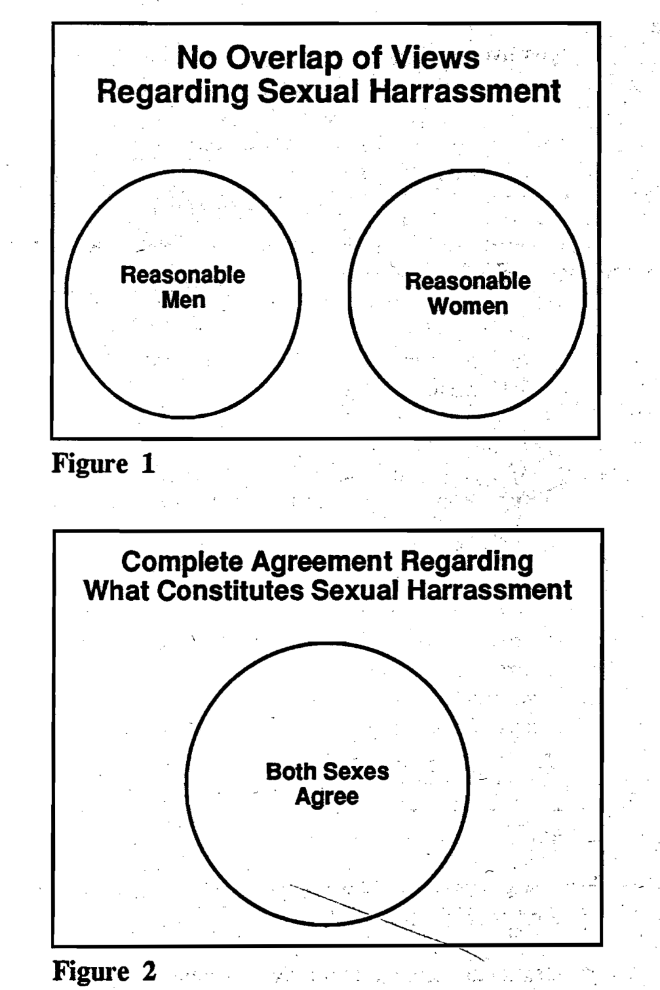

Slide 51
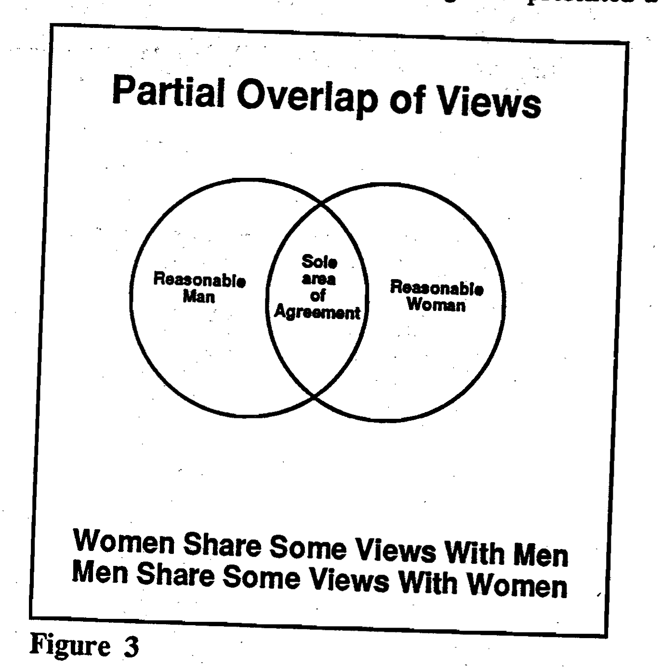

Slide 52
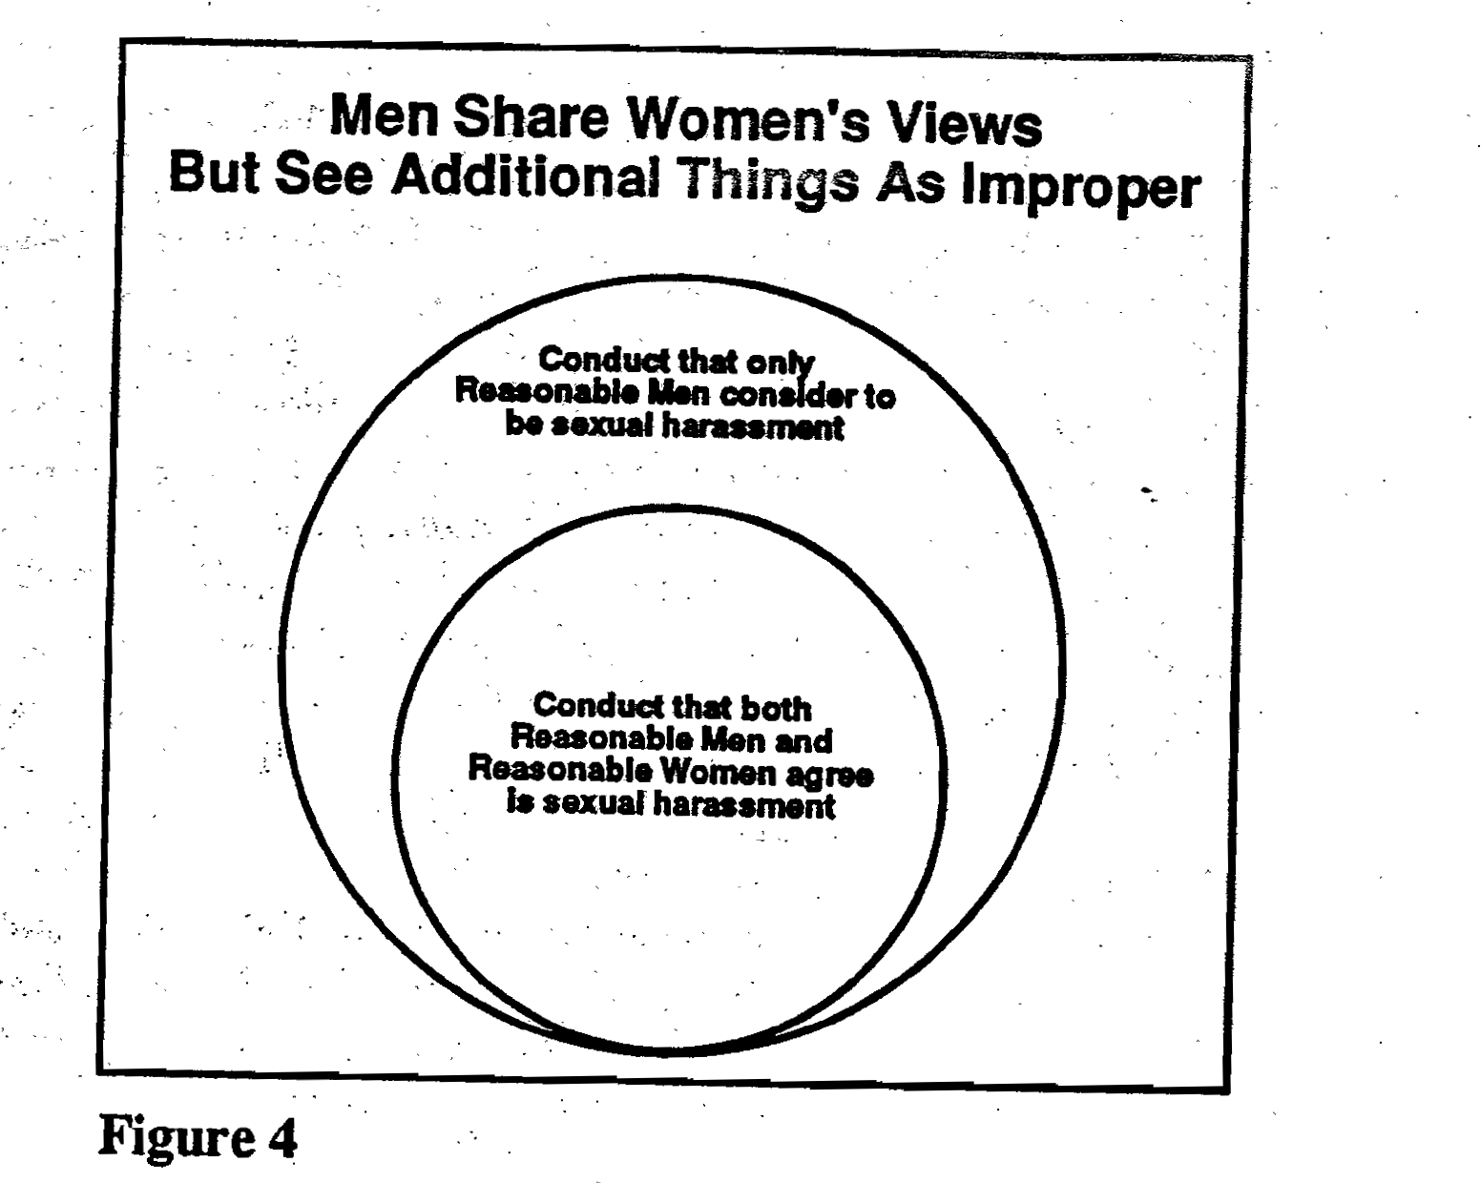

Slide 53
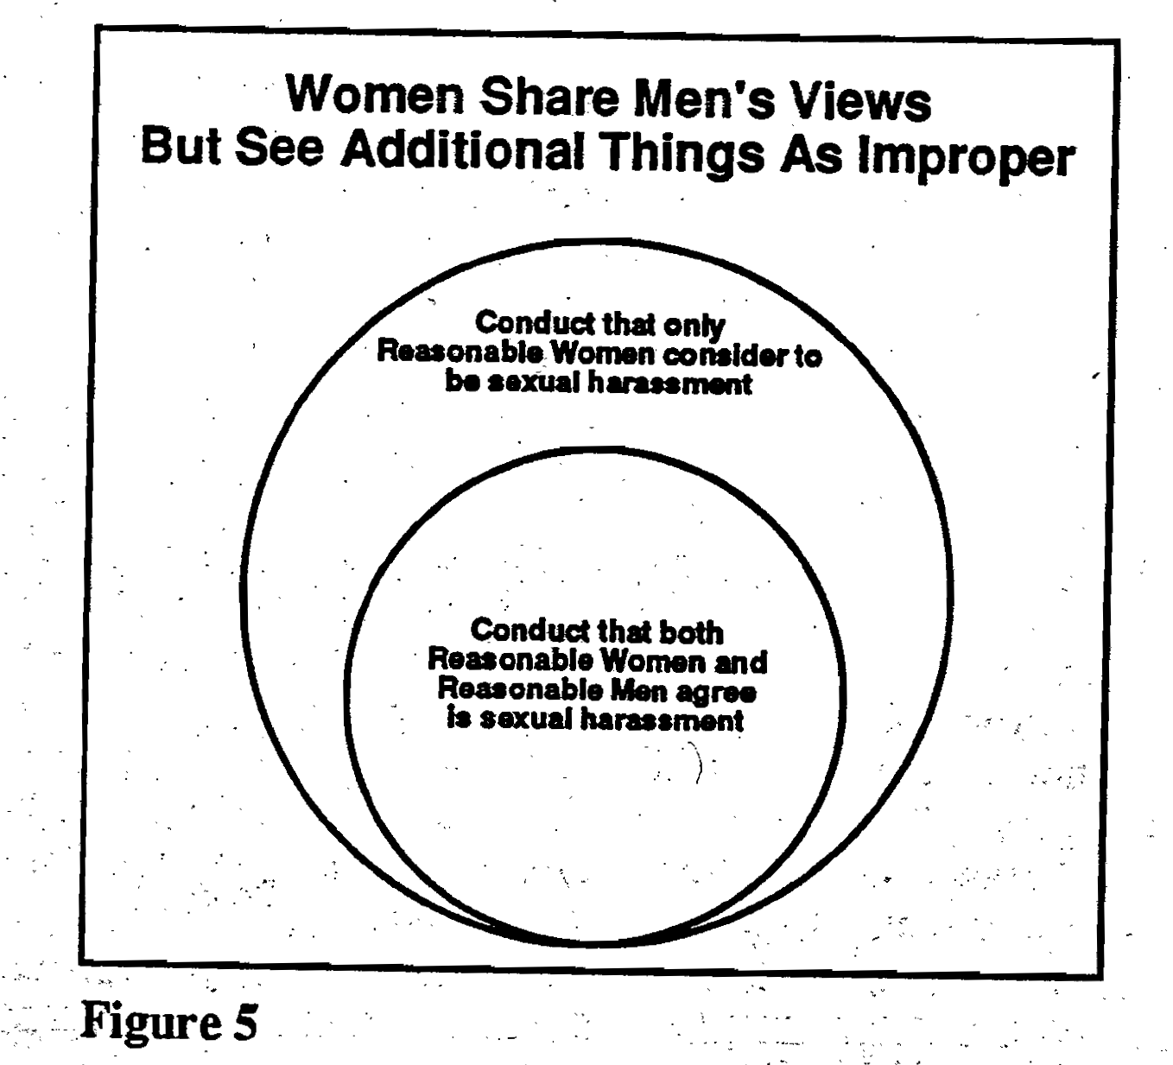

Slide 54
Figure 5 is considered most accurate (see Adler and Peirce)
But Figure 5 sees Reasonable Woman standard as Reasonable Man Plus standard

Slide 55
Reasonable Person Standard in Criminal Law
Standards of reasonableness (RP, RW) are used mainly in civil cases (negligence).
However, the standard is also pushed to be used in some criminal cases.
One area is the use of the reasonable person concept in the defense of rape.

Slide 56
There has also been discussions about the possible use of the RW standard in rape cases.
Kim Scheppele’s discussion of rape cases

Slide 57
Rusk v. State (Maryland Court of Appeals, 1979)
Eddie Rusk was convicted by a jury of raping a woman “Pat”.
He met her at a singles bar.
When she said she was leaving, Rusk asked Pat to drive him home. She agreed, drove him to a part of the city she didn’t know, and refused his several invitations to come in.

Slide 58
He took the car keys from the ignition and invited her in again.
Pat testified that she believed it was unsafe to try to escape on foot and that she hoped to be able to convince Rusk to give back her car keys and to let her in.
She followed him into his room, and made n attempt to leave even when he went down the hall to go to the bathroom.

Slide 59
She asked for her car keys back and, when he refused, begged to be able to leave with her car.
Rusk said she couldn’t, but he had no weapon and did not use overwhelming physical force.
Rusk pulled her onto the bed and undressed her.

Slide 60
Pat started to cry and Rusk put his hands on her throat and “started lightly to choke” her.
She asked: “If I do what you want will you let me go without killing me?”
And he answered “yes.”

Slide 61
She performed oral sex, and then they had sexual intercourse.
After which he gave back the car keys and said she could leave.
Charged with the rape. Rusk claimed she had consented to sex with him.

Slide 62
Rape = Sex without consent
Existing standard is the subjective standard of mens rea.
Typical defense runs like: “I thought she consented.”
Using the RW standard in rape cases means asking the court to see the criminal nature of the defendant’s conduct from a viewpoint closer to the victim than the defendant.

Slide 63
 | Existing | Reasonable Woman Standard (if adopted)
Standard | mens rea (from the defendant’s viewpoint) | Reasonable Woman Standard
Nature of the standard | Subjective (basically an honesty standard) | Objective (the standard of RW); it is closer to the viewpoint of the victim
Question asked | Did the defendant honestly believe that he had consent? | Did the plaintiff do everything that a reasonable woman would have done to convey to the defendant that there was no consent?

Slide 64
The Jury System and American Legal Culture

Slide 65
Pros of Jury system
Democratic
Reflects the values of a community
Allows a separation of power within the court system

Slide 66
Cons
time consuming
complicates trial procedures
populist
unpredictable

Slide 67
Jury is like a black box?
deliberation process not open
reasoning process not open to review

Slide 68
The jury is the only decision-making institution in the legal system that is not required to account for its decision
That means a jury has the power to nullify the law
whether a jury has the right to nullify the law is controversial and subject to debates.

Slide 69
Does a jury have the right to nullify?
In most states, judges instruct jurors that it is their duty to apply the law as it is given to them, whether they agree with the law or not.
Only in a handful of states are jurors told that they have the power to judge both the facts and the law of the case.

Slide 70
strong version of jury nullification
Jury nullification occurs when a jury returns a verdict of "Not Guilty" despite its belief that the defendant is guilty of the violation charged. The jury in effect nullifies a law that it believes is either immoral or wrongly applied to the defendant whose fate that are charged with deciding.

Slide 71
weak version of jury nullification
Jury nullification also occurs when a jury inadvertently reinterprets the law.
the case of Bernhard Goetz

Slide 72
US v. Kleinman (9th Circuit 2017)
A court about a lower court’s instruction to the jury:
“You cannot substitute your sense of justice, whatever that means, for your duty to follow the law, whether you agree with it or not. It is not for you to determine whether the law is just or whether the law is unjust. That cannot be your task. There is no such thing as valid jury nullification. You would violate your oath and the law if you willfully brought a verdict contrary to the law given to you in this case.”

Slide 73
Effects of jury nullification
commonsense justice
More moralistic
Less legalistic

Slide 74
Court Trials in Mass Media

Slide 75
Reality | Popular Media
Trials are infrequent | Trials are regular
Trials are technical | Trials are full of human stories
Trials are uneventful | Trials are dramatic
Judges do not often examine witnesses themselves | Judges assumes a more active role. In TV courts, they examine witnesses.
Judges more legalistic | Judges more moralistic

Slide 76
Common setup of a TV court/Syndi Court
  Like a real courtroom
  “realistic” procedures
  “The people are real.” “The cases are real.” “Her rulings are final.”

Slide 77
TV Court Celebrity
Who is Judge Judy?
  an arbitrator
Why can’t other judges act like Judge Judy?
  prior contractual agreement
  financial incentive

Slide 78
Problems of Syndi-Court Justice
conflict of interests
  justice v. ratings
  Who pays?
ideology (Kohm’s article)
  rugged individualism “The law helps those who help themselves.”
  rule of law or rule of person?
Feedback to real justice
  Frequent viewers’ distorted perception of court trials

Slide 79
 | Frequent Viewers | Non-frequent Viewer
Judge should have an opinion about the outcome | 75% | 48.6%
Judge should make opinion clear or obvious to jury | 76.5% | 31.6%
Judge should frequently ask questions | 82.5% | 38.2%
Judge should be aggressive with litigants or express displeasure with testimony | 63.8% | 26.3%
Judge’s silence | 73.8% | 13%
The survey was of 241 jurors serving in Manhattan, New York, the District of Columbia and Hackensack, New Jersey. From Kimberly Podlas, Blame Judge Judy: The Effects of Syndicated Television Courtrooms on Jurors, 25 AMERICAN JOURNAL OF TRIAL ADVOCACY 557 (2002).

